Slide 1
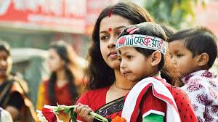
Welcome to our English class

Slide 2
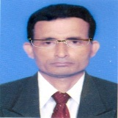

Identity
Manik Chandra Majumder
Senior Teacher (English)
Gazirhat High School
Senbag, Noakhali.
Mobile No: 01717155169
Email: manikmajumder01@gmail.com
Class : Nine-Ten
Subject : English 1st paper
Time : 50 Minutes
Date : 00/00/2018

Slide 3
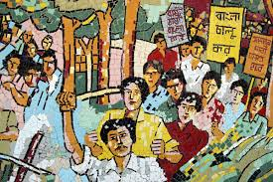
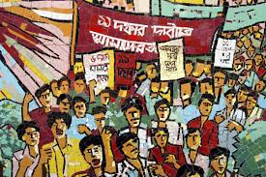
Let’s see the pictures and talk about them.
What are the pictures about?
What are they doing ?

Slide 4
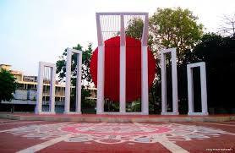
Why was the Shaheed Minar built?
What does the picture commemorate us?
Where is the Central Shaheed Minar situated?

Slide 5
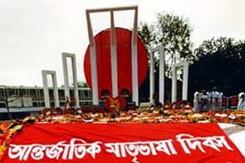

Can you guess about our today’s topic?
Our today’s topic is……
International Mother Language Day-1
Unit : 3
Lesson : 3
Page No : 37

Slide 6
Learning Outcomes
After the end of the lesson students will be
able to :
a) tell about Shaheed Minar.
b) narrate about the back ground of it.
c) take interview of the language activists.
d) write paragraph.

Slide 7
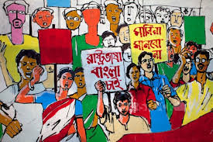
Look and talk about the pictures with your partners
When did the language movement take place ?
Who took part in the Language movement ?

Slide 8
Observe the text related video
Individual work-1
Now write down the name of some language activists.

Slide 9

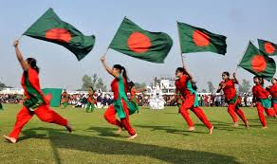
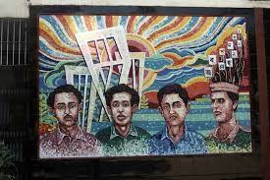
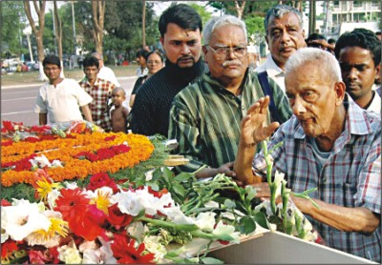
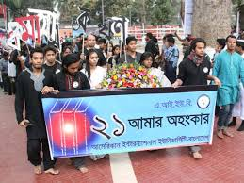
Word meaning and sentence making.
Meaning: Who sacrifices life for noble purpose.
Meaning : Freedom, Liberty , Emancipation
Meaning: Respect, Honour, Homage
Meaning: Unforgettable, Notable, Eminent
Meaning : Demonstration, Rally, manifestation
Click box
Procession (N)
Tribute (V)
Memorable (Adj)
Independence (N)
Martyr (N)
Sentence: Students arranged a procession to celebrate 21 February.
Sentence: Independence is the birth right of human beings.
Sentence: We pay tribute to the language martyrs.
Sentence : We should respect our language martyrs.
Sentence: 21 February is a memorable day in our national history.

Slide 10
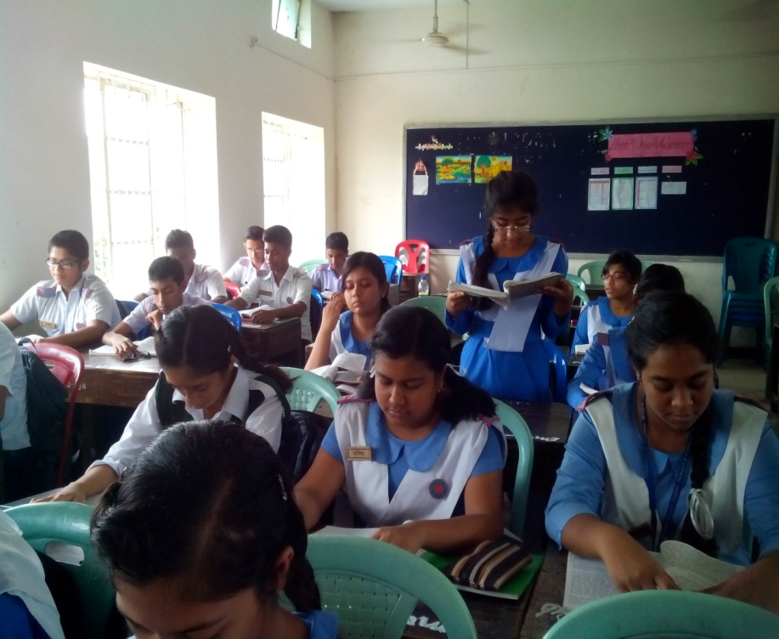
Loud/silent Reading
Para 1-4
21st February is a memorable day…………

Slide 11
Pair work (Writing)
Write the answer of the questions and compare with your partner
a) Who took part in language movement ?
b) When and where did Md. Ali Zinnah declare
Urdu would be the state language of Pakistan ?
c) Who claimed first Bangla to be the state
language of pakistan ?

Slide 12
Group work
Complete the following chart.
Time | What happened
1947
1948
1952

Slide 13
Now match your answer
Time | What happened
1947 | India and Pakistan divided .
1948 | Md. Ali Zinnah, the then Governor general of Pakistan declared that Urdu would be the only state language of Pakistan
1952 | All classes of people headed by the students of DU bought out procession demanding Bangla as one of the state language. But police opened fire on the procession killing several students

Slide 14
Individual work-2
Match the words with their meanings.
Words | Meanings
tribute | To cause of stimulate
climax | to refuse to obey
outlaw | to give in
defy | the ability to keep increasing or developing
provoke | an act to show respect or admiration
relent | the most exciting point in time
Momentum | to ban

Slide 15
Match your answer.
Words
Meanings
tribute
To cause of stimulate
climax
to refuse to obey
outlaw
to give in
defy
the ability to keep increasing or developing
provoke
an act to show respect or admiration
relent
the most exciting point in time
Momentum
To ban

Slide 16
Evaluation
a) Who are the known language martyrs ?
b) When was the seed of language movement sown ?
c) Where did the police open fire to the procession ?
d) Why did the then government outlaw all sorts of public
meeting in 1952 ?

Slide 17

HOME WORK
Write a paragraph On “International Mother Language Day”.

Slide 18


This lesson is dedicated to the all language martyrs and activists.
As our language is Bangla , our culture should be Bangla.
Thank you all

