Slide 1
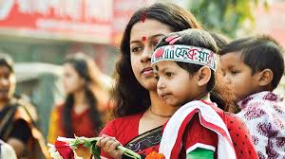
Welcome to our English class

Slide 2
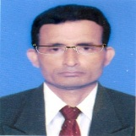

Identity
Manik Chandra Majumder
Senior Teacher (English)
Gazirhat High School
Senbag, Noakhali.
Mobile No: 01717155169
Email: manikmajumder01@gmail.com
Class : Nine-Ten
Subject : English 1st paper
Time : 50 Minutes
Date : 00/00/2018

Slide 3
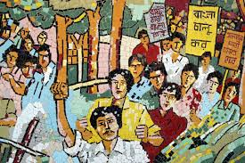


Let’s talk about back ground the pictures .

Slide 4
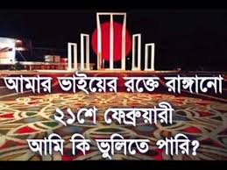

What is the other name of 21st February.
When does the International Mother Day celebration begin?

Slide 5
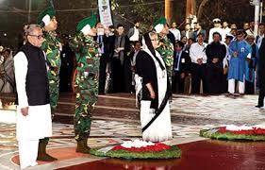
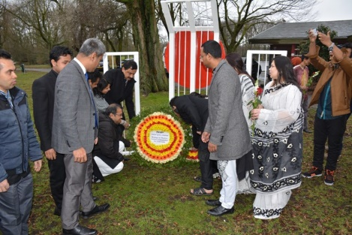
Can you guess about our today’s topic ?
Yes, about the celebration of 21st February in home and abroad.

Slide 6
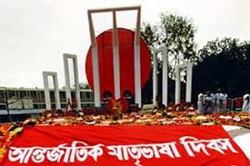
Our today’s topic is……
International Mother Language Day-2
Unit : 3
Lesson : 4
Page No : 39

Slide 7
Learning Outcomes
After the end of the lesson students will be able to :
a) ask and answer questions,
b) narrate about the back ground of our Language Movement.
c) describe the tribute of world community toward our
language martyrs,
d) write informal letter.

Slide 8
Observe the text related video
Individual work-1
Now write down the name of some language activists.

Slide 9
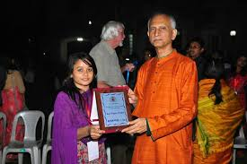
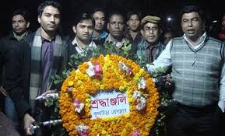
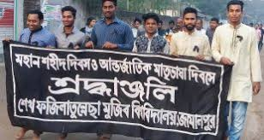
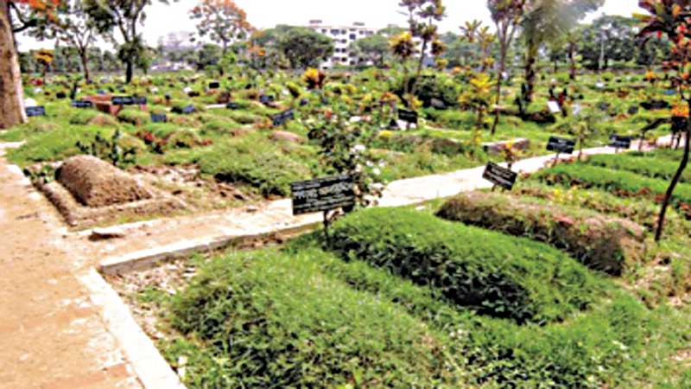
Click Word
Vocabulary and sentence making.
Meaning :Cemetery, Burial
Meaning : acknowledgement
Meaning : Rally, demonstration
Meaning : Circular arrangement of flowers
Recognition (N)
Wreath (N)
Procession (N)
Graveyard (N)
Sentence: Student arranged a mourning procession to celebrate 21st February.
Sentence: We pay tribute to the language martyrs offering floral wreath.
Sentence: 21st February has got global recognition as International Mother Language Day.
Sentence: People go to Azimpur graveyard and pray for the martyrs .

Slide 10
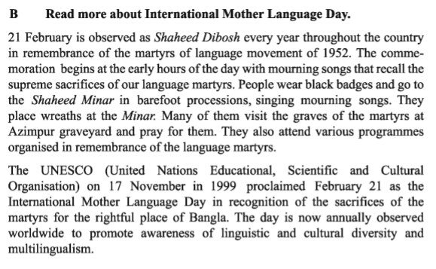

Slide 11
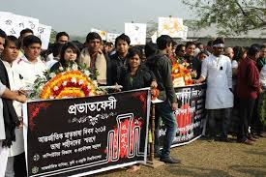
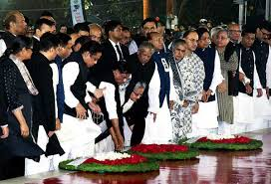
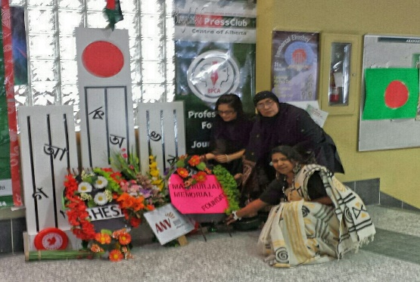
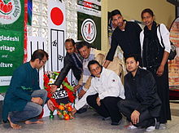
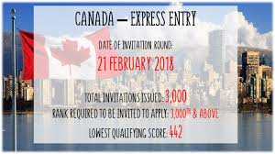
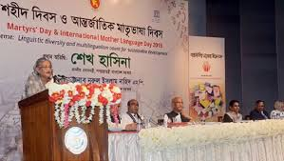
Observe some text related pictures
The day is celebrated with different programmes in home and abroad.

Slide 12
Pair work (Writing)
Write the answer of the questions and compare with your partner
a) Why is 21 February called Shaheed Didosh?
b) Why do people go to the Shaheed Minar? How do they go there?
c) Why is 21 February now observed throughout the world?

Slide 13
Group work-1
Match the words with their meanings.
Words | Meanings
Wreath | Encourage
In remembrance of | In appreciation of
Proclaim | Practice of several language
Promote | An arrangement of flower in shape of circle
Diversity | Declare
Multilingualism | In memory of
In recognition of | Variety

Slide 14
Group work-2
Complete the passage with suitable words.
On 21 February 1952..……. was shed at a place between Dhaka Medical College and Dhaka University………to establish Bangla as a state …………of Pakistan.
All subsequent movements……………The struggles for independence had their origin from the historic language ……….. . Shaheed Minar is the ……….. Of the supreme sacrifice ……. the mother tongue.
blood
area
language
including
movement
symbol
for

Slide 15
Evaluation
Choose the best answer from the alternatives:
a) Bang as a mother tongue came through----------.
i) movement
Cor. Ans:
i) movement
ii) sentiment
Cor. Ans:
iii) politics
iv) diplomacy
b) The UNESCO proclamation came in----------.
Cor. Ans:
i) 1978
ii) 1999
Cor. Ans:
ii) 1999
iii) 1998
iv) 1980

Slide 16
c) Here the word ‘proclamation’ means-----.
Cor. Ans:
Cor. Ans:
i) decision
ii) statement
iii) declaration
iii) declaration
iv) nomination
d) Mourning songs refers the feeling and showing.
Cor. Ans:
Cor. Ans:
ii) sadness
i)annoyance
ii) sadness
iii) enjoyment
iv) unhappiness
e) Shaheed Minar is the ------------ of the supreme sacrifice for the mother tongue
Cor. Ans:
Cor. Ans:
i) symbol
ii) emotion
i) symbol
iii) recognition
iv) promotion

Slide 17

HOME WORK
Write a letter to your friend describing how you have observed this year’s 21 February at your school.

Slide 18


This Class is dedicated to the all language movement martyrs and activists.
As our language is Bangla , our culture should be Bangla.
Thank you all

