Slide 1
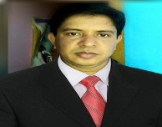
WELCOME
Md. Iqbal Hossai. Parashuram, Feni 01813132522

Slide 2
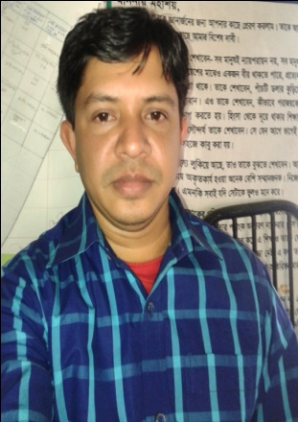
Presented by……
Md.Iqbal Hossain.
Assistant Teacher
Parshuram Model Govt:primary School
Parshuram,Feni
Md. Iqbal Hossai. Parashuram, Feni 01813132522

Slide 3
Class: Two
Subject: English
Page: 41
Md. Iqbal Hossai. Parashuram, Feni 01813132522

Slide 4
Learning Outcomes
Speaking :
1.1 to repeat after the teacher and say
simple words and phrases with proper
sounds and stress.
Reading :
1.4 to read words and phrases with the help
of visual clues. (about 30 new words)
and simple sentences.
Writing :
3.1 to write words and phrases using non cursive
capital and small letters.
4.1 to copy and write cardinal numbers up to
10 both in figures and in words.
Speaking :
1.1.2 say simple words and phrases with
proper sounds and stress.
Reading :
1.4.1 read words and phrases with the help of
visual clues. (about 30 new words ) and
simple sentences.
Writing :
3.1.2 write words and phrases using noncursive
small letters.
4.1.2 write numbers up to 10 in figures and in
words.
Md. Iqbal Hossai. Parashuram, Feni 01813132522

Slide 5
Look, listen and say.
square
Md. Iqbal Hossai. Parashuram, Feni 01813132522

Slide 6
Look, listen and say.
triangle

Slide 7
Look, listen and say.
circle

Slide 8
Look, listen and say.
rectangle

Slide 9
Mr.Shape

Slide 10
Look, count and write
5
………….........circles
………… triangles
………….rectangles
……………square
Circle
3
4
1
Look at Mr. Shape & Complete the sentences with given words.
Square
nose
eyes
hands
His ……………………..is a triangle.
His…………………….… are circles.
His …………….…..are rectangles.
Ractangle
Triangle

Slide 11
GOOD BYE

