Slide 1
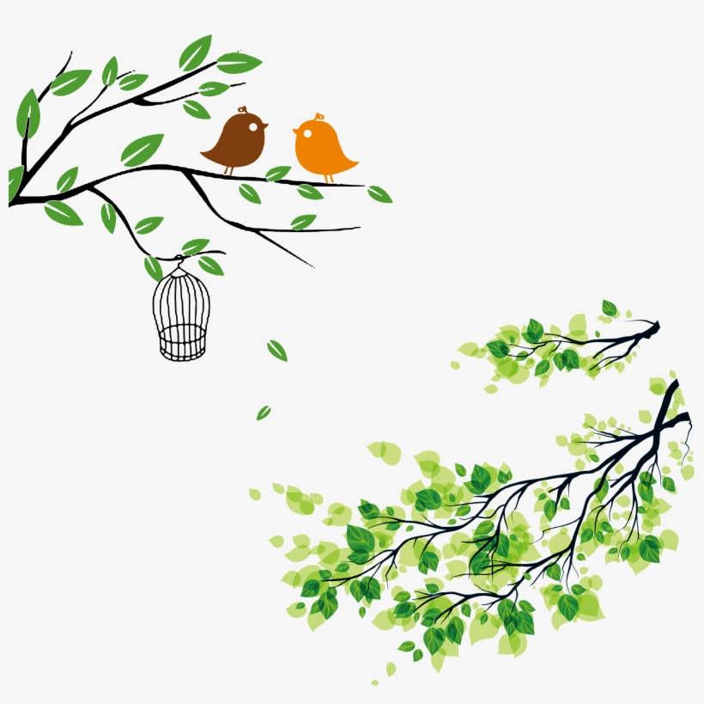
WELCOME

Slide 2
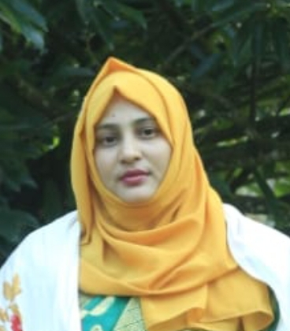
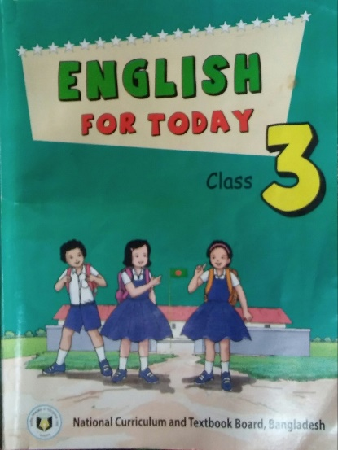
INTRODUCTION
Jasmin akter jahan
ASSISTANT TEACHER
Dorakul GOVT.PRIMARY SCHOOL
Companigonj,Sylhet.
EMAIL:jakterjahan@gmail.com
Class : Three
Sub: English
Lesson: 4 – 6,Unit: 23
Time: 45 minutes

Slide 3
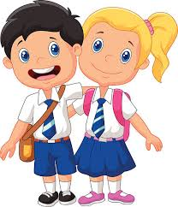
Good morning, students.
Good morning, teacher.
STUDENTS
How are you today?
Fine. and you?
TEACHER
Fine, thank you.

Slide 4
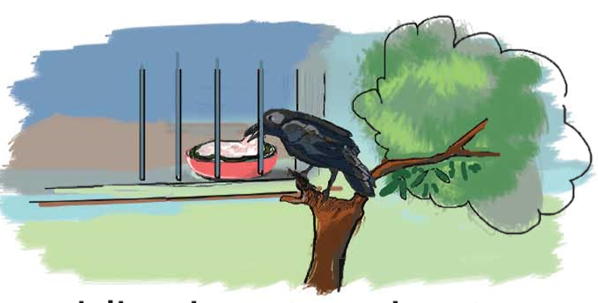
What do you see in the picture?

Slide 5
Welcome
today's lesson
What do they do?

Slide 6
Learning outcomes:
By the end of the lesson students will be able to……
Listening: 1.1.1- recognize English sound difference in the context
of words.
Speaking: 1.1.1- repeat words, phrases and sentences after the teacher with proper sounds and stress.
1.1.2- say words, phrases and sentences with proper
sounds and stress.
Reading: 1.5.1- read simple sentences with proper
pronunciation and stress.
5.1.3- read text

Slide 7
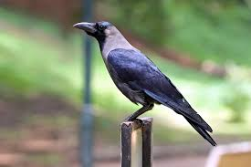
Look at the picture and say with me
I’m a crow. I live in a tree. I get up early in the morning. I’ m active all day.
I fly in the sky and look for food.

Slide 8
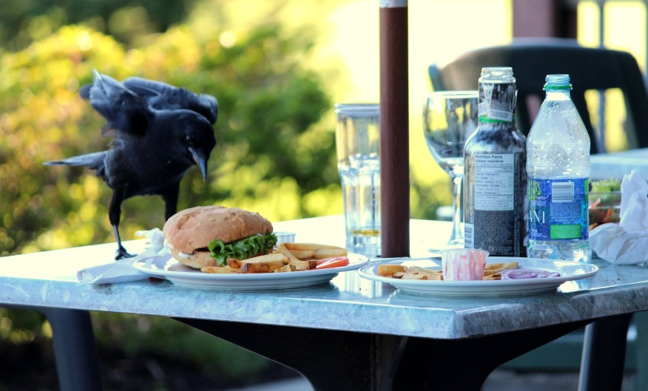
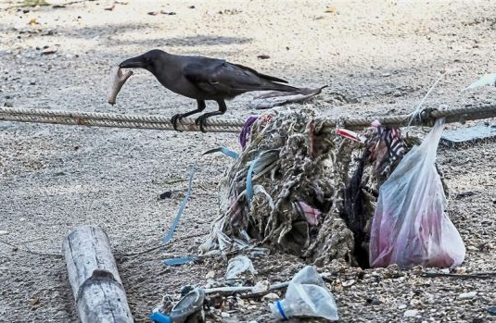
Look at the pictures and say with me…
Sometimes I take food from people. I’m very quick. Sometimes I eat dirty things.

Slide 9
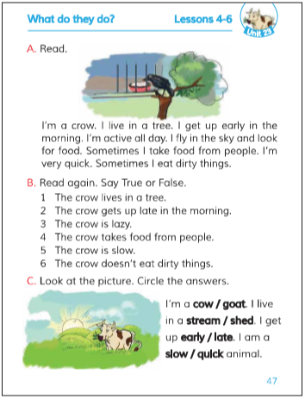
Open your book at page 47.

Slide 10
Teacher’s reading Loudly
Everybody listen and
say after me.
I’m a crow. I live in a tree. I get up early
in the morning. I’ m active all day.
I fly in the sky and look for food. Sometimes
I take food from people. I’m very quick.
Sometimes I eat dirty things.

Slide 11
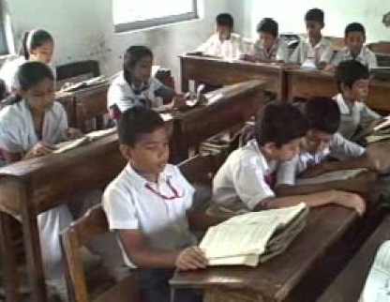
Student’s reading silently

Slide 12
We find out some new words
No | New word | Word meaning
1 | Active | সক্রিয়
2 | Quick | তাড়াতাড়ি
3 | live | বেচেঁ থাকা
4 | Fly | উড়া

Slide 13
Word , similar word and make sentences
The crow lives in a nest.
Live
Nest
Active
The crow is active all day.
Working
Dirty
The crow eats dirty things.
Unclean

Slide 14
Let’s work
in group
B. Read again. Say true or False.
1. The crow lives in a tree.
Answer: True
2. The crow is lazy.
Answer: False
Answer: False
3. The crow is slow.
4. The crow doesn’t eat dirty things.
Answer: False
5. The crow takes food from people.
Answer: True

Slide 15
Let’s work in pair
A. Read the text again and again
I’m a crow. I live in a tree. I get up early in the morning. I’m active all day. I fly in the sky and look for food. Sometimes I take food from people. I’m very quick. Sometimes I eat dirty things.

Slide 16
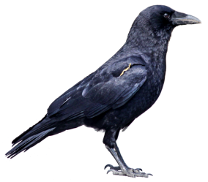
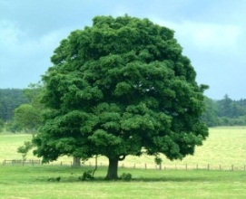
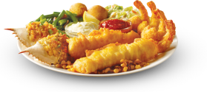
Individual work
See the pictures and say about these
Tree
People
Sky
Crow
Food

Slide 17
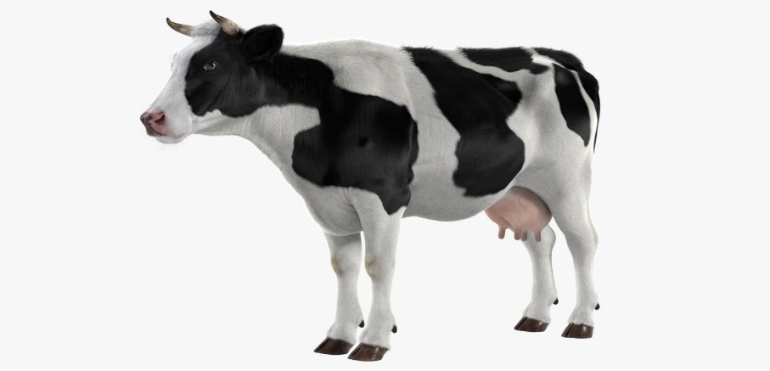
Checking learning
I’m a cow / goat.
cow
I live in a stream/ shed.
shed
I get up early / late.
early
slow
I am a slow / quick animal.

Slide 18
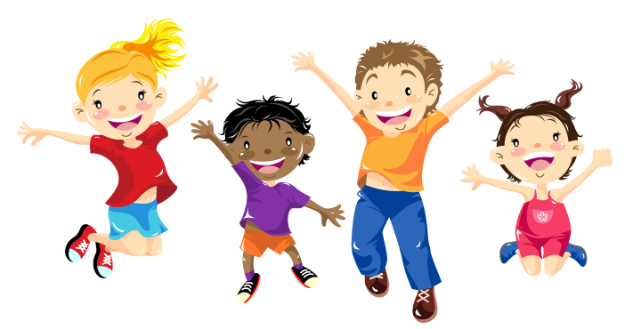
THANKS ALL

