Slide 1
Welcome

Slide 2
Good morning students!
Good morning teacher!
How are you?
I’m fine, thank you.

Slide 3
Introductions
Class: Two
Subject: English
Unit: 01
Lesson: 4-6
Title: Alphabet
Part: C
Time: 40 minutes
Date: 15th April 2020
MD. JAHIRUL ISLAM
Assistant Teacher
Uttar Charkoralia Sahebkandi GPS
Haimchar, Chandpur

Slide 4
Learning outcomes
Completing the session the students will able to
Speaking
1.1.2 say simple words & phrases with proper sounds & stress..
Reading
1.4.1 Read words & phrases with the help of visual clues(about 30 new words) & simple sentences.
Writing
1.2.1 Write non-cursive small letters.

Slide 5
Warm up activities
Let’s listen a greeting song

Slide 6
Reviewing
Can you recall the words
which we learn yesterday?
Ant
Cup
Egg
Bat
Doll
Teacher’s Drilling………..
WCW
Continue…..

Slide 7
Can you
Spell the words?
Ant
Cup
Egg
Bat
Doll
Teacher’s Drilling………..
WCW

Slide 8
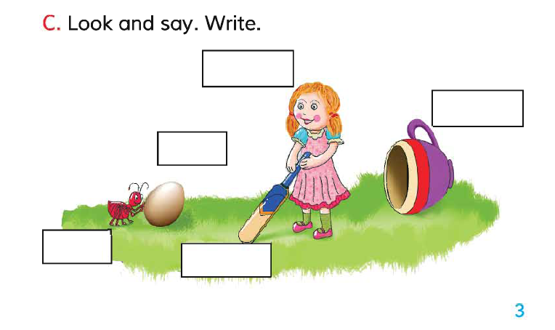
Open page at 3. See activity C….
Now !
See the pictures.
Teacher’s Drilling………..
WCW
Continue…..

Slide 9
See the pictures & say,
What do you see there ?
Pair Work
Student’s Drilling…
PW

Slide 10
Sima !
What does ant do?
Roni!
what does doll do?
The Ant touches an egg?
The Doll is playing
by a bat.
Teacher’s Drilling………..
WCW
Continue…..

Slide 11
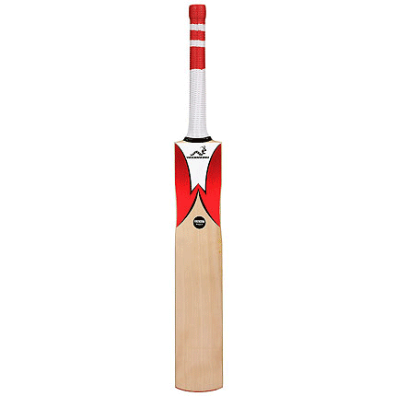
What is this?
Bat
Spell it!
Roni!
write down on the board.
Teacher’s Drilling………..
WCW
Continue…..

Slide 12
Doll
Now!
Fill the box by the name of the pictures
Cup
Egg
Ant
Bat
Teacher’s Drilling………..
WCW
Continue…..

Slide 13
Doll
Now!
Exchange your writing with your friend, next one.
Cup
Egg
Ant
Bat
Then!
Find out if there any corrections.
Teacher’s Drilling………..
WCW
Continue…..

Slide 14
Doll
Ok!
Back your friend’s writing now!
Cup
Egg
Ant
Bat
And!
Find out if there any corrections by yourself!
Teacher’s Drilling………..
WCW

Slide 15
Now !
Let’s recall our today’s lesson.
identify the pictures & names.
Fill up the box with right names.
Correct the misspelled words.
Teacher’s Drilling………..
WCW

Slide 16
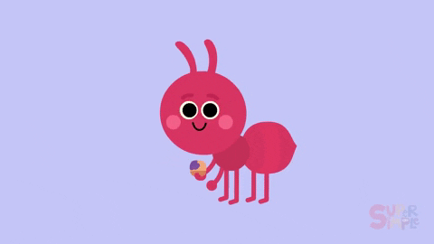
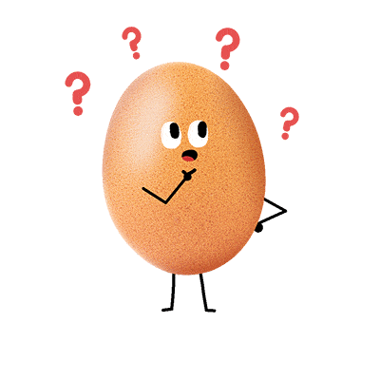
Evaluation
Ant
Cup
a
Bat
Egg
Doll
Can you tell me
The name of the Pictures & word’s spellings one by one.
Teacher’s Drilling………..
WCW

Slide 17
Home works
Bring the same words written on your exercise book at least one page……..

Slide 18
Thank you!
That’s all for today!
Goodbye!

