Slide 1
Welcome to my class

Slide 2
Subject : English
Unit: 11
Lesson:2-3
Part of lesson: B
Page:42,43
Raihana Haque
Head teacher
Banshgari one GPS
Bhairab,Kishoreganj

Slide 3
Learning outcomes:
Students will be able to….
3.4.1 understand statements made by the teacher & students
7.2.1 make requests and respond.
6.1.1 read instructions and early them out .

Slide 4
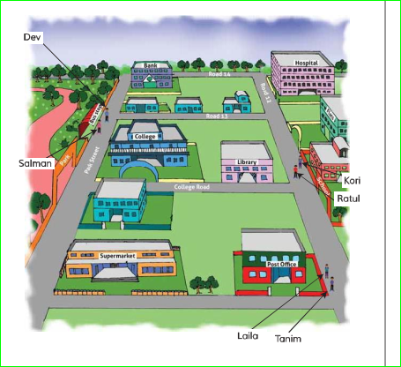
Let’s have look!
What have you seen in the picture?

Slide 5
Today we will talk about the picture and read the dialogues
Where’s the library?

Slide 6
Open at page -43
Look and listen carefully

Slide 7
I am playing an audio and you listen and read attentively .

Slide 8
New words
Continue
Keep up
Continue your study never give up.
Straight
Directly
Go straight along with this road.
Directions
Instructions for someone how to get the place
Give directions how to get the school.

Slide 9
Look , listen and Say
1. Who are in the first dialogue?
2.Acording to the text where is the library?
3.Who is asking about library?
4.Who are the second dialogue?
5.How to get supermarket?
6.Who are the last dialogue?
7.How to get hospital?

Slide 10
One day One word
Corner
Curve
পথের বাঁক
The hospital is on the corner.
Lets listen summary of the text .
We have learnt about how to give directions.

Slide 11
Home Work
Write a dialogue about your school directions by following the model .

