Slide 1
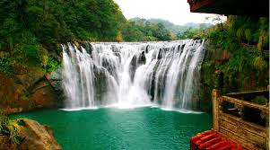
Welcome to English class

Slide 2
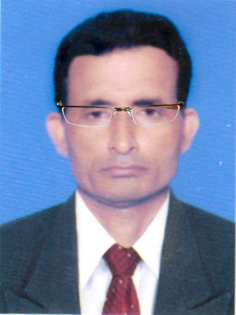

Identity
Manik Chandra Majumder
Asst. Teacher
Gazirhat High School
Senbag, Noakhali.
Mobile No: 01717155169.
Email: Manikmajumder01@gmail.com
Class : Nine -Ten
Subject : English 1st First paper
Time : 55 minutes
Date : 00/00/2018

Slide 3
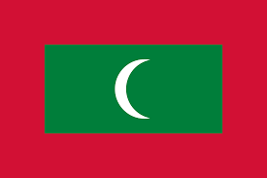
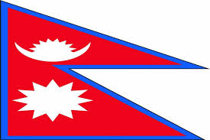
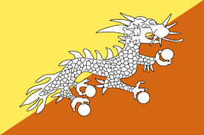
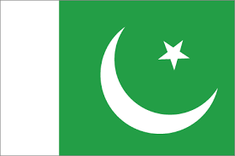
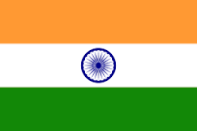
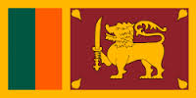
What can you see in the pictures?
Are you familiar with flags of the states ?
Maldives
Nepal
Bhutan
Pakistan
India
Sri Lanka

Slide 4
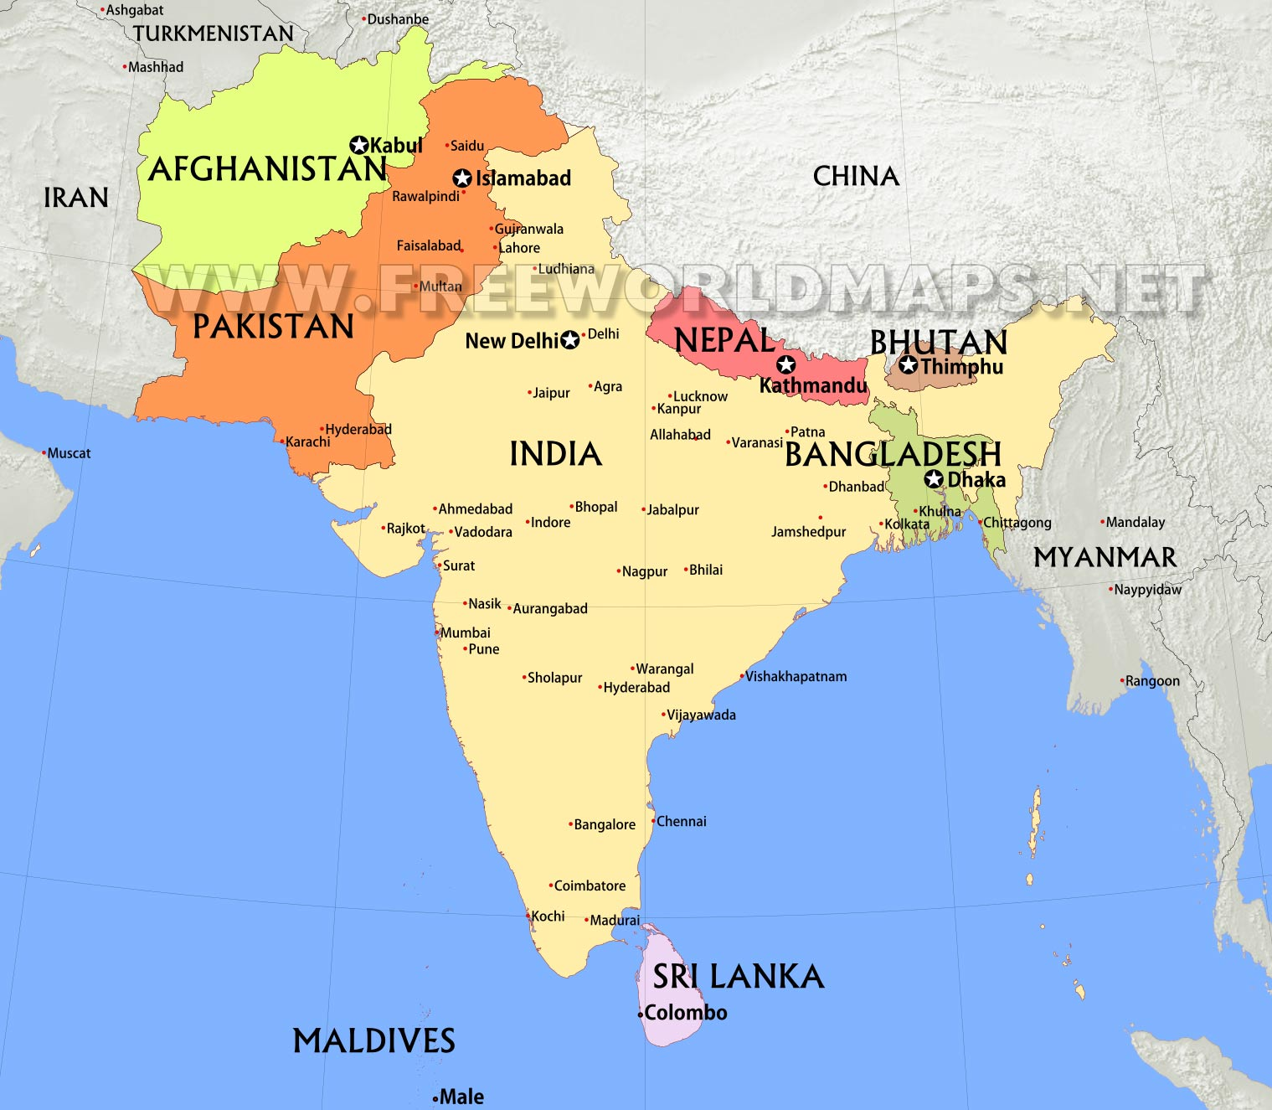
Let’s see the location of the states in the map of South Asia.
Click state Name
South Asia Map
Bangladesh
India
Pakistan
Nepal
Bhutan
Sri Lanka
Among the countries
Sri Lanka
lies in Indian Ocean.

Slide 5
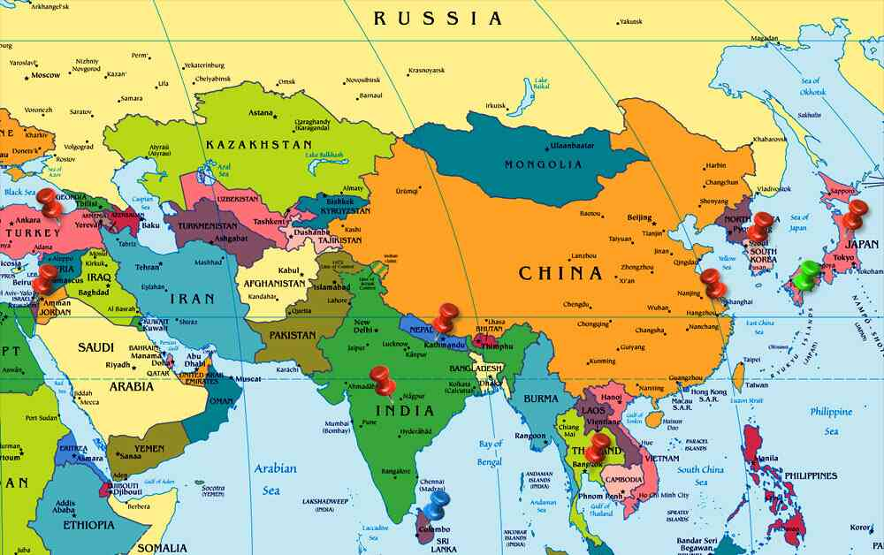
Look at the map. And discuss in pair.
a) Which country lies in
Indian Ocean?
b) Among the countries is there
any country like an Island ?
c) What is the name of
this country?

Slide 6
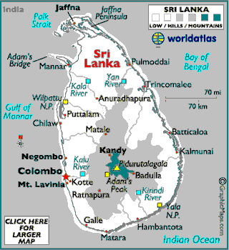
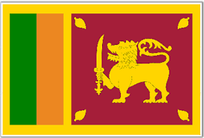
Let’s know more about Sri Lanka
Unit : Six
Lesson : Two
page : 88
Sri Lanka : The pearl of the Indian Ocean

Slide 7
Learning Outcomes
After we have studied this lesson, we will be
able to -----
a) ask and answer questions.
b) read, comprehend and summerise texts.
c) write letters to friends describing places
of interest.

Slide 8
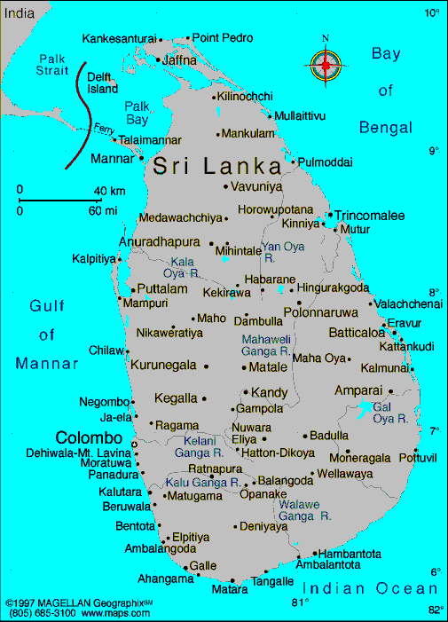
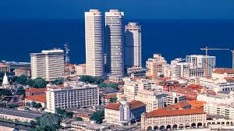
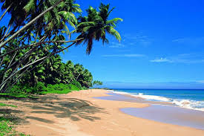
Look at the pictures
Map of
Sri Lanka
Colombo, Capital of Sri Lanka
Sri Lanka sea beach

Slide 9
Sri Lanka has many nicknames: Serendip, Ceylon, Teardrop of India, Pearl of the Indian Ocean.
Sri Lanka located in Indian Ocean
LikeTeardrop of India

Slide 10
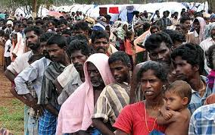
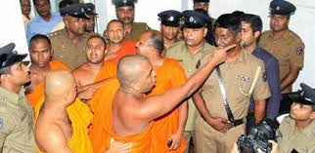
Sri Lanka has a modest size.
It’s population is about 20 million.
It is a multi-religious, multi-racial and multi-lingual country.

Slide 11
North
It’s measures about 415 km from north to south.
East
And 220 km from east to west.
West
South

Slide 12
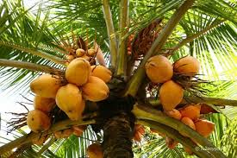
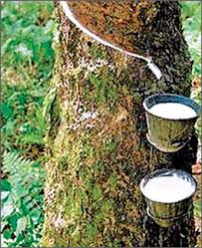
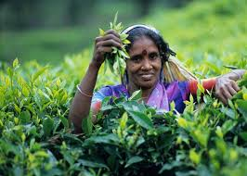
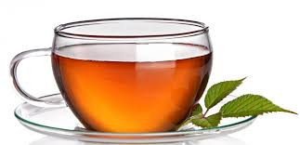
Sri Lanka’s economy traditionally based on agriculture. It exports tea, rubber and coconuts. Sri Lanka is the world largest tea exporter.

Slide 13
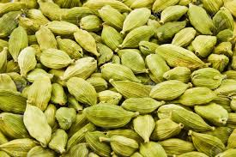
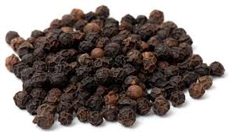
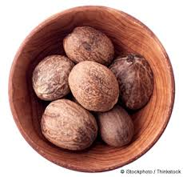
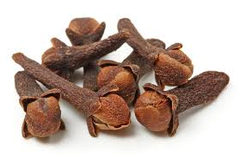
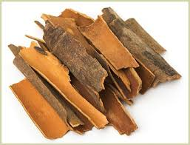
Sri Lanka is also major producer and supplier of spices such as……..
Cinnamon
Cardamom
Pepper
Cloves
Nutmeg

Slide 14
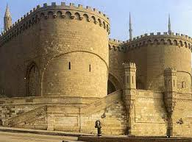
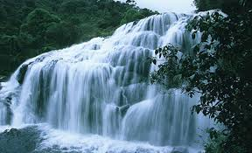
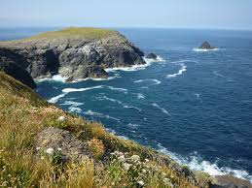
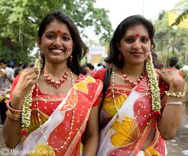
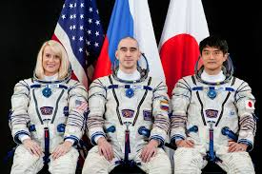
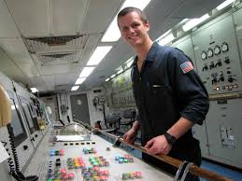
Word meaning and sentence making.
Click Word
Meaning : A person trained to travel in spaceship.
Meaning : Shape of sea shore
Meaning : Castle, Fort, Shelter
Meaning : Flowing/ Falling, Flowing downward
Meaning : Conventional, Inherited, Fundamental
Meaning : Sailor, Mariner
Traditional
Astronaut
Mariner
Coastline
Citadel
Cascading
Sentence: Sri Lanka has more than 1340 kilometres of coastline.
Sentence : People wear traditional dresses on the occasion Pahela Baishakh.
Sentence : Sri Lanka is blessed with cascading waterfalls.
Sentence: Neil Armstrong was a famous astronaut.
Sentence: Emperor built a citadel to protect his kingdom.
Sentence : Mariners work in ships.

Slide 15
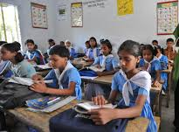
Silent Reading
When someone comes to Sri Lanka, they may……

Slide 16
Individual work
a) Write down the nicknames of Sri Lanka
b) Which country has the highest literacy rate in south
Asia?

Slide 17
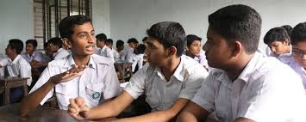
Group work
From your reading of the text complete the table with no more than two words and/ or numbers. (Page-90)

Slide 18
Sri Lanka: Facts
People | Economy | Natural beauty
There are a) …… …… four main ethnic groups. They are Sinhalese, Sri Lankan Tamils, b)....... ………. and Sri Lankan Moors who are known as c) ………. The earliest residents of Sri Lanka are known as d)…….. | Agriculture is a traditional form of economic activities in Sri Lanka . The country export many crops and a) …….. Sri Lanka tops the world in tea export. The spice b)……. was found first in Sri Lanka. | Sri Lanka is blessed with awesome natural beauty. There are blue seas , sandy beaches, green hills and flowing a)…... .The country has a rich wild life. A wide variety of fruits and c)…….. are also available. Travellers can enjoy the c)……. view sitting at the plam shaded lagoons.

Slide 19
Now, match your answer
People | Economy | Natural beauty
There are a) more than four main ethnic groups. They are Sinhalese, Sri Lankan Tamils, b) Indian Tamils and Sri Lankan Moors who are known as c) Muslims. The earliest residents of Sri lanka are known as d) Veddhas. | Agriculture is a traditional form of economic activities in Sri Lanka . The country export many crops and a) spices. Sri Lanka tops the world in tea export. The spice b) cinnamon was found first in Sri Lanka. | Sri Lanka is blessed with awesome natural beauty. There are blue seas , sandy beaches, green hills and flowing a) waterfalls. The country has a rich wild life. A wide variety of fruits and b) spices are also available. Traveller can enjoy the c) glorious view sitting at the plam shaded lagoons.

Slide 20
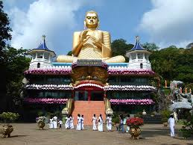
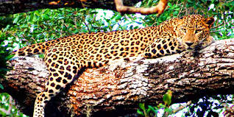
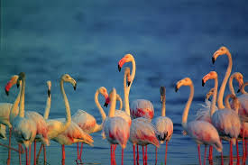
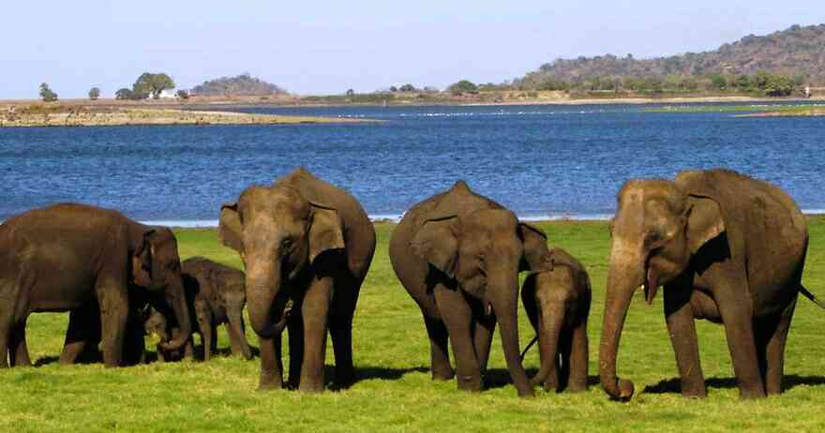
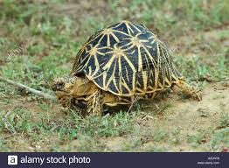
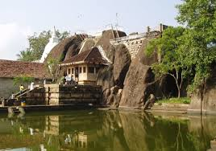
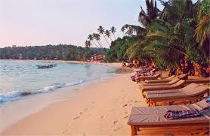
Read the small descriptions of some of the best tourist places in Sri Lanka & their attraction. Then discuss the questions that follow.
Hikkaduwa,a coral reef and sand beach
Anuradhapura, ancient capital of Sri Lanka.
Bundala National park. A home Dambulla
of birds and animals
Elephant
Leopard
Dambulla,a temple complex
Turtle

Slide 21
Now make a dialogue with your partner about the best tourist places of Sri Lanka.

Slide 22
Observe the video attentively.
Now, write a short description of Bundala National Park.

Slide 23
Evaluation
1. What do you mean by the word Ayubown?
2. What are the nicknames of Sri Lanka?
3. Where is Sri Lanka situated and what is the name of
it’s capital?

Slide 24

HOME WORK
Write a short description of Sri Lanka’s economic activities and natural beauty.

Slide 25


