Slide 1
The teachers who will use the content in their own classroom may explain all the words if needed.
The teachers are requested to follow the notes given below the slides.

Slide 2
Welcome to my class

Slide 3
PARVIN AKTER
Lecturer, English
Rampur Ideal
Alim Madrasah
Sadar, Chandpur
Mobile : 01718295712
E-mail: parvinakter1335@gmail.com
I
D
E
N
T I
T
Y
Sub: English Grammar
&Composition
Class : IX-X
Unit : Eight
Topic :Preposition
of Time & Place
Time :45 minutes

Slide 4
Look at the image. Can You Guess Today’s Lesson……?

Slide 5
Lesson Declaration
Today’s lesson is…..
Preposition of time & place

Slide 6
LEARNING OUTCOMES
After this lesson, students will be able to…..
1. use prepositions of time and place
2. identify prepositions in the passage
3. use prepositions in sentences

Slide 7
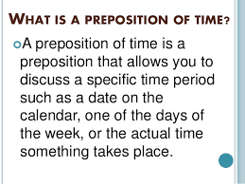

Slide 9
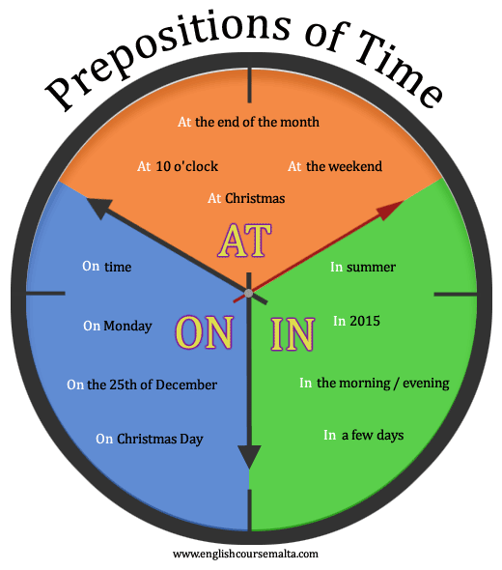
[Note: For better understanding teacher will explain it]

Slide 10
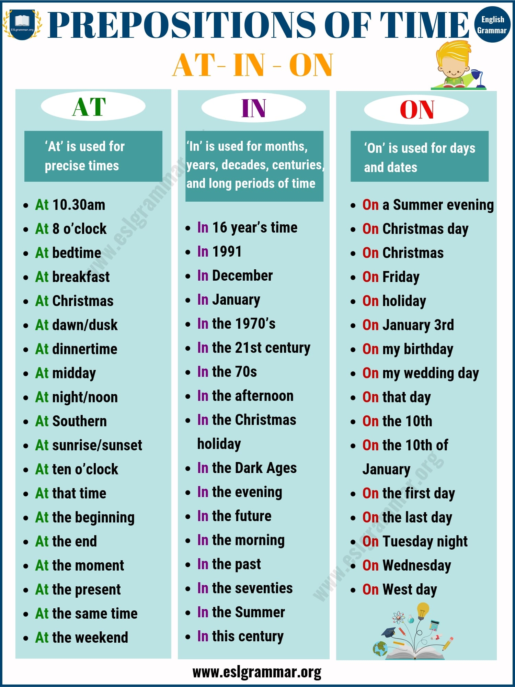

Slide 11
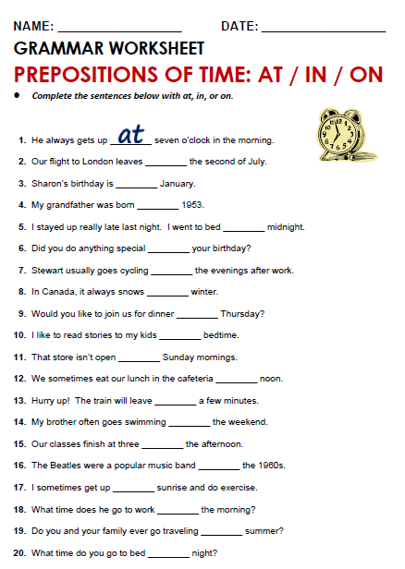
Pair Work
Time-5 mins

Slide 12
Match the answers
At
On
In
In
At
On
In
In
On
At
On
At
In
At/on
In
In
At
In
In
at

Slide 13
Other Prepositions of time

Slide 14
Note: Teacher will explain this part and give more example if necessary

Slide 16
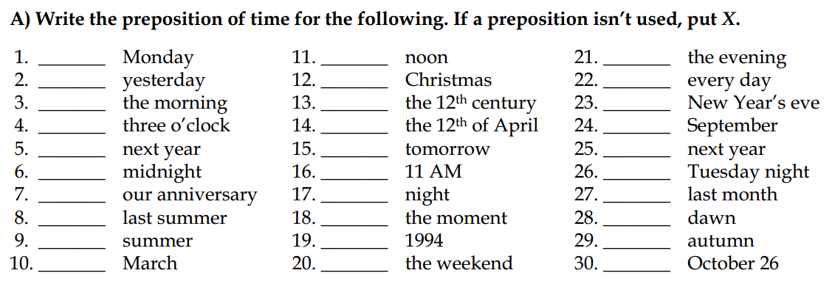
Individual Work
Time: 7 mins
Note: Teacher will confirm the work in the class.

Slide 17
Correspond the answers
On
X
In
At
X
At
On
X
In
In
At
At
In
On
X
At
At
At
In
At/on
In
X
On
In
X
On
X
At
In
on

Slide 18
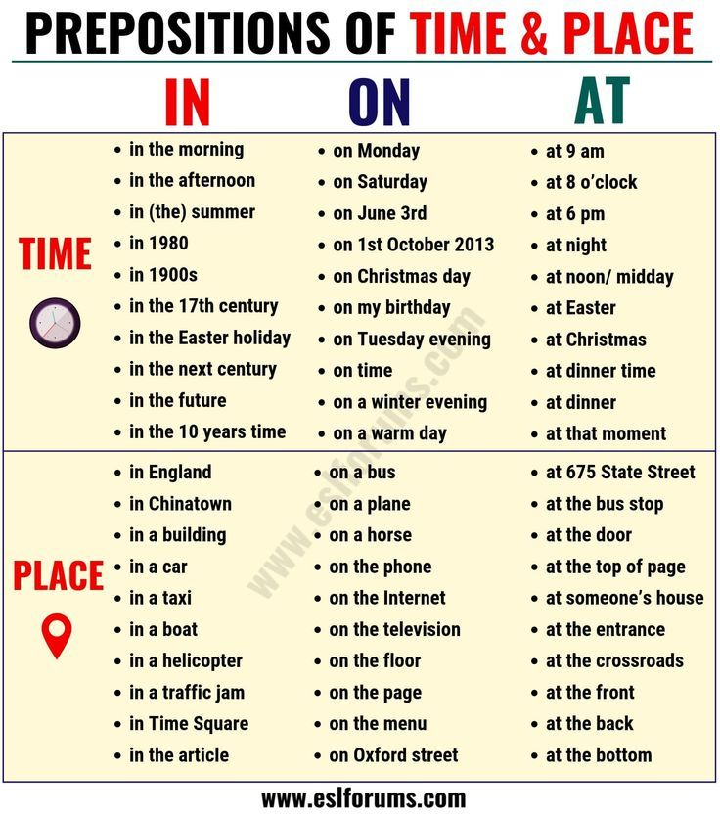
IN, ON, AT- in both time and place

Slide 19
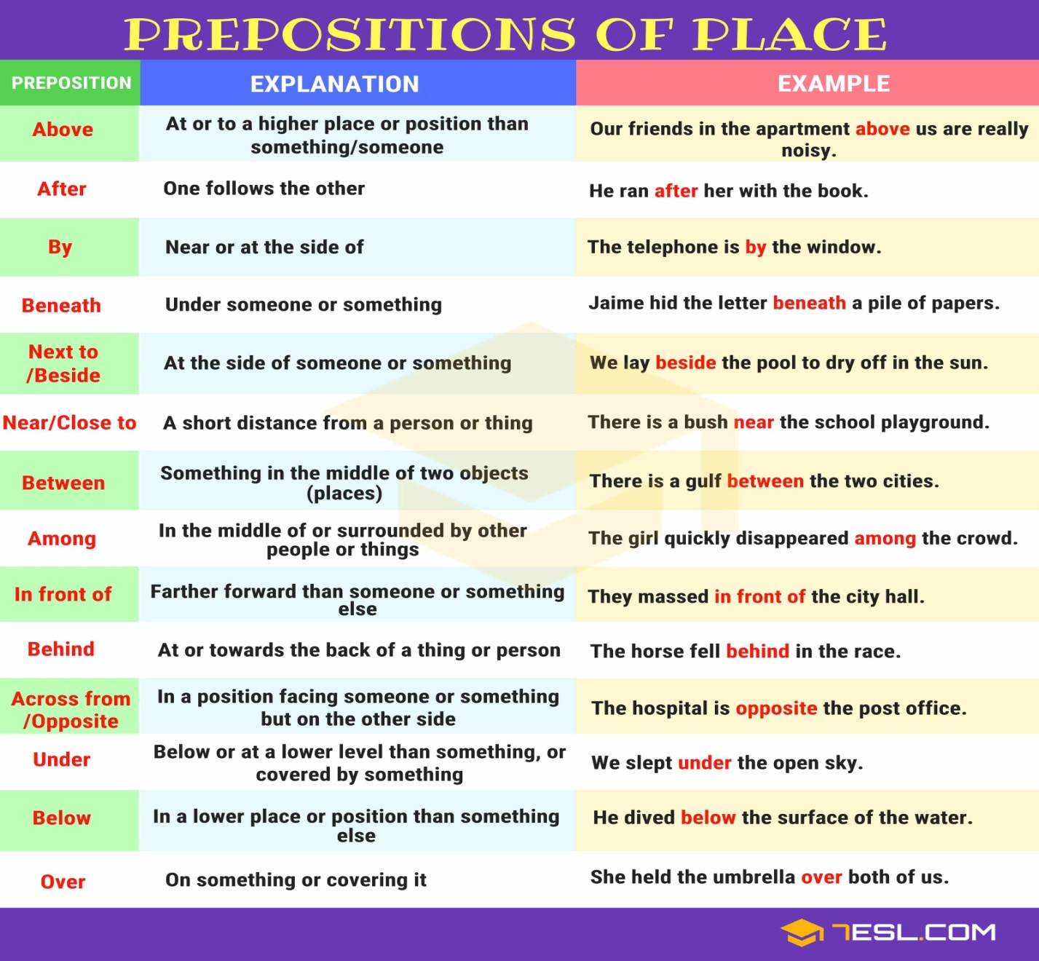
Other Prepositions of Place

Slide 20
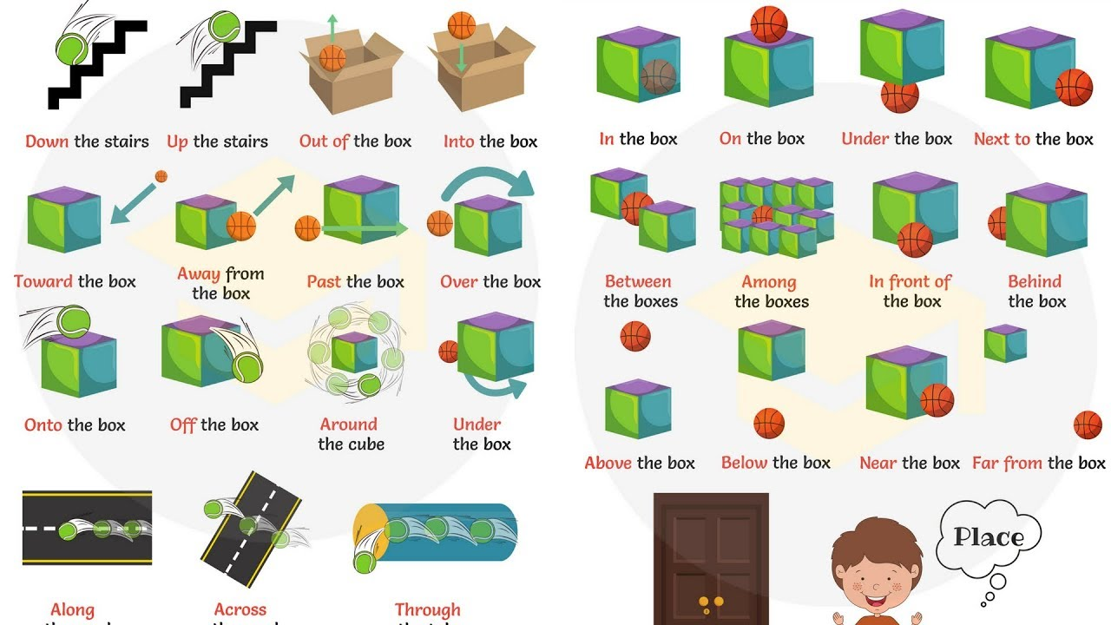
Note: Teacher will help students to understand this part.

Slide 21
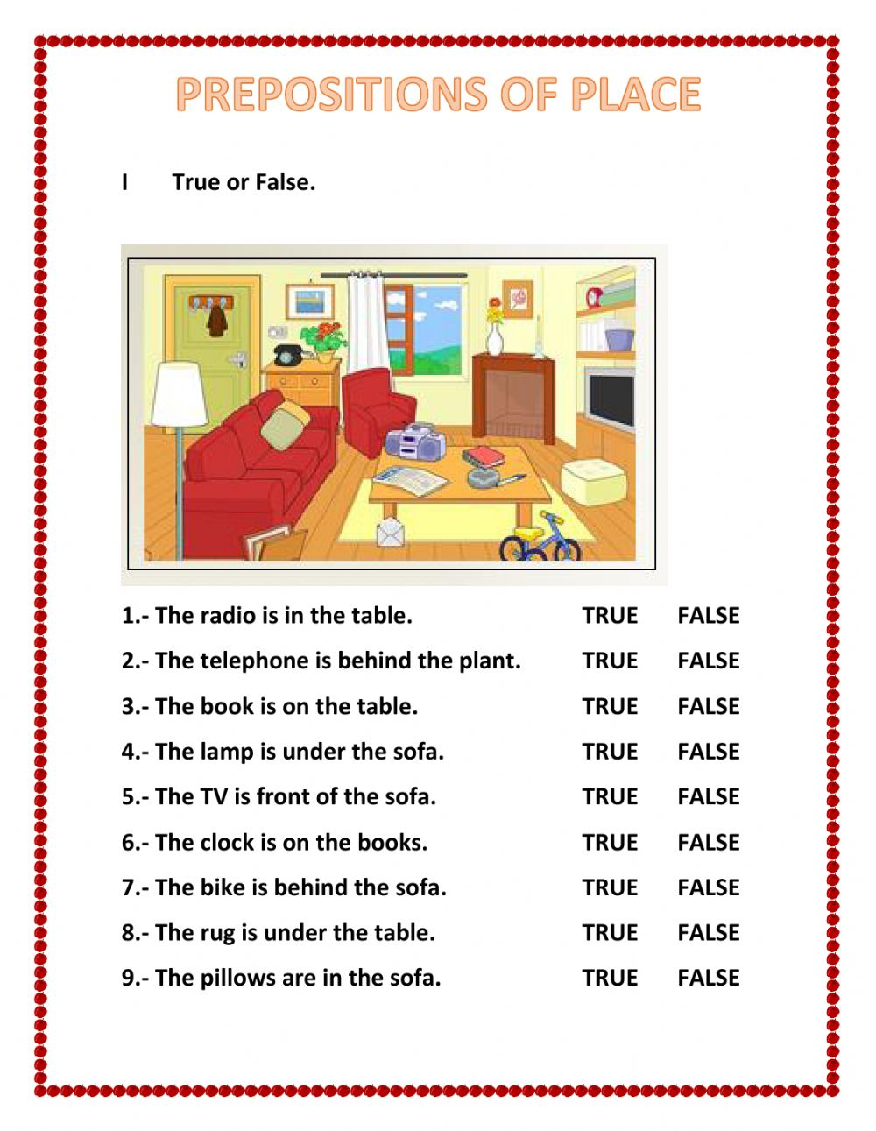
Evaluation
Time: 3 mins

Slide 22
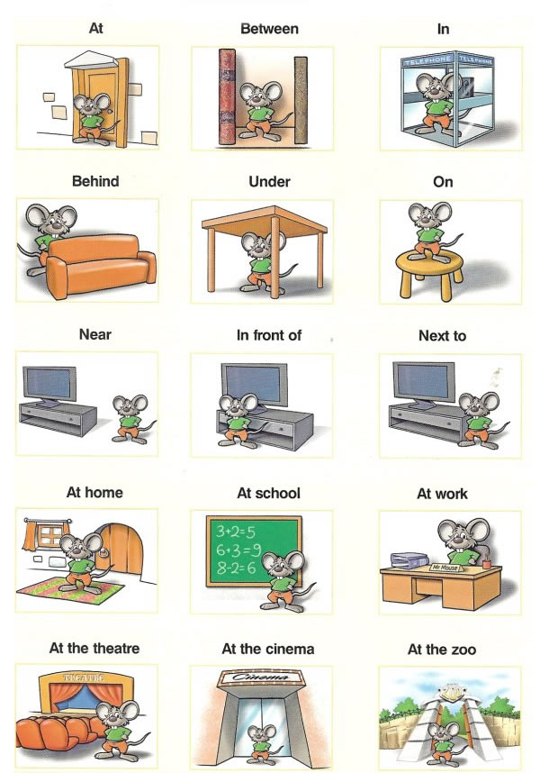
Home Work :Make sentences using the pictures.
For example: The rat is at the door.

