Slide 1
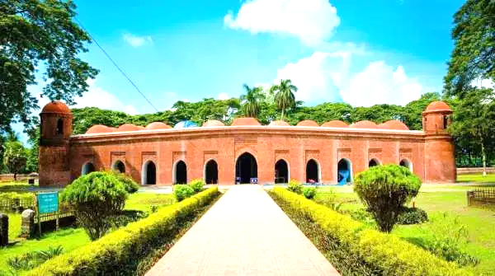
Good Morning

Slide 2
Introducing:
Mohammad Azharul Islam
Assistant Teacher (English)
Hugra Habib Kader High School
Tangail Sadar, Tangail
Class: Nine-Ten
Subject: English for today
Unit: 8 Lesson: 01
Time: 50 Minutes

Slide 3
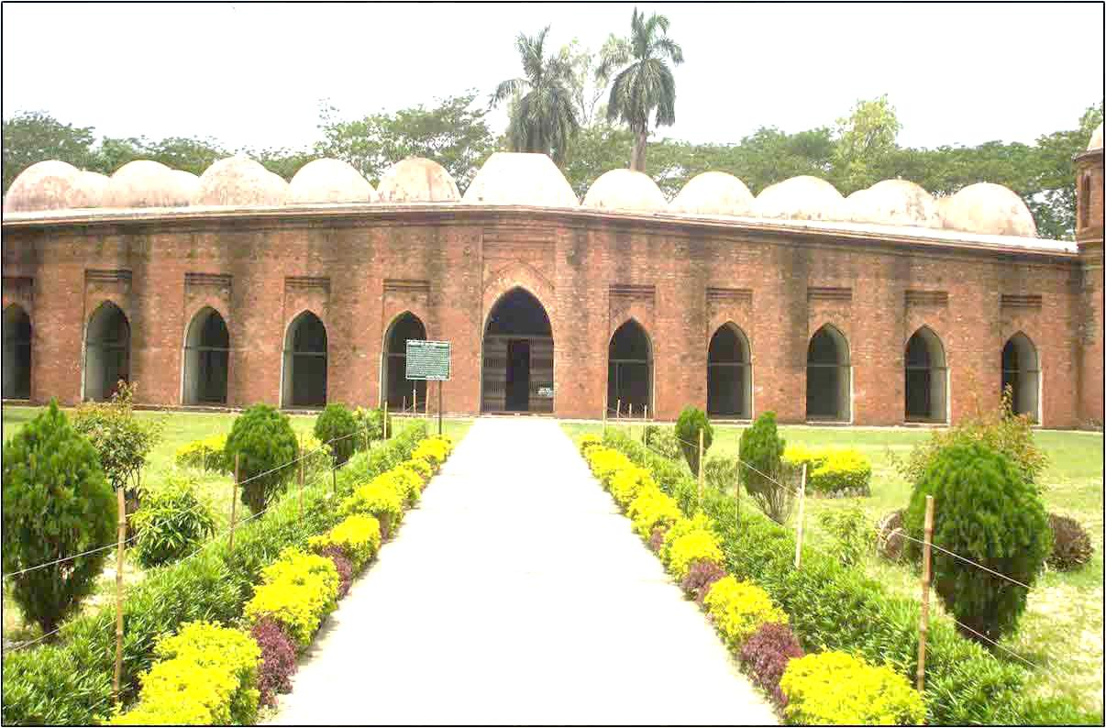
What is the picture about?
The Shat Gambuj Mosque in Bagerhat.

Slide 4
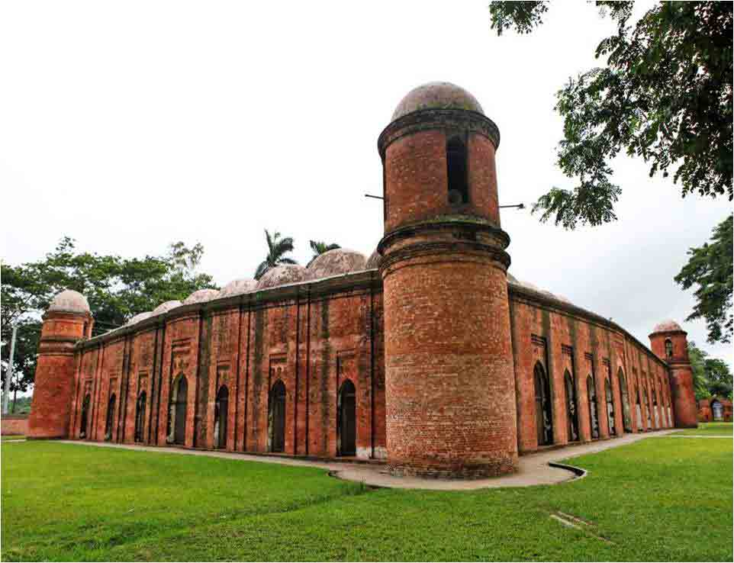
Seven arch doors in the north
Seven arch doors in the south

Slide 5
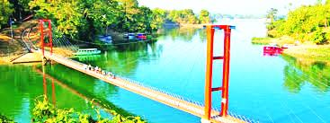
What is the picture about?
A network of bridge and reservoirs

Slide 6
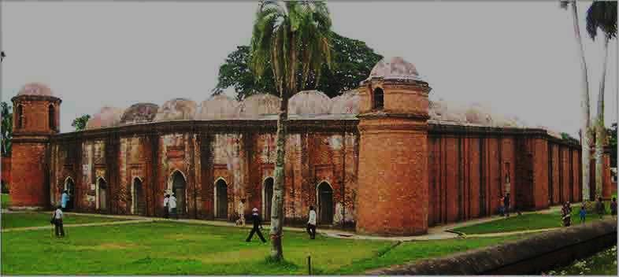
Lesson declaration:
The Shat Gambuj Mosque

Slide 7
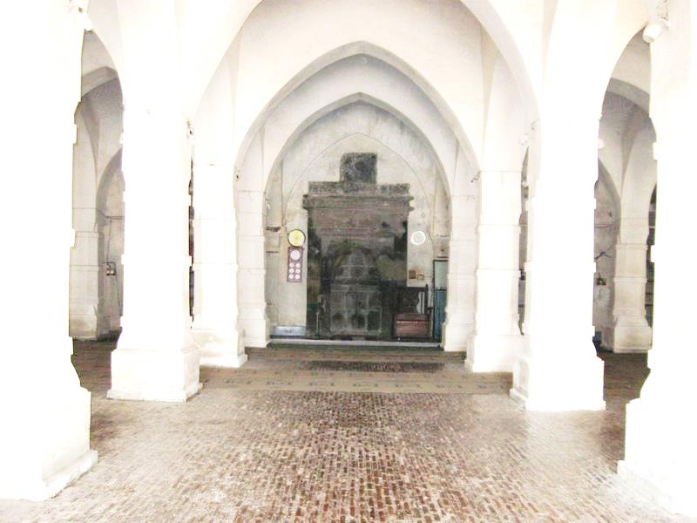
Inside of the Shat Gambuj Mosque

Slide 8
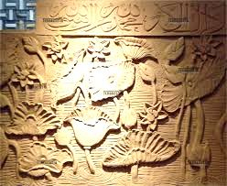
Look at the picture
Terracotta flowers and folic

Slide 9
Learning out comes
After finishing the lesson learners will be able to-
1. Answer the questions.
2. Write a paragraph.
3. Choose the best answer from the alternative
Write a letter about a historical place.

Slide 10
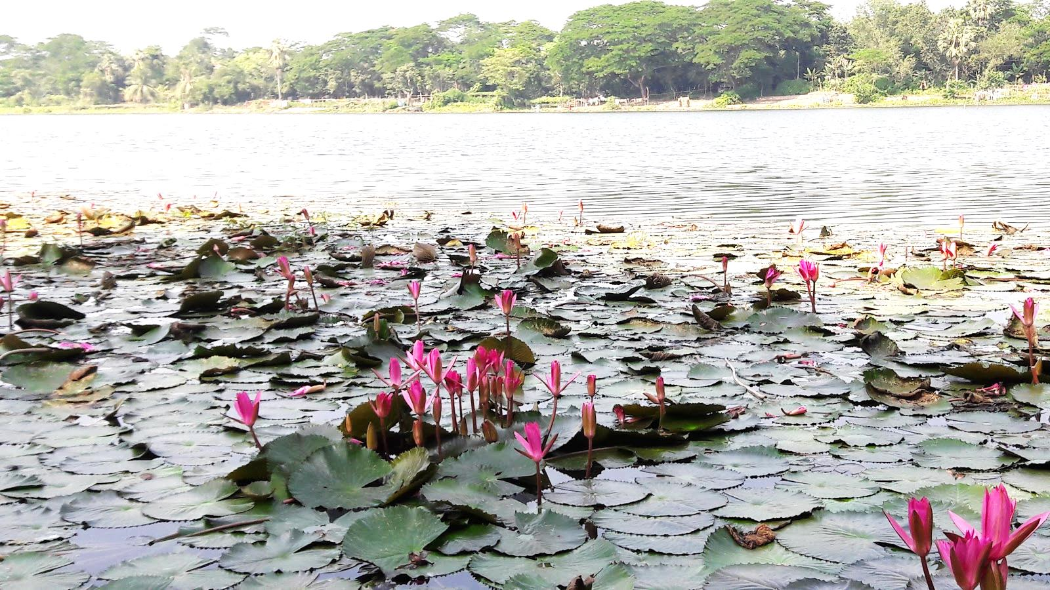
Look at the picture
Ghora Dighee the Shat Gambuj Mosque

Slide 11
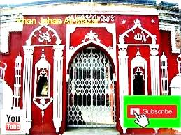
Look at the picture
The tomb of Khan Jahan Ali

Slide 12
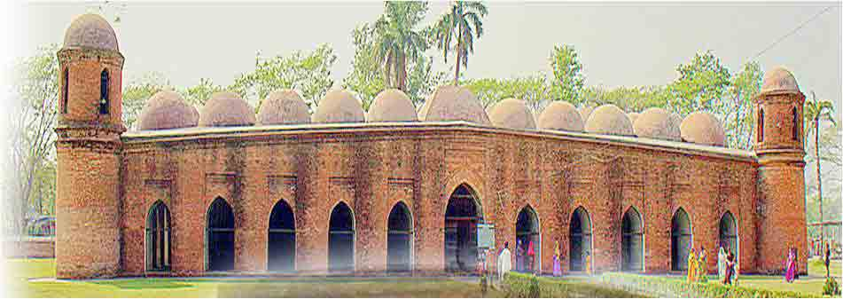
Smaller domes in 4 corners
77 low height domes
1
3
1o
2
4
5
6
7
8
9
11
11 Arched doorways on east
Notes:
In the eastern side of the mosque 11 arched doors are shown.

Slide 13
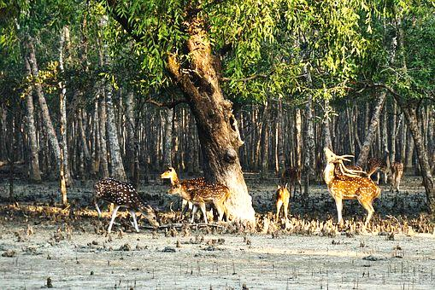
Look at the picture
The Mangrove forest of Sundarban.

Slide 14
Individual Work:
What do you mean by ‘Heritage’?
When did the Shat Gambuj mosque become a World Heritage Site?
Who founded the Shat Gambuj Mosque?
What did Khan Jahan do to make Bagerhat city hospitable?
Answers:
(1) ‘Heritage’ is what we inherit from the past, live with in the present and pass on to our future generations.
(2) The Shat Gambuj Mosque became the World Heritage Site in 1985.
(3) The religious person and Turkey General Khan Jahan Ali.
(4) Khan Jahan built a network of roads, bridges, public buildings and reservoirs to make the city hospitable.

Slide 15
Peer work
Write a letter to your non- Bangladeshi friend abut a historical place.

Slide 16
Evaluation
Choose the best answer from the alternatives:
The number of domes of the mosque are ---- (i) 66 (ii) 77 (iii) 87 (iv) none
(b) The founder of the Shatgambuj mosque is--.
(i) Khan Jahan Ali (ii) sultan Mahmood (iii) sher Khan (iv) Isha Khan
(c) The mosque was built in--- century (i) 12 (ii) 13 (iii) 14 (iv) 15
(d) The thickness of the arch is --- feet (i) 6 (ii) 7 (iii) 8 (iv) 9
(e ) The Mosque is situated near
(i) Cox’s Bazar (ii) Rangamati (iii) Bandarban (iv) Sundarban

Slide 17
Home work
Write a paragraph about the on
The Shat Gambuj Mosque.

Slide 18
Thank
you all

