Slide 1
Welcome

Slide 2
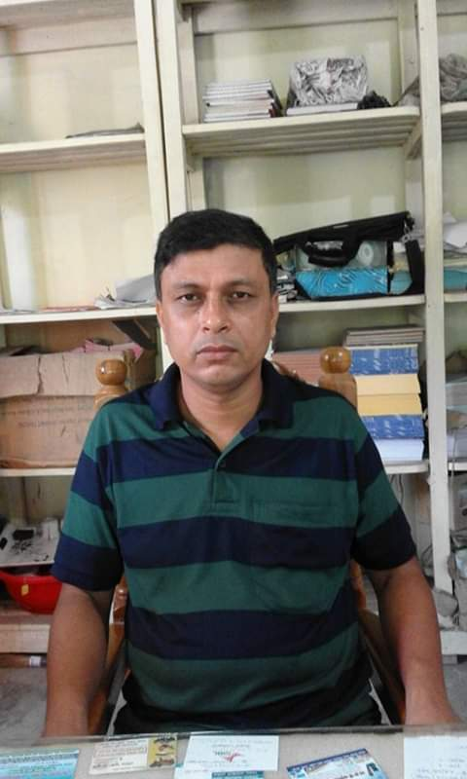
Introduction
Sultan Ahmed Miazi Assistant Teacher (English) Balia k.B.D.N.Dakhil Madrasah.
Chandpur Sadar,Chandpur.
Mobile---01817106106 English Grammar & Composition
Class: Seven,
Time-45 Mins
U- 2 L-

Slide 3
Black Zone
Blue zone
Red Zone
Future
Past
Bus stop
Present
Car

Slide 4
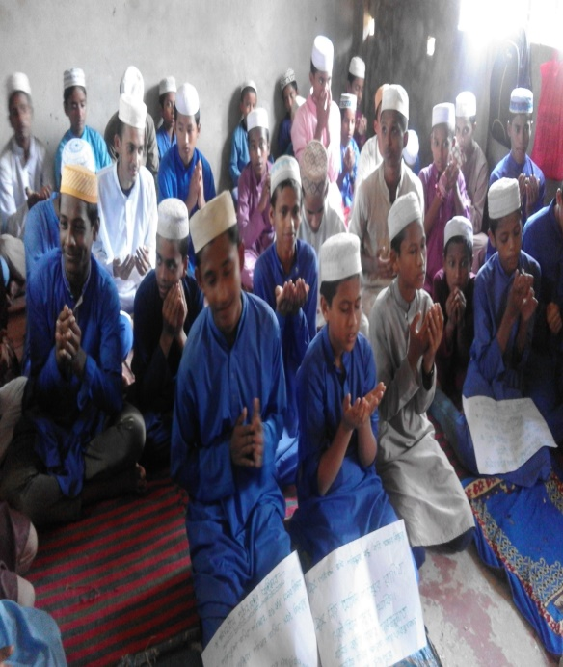
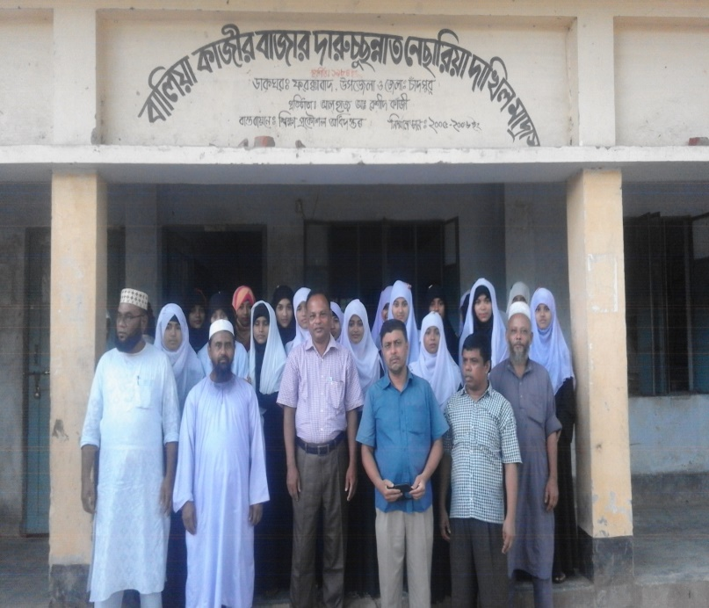
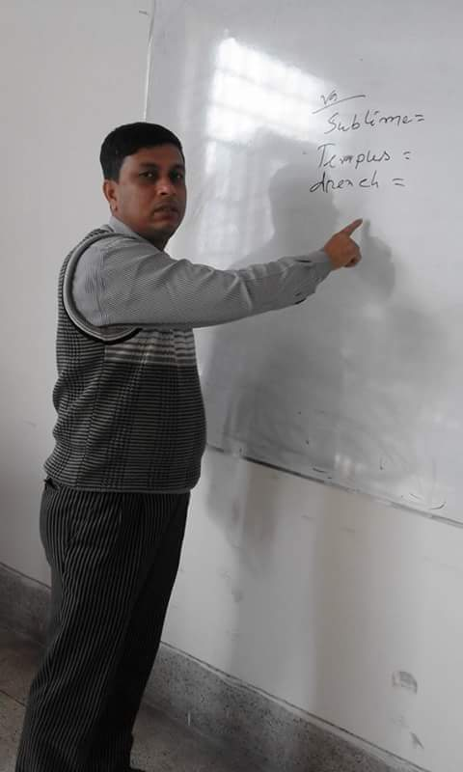
1994
2015
2021
past
Present
Future
01.What do you see here?
02.Find out the difference among the picture

Slide 5
Today’s Topics:
Tense

Slide 6
Learning Outcomes
After completing the class we will be able to
01.write sentences in different tenses
02.use the right form of verbs

Slide 7
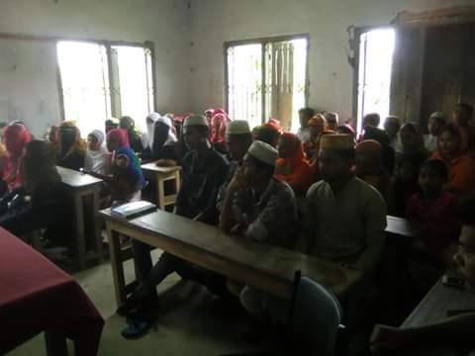
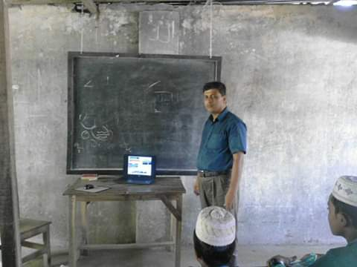
1994
2015
2021
Tense indicates time of an action
I go to school regularly
I went to Dhaka yesterday
I shall go to Comilla tomorrow
Here the words written in red indicate time of action

Slide 9
Tense are three types
These are
Present Tense
Past Tense
Future Tense

Slide 10
Each tense is classified into four and these are
present
past
future
Indefinite
Indefinite
Indefinite
Continuous
Continuous
Continuous
Perfect
Perfect
Perfect
Perfect
Continuous
Perfect
Continuous
Perfect
Continuous

Slide 11
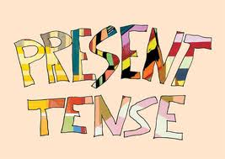

Slide 12
Present Tense
Present tense indicates an action that takes place in present time

Slide 13
Present tenses are four types and these are
Present Indefinite
Present Continuous
Present Perfect
Present perfect Continuous

Slide 14
Present Indefinite
Universal truth
Habit
Present indefinite tense means universal truth ,the action that is usual and the action that takes place regularly
Structure :Subject + present form of verb

Slide 15
Present Indefinite
Structure
eat ,ate, eaten
I eat
Subject + present form of verb

Slide 16
Keep in mind
I eat
He eats
We add s or es after the base form of verb, if the subject is third person and singular number

Slide 17
Individual work
Identify the sentence that are written in Present Indefinite
01.I like tea
02.He is a intelligent boy
03.He came to Dhaka yesterday 04. Who is your food?
05. We had a cow
Answer:01,02,04

Slide 18
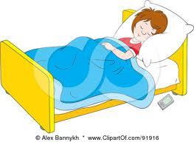
Present Continuous tense
Sleeping
Running
Present continuous tense indicates an action that is taking place

Slide 19
Structure : subject +am / is / are + verb + ing
Keep in mind
01.Gradually,day by day , step by step, now these words indicate present continuous tense
Example: I am improving gradually

Slide 20
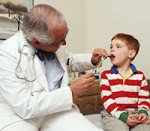
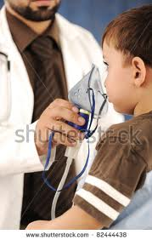
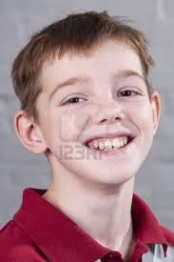
Present Perfect
I have visited the doctor for two times
January
March
June

Slide 21
Present Perfect tense means an action that is finished, but the result is not finished yet.
Structure : Subject + have /has + past participle of verb
Attention
The sentence that contains already, ever, never , is in present perfect tense

Slide 22
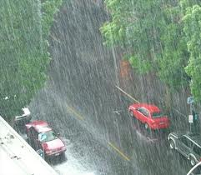
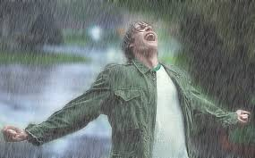
Present perfect continuous tense
It has been raining since morning
Morning
Evening
Present perfect tense means an action that is taking place from first time

Slide 23
Structure :Subject + have /has +base form +Ing
I have been working as a teacher since 2011

Slide 24
Assessment
He …….to school regularly(go)
I ………my work already(do)
I………..for two hours(read)
At present woman……an important role(play)
What …….your name?(be)

Slide 25
Home work
Write five sentences in Present Indefinite , continuous perfect and perfect continuous

Slide 26
Thank you

