Slide 1
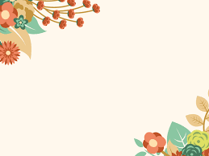
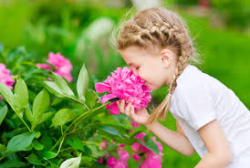
Welcome to the presentation

Slide 2
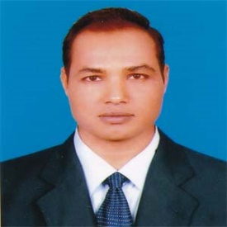
Teacher’s Identity
Md. Mizanur Rahman
B.A.(Hons.), M.A. in English, B.Ed.
Assistant Teacher
Police Lines School and College, Pabna.
E-mail: mizanplsc@gmail.com
Cell Phone :01737979719

Slide 3
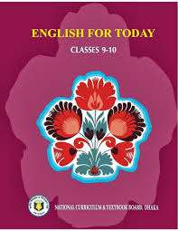
Lesson’s Introduction
Class: Nine/ Ten
Subject: English 1st Paper
Unit: Nine (Unconventional Jobs)
Lesson: Three
Lesson Title: Floral Career
Class Duration: 40 minutes
Date: 04/03/2020

Slide 4
Learning Outcomes
The students will be able to:
i.read intensively and extensively.
ii. participate in debate, discussion.
iii. write a short paragraph about the job of a florist.

Slide 5
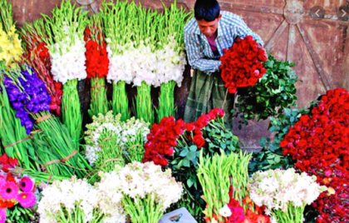
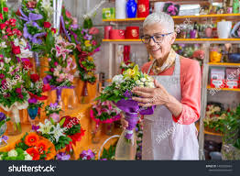
A. Look at the pictures and say what you see in them.

Slide 6
Today’s Lesson
Floral Career

Slide 7
B. Work in pairs. Choose a job from the box below but don’t tell your partner. Ask and answer the following Yes / No questions to find out what the job is.
Pair Work
Do you----------? | Do you have to-----? | Did you have to----?
Work inside | Wear a uniform | Study at college
Earn a lot | Work in shifts | Do a lot of training
Work with people | Use your hands | Do internship
Use a computer | Get up early
 | Speak English

Slide 8
Let’s introduce with new words
Fragrance
A pleasant, sweet smell
Syn. Scent, perfume
Have you ever enjoyed the fragrance of rose
Florist
A person who sells and arranges flowers
A florist’s job is an unconventional job

Slide 9
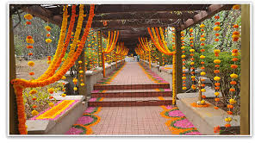
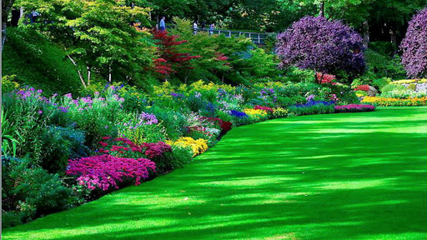
Floral
Decorated with or depicting
Syn. flowery
You can see the professional performance of a florist by seeing eye catching floral displays.
Greenery
Green foliage
Syn. foliage, vegetation
A florist displays flower by using both real and artificial flowers with other greeneries.

Slide 10
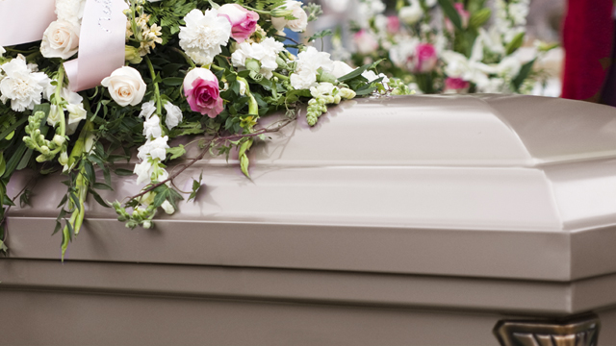
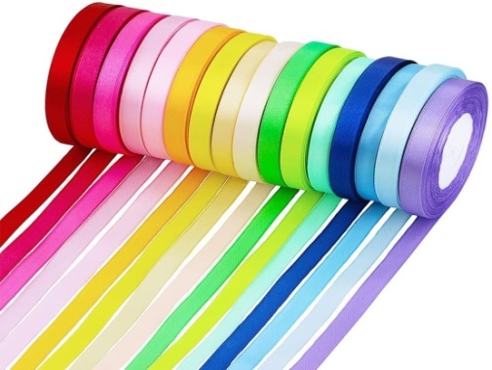
Funeral
A ceremony at which a dead person is buried or cremated
Burial, entombment
During funeral people use flowers
Ribbon
A long , narrow strip of fabric used for tying or decoration
Syn. strip
A florist needs good sense for selecting flowers, ribbons to make beautiful arrangements.

Slide 11
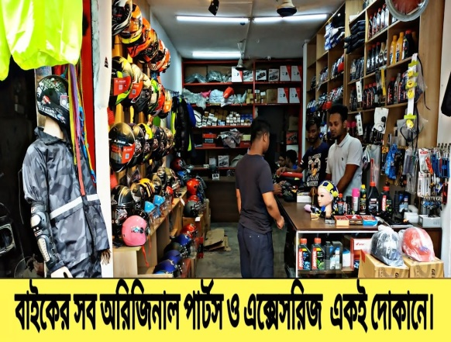
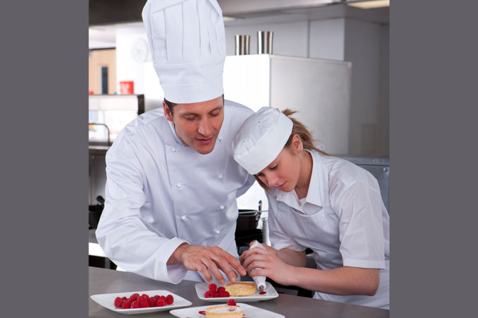
Spare parts or things of necessities
Accessories
Syn. frills
A florist has good sense for selecting flowers, ribbons and other accessories .
Apprentice
Some one who works for an expert in order to learn something .
Syn. Trainee, learner
Apprentice helps a man to be successful one.

Slide 12
Individual Work
Read the lesson silently.
Have ever thought of a very creative career? Have you dreamt of a rosy environment full of colour and fragrance? How much would you live it if you were placed in a store full of flowers the whole day? I’m just going to give you some clues about such a job which can also be a business.
Yes, Daisies, violets, tulips, marigolds, dahlias, bellies, jasmines. Roses and all those things of beauty can also earn you a living if you handle them professionally. If you start such a profession you will be called a florist. A florist’s career is a good choice as an unconventional job for many around the world. Wherever you see eye-catching floral displays, you actually see the professional performance of a floral designer.
Using both real and artificial flowers with other greeneries, florists prepare flower displays for a variety of events such as weddings, birthdays. Anniversaries, Valentine’s day, official receptions and even funerals. Every flower comes with its distinct colour, design, value and meaning which flower designers have to know will. There are conventions and meanings associated with flowers. We know that conventionally roses are meant for romance and marriage anniversaries and tulips for birthdays.

Slide 13
Although formal education or a diploma is not always essential for florists, they must have good taste, a good eye fro colours, shapes and proportion. They have to have good sense for selecting flowers, ribbons and other accessories to make beautiful arrangements. Professional florists are knowledgeable about not only flowers but also designs about techniques. Most florists learn the trade mainly through apprenticeship in a flower farming job and also by attending formal floral schools and courses. However, a true passion for flowers and a bit of aesthetic sense are all that can make a florist’s career successful.
Flower designers earn fairly handsome money. But the bonus is that they work in a fresh and beautiful environment which their clients also enjoy. They work with flowers all day long in a pleasant and fragrant atmosphere with vivid colours around. But their is a disadvantage too, if you are inclined to see so. Florists deal with flowers, but miss their honey!

Slide 14
Group Work
Write the answer of the following questions
How is the career of a florist?
What qualities do you need to have for a florist’s job?
How do most florist learn the trade?
What is the extra advantage of a florist’s job?

Slide 15
D. Suppose you have met a florist in a flower shop . Write an imaginary interview with him ? Her.
Evaluation
Florist
Myself
It will be applied by turns
Good morning and thank you. But I haven’t come to buy flowers.
Florist: Good morning. What type of flowers do you need, Sir?
Florist : So, why have you come, Sir?
Myself : I wish to talk to you.
Myself : There are many professions in our society. But you’re selling flowers. Can you tell me the reasons?
Florist : Yes, you can ask me anything.
Florist : I live flowers. I have some extra qualities. I can prepare bouquets of many sizes. I can sell the flowers using some techniques. Besides, the buyers like me too.
Myself : How much money can you earn a day?

Slide 16
Myself
Florist
Myself : Very good, Do you enjoy your profession?
Florist : More than seven hundred taka.
Myself : Thank you.
Florist : Of course. I enjoy it.
Florist : Welcome.

Slide 17
Home work
E. Write a short paragraph giving reasons why you like or dislike the job of a florist.

Slide 18
Thanks to all

