Slide 1
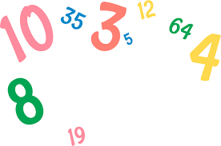

Slide 2
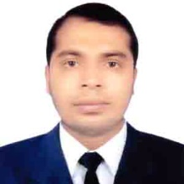
Teacher’s Identification
Misbahul haque
Assistant Teacher
Lontirmati government primary school
Kanaighat,Sylhet.
Mobile No:01715453647
Email:mhhaque520@gmail.com

Slide 3
Let’s listen a song

Slide 4
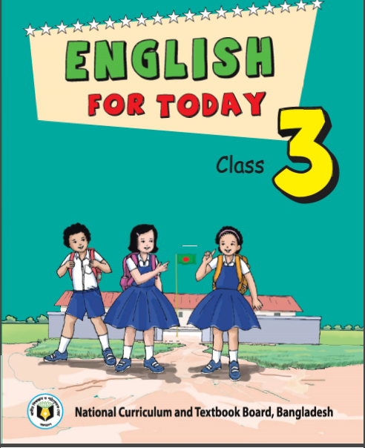
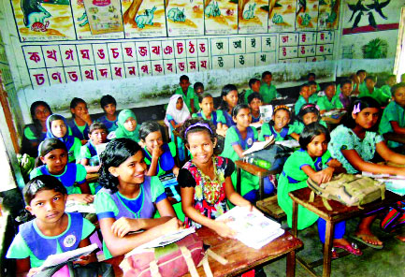
Lesson introduction
Class:Three
Subject:English
Unit:06
Lesson:1-3
Lesson’s name:Numbers
Activity:A
Page:12
Time:40minute

Slide 5
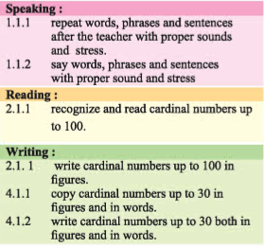
Learning outcomes
Students will be able to…

Slide 6
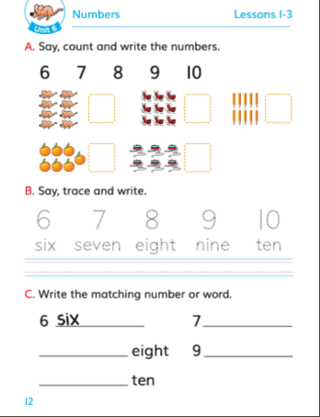
Lesson declaration
Open at page 12.Today’s lesson is Numbers.

Slide 7
How many Balls are there?
6
Six

Slide 8
How many Caps are there?
7 Seven

Slide 9
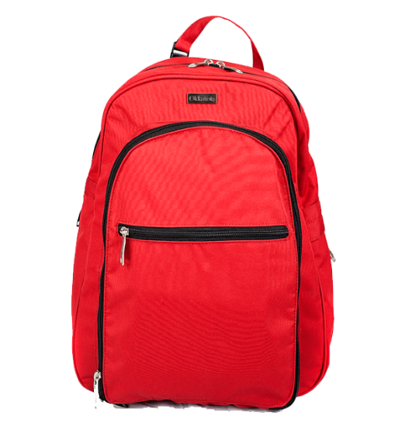
How many Begs are there?
8
Eight

Slide 10
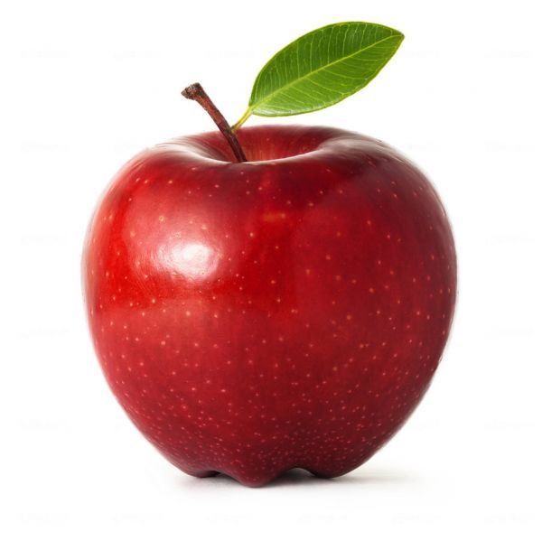
How many Apples are there?
9 Nine

Slide 11
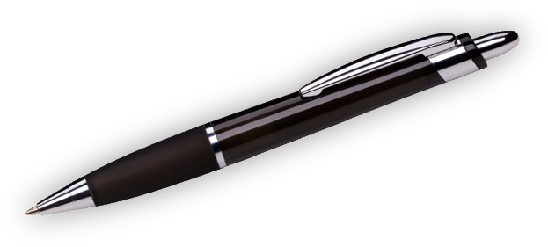
How many Pens are there?
10
Ten

Slide 12
Match the following numbers
10
6
9
7
8
Six
Seven
Eight
Nine
Ten

Slide 13
Group work
All the students will be divided in three Groups:
Padma
Write down the missing numbers 5.…. ….. 8….. …...11

Slide 14
Magna
Write down the missing number 5.…. ….. ….. 9…..11
Jamuna
Write down the missing number 5.…. 7….. ….. .....11

Slide 15
Answer of group works
Padma
Write down the missing numbers 5…6…7…8…9…10…11
Maghna
Write down the missing number 5..6 ...7. …8.. 9…10..11
Jamuna
Write down the missing number 5..6. 7…8.. …9.. ..10...11

Slide 16
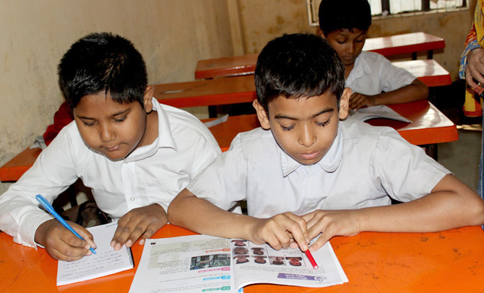
Pair work
6
7
8
9
10
All the students will be divided in pair.From every pair one student will count the numbers and say loudly from 6-10.Another one will listen attentively.By the way everyone will count and say the numbers.

Slide 17
Evaluation
Count and write down the number of Pencils.
9

Slide 18
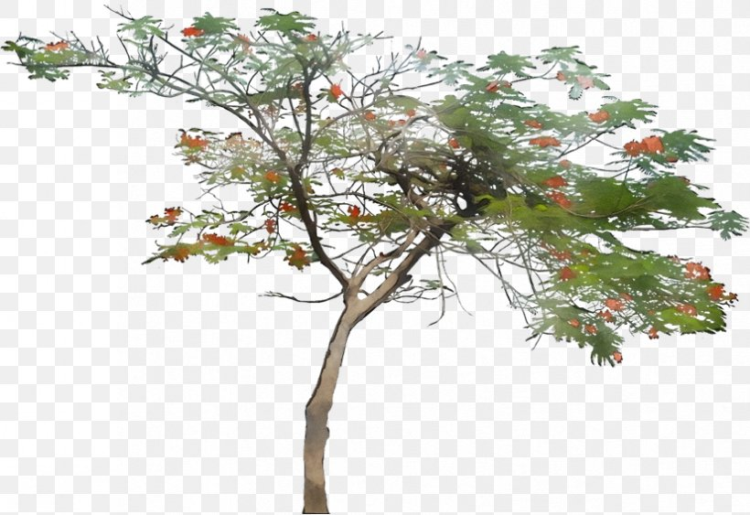
Count and write down the number of Birds.
7

Slide 19
Homework
Learn the Numbers:
6 | Six
7 | Seven
8 | Eight
9 | Nine
10 | Ten

Slide 20
No more today

