Slide 1
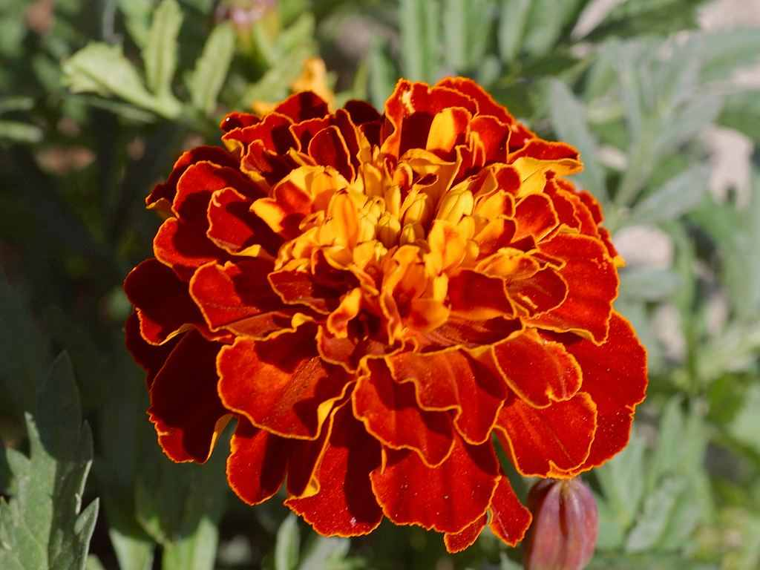
welcome

Slide 2
Teacher’s Introduction :
Shahinur Rahman Shahin
Assistant Teacher
Shibpur Govt. Primay School.
Birampur,Dinajpur.

Slide 3
Lesson Introduction
Class- Five Time-50 minutes.
Subject-English Date-21.6.2012
Lesson-Visit at the zoo
Lesson unit –Here …….head.

Slide 4
Learning outcomes:
Students will be able to---------------
1. recite the poem with correct pronunciation, stress and intonation.
2. write name of two animals of Bangladesh.

Slide 5
What can you see in the video?
Animals
Where can you see these animal?
At the zoo

Slide 6
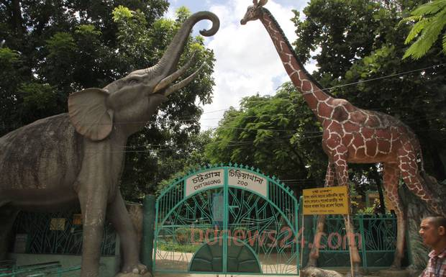
Today’s lesson------------
‘At the zoo’

Slide 7
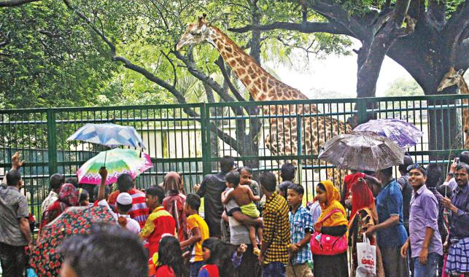
What is this?
This is a zoo.

Slide 8
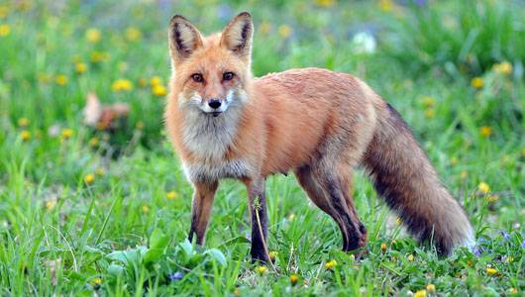
Fox

Slide 9
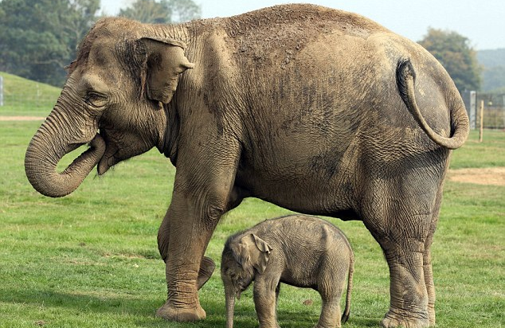
Elephant

Slide 10
Pair work-------
What’s the main theme of the poem?
Do you know the fox? Write two sentences about the animal.

Slide 11
Recice the poem by teacher.

Slide 12
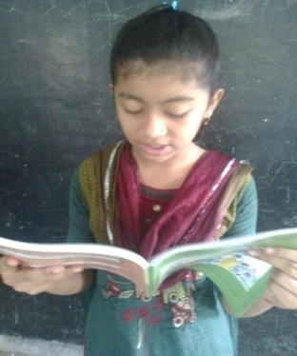
Recice the poeam by students.

Slide 13
New words:
an area in which animals, specially wild animals, are kept so that people can go and look at them.
Zoo-
Fox-
Fox is a very cunning animal.
Elephant is the largest of all land animals in the world.
Elephant-

Slide 14
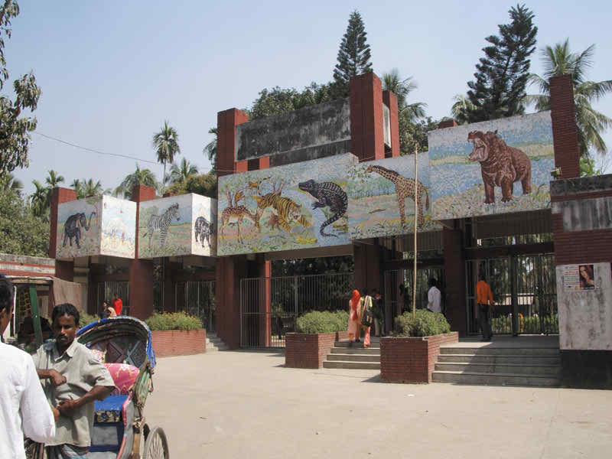
Group work: Time:7 minutes.
Have you ever go to a zoo? Explain your experience with in five sentences.

Slide 15
Silent Reading
by students.

Slide 16
Evaluation:
Recite the poem one after another.
Write the name of five animals which you know.
Write down the correct spelling----
ozo, ebjar, xfo.

Slide 17
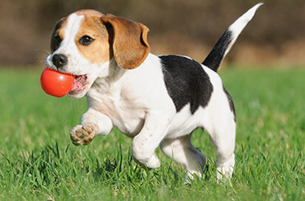
Homework:
Write five sentences about your pet animal.

Slide 18
‘Goodbye’
Thanks everybody.

