Slide 1
Welcome

Slide 2
Teacher’s Identity MD.BELAL HOSSAIN (Assistant Teacher) Dhamti Habibur Rahman HIGH SCHOOL Debidwar,comilla MOBILE -01812205031

Slide 3
Lesson Introduction Class –Eight Subject – English Second Paper Lession – Voice Time – 50 Minutes Date – 29/02/2020

Slide 4
Learning outcome at the end of the lesson students will be able to : # tell about voice. # tell about the classification of Voice. # change the voice .

Slide 5
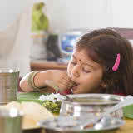
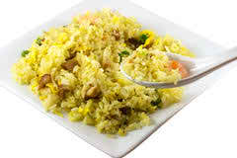
Look at the picture
A girl is eating rice.
Rice is being eaten by a girl.

Slide 6
THEREFORE – TODAY OUR LESSON IS ABOUT
VOICE

Slide 7
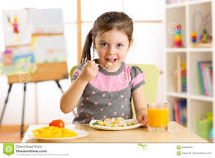
What is Voice
Voice is the form of the verb which indicates whether the subject does the work or something has been done to it.
The girl eats rice.
Rice is eaten by the girl.

Slide 8
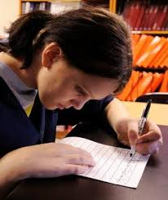
Voices are two kinds-
1. Active Voice
2. Passive Voice
Active Voice: When the Subject of Sentence is the doer or actor, the Verb is in Active Voice. It is so because the Subject is Active.
The girl writes a letter

Slide 9
Passive Voice: When the Subject of a Sentence is acted upon, the Verb is in Passive Voice. It is so because the Subject is Passive
A letter is written by the girl .

Slide 10
Rules for changing Active Voice into Passive Voice
Assertive Sentence
First-The Object of the verb in the Active Voice becomes the Subject of the verb in the Passive Voice. Such as
Subject | Object
I | Me
You | You
He | Him
She | His
We | Us
They | Them
It | It

Slide 11
Next-Auxiliary Verb, according to the Number & Person of the new Subject or according to the Tense of the Sentence.

Slide 12
Verbs accoiding to Tense
Active | Passive
V-1 | Am+v3/is v3/are+v3
V2 | was+v3/were+v3
am/is/are+v-1+ing | Am being+v3/are being+v3
Was/were+v1+ing | Was/were+being+v3
Have/has+v3 | Have been+v3/has been+ v3
Had+V3 | Had been+V3

Slide 13
Rules for changing Active Voice into Passive Voice in short
Object - subject
Auxiliary verb according to Tense,person and number .
V3+ext.
By/to/with/for/in/at/ about
Subject – object

Slide 14
Rule: If an Active Voice includes with may, might, can, could, should, would, must, ought to, used to, at the time changing into Passive Voice “ be” will be added after that auxiliary.
Active- We should love our country.
Passive- Our country should be loved by us.
Rule: If an Active Voice includes with am to/is to/are to, have to/has to, had to, am going to/is going to/are going to, was going to/were going to, at the time changing into Passive Voice “ be” will be added after that.
Active: I have to do it.
Passive: It has to be done by me

Slide 15
Rule: If an active voice includes with present participle, at the time changing into passive voice, there will be no change of the present participle. Object after the principal verb will be the subject of the passive voice.
Active: I saw her reading a book.
Passive: She was seen reading a book by me

Slide 16
Rule: If an Active Voice has two Objects, at the time
of changing into Passive, any object can be taken to
use as a Subject. But it is better to take the Personal
object/Pronominal object to use as a Subject of the
Passive Voice. The other/unused object is called Retained
Object. It will be replaced after the Verb.
Active: Mr. Roy teaches us English.
Passive: We are taught English by Mr. Roy.

Slide 17
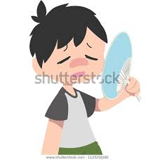
Rule: If an Active Voice takes an Reflexive Object (myself, himself, herself, yourself, yourselves, ourselves, themselves), at the time changing into Passive, Subject and Object will not be changed.
Active: The girl fans herself.
Passive: The girl is fanned by herself.

Slide 18
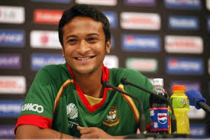
Rule: In spite of having Object, Some Transitive Verb (elect, select, nominate, make, call, think, appoint) cannot express the complete meaning. To express the Complete meaning it needs another/extra Object. This kinds of Objects are called Factitive Object. At the time of changing into Passive Voice this Factitive Object willnot be the Subject. Then the Pronominal Object before the Factitive is to used
Active: We made him Captain.
Passive: He was made Captain by us.

Slide 19
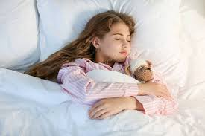
Rule: Taking some supporting Object, some Intransitive Verb is used as a Transitive Verb. This kinds of are called Cognate Object
Active- She slept a sound sleep.
Passive: A sound sleep was slept by her.

Slide 20
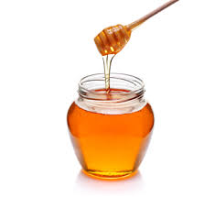
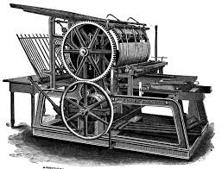
Rule: A Quasi Passive Voice is Active in form but passive in form. Such as
Honey tastes sweet.
The book is printing.

Slide 21
If the Quasi Passive includes a complement in its Active form, the rule of the Passive form will be
Subject + Aux.V + PV₃ + Complment/Adjective
Or
Subject + Aux.V + Adjective/Complement + when it is + PV₃
Active: The rose smells sweet
Passive: The rose is smelt sweet
Or—The rose is sweet when it is smelt

Slide 22
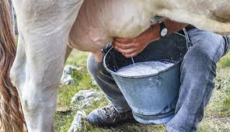
If the Quasi Passive includes no complement in its Active form, the rule of the Passive form will be
Subject + Verb + being + PV₃
Active: The cow is milking
Passive: The cow is being milked

Slide 23
Evaluation
Change the voice
1They ARE playing football.
2. We elected him Chairman.
3. Rana killed himself.
4. The cow gives us milk.
5. The mango tastes sweet
6. The book is printing.
Answer
1.Football is being played by them.
2. He was elected Chainman by us.
3. Rana was killed by himself.
4.We are given milk by the cow.
5. The mango is tasted sweet.
6. The book is being printed.

Slide 24
HOME WORK
Change the voice
His failure surprised me
Arifa is singing a song.
He called me a fool.
The girl dreamt a sweet dream.
The sun gives us light.
The boy annoyed me.
I know him well.
Rice sells cheap.
They have done the work.

Slide 25
Allah Hafez.
See you again.

