Slide 1
electrical engineering fundamentals
Sub. Code: 66712
Presented by-
Mir Shafiul Islam
Instructor (Tech.)
Dept. of Electronics
Chattogram Mohila Polytechnic Institute
Mob: 01312-114266;
Email: shafi.cmpi@gmail.com
Web: msishafi.blogspot.com

Slide 2
Chapter-05
Concepts
of
Electrical Circuits

Slide 3
Chapter outline
Chapter-05
5.1 Define electric circuit.
5.2 Name the different types of electric circuits.
5.3 Define series circuit, parallel circuit and mixed circuit.
5.4 Describe the characteristic of series circuit and parallel circuit.
5.5 Calculate the equivalent resistance of series circuit and parallel circuit.
5.6 Solve problems: DC series circuit, parallel circuit and mixed circuit.
5.7 Define inductor, capacitor, inductive reactance & capacitive reactance.
5.8 Formula of inductive reactance, capacitive reactance & impedance.

Slide 4
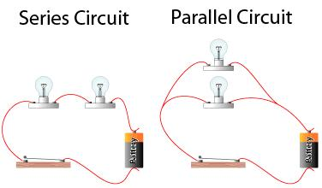
Types of Electric Circuit

Slide 5
Resistance in Series
When some conductors having resistances R1, R2 and R3 etc. are joined end-on-end as in Fig. 1.12, they are said to be connected in series. It can be proved that the equivalent resistance or total resistance between points A and D is equal to the sum of the three individual resistances. Being a series circuit, it should be remembered that
current is the same through all the three conductors
(ii) but voltage drop across each is different due to its different resistance and is given by Ohm’s Law
and
(iii) sum of the three voltage drops is equal to the voltage applied across the three conductors.

Slide 6
Resistance in Series (Cont….)
There is a progressive fall in potential as we go from point A to D as shown in Fig. 1.13.

Slide 7
Resistance in Series (Cont….)
As seen from above, the main characteristics of a series circuit are :

Slide 8
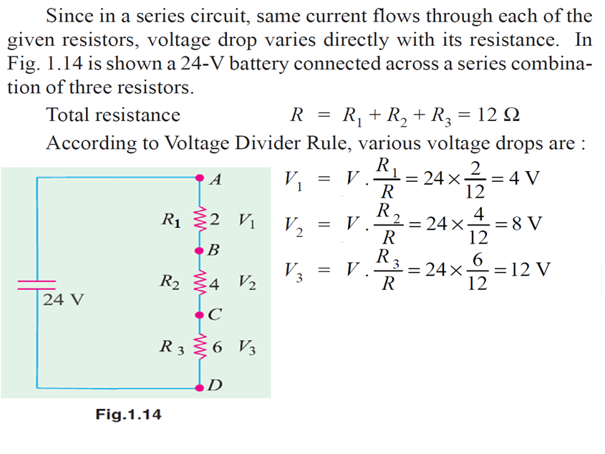
Resistance in Series (Voltage Divider Rule)

Slide 9
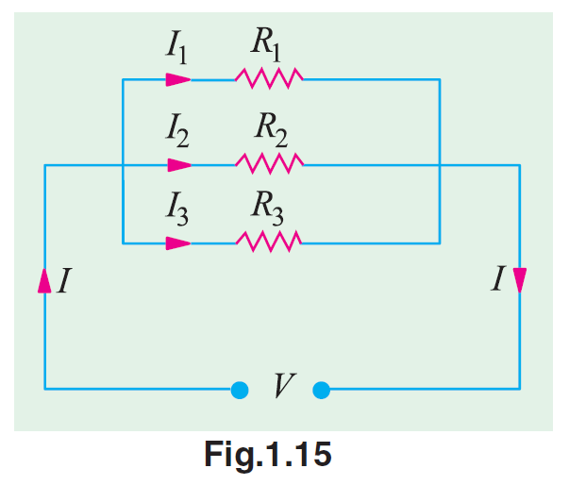
Resistances in Parallel
Three resistances, as joined in Fig. 1.15 are said to be connected in parallel. In this case:
p.d. across all resistances is the same
current in each resistor is different and is given by Ohm’s Law and
the total current is the sum of the three separate currents.

Slide 10
Resistances in Parallel (Cont….)
The main characteristics of a parallel circuit are :

Slide 11
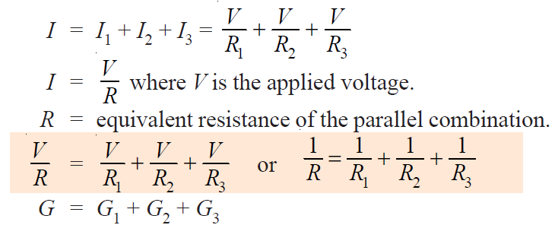
Resistances in Parallel (Cont….)

Slide 12
Resistances in Parallel (Current Divider Rules)

Slide 13
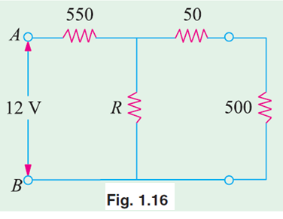
Mathematical Problems (Some Examples)
Example -01 What is the value of the unknown resistor R in Fig. 1.16 if the voltage drop across the 500Ω resistor is 2.5 volts ? All resistances are in ohm.

Slide 14
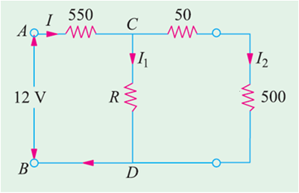
Mathematical Problems (Some Examples)
Solution -01:
At first we find the value of
I₂ = 2.5/500 = 5x10⁻³A = 5mA
Voltage across 50Ω is
50 x 5x10⁻³V = 0.25V
Now, V_{CD} = 2.5V +0.25V = 2.75V
and, V_{AC} = (12 - 2.75)V = 9.25V
I = 9.25/550 = 16.82x10⁻³A = 16.82mA
At point “C” according to KCL, I = I₁ + I₂
S0, I₁ = I – I₂ = 11.82mA
Now, R = V_{CD} / I₁ = 2.75V / 11.82mA
= 232.66Ω (Ans.)

Slide 15
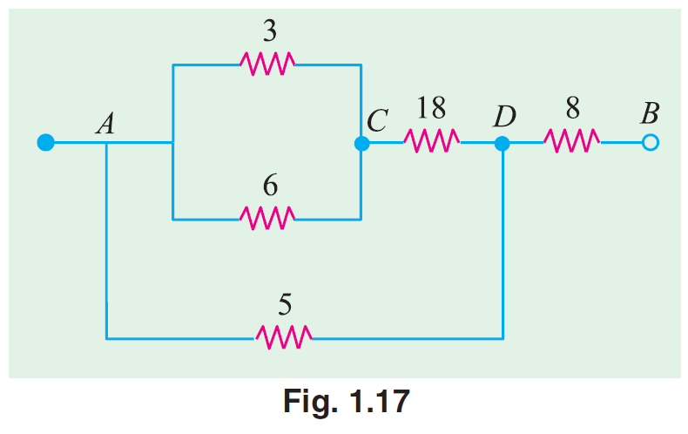
Mathematical Problems (Some Examples)
Example-02 Calculate the effective resistance of the following combination of resistances and the voltage drop across each resistance when a P.D. of 60 V is applied between points A and B.

Slide 16
Mathematical Problems (Some Examples)
Solution-02:
Here, applied voltage V_{AB} = 60V
R_{AB} = [(3||6+18)||5+8]
= [(2+18)||5+8]
= 4+8
=12Ω
Total current, I = V_{AB} / R_{AB}
= 5A
V_{DB} = 8x5V = 40V [voltage drop @8Ω]
V_{AD} = (60-40)V = 20V [voltage drop @5Ω]
V_{CD} = (20/20)x18 = 18V [voltage drop @18Ω]
V_{AC} = (20-18)V = 2V [voltage drop @3Ω & 6Ω]

Slide 17
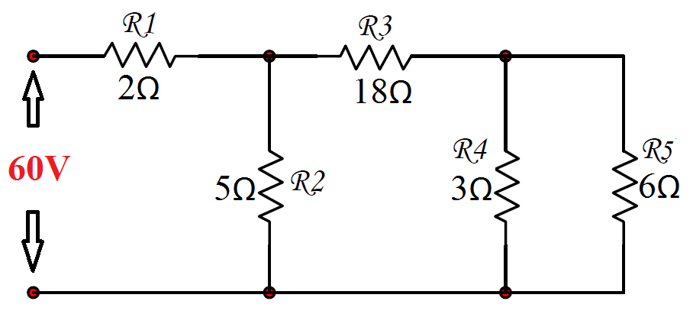
Mathematical Problems (Some Examples)
Example-03 Calculate the total current, voltage drop across the resistance 5Ω and the total power of the following circuit. (Example has taken from your text book)

Slide 18
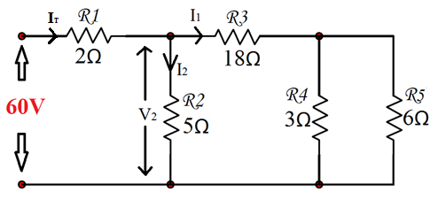
Mathematical Problems (Some Examples)
Solution-03:
From this figure,
Applied voltage, V_{T} = 60V
Total resistance, R_{T}
= (3||6+18)||5+2
= (2+18)||5+2 = 20||5+2
= 4+2 = 6Ω
Now, Total current, I_{T} = V_{T} /R_{T} = 10A
Total power, P_{T} = V_{T}² /R_{T} = 3600/6 = 600watt
P_{T} = I_{T}² x R_{T} = 100 x 6 = 600watt
Voltage across 5Ω is,
V₂ = (60/6) x 4
= 40V [using voltage divider rules]

Slide 19
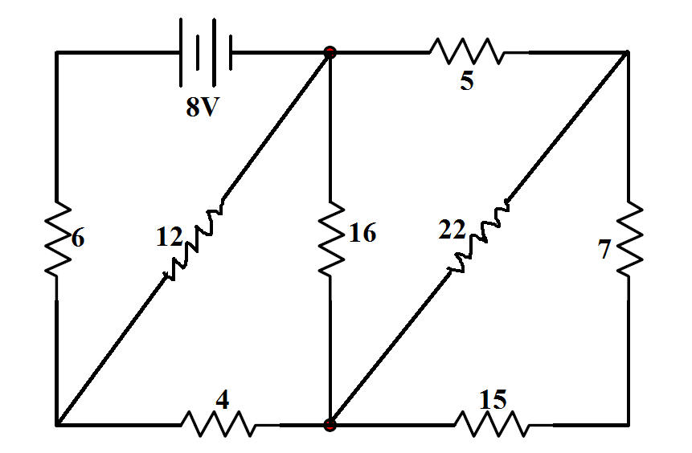
Mathematical Problems (Some Examples)
Example-04 Calculate the voltage drop across the resistance 6Ω from the following circuit. (Example has taken from your text book)

Slide 20
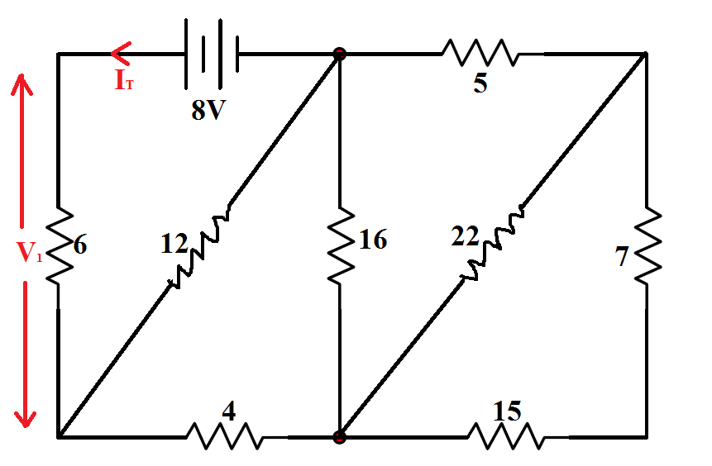
Mathematical Problems (Some Examples)
Solution-04:
From this figure,
Applied voltage, V_{T} = 8V
Total resistance, R_{T}
= [{(15+7)||22+5}||16+4]||12+6
= 12Ω
Now, Total current, I_{T} = V_{T} /R_{T} = 0.67A
Voltage across 6Ω is,
V₁ = 0.67 x 6
= 4V (Ans.)

Slide 21
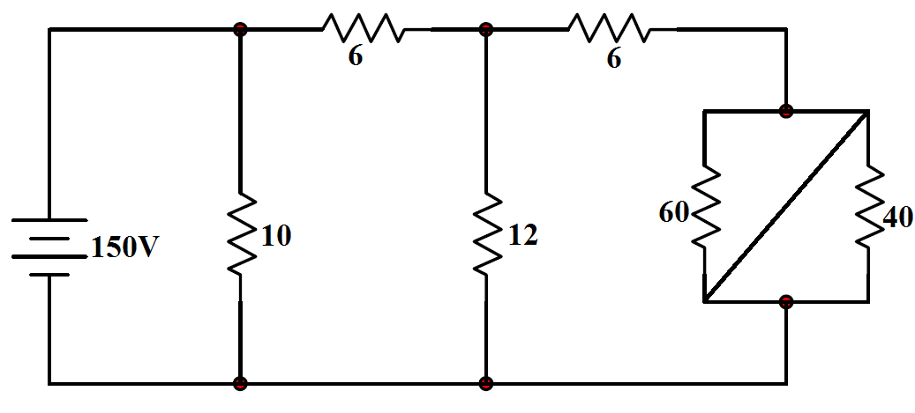
Mathematical Problems (Some Examples)
Example-05 Calculate the total resistance and total current of the following circuit. (Example has taken from your text book)

Slide 22
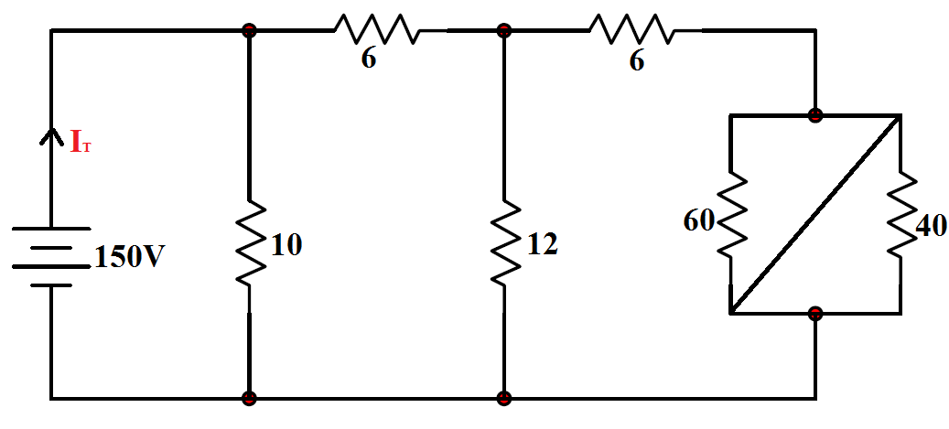
Mathematical Problems (Some Examples)
Solution-05:
From this figure,
Applied voltage, V_{T} = 150V
Total resistance, R_{T}
= (6||12+6)||10
= 5Ω (Ans.)
Now, Total current, I_{T} = V_{T} /R_{T} = 30A (Ans.)

Slide 23
? ?
?

Slide 24
THANK YOU ALL

