Slide 1


Slide 2


Teacher`s Identity
Lutfor Rahman
Assistant Teacher,
Kundarampur, Government Primary school School,
Ghoraghat, Dinajpur.
E-mail: mlutfor81@gmail.com

Slide 3

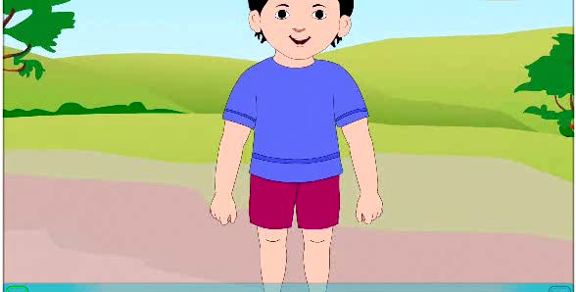
Dear students let’s enjoy the rhyme

Slide 4

Today’s lesson is-

Slide 5

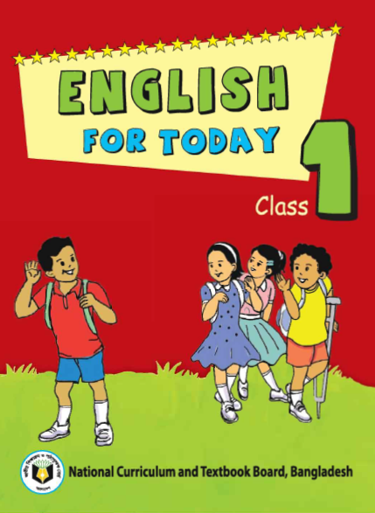
Lesson introduction
Subject : English
Class : One
Unit : 13
Lesson : 1-3
B. Rhyme: 2 hands go clap clap
Date : 0/0/2020

Slide 6

Learning outcomes
Listening
4.1.1 : Enjoy the rhythm and music of simple rhymes
Speaking:
4.1.1:Repeat rhymes after the teacher.
4.1.2 Recite rhymes individually.

Slide 7
Student’s do the activities
Come here
Clap your hand
Tap your
feet
Open your eyes wide

Slide 8

New words
Draw
Take
Come
ছবি আকাঁ
নেওয়া
আসা

Slide 9


Let`s listen the rhyme
2 hands go
clap clap.
2 feets go
tap tap tap.
2 eyes are
open wide.
1 head goes
side to side

Slide 10

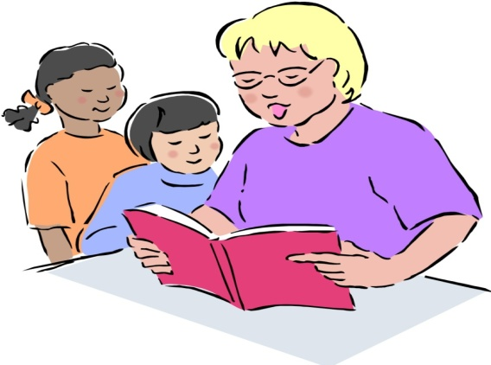
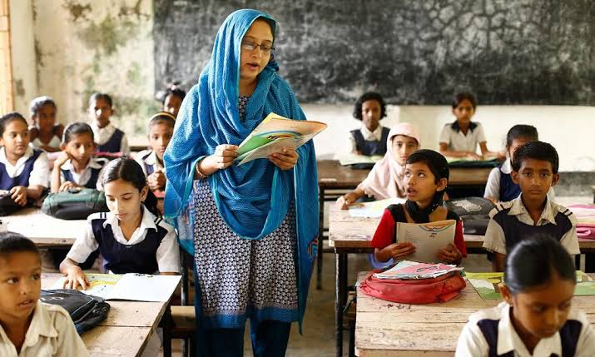
Teachers recitation
Look ,listen and say
2 hands go
clap clap.
2 feets go
tap tap tap.
2 eyes are
open wide.
1 head goes
side to side

Slide 11

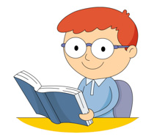
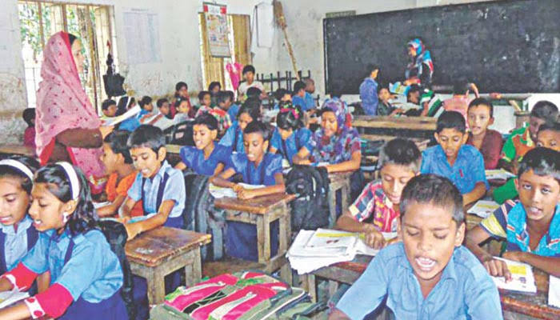
Students recitation
Imdividual Reading (IW)

Slide 12

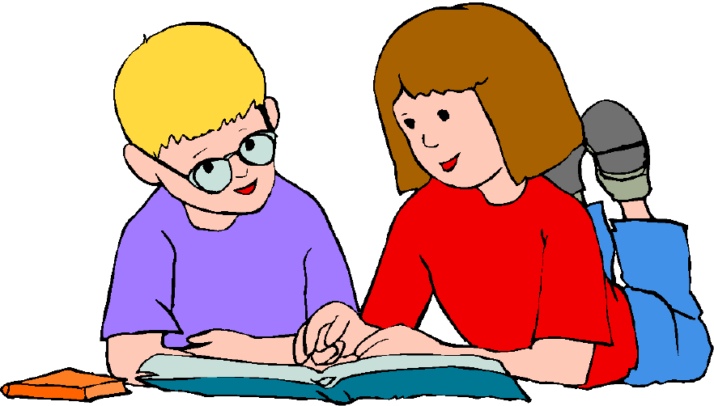
Pair Work
One student say the rhyme and other listen

Slide 13
Evaluation
1.Say –2 hands go-----------
2.Say the next line:1 head goes-------------------

Slide 14


