Slide 1
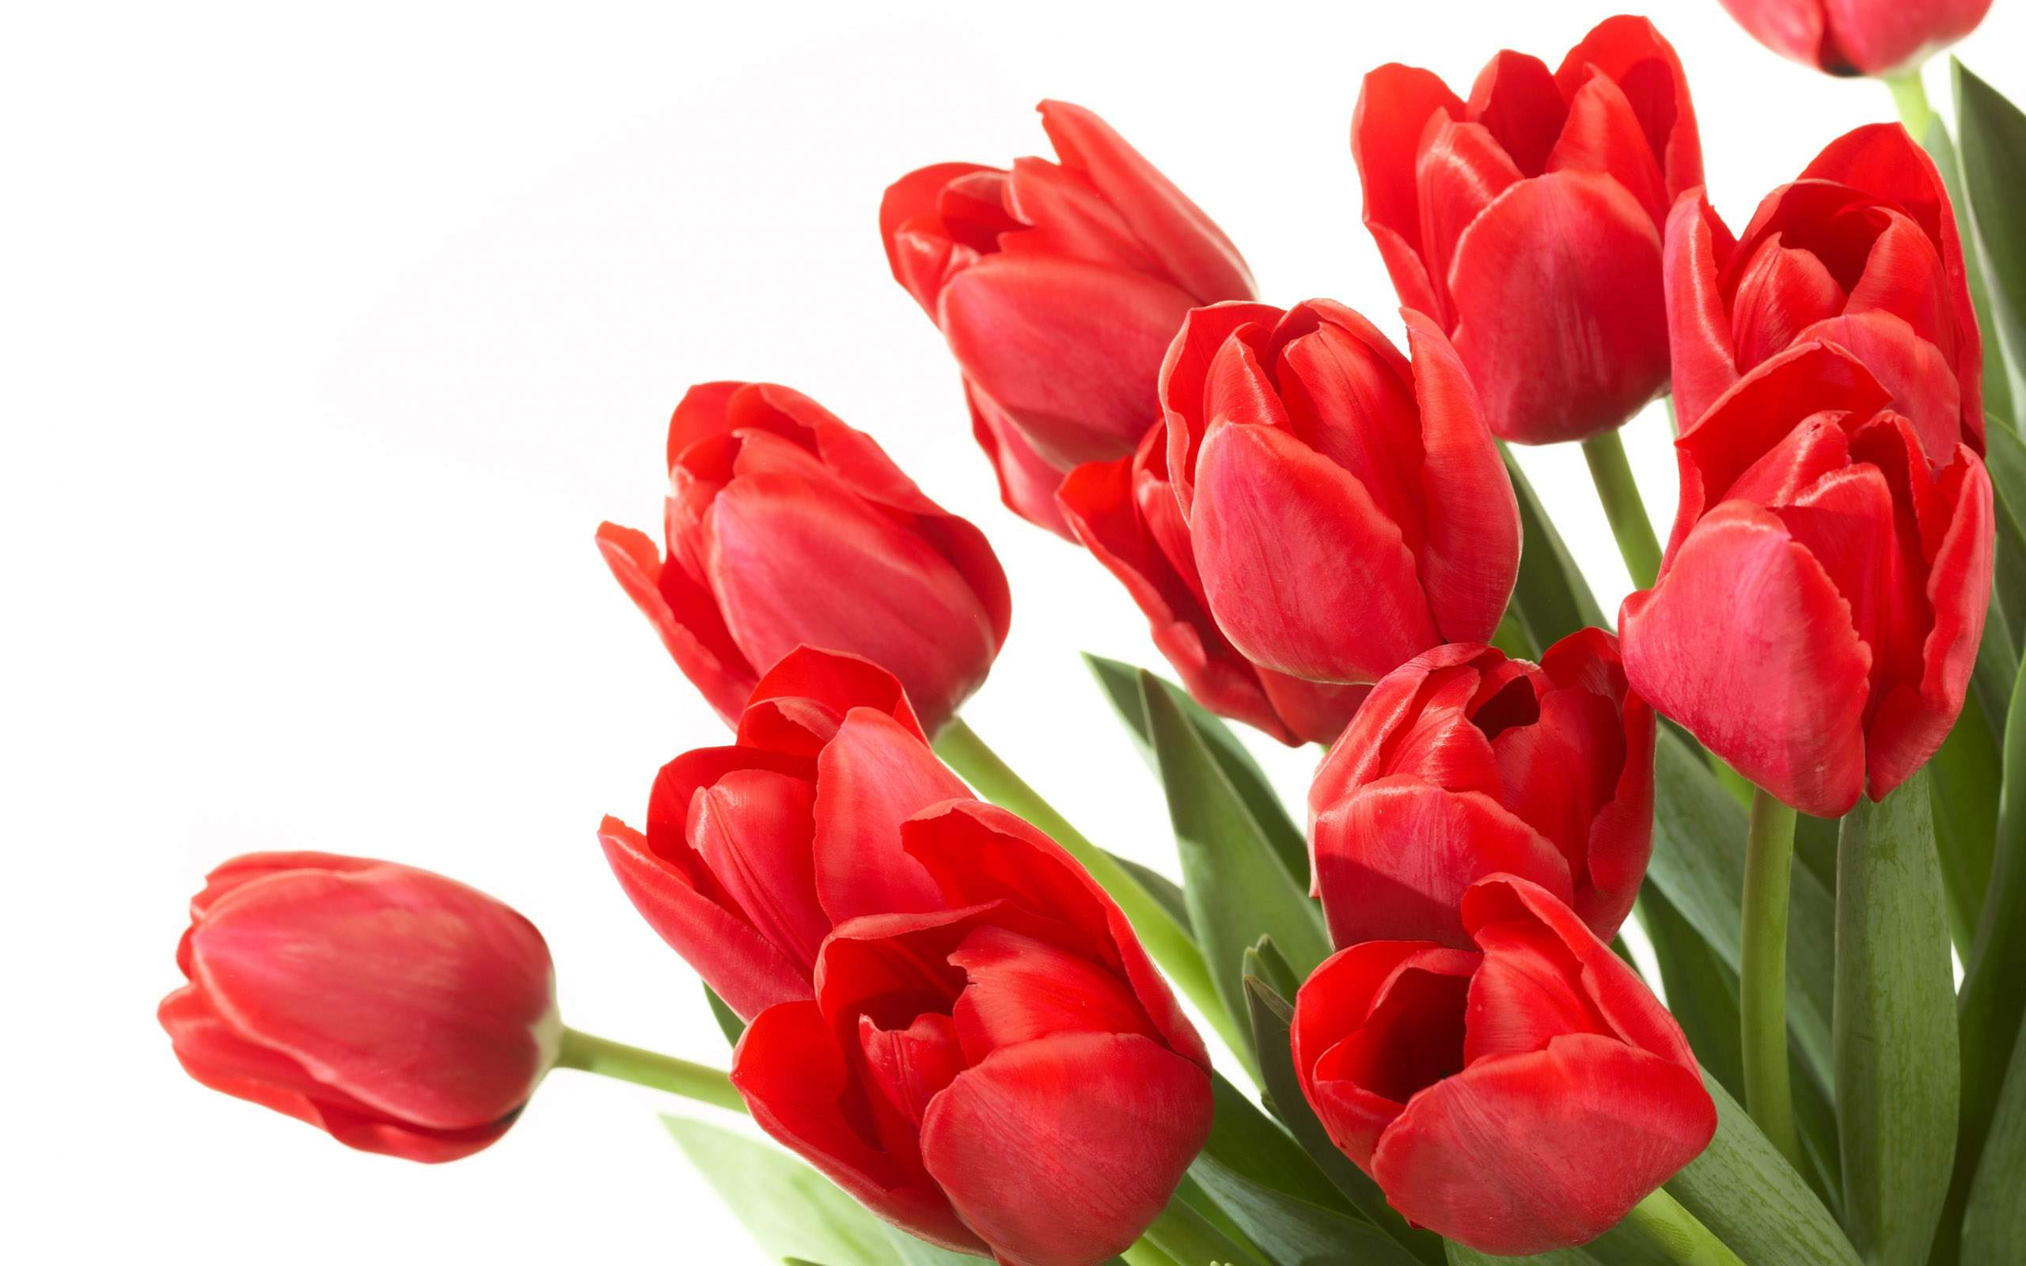
welcome

Slide 2
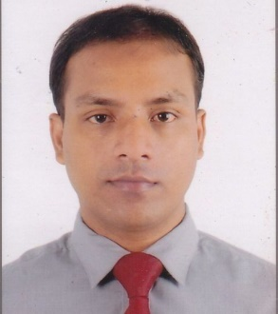
Identity
MD.AHSAN HABIB
ASSTS. TEACHER
(ENGLISH)
SPPM HIGH SCHOOL
CHHATAK
SUNAMGONJ
CLASS- EIGHT
ENGLISH 1ST PAPER
UNITE- 2
LESSON-1

Slide 3
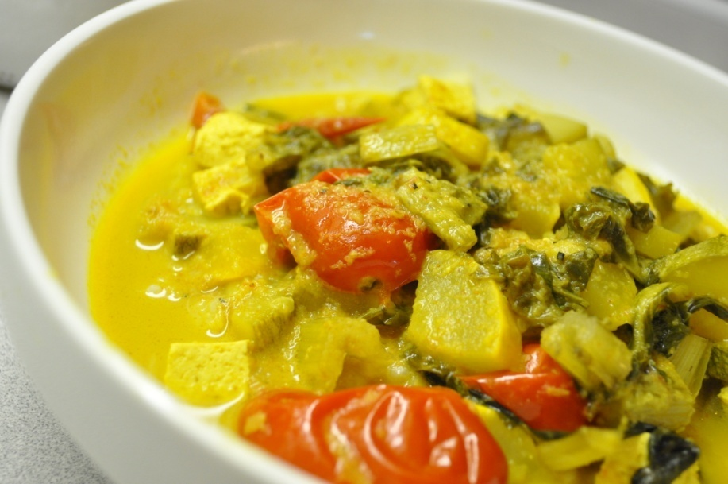
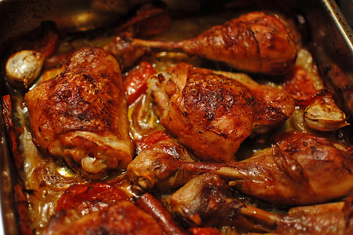
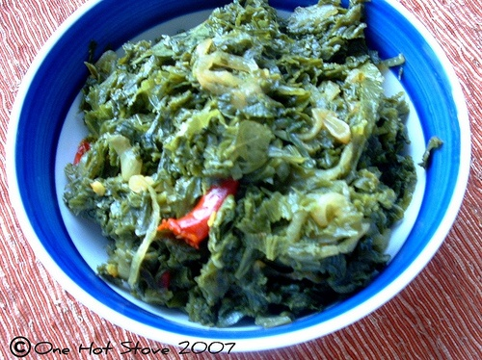
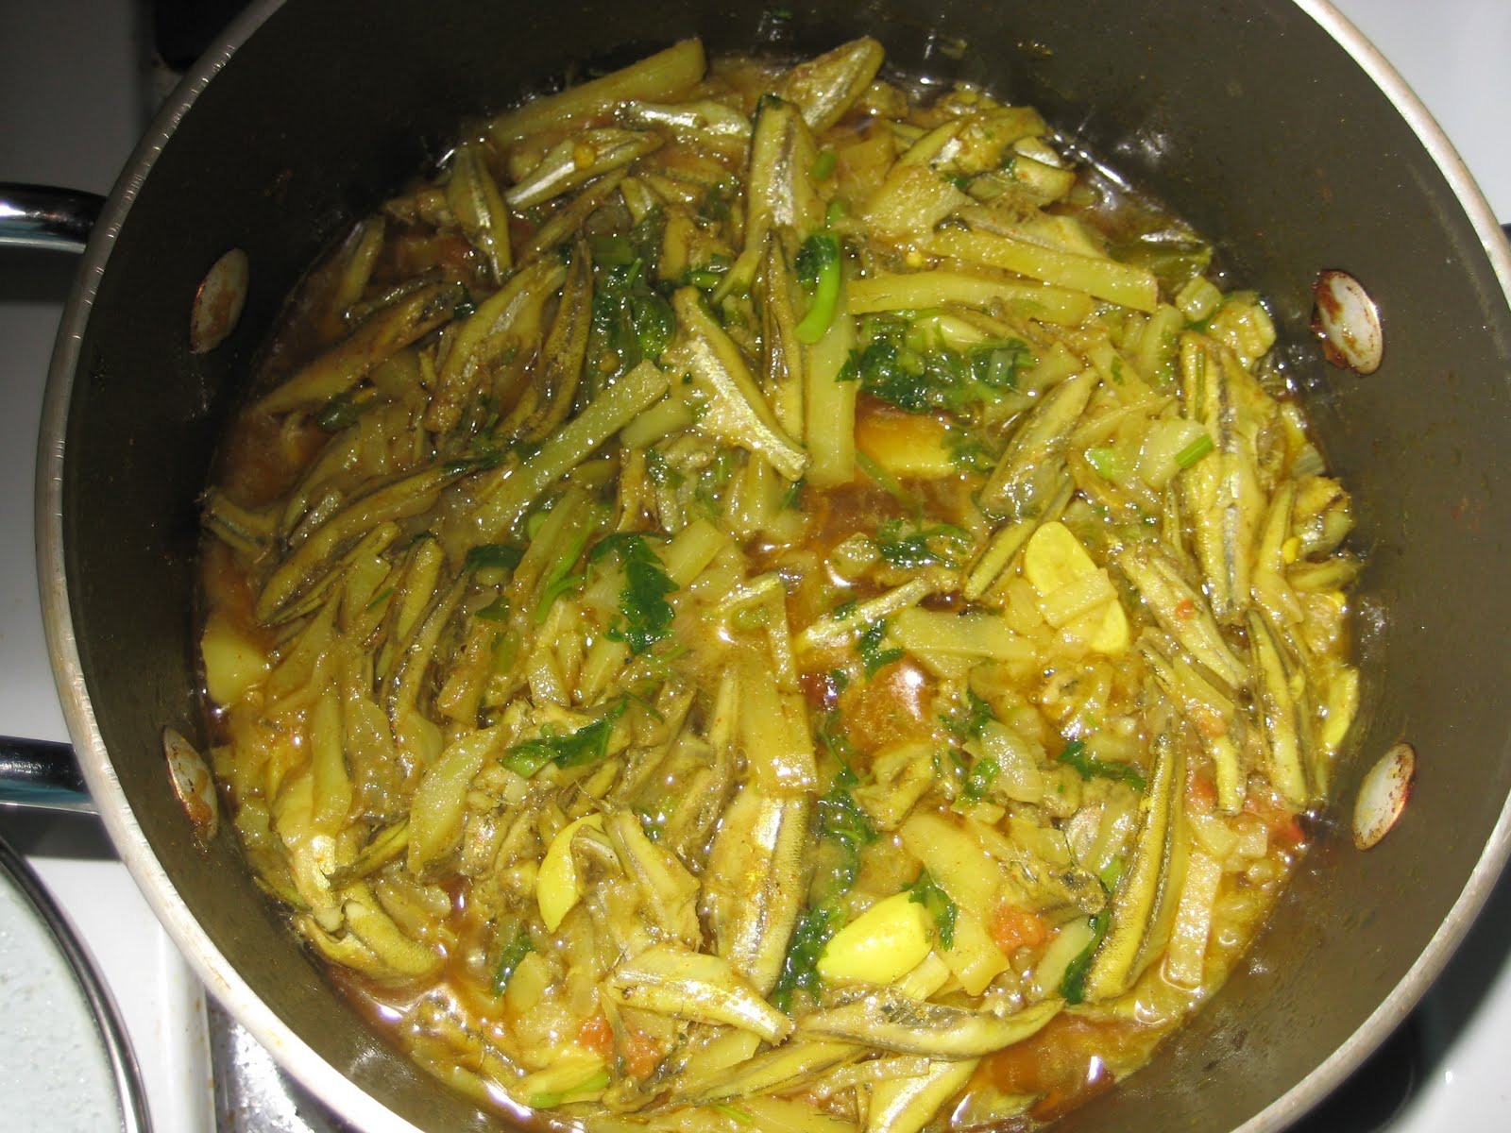
Vegetable curry
Chicken curry
Leafy vegetables curry
Small fish curry

Slide 4
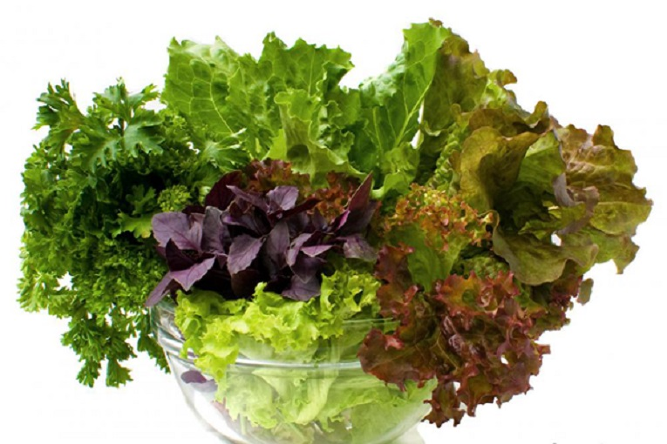
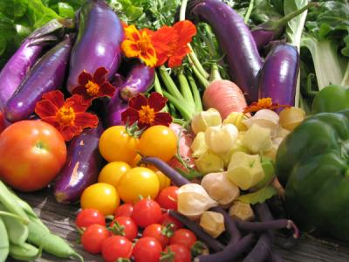
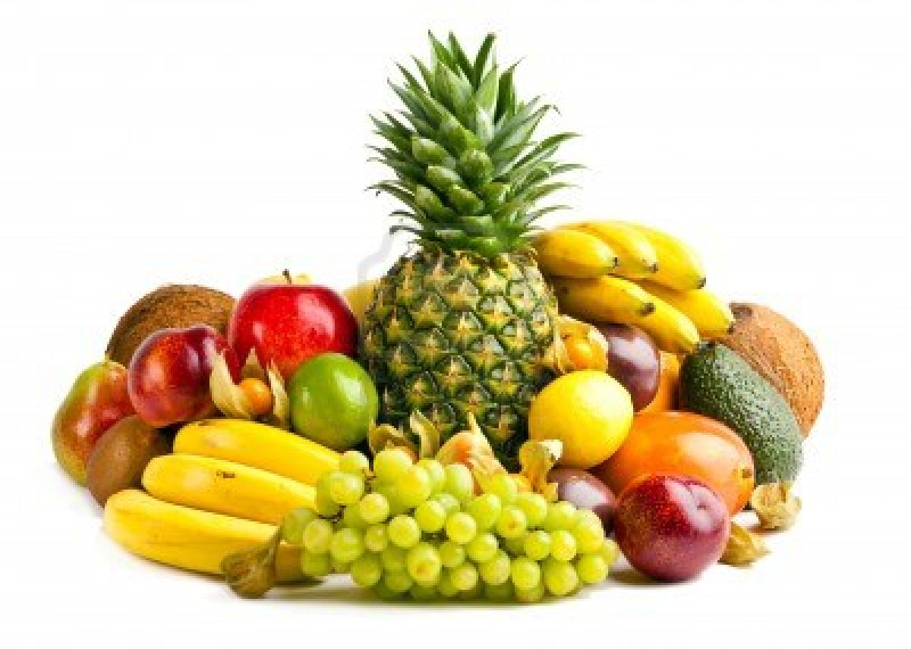
Colorfull vegetable
Leafy vegetable
fruits

Slide 5
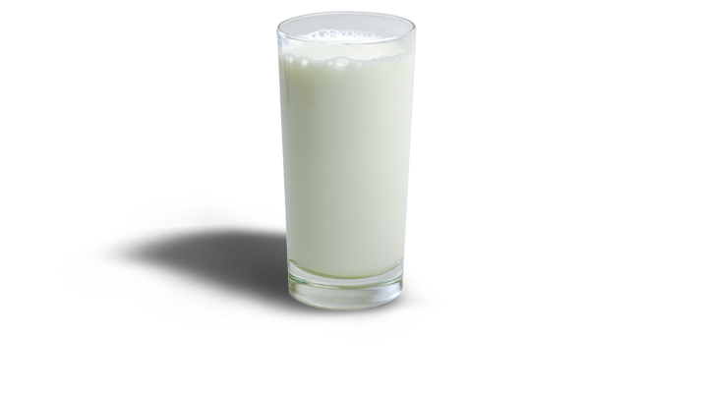
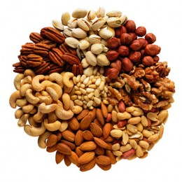
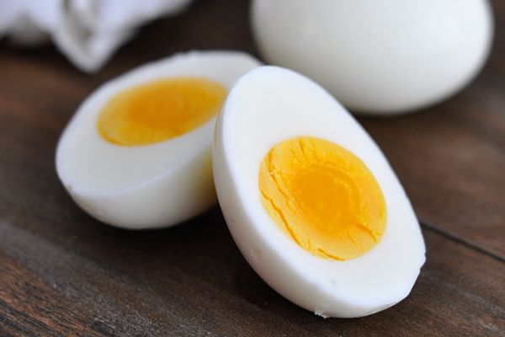
Milk
Nuts
Egg

Slide 6
GOOD FOOD

Slide 7
LEARNING OUTCOMES
AFTER COMPLETE THIS LESSON, STUDENTS WILL BE ABLE TO:-
We know able to about good food.
We know how to grow help in nutritious food?
We know how much food does a person need to eat day.

Slide 8
VOCABULARY

Slide 9
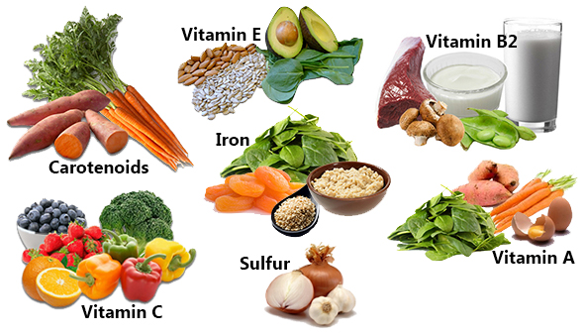
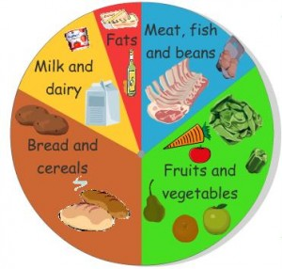
NUTRIOUS
NUTRIENT,
HEALTHY
MATERIALS,
THINGS
SUBSTANCE

Slide 10
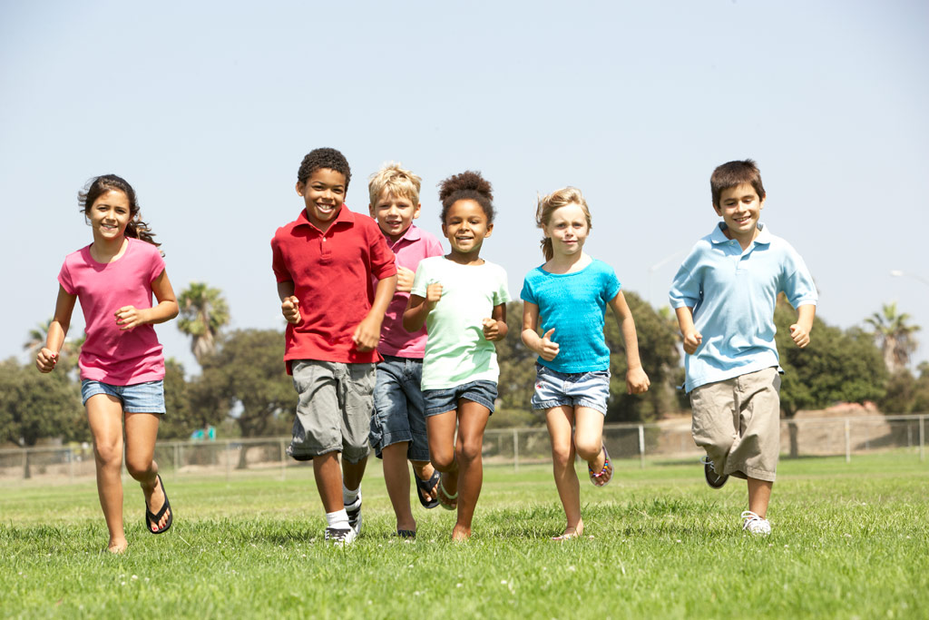
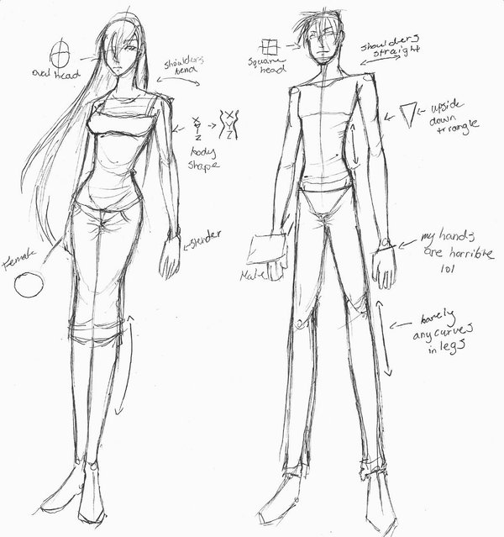
PHYSICAL
ABOUT BODY
STRUCTURE
FRAME, SHAPE

Slide 11
Are all these foods need for our body?

Slide 12
IT IS NUTRIOUS FOOD

Slide 13
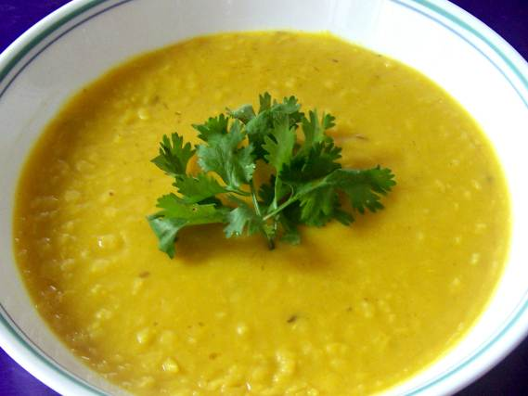
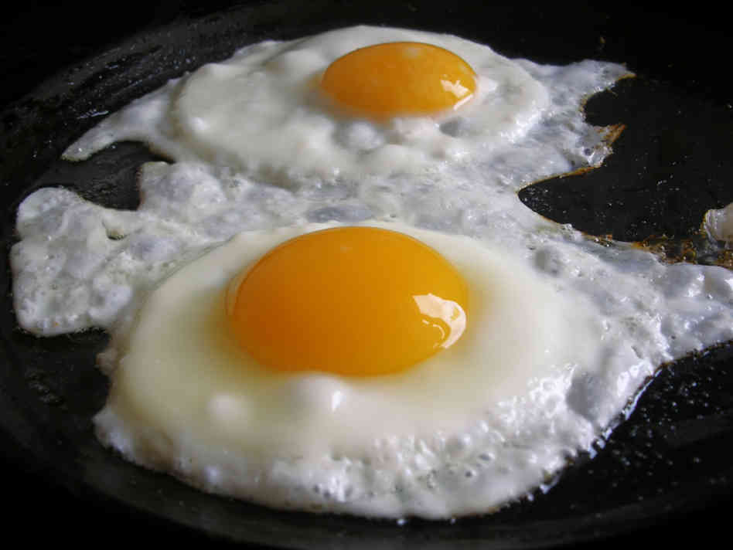
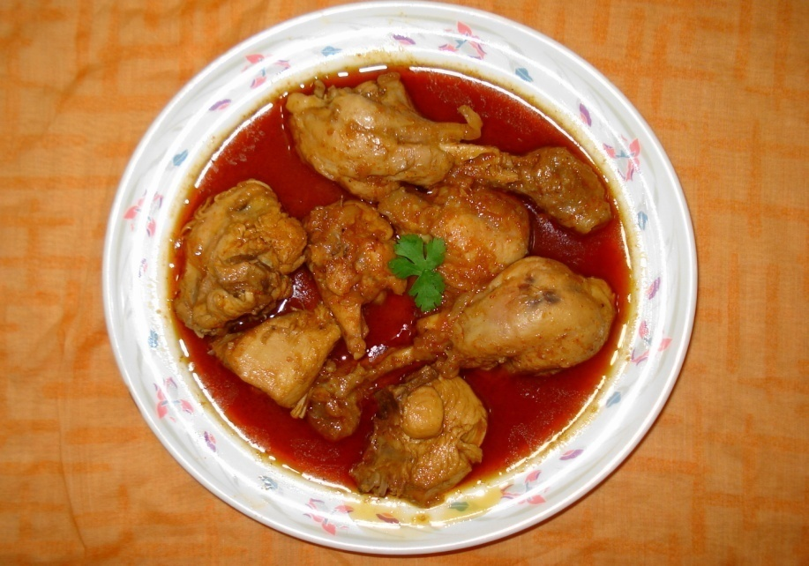
EVERYDAY WE SHOULD EAT CERTAIN AMOUNT OF FOOD

Slide 14
Complete the sentences individually
We should eat good food……………………
We should not eat more then……………..
Eating too much food is……………………….
Good food means ……………………………….

Slide 15
Correct answer
We should eat good food to grow properly.
We should not eat more then though the food is good.
Eating too much food is not good for health.
Good food means the right kind of food.

Slide 16
EVALUATION
What is good food?
Why do we eat food?
What is meant by nutrious food?

Slide 17
HOMEWORK
HOW MUCH FOOD DO YOU NEED A DAY?

