Slide 1
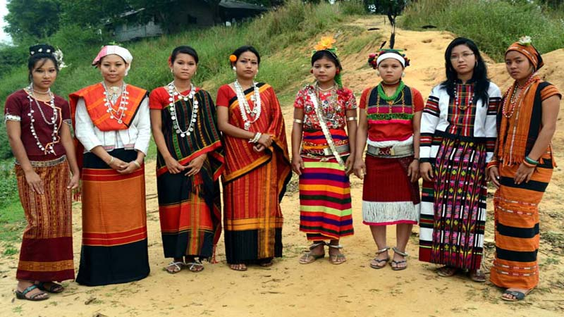
Welcome

Slide 2
Introduction
Abdul Aziz
Assistant Teacher (English)
Madhaia Bazar Sadim High School
E-mail azizabidpur@gmail.com
Class –Eight
English First Paper
Unit -01, Lesson -03,Sec: B
Our ethnic friends

Slide 3
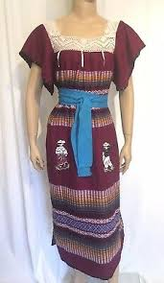
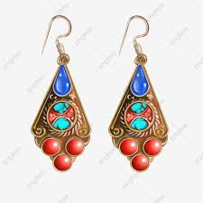
Look at the pictures
What can you see in the picture?
In the picture, I can see a beautiful dress for ethnic girls. In picture 2, I can see two ornaments of women and in the third picture I can see a scarf of ethnic women.

Slide 4
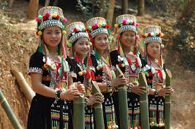
So, Our Today’s Lesson is
Our ethnic friends(1)

Slide 5
Learning Outcomes
After the end of the lesson, Students will be able to –
Talk about ethnic people
Infer vocabulary
Ask and Answer Questions

Slide 6
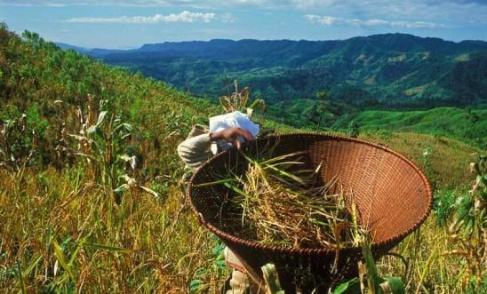
The ethnic people in Bangladesh hold a very important place in the culture of the country. The majority of these people live in the Chittagong Hill Tracks.
Read the text.
Sec: B
Individual Work

Slide 7
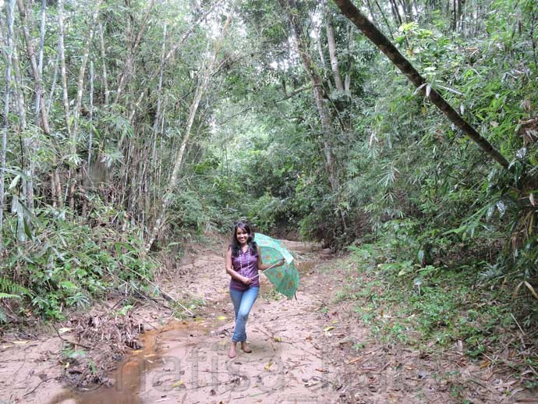
The other live in the regions of Mymensingh, Rajshahi and Sylhet. They live in forest areas, in the hills and in rural areas.
Read the text.
Sec: B
Individual Work

Slide 8
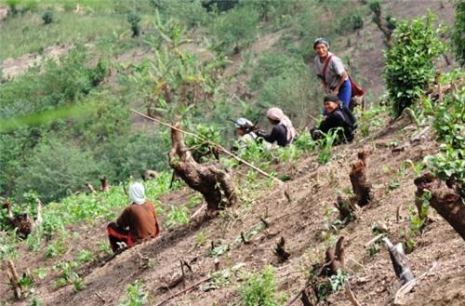
They do Jhum cultivation. For this they clear a piece of land in the forest, prepare it and sow seeds in it. They are mostly farmers. By religion they re Hindus, Christens or Buddhists. They speak their own mother tongues.

Slide 9
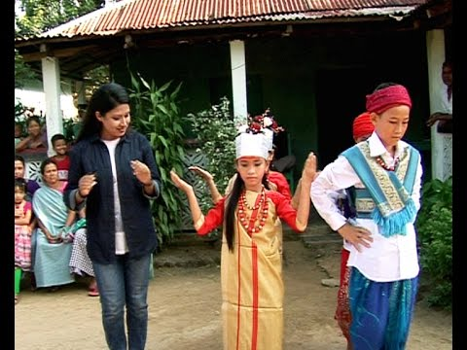
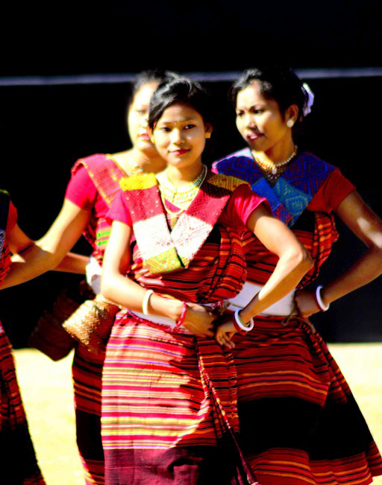
Some of them are the Chakmas, the Marmans, the Triperas and the Moorangs, who live in the Hill Tracts. The Santals live in Rajshahi. The Khasias and the Moniuries, live in Sylhet and the Hajongs and the Garos in Mymensingh.

Slide 10
Key Words
Main Words | Meanings
Ethnic | Relating to a particular race of people
Majority | The large number of something
region | A particular area of the world
Shifting | Alaways changing and moving
Rural | Relating to villages
Area | A particular place
Clear | To remove something from somewhere.
Prepare | Make something ready for use.
নৃতাত্ত্বিক
সংখ্যাগরিষ্ঠ
এলাকা,অঞ্চল
স্থানান্তর
গ্রাম্য
এলাকা
পরিস্কার করা
প্রস্তুত করা

Slide 11
Pair Work
Ask and answer the questions in pairs.
1. Do you know where the ethnic people live?
Ans: Yes I do. The ethnic people live in Sylhet, Mynmensingh,Chittagong and Rajshahi
3. What are they called?
Ans: They are called tribal people or tribes.

Slide 12
Group Work
Work in groups and answer the questions.
Where do you find the Marmans?
Ans: We find the Marmans in the Hill Tracts.
2. What language do they speak at home?
Ans: They speak in their mother tongue at home
3. Where do they do Jhum cultivation?
Ans: They do the Jhum cultivation in the forests.

Slide 13
Evaluation
Write true or false. If false, give the correct answer.
Most of the ethnic people are farmers
True
By religion all of them are Buddhists
False. C/A: By religionThey are Hindus, Buddhists and Christans.
The Moorangs are an ethnic group
True
They practice Jhum cultivations.
True

Slide 14
Write a short paragraph on “Our ethnic friends by using your own language.
E-mail: azizabidpur@gmail.com

Slide 15
Thank you

