Slide 1
WELCOME

Slide 2
Introduce:পরিচিতি
Class: Six
Sub: English 2nd Paper
Lesson:5 –Article
Time: 50 Minutes
SHAH MOHAMMAD LUTFUL HAIDER
Asst. Teacher
LUTFUNNESSA GIRL’S HIGH SCHOOL

Slide 3
Objectives:
To learn the kinds of Articles
To learn the use of Articles

Slide 4
Lesson Title:
Articles

Slide 5
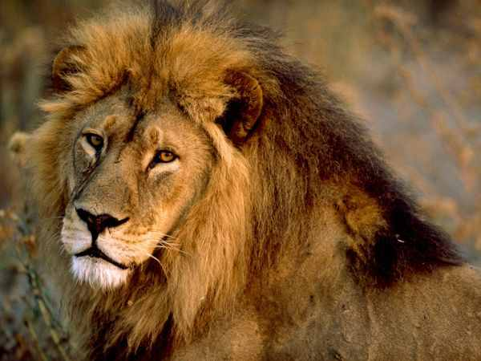
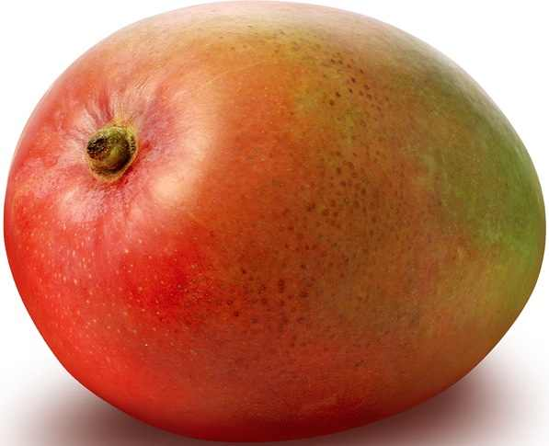
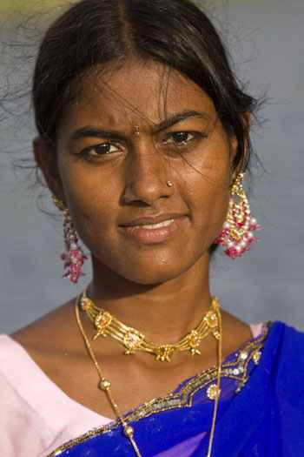
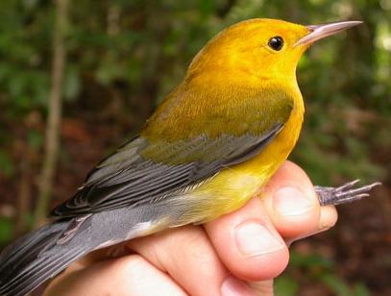
A
book
A
lion
A
student
A
Mango
A
woman
A
bird
Here,‘A’ is an article.
They are consonant Sound

Slide 6
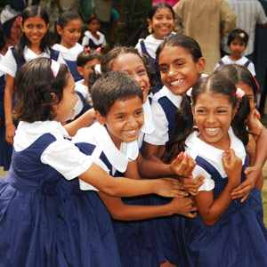
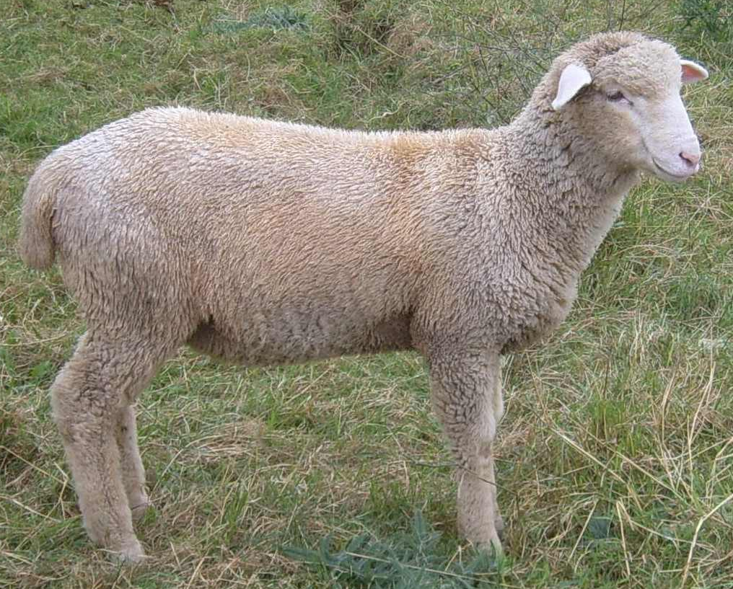
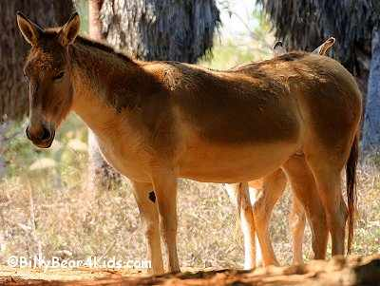
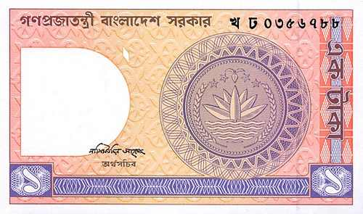
Special uses of ‘a’.
A
ewe
A
One eyed man
A
uniform
A
One taka note
A
european
The words shall be pronounced as ‘u’ or ‘oa’.

Slide 7
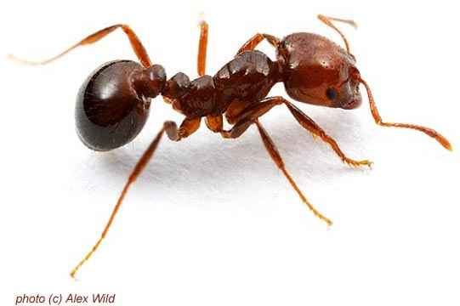
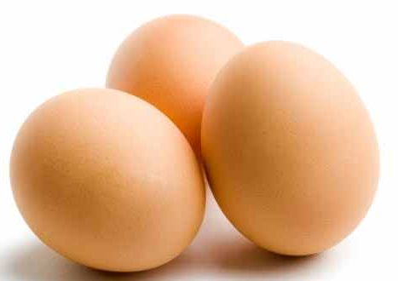
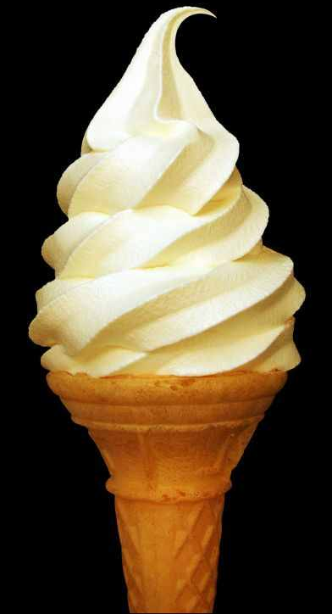
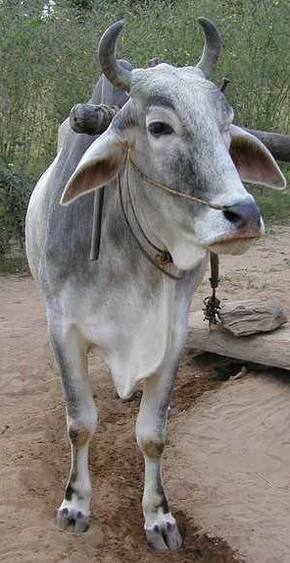
An
ant
An
egg
An
umbrella
An
An
ox
Ice-cream
Here,‘An’ is an article.
They are vowel Sound

Slide 8
Special uses of ‘an’.
An
hour
An
honest man
Here,‘h’ is silent.
It is vowel Sound
Here ‘A & An’ are indefinite article.

Slide 9
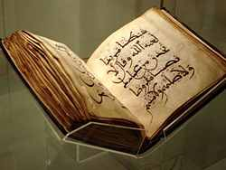
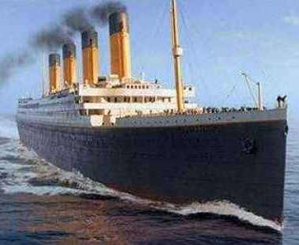
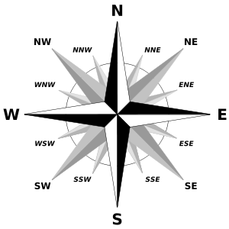
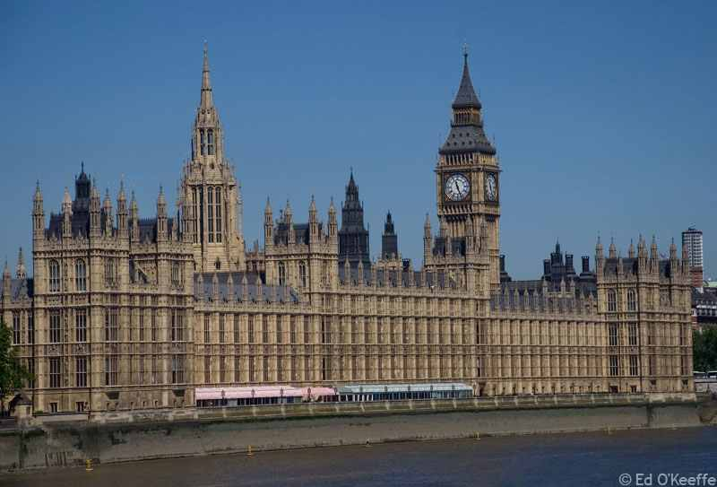
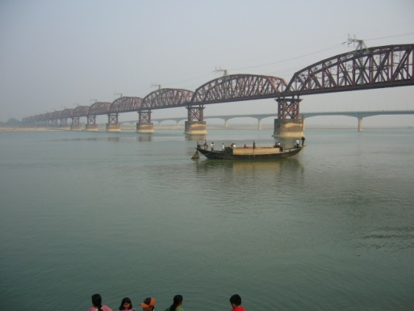
The
Quran
The
Titanic
The
North
The
Westminster palace
The
Padma

Slide 10
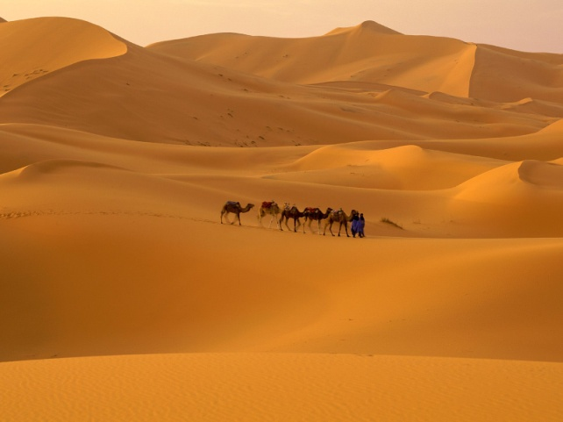
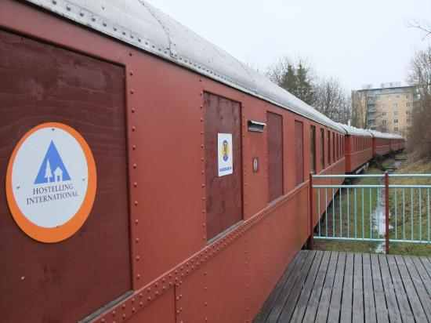
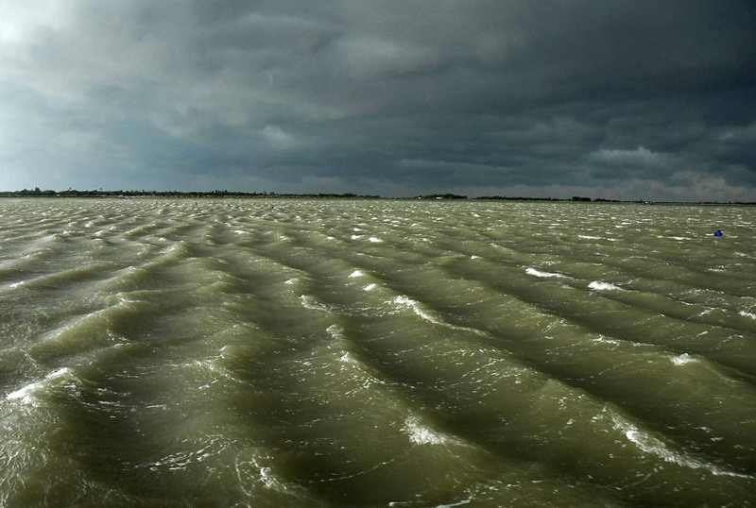
The
Shahara
The
Jamuna Express
The
Bay of Bengal
The
Bangladesh Times
Here ‘The’ is definite article.

Slide 12
Group Work:
Group: A
Fill in the blanks with Definite and Indefinite Articles.
…... owl lived in ….. tree. As the owl looked up at …… sky she saw……moon shining brightly.
An
a
the
the
Group: B
Fill in the blanks with Definite and Indefinite Articles.
….. grass hopper is …. small animal. It is …. insect. It looks like ….. grass it lives in.
A
a
an
the

Slide 13
Evaluation:
What is the kind of article?
What are they?

Slide 14
Home work.
Shohan has …….. boat. It is ……. blue boat. He rows it with …… oar for …….. hour every day. Do you like …….. colour of ……. boat?

Slide 15
Thank you
Bless to you all.

