Slide 1
Welcome to My Class
Stay home
Save yourselves
17/08/2020

Slide 2
Teacher’s Identity
Ranjan Kumar Roy
Lecturer in English
Kaharole Govt.College
Phone:01723993090
Be fit for the future
17/08/2020

Slide 3
English For Today
Unit-14
Lesson-03
Title of the lesson: The Legend of Gazi

Slide 4
Learning Outcomes
1.Know about Legend.
2.Know about Gazi pir.
3. Know about some words meaning and synonym.
4. How to make a flow chart.

Slide 5
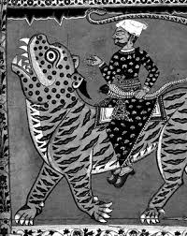
The scroll painting of Gazi Pir

Slide 6
The Legend of Gazi
According to some myths and legends, Gazi Pir was a Muslim saint who is said to have spread Islam in the parts of Bengal close to the Sunderbans. He was credited with many miracles. For example, he could supposedly calm dangerous animal and make them docile. He is usually depicted in paats or scroll paintings ridding a fierce-looking Bengal tiger , a snake in his hand ,but no apparent danger. According to some stories , he also fought crocodiles who threatened the people of a region full of canals and creeks , indeed ,a kind of watery jungle bordering the Bay of Bengal.

Slide 7
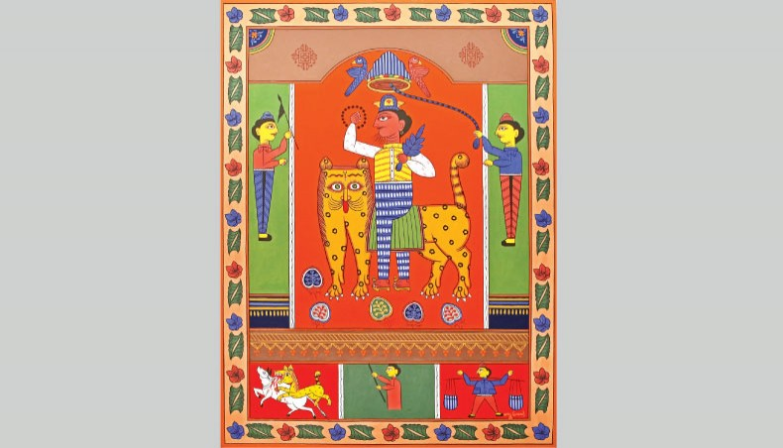
Some extra-ordinary power of Gazi Pir
Some extra-ordinary power of Gazi Pir
The dangerous animal could be made calm and docile.
The dangerous animal could be made calm and docile.

Slide 8
Because of his alert and vigilant presence, all predatory animals were said to have kept within bounds. It was also believed that he enabled villagers to live close to forests and jungles and cultivate their lands. Consequently, people of these regions would pray to him for protection. The story of Gazi Pir has been preserved in folk literature as well as art and has been performed in indigenous theatre. In fact, some Gazi’s paat scroll are part of the collection of the British
Museum.

Slide 9
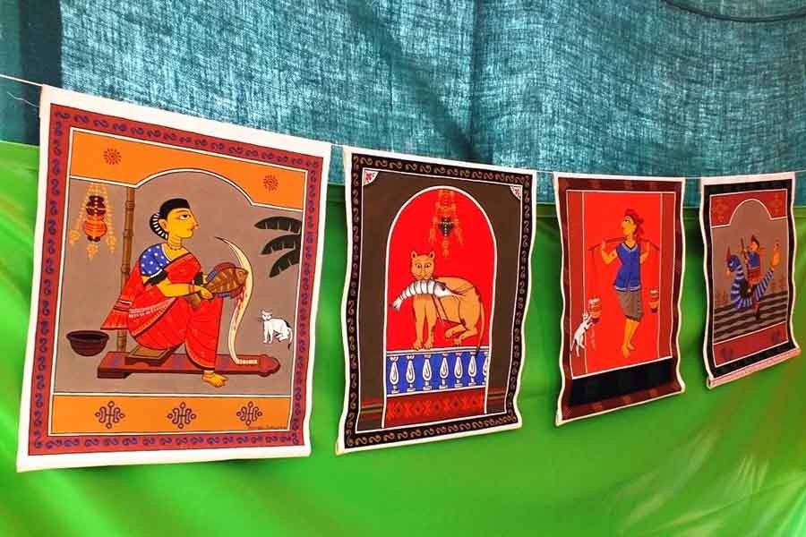
Gazi’s paat scrolls at the British Museum

Slide 10
 | Word meaning with synonym
Admire | Praise. (প্রশংসা করা )
Apparent | Seemingly. ( প্রতীয়মান)
Creek | Inlet. ( খাঁড়ি , খাত )
Docile | Bound ,Subject. (বাধ্য করা )
Indigenous | Internal. ( দেশীয়)
Legend | Myth, Fable. ( পৌরাণিক)
Miracle | Supernatural ( অলৌকিক ঘটনা )
Orchestra | Musician group. ( বাদক দল )
Predatory | Fearful. ( ভীত )
Scroll | Volume. ( লেখ্যপট )
Strum | Thrum. ( আনাড়ির মতো বাজানো )
Threaten | Blackmail. ( ভীতি দেখানো )
Vigilant | Awaken. ( সজাগ )

Slide 11
Make a follow chart showing the specialities of Gazi Pir. One is given for you.
1. Being credited with miracles
2.
3
4
5
6

Slide 12
The rules for writing a flow chart.
The answer should not be full sentence.
Answer should be short note.
Subject should not be included.
Full stop ( . ) should not be used.
All answers must flow the first rule that is given in the first box.
The above flow chart flows the rule of Gerund which works as noun or verb . So the beginning of every answer will be : verb + ing / noun.

Slide 13
Answer:
1.Being credited with miracles
2.Ability to calm dangerous animals and make them docile.
3.Having bravery and heroism
4.Daring to fight crocodiles
5.Ability to control all predatory animals
6.Having tendency to help and protect endangered people.

Slide 14
Thanks You
Stay Home
Protect yourselves
Wear Mask outside of your Home
Wash your hand with soap till 20 seconds
Follow the rules of hygiene.

