Slide 1
WELCOME EVERYBODY

Slide 2
Introduction of teacher
Nasima Akter
Assistant teacher
Chatia Chala govt. primary school
Sakhipur, Tangail

Slide 3
Introduction of the lesson
Class: Two
Subject: English
Lesson title: parts of the body
Time:40 min
Date:01/03/18

Slide 4
Learning outcomes-
At the end of the lesson the students will be able -
1.1.1-To become familiar with English sounds by listening to common English words.
1.1.2- To say simple words and phrases with proper sounds and stress.

Slide 5
Let’s see a video

Slide 6
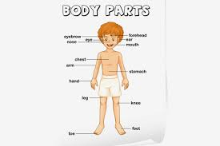

Slide 7
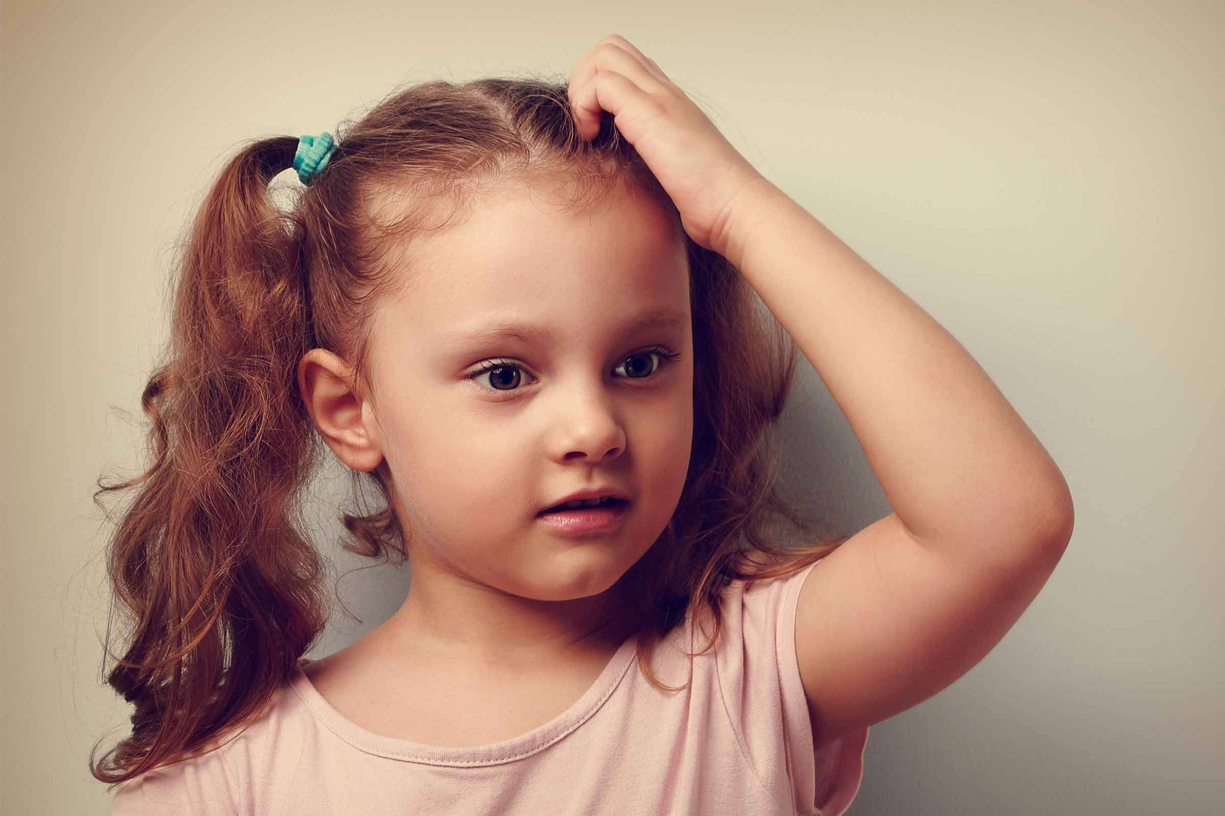
Head

Slide 8
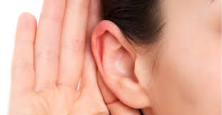
Ear

Slide 9
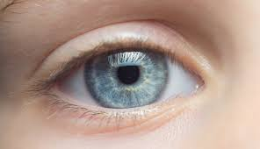
Eye

Slide 10
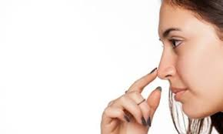
Nose

Slide 11
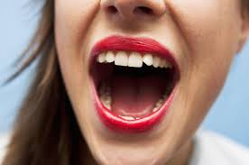
Mouth

Slide 12
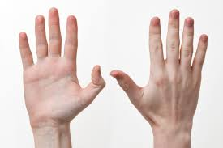
Hand

Slide 13
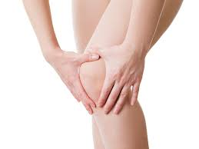
Knee

Slide 14
Toes

Slide 15
Connect of text book:
I will say the students to take their books and open at page 25.

Slide 16
Group work:
Now I divided you some groups and you will work some group work. A student say the words and others listen and say with him.

Slide 17
Checking and learning :
I will ask 2/3 students to come in front and ask them to say and see some parts of the body.

Slide 18
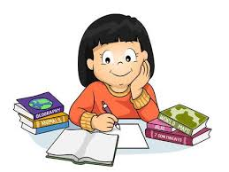
Home work
You will bring to write the name of your parts of body.

Slide 19
THANKS ALL

