Slide 1
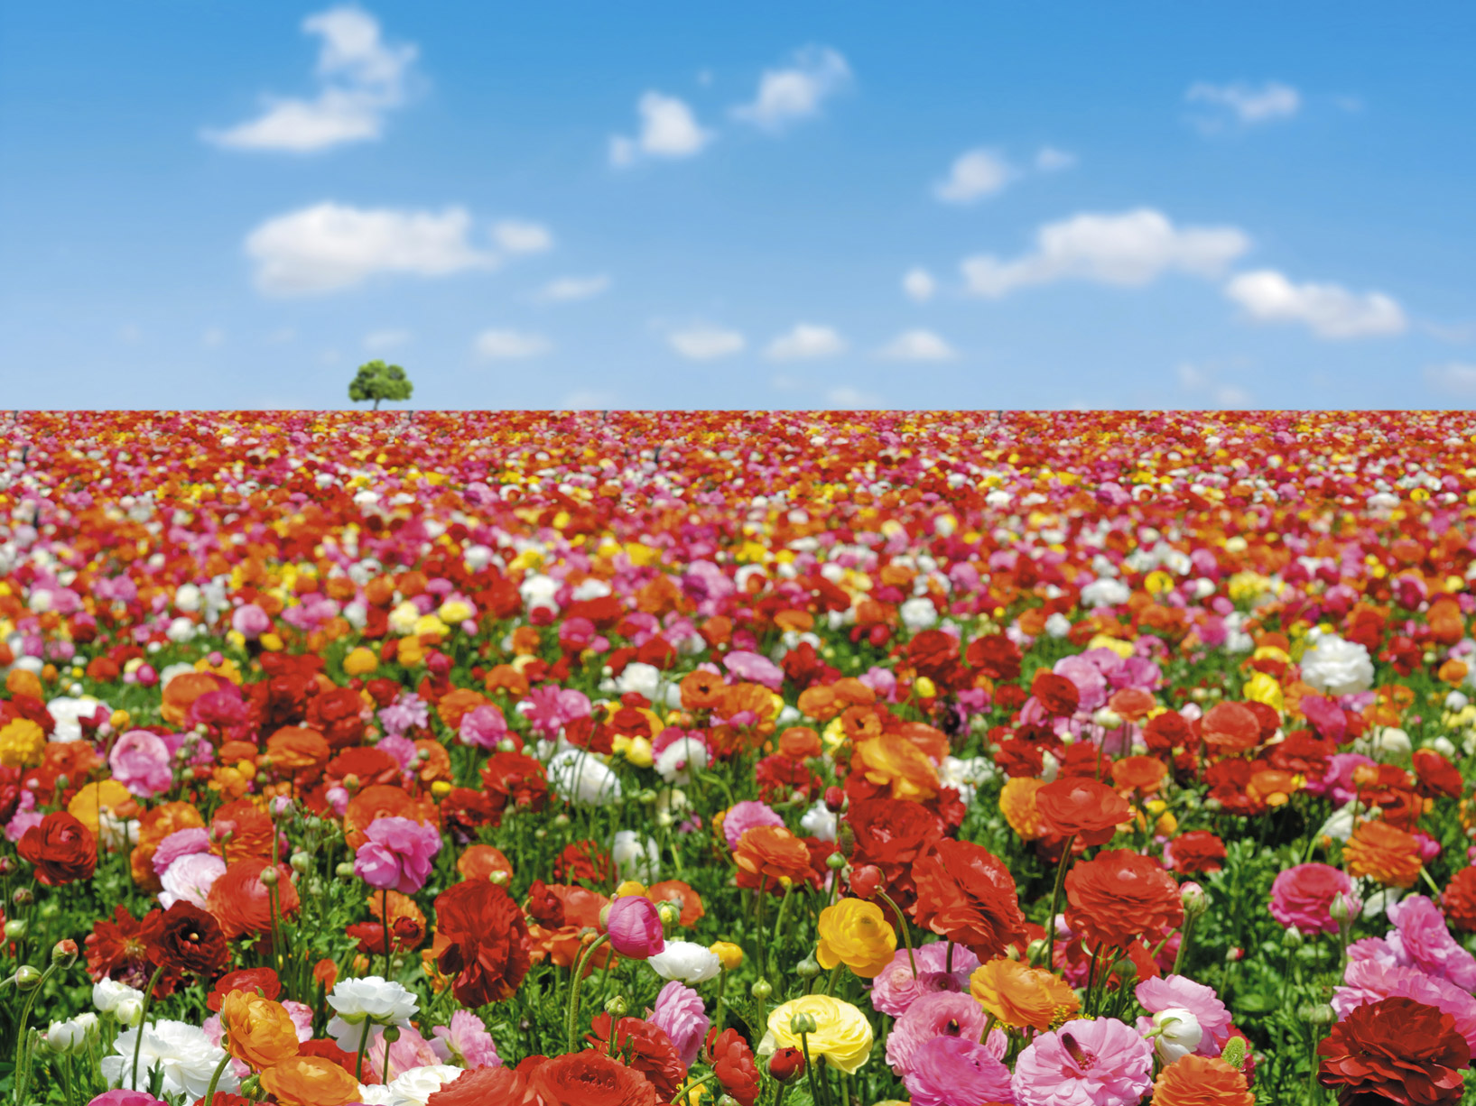

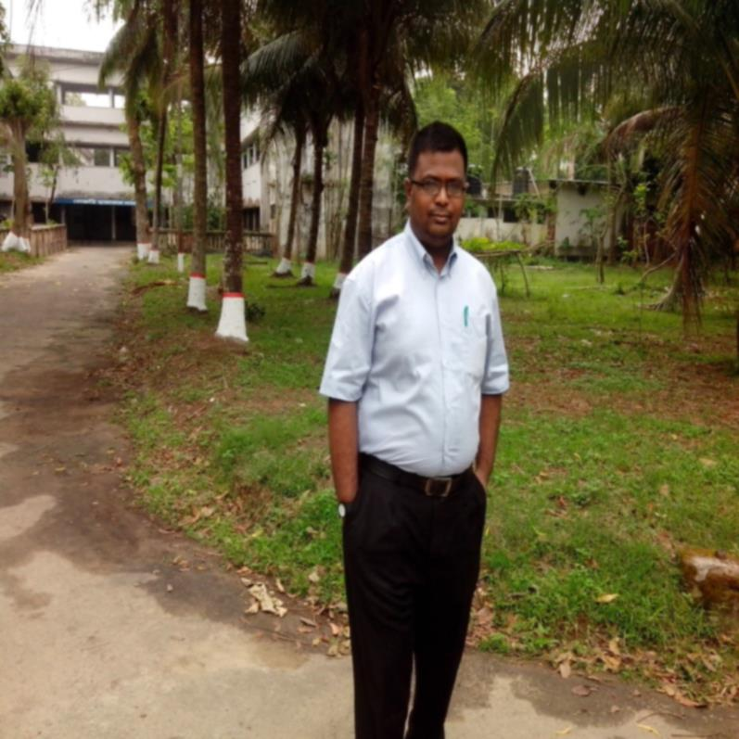


Slide 2

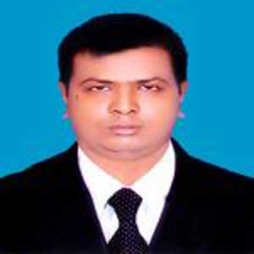
Md.Mamunur Rashid
B.A. (Hons);M.A. in English & B.Ed
Trained in ELP (online) By U.S. Department of State
_{Trained in ELT; CPD-1;}
_{Assistant Teacher (English)}
Jilani Singergari High School, Kishoregonj, Nilphamari.
Mobile: 01779194656; 01917624627
Introduction
Subject :English 2nd Paper
Unit:7 ,Lesson :1
Time :50 minutes

Slide 3
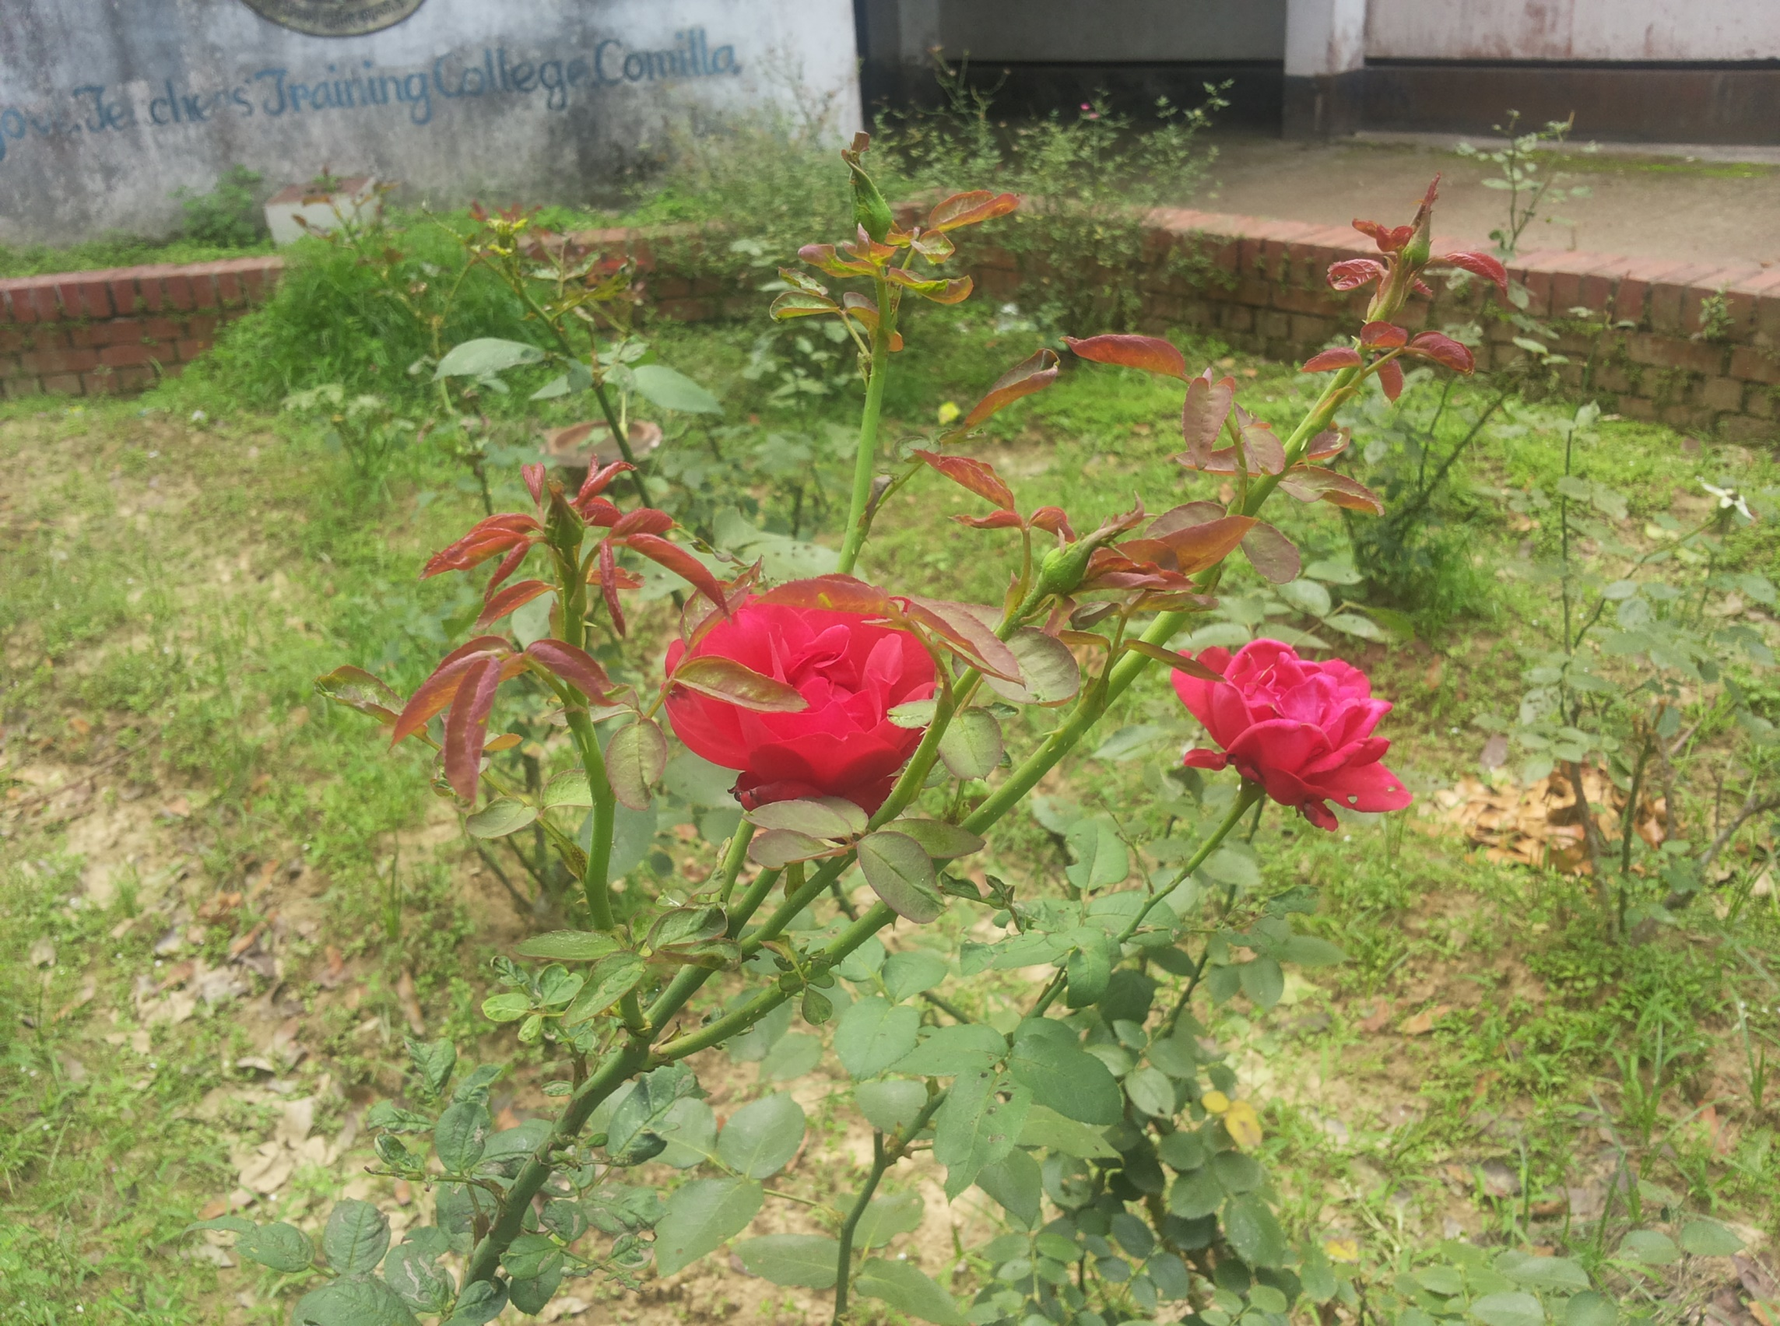

TAG
QUESTIONS

Slide 4
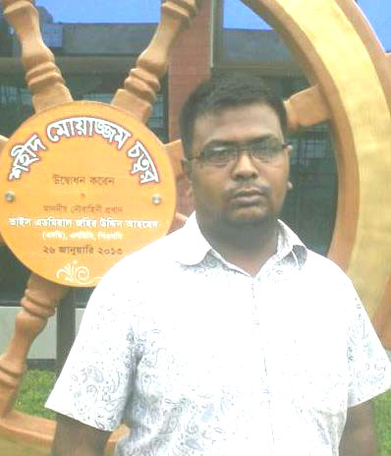
WHEN WE USE TAG QUESTIONS?
We use tag questions at the end of statements to ask for confirmation. They mean something like: "Am I right?" or "Do you agree?" They are very common in English.

Slide 5
TAG QUESTIONS BASIC STRUCTURE
+ Positive statement | - Negative tag?
It is a great day, | isn’t it?
- Negative statement | + Positive tag?
You don’t know her, | do you?

Slide 6
TAG QUESTIONS
BASIC STRUCTURE OF SUBJECT
Steatement’s Subject | tag subject?
Nobody, None, No one | They?
Everybody,Everyone,somebody,some one | They?
Every,Some,No+Thing | It?
Let's/ let us | Shall we?
Imperative Sentence if it afffirmative or negative or Let+me,him,her,them,our,your. | Will you?

Slide 7
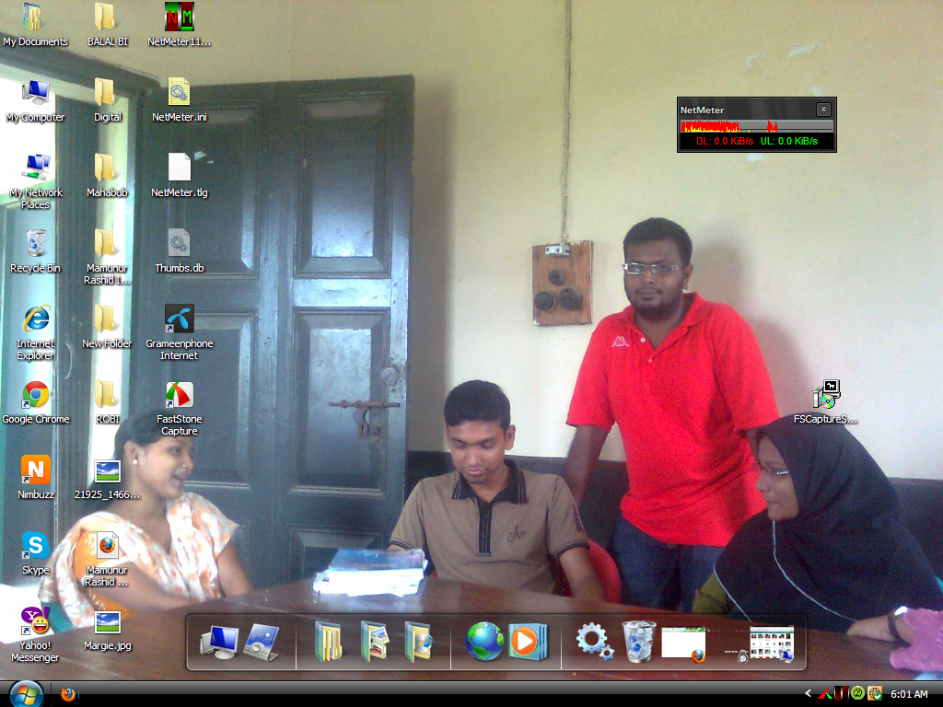
EXAMPLES

Slide 8
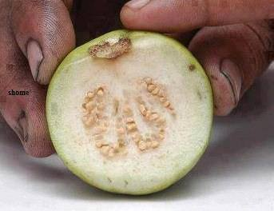
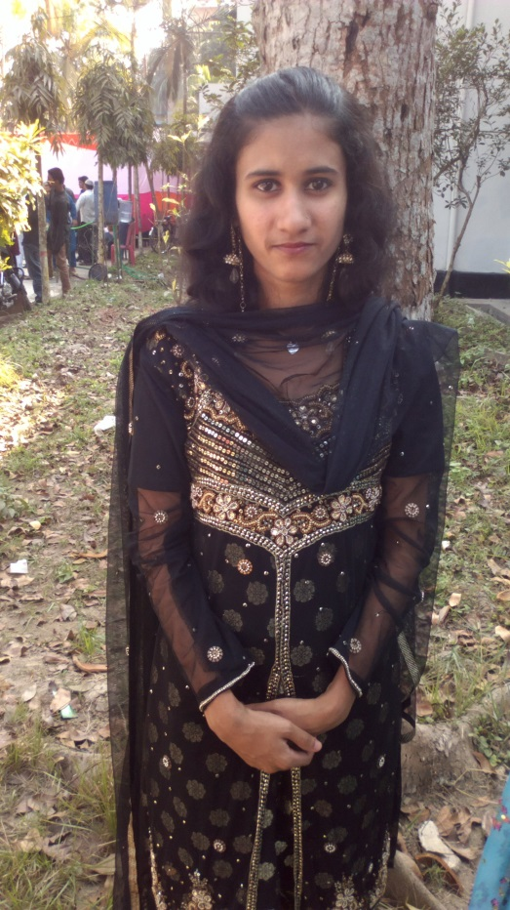
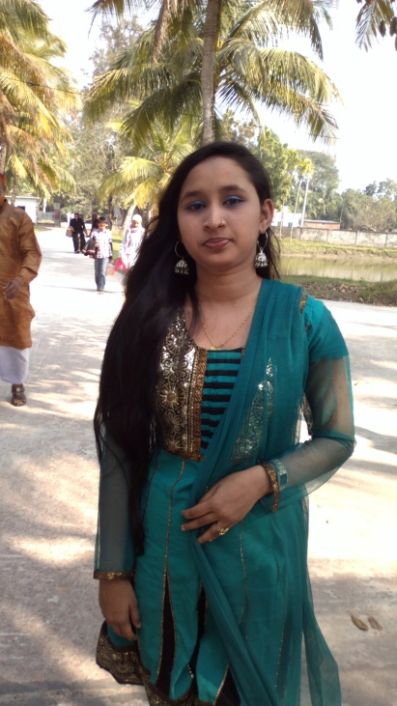
AFFIRMATIVE (statment) + NEGATIVE (tag):
You are from Colombia, aren’t you?
NEGATIVE (statment) + AFFIRMATIVE (tag)
You don’t speak english, do you?

Slide 9
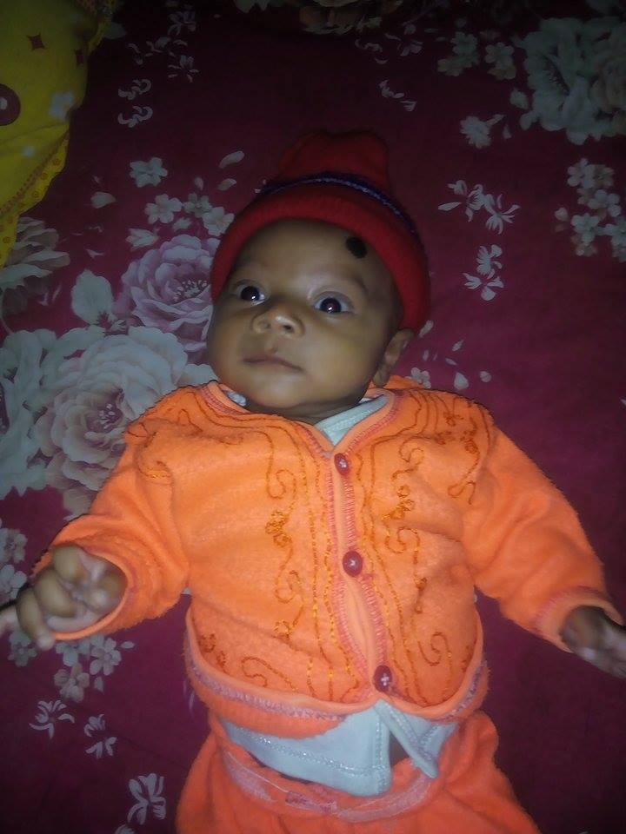
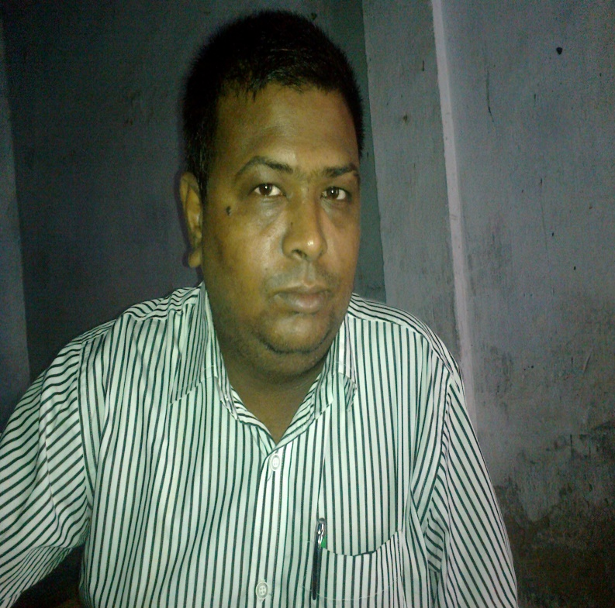
Some special cases
I am right, aren't I? | aren't I (not amn't I)
You have to go, don't you? | you (do) have to go...
I have been answering, haven't I? | use first auxiliary
Nothing came in the post, did it? | take statements with nothing, nobody etc like negative statements

Slide 10
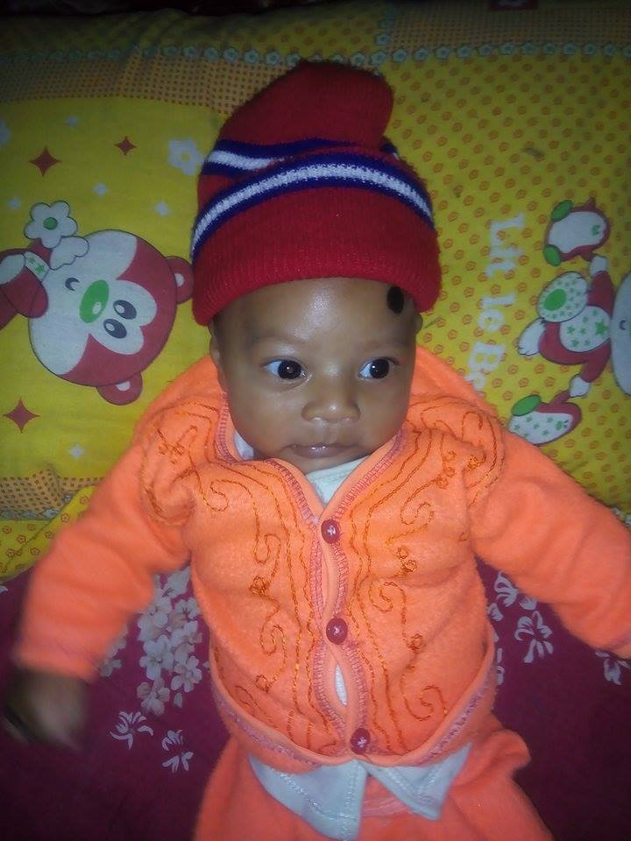
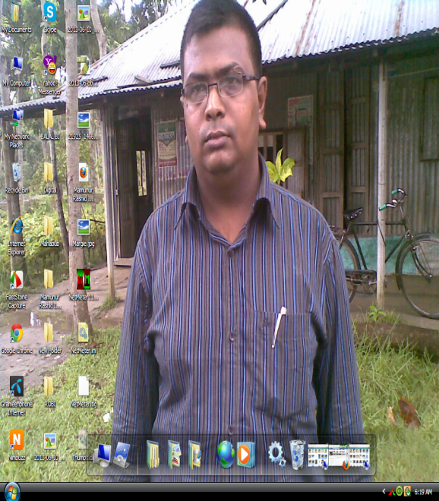
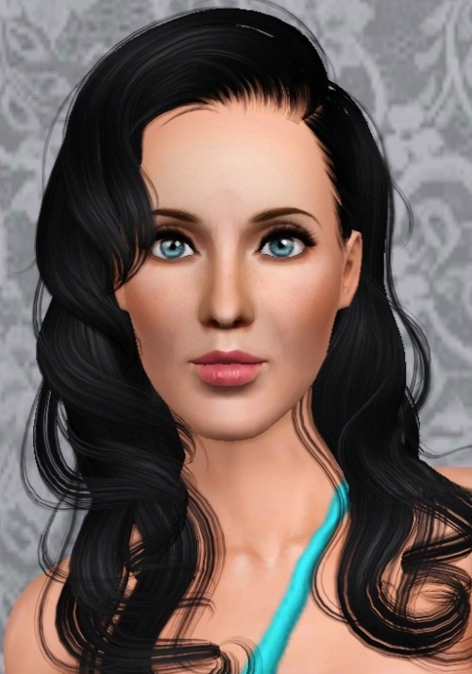

You don’t really love her, do you?
He can’t swin, can he?
It will work, won’t it?

Slide 11
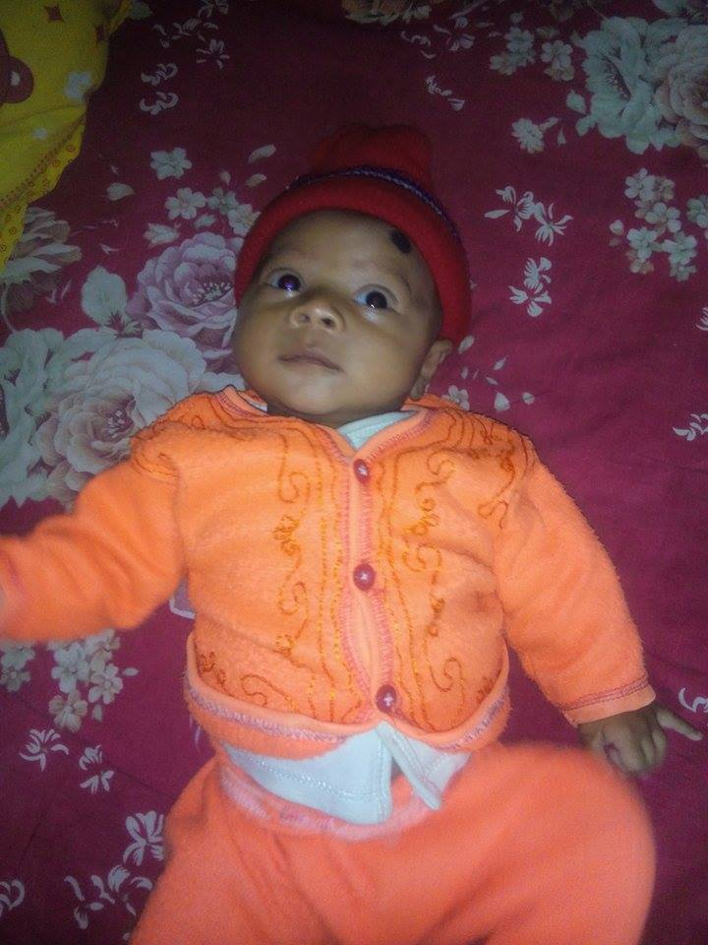

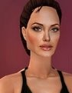
You didn’t go to the party, did you?
She would buy a car if she had the money, wouldn’t she?

Slide 12
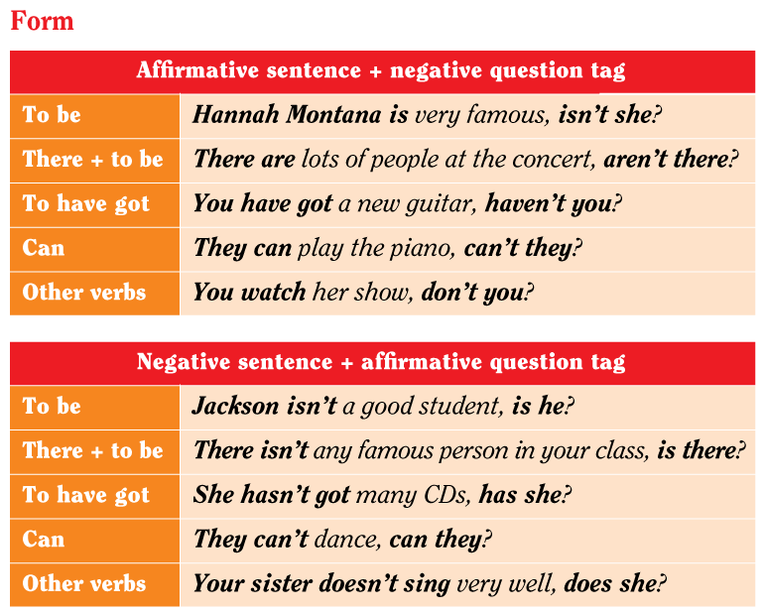

Slide 13
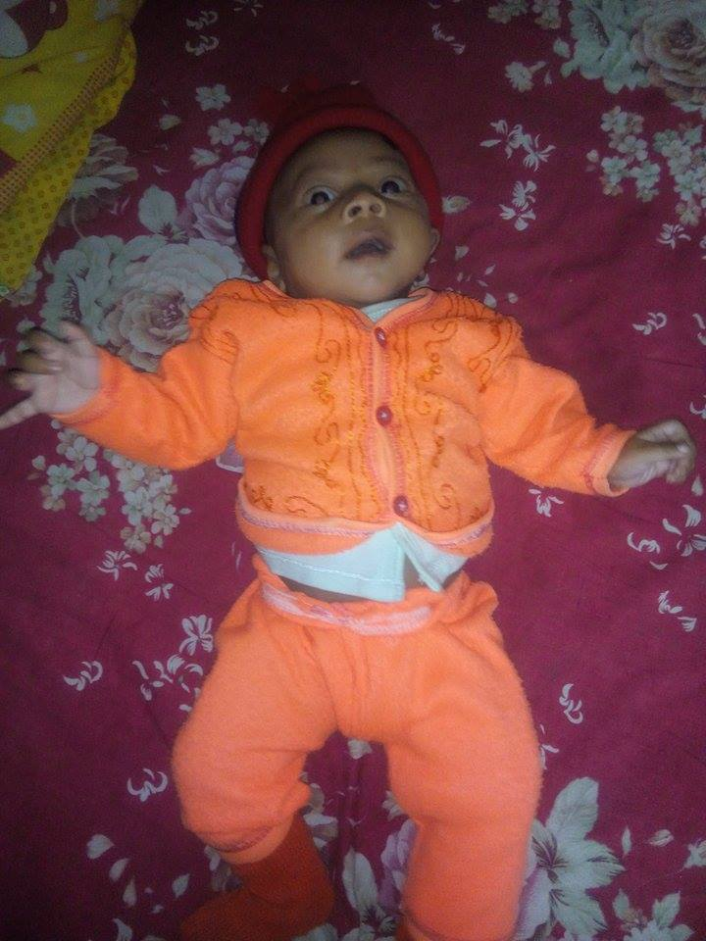


No living being is above death, …?
are they?
are you
don’t you

Slide 14
Money is a must for our life,.....?
do we
Isn’t it
have we

Slide 15
One can do almost nothing without it, …?
can’t you
don’t you
can one

Slide 16
But money can hardly bring happiness, …?
can’t you
don’t you
can it

Slide 17
What you need most to be happy is contentment , …?
can’t you
don’t you
Isn’t it

Slide 18
That is why few people lead a happy life, …?
do they
isn’t it
does it

Slide 19
None is none under the sun, …?
are they
doesn’t he
is he

Slide 20
never, no, none, no one, nobody, neither, nothing, barely, hardly, rarely, scarcely, seldom, hardly, ever, few, little etc

Slide 21
So one should work for one’s shake, …?
can’t you
don’t you
should one

Slide 22
He has lost everything. What a pity, …?
Don’t you
isn’t it
do you

Slide 23
My sister shut the door, …?
aren’t I
Didn’t she
don’t I

Slide 24
The colour of the shirts seldom charms me, …?
Does it
do they
get they

Slide 25

Kindly do him a favour, …?
Will you
is she

Slide 26
Most of the students who fail in English do not have strong foundation in English Grammar, …?
isn’t it
don’t you
Have they

Slide 27
Yes,they can’t help learning gammar, …?
isn’t it
Can they
Don’t they

Slide 28
Everyone would do.so, …?
Wouldn’t they
Don’t they
am I

Slide 29
You need not do this, …?
isn’t it
Need you
am I

Slide 30
There is a little water in the pond, …?
isn’t it
Don’t they
Isn’t there

Slide 31
No, they read only to pass the Examination, …?
isn’t it
Don’t they
am I

Slide 32
No, they read only to pass the Examination, …?
isn’t it
Don’t they
am I

Slide 33
No, they read only to pass the Examination, …?
isn’t it
Don’t they
am I

Slide 34
No, they read only to pass the Examination, …?
isn’t it
Don’t they
am I

Slide 35
No, they read only to pass the Examination, …?
isn’t it
Don’t they
am I

Slide 36
No, they read only to pass the Examination, …?
isn’t it
Don’t they
am I

Slide 37
No, they read only to pass the Examination, …?
isn’t it
Don’t they
am I

Slide 38
No, they read only to pass the Examination, …?
isn’t it
Don’t they
am I

Slide 39
No, they read only to pass the Examination, …?
isn’t it
Don’t they
am I

Slide 40
No, they read only to pass the Examination, …?
isn’t it
Don’t they
am I

Slide 41
No, they read only to pass the Examination, …?
isn’t it
Don’t they
am I

Slide 42
No, they read only to pass the Examination, …?
isn’t it
Don’t they
am I

Slide 43
No, they read only to pass the Examination, …?
isn’t it
Don’t they
am I

Slide 44
No, they read only to pass the Examination, …?
isn’t it
Don’t they
am I

Slide 45
No, they read only to pass the Examination, …?
isn’t it
Don’t they
am I

Slide 46
Yes, teachers should motivate them to learn the basic things, …?
Shouldn’t they
doesn’t he
can Peter

