Slide 1
Manik

Slide 2
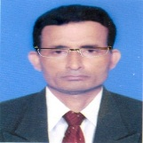
Identity
Manik Chandra Majumder
Senior Teacher
Gazirhat High School
Senbag, Noakhali.
Mobile No: 01717155169
Email: manikmajumder01@gmail.com
Class : Nine-Ten
Subject : English 1st paper
Manik

Slide 3
Look at the pictures and say what you see in them.
These are the traditional communication systems.
Manik

Slide 4
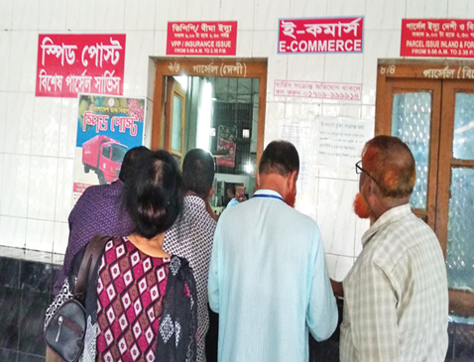
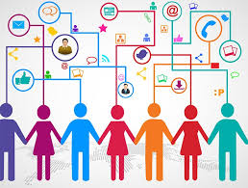
Look at the pictures and say what you see in them.
Modern communication/ e-communication systems.
Manik

Slide 5
Our today’s topic is---
Media and modes of
e-communication
Class : Nine-Ten
Unit : Thirteen
Lesson : One
Manik

Slide 6
Learning Outcomes
After the end of this lesson students will be able to-------
a) surf the internet,
b) ask and answer questions,
c) read and comprehend text,
d) read and write email;
f) describe the benefit of e-communication
system.
Manik

Slide 7
Look at the pictures and say what you see in them
Manik

Slide 8
Work in pair. Discuss which of the following words you are familiar with. How are they related to e-communication?
facebook, e-mail, web site, blog, e-commerce, twitter, e-learning, iPod, tablet pc, information super high way, social network, smart phone.
Here we see some e-communication related words. These words are now very common to all. Facebook and Twitter are website pages. People use them for social networking
E-mail is used to send and receive message as letters.
Website is a particular area located on the internet. People use it as an address of a person or institution.
Blog is an informational website published on the World Wide Web.
E-commerce is electronic commerce in fact internet based commerce or business.
Tablet PC is small laptop computer.
E-learning is internet based teaching and learning system as online school.
IPod and smart phone are mobile phone of the 3rd or 4th generation.
Social network means internet based communication.
Super highway means world wide Internet connectivity line.
Manik

Slide 9
facebook, e-mail, web site, blog, e-commerce, twitter, e-learning, iPod, tablet pc, information super high way, social network, smart phone.
A dialogue between S1 and S2 about above words.
Which of the following words are you familiar with?
I am familiar with almost all the words.
S1
How are they related to e-communication?
S2
I think, we can instantly communicate with one another from any remote corner of the world .
Manik

Slide 10
Read the text and answer the questions that follow.
Let's imagine a citizen's ordinary day at work. The morning probably starts with a cup of coffee/tea, followed by greeting the colleagues. Then comes the inevitable, which is logging in the computer. For many of us the third step has become an automatic behaviour and it dominates the rest of our work day, receiving and sending dozens of email.
Manik

Slide 11
An e-mail is an electronic mail. It is a computer-aided way of exchanging digital text message from a sender to one or multiple recipient/s.
Manik
Notes:
ক্যাপশন আসার আগে ছবি দেখে উত্তর নেওয়ার চেষ্টা করতে হবে।

Slide 12
E-mails operate through a network of computers linked by the internet.
network of computers
Manik

Slide 13
There are commercial server agencies such as Yahoo, Gmail, Ymail, Hotmail, etc. that accept the text messages from the sender, forward it and deliver instantly to the digital mailbox of the recipient. If the recipient is not online, the message is stored and delivered later when the recipient is online. It works instantly just with the click of your mouse. It has been a powerful communication tool in modern life.
Manik

Slide 14
Vocabulary
Colleague
a person with whom one works in a profession / workmate
Dominate
Take over, control
Greeting
Complements, salutation, addressing
Imagine
See in one’s mind’s eye, visualise
Recipient
The person who receives
Inevitable
That one cannot avoid or prevent

Slide 15
Individual Work
1. What is an e-mail?
2. How do e-mails operate?
3. How do the commercial servers serve in the process of
an e-mail?
4. ‘It has been a powerful communication tool in modern
life .’ Explain the statement.
5. How do e-mails affect our daily work schedule?
Manik

Slide 16
Match your Answer
1. What is an e-mail ?
2. How do e-mails operate ?
4. ‘It has been a powerful communication tool in modem life .’ Explain the statement.
3. How do the commercial servers serve in
the process of an e-mail?
5. How do e-mails affect our daily work schedule?
Answer 2: E-mails operate through a network of computers linked by the internet.
Answer 5: Sending and receiving dozens of e-mail has become a habit of many of us. Thus e-mail affects our daily work schedule.
Answer 3: The commercial servers accept the text messages from the senders, forward them and deliver them instantly to the digital mailbox of the recipient.
Answer 1: Email means electronic mail. It is the text messages that can be sent from the sender to the recipient through internet.
Answer 4: E-mail can be sent within seconds. It is also very cheap. To prepare an email is very easy task. It can be sent anywhere the sender wishes. It can also be received from anywhere the receiver stays. That is why it has become a very powerful communication tool in our modern life.
Manik

Slide 17
Process of creating e-mail account
Open any browser and write gmail.com in search bar and search
Manik

Slide 18
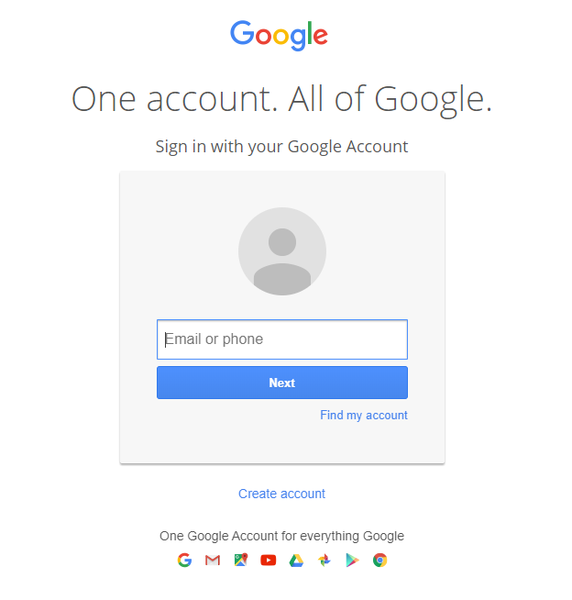
Put your mail address , password/Create Account
Manik

Slide 19
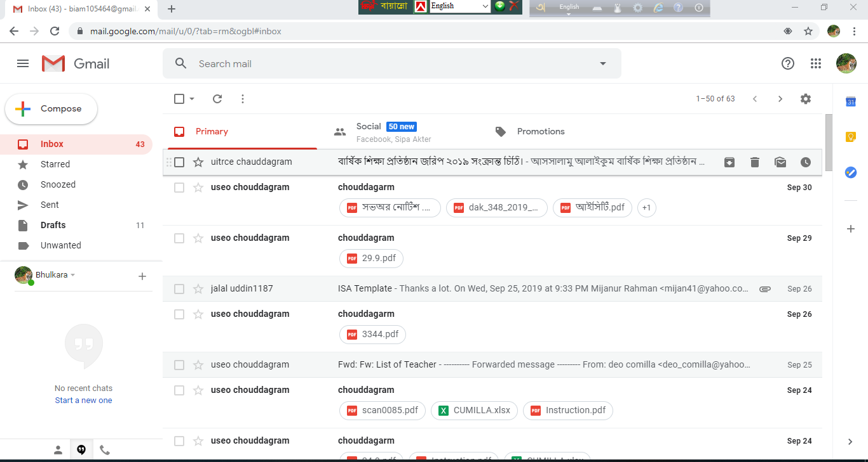
Click compose
Manik
Notes:
ক্যাপশন আসার আগে ছবি দেখে উত্তর নেওয়ার চেষ্টা করতে হবে।

Slide 20
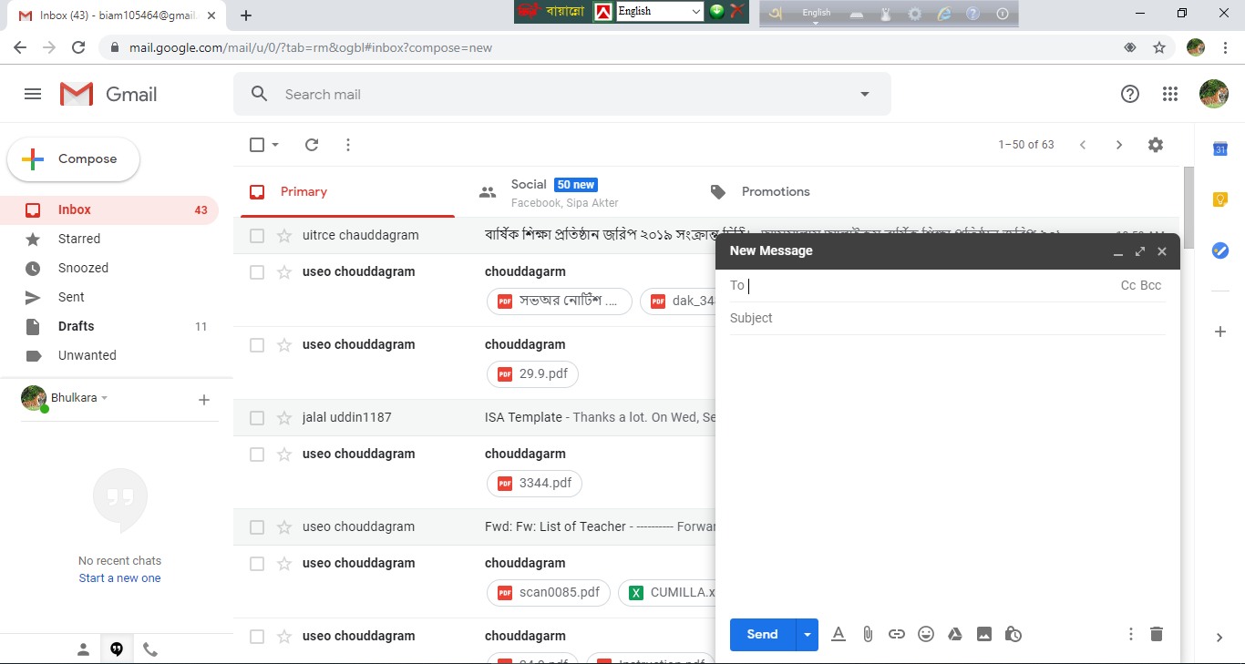
Give receiver address
Write mail subject
Compose your mail
Click send button
Manik
Notes:
ক্যাপশন আসার আগে ছবি দেখে উত্তর নেওয়ার চেষ্টা করতে হবে।

Slide 21
Read the following text. It gives the information about the origin of the e-mail. Choose the appropriate forms of the verbs from the box to complete the sentences. You can use a verb more than once.
Sending text messages electronically could be a)---------to date back to the Morse code telegraph of the mid 1800s and the 1939 New York World's Fair. In the fair, IBM b)---------a letter of congratulations from San Francisco to New York on an IBM radio-type, c)--------- it a high-speed substitute for mail service in the world of tomorrow. Teleprinters were d)-------- in Germany during World War II. The use e)--------- until the late 1960s when there was a worldwide Telex network. Additionally, there was the similar American system f)-------TWX which g)--------- important until the late 1980s. With the introduction of MIT's Compatible Time-Sharing System (CTSS) in 1961, for the first time multiple users were h)--------- to log into a central system from remote dial-up terminals. They were also able to store and share files on the central disk. Informal methods of using this to pass messages i)--------- and were j)------ to create the first true c-mail system.
Manik

Slide 22
send | say | use | remain | call | expand | allow | Develop | spread
Sending text messages electronically could be a)---------- to date back to the Morse code telegraph of the mid 1800s and the 1939 New York World's Fair. In the fair, IBM b)------------a letter of congratulations from San Francisco to New York on an IBM radio-type, c)------------it a high-speed substitute for mail service in the world of tomorrow. Teleprinters were d) -----------in Germany during World War II. The use e)----------------until the late 1960s when there was a worldwide Telex network. Additionally, there was the similar American system -f)-------------TWX which g)-------------important until the late 1980s.
With the introduction of MIT's Compatible Time-Sharing System (CTSS) in 1961, for the first time multiple users were h)-----------to log into a central system from remote dial-up terminals. They were also able to store and share files on the central disk. Informal methods of using this to pass messages i) --------- and were j)--------------to create the first true c-mail system.
Manik
called
said
used
expanded
allowed
developed
spread
sent
remained
calling

Slide 23
Evaluation
Choose the correct answer from the alternatives.
Q: a) To check e-mail has become our ---------act.
Cor. Ans:
i. voluntary
ii. main
Cor. Ans:
iv. habitable
iii. essential
iv. habitable
Q: b) People receive and send ---------- message.
i. manual
ii. verbal
Cor. Ans:
Cor. Ans:
iii. digital
iii. digital
iv. postal
Manik

Slide 24
Q: c) Which of the following statement is true about an
automatic behaviour.
Cor. Ans:
i. operating computer
ii. Receiving and sending text
Cor. Ans:
iv. Receiving and sending emails
iii. logging in the computer
iv. Receiving and sending emails
Q: d) What is the antonym of the word ‘ multiple’?
Cor. Ans:
ii. individual
Cor. Ans:
i. single
i. single
iii. various
iv. absent
Q: e) E-mail works through a network of computers connected by the-------------.
Cor. Ans:
i. television
ii. transistor
Cor. Ans:
iii. internet
iv. radio
iii. internet

Slide 25
Home work
Suppose you are Sumon lives at Mirpur, Dhaka. Your friend Nisan having an e-mail account nisan123@gmail.com . Now write an e-mail to your friend about the preparation of your coming Examination.

