Slide 1
WELCOME TO THE CLASS

Slide 2
Identity
Md. Afsar Ali
Senior Asst. Teacher
Majhira Model High School
Shajahanpur, Bogura

Slide 3
LESSON IDENTITY
Class Eight
English for today

Slide 4
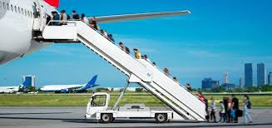
A. Look at the picture and talk about it.
1. Do you know what the picture is about?
2. What are the people doing?

Slide 5
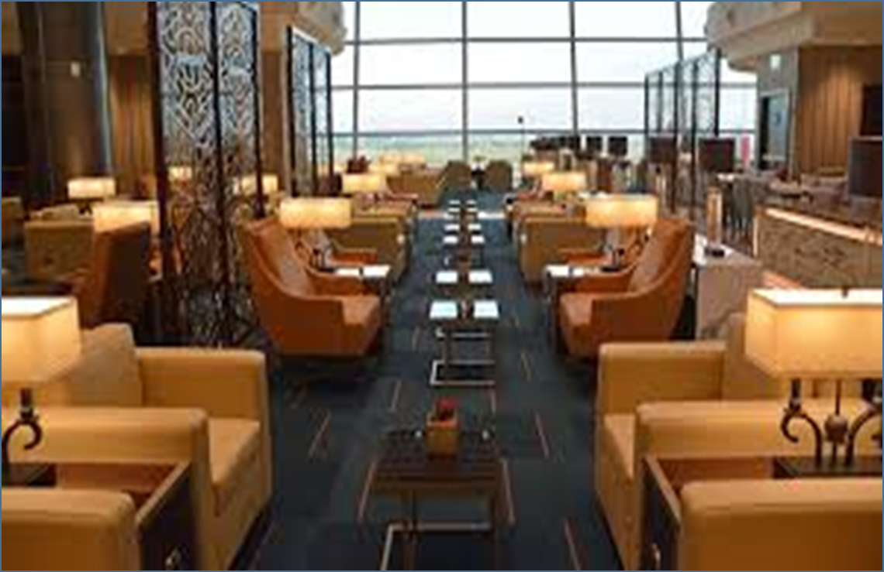
Our today’s lesson is…….
Boarding the plane
Unit:6 Lesson: 4 Page:65

Slide 6
LEARNING OUTCOMES
By the end of the lesson, the students will be able to…
to talk about the pictures.
to read and understand the text.
to write answer to the questions.
to write a letter.

Slide 7
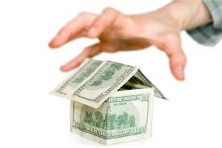
Let us introduce with some key words.
take hold of suddenly and forcibly.
Seize
she seized hold of the door handle

Slide 8
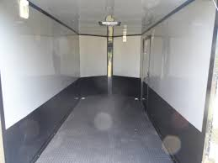
surrounded or closed off on all sides
Enclosed
She is waiting in a dark enclosed place.

Slide 9
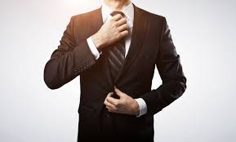
the rigid observance of rules of convention or etiquette.
Formality
he retained the formality of his social background

Slide 10
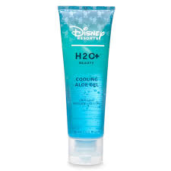
a liquid or semiliquid substance.
Gel
Everything seemed to gel for the magazine

Slide 11
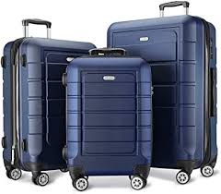
suitcases or other bags in which to pack personal belongings for traveling.
Luggage
He left his luggage in the office.

Slide 12
Read the passage carefully and answer the following questions.
Mita, Zara, Mr and Mrs Islam all sit at the lounge. They all have hand luggage with them. Mr Islam asks, “Mita, Zara are you two carrying any liquid, lotion, gel or cream in your carryon luggage?” “I have a small lip gel in it. Why uncle?” “Well, if it is a very small one, there is no problem. But if you have more than 100 ml, you have to put it in the checked in luggage. These are not allowed on board in hand luggage.
For security reasons, the officials who do the baggage checking will seize and throw them away”. Mita, Zara, Jhuma Islam and Mazharul Islam go through the security checking and wait in the enclosed area. All the formalities are done. Now they are waiting to board the plane.
Mita, Zara and her parents board the plane after their row number is announced. Mita gets a window seat. Her seat number is F23 C. Zara sits beside her on an isle seat and her parents sit behind them.

Slide 13
Pair work
Answer the following questions.
Who had a small lip gel in the hand luggage?
2. How much liquid or gel is allowed to carry in the hand luggage?
3. Why are liquid, gel and cream not allowed on board a plane?
4. Which row is Mita sitting in?

Slide 14
Individual work
Choose the best answer from the alternatives.
The word ‘Lotion’ in the text means?
(a) a fluid for external application to human body or something.
(b) a fluid for internal application to human body or something.
(c) a gel for external application to human body or something.
(d) one kind of toothpaste.
2. ‘Board’ means…………
(a) to enter in a ship or any carriage (b) to go on an another country
(c) get down (d) to put something in a ship or any carriage
3. Where do Mita, Zara Mr. and Mrs. Islam sit at?
(a) They sit at the bus terminal. (b) they sit a the railway station
(c) they sit at the lounge (d) they sit at the launch ghat.
4. What is the meaning of the word ‘announce’ in the passage?
(a) call (b) crowd
(c) declare (d) get off

Slide 15
Home work
Suppose, you are Rana/Rina and you have gathered an experience of a plane journey. Write a letter to your friend Nabil/Nabila about your feelings to board the plane first time.

Slide 16
Goodbye
See you again

