Slide 1
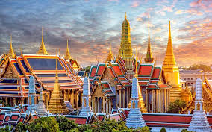
WELCOME TO THE CLASS

Slide 2
Identity
Md. Afsar Ali
Senior Asst. Teacher
Majhira Model High School
Shajahanpur, Bogura

Slide 3
LESSON IDENTITY
Class Eight
English for today

Slide 4
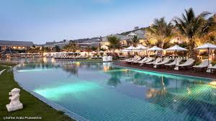
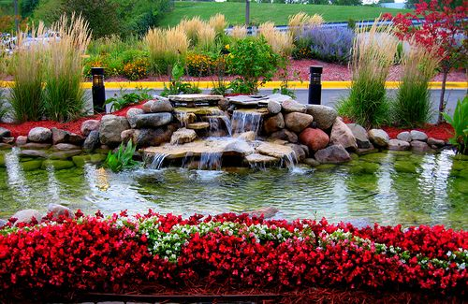
A. Look at the picture and talk about it.
2. What could be this place?
3. How do you know?
1. What do you see?

Slide 5
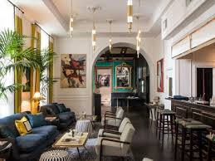
Our today’s lesson .................
The destination
Unit:6 Lesson: 8 Page: 73

Slide 6
LEARNING OUTCOMES
By the end of the lesson, the students will be able to…
to talk about the pictures.
to read and understand the text.
to write answer to the questions.
to fill in the gaps.

Slide 7
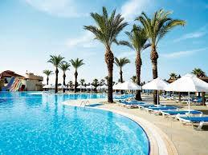
Let us introduce with some key words.
To attract or interest somebody very much
Fascinate
The garden attracts him very much.

Slide 8
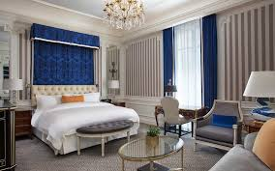
A place to which somebody or something is going or being sent.
Destination
His destination is to be a great poet.

Slide 9
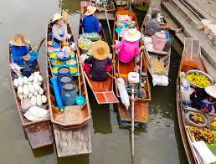
A movable market or a special market in small boats in Bangkok.
Floating market
Mita went to the floating market in Bangkok.

Slide 10
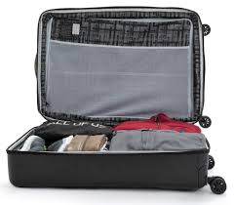
Case with flat sides and a handle, used for carrying clothes etc. when anybody is travelling
Suitcase
He took a large suitcase while going to Bangkok.

Slide 11
Read the passage carefully and answer the questions.
Mita looked around and saw a garden of trees and flowers welcoming her. There was a small fountain at the middle of the garden, bringing in cool breeze. Mita loved the place. Mita bought a suitcase as well as a piece of carry-on luggage. She carried her luggage to the elevator and pressed a button that said 6. Her uncle’s apartment was on the 7th floor. It was a nicely done two-bedroom apartment. Mita and Zara were going to share the same room.
It was nearly 8 p.m. when they all got settled. They finished dinner and started to plan for the next day. Mita read about the floating market in the internet, and wanted to see one. “Well, then you have to wake up very early tomorrow. The market sits early in the morning and is over before noon. We are going to the Tha Kha floating market tomorrow,” said Mr. Islam. “Wow!” cried out Mita and Zara together. “Thank you, uncle.” “Thank you, dad.”

Slide 12
Fill in the blanks with appropriate words.
Mita was(a)......................to see such a big airport. After completing immigration, they all came out of the (b)............ .Mr. Mazharul Islam went to the taxi (c)...............and bought a ticket. They stood in a live and (d)...............for their turn. Soon their taxi came and they all (e)................into it.
Individual work
Excited
airport
counter
waited
got

Slide 13
Pair work
C. Answer the following questions.
Why Did Mita think that the garden was welcoming her?
When did they all start to plan for the next day?
What did they plan to see?
Why would Mita and Zara wake up early in the morning?
Answer
1. It was a feeling that led Mita think that the garden was welcoming her because the garden, flowers, fountain and cool breeze all were charming.
2. After finishing diner they all started to plan for the next day.
3. The planned to seen the Tha Kha floating market.
4. Mita and Zara would wake up early in the morning with a view to visiting the Tha Kha floating market.

Slide 14
Home work
D. Write a summary of the passage of your own words.

Slide 15
Goodbye
See you again

