Slide 1
Welcome to all

Slide 2
Teacher’s Introduction
Md. Babar Ali
Assistant Teacher
Dighulia Shahid Mizanur Rahman High School, Tangail
Class : Seven
Subject : English first paper
Unit : 4
Lesson : 4

Slide 3
Learning outcomes:
By the end of the lesson students will be able to-
a.Read silently to understand
b.Identify present continuous tense
c.Use vocabulary

Slide 4
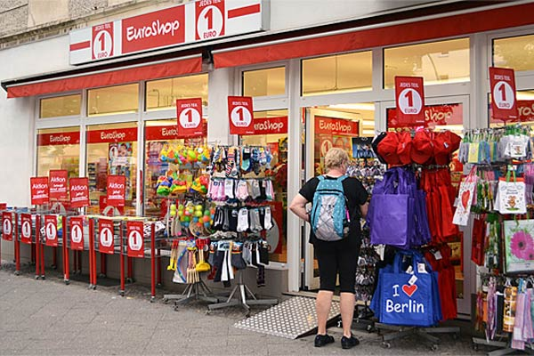
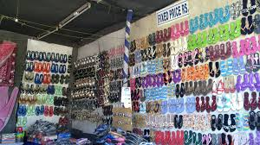
Look at the pictures.
What kinds of things do you find in the shops?
Who is the shopkeeper?

Slide 5
Today, our lesson is Fixed Price Shop
Write down the following words-
Bargain-----haggle
Offer-----propose
Suppose-----guess
Buy-----purchase

Slide 6
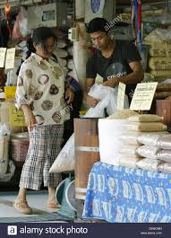
Look at the pictures
1.What do you see in the pictures?
2.What are they doing?
3.Do you know what kind of shop these are?

Slide 7
Read the text silently and answer the following questions.
1.Do you go shopping? Where is the shop?
2. What do you usually buy?
3.Do you bargain? Why do you do that?

Slide 8
Possible answers : 1. Yes, I go shopping. The shop is near our house. 2. I usually buy necessary things. 3. Yes, I bargain to agree on a price.

Slide 9
Evaluation: 1. We need not bargain in ---------------------. A. a fixed price shop B. a grocery shop C. a stationary shop 2. A fixed price shop has a number of --------------------. A. benefits B. problems C. risks 3. ‘Buy’ means ---------. A. sell B. purchase C. offer 4. What is the meaning of ‘vend’? A. sell B. buy C. agree

Slide 10
Home work
Write a paragraph about a fixed price shop.
1.Do you know about a ‘Fixed-Price’ shop?
2.Where is it? What does it sell?

Slide 11
Thank you

