Slide 1
Welcome you all, dear students.
Notes:
Welcome slide. This picture is related to the topic. So I have chosen it. Teacher may change it if he wants.

Slide 2
IDENTITY
Teacher
Lesson
Hirendra Debnath
MA(English),Bed
Assistant Teacher(English)
Puran Bazar Girls’ High School
01789-916684
Hirendra Debnath
hirendra0501@gmail.com
English For Today
Classes : IX-X

Slide 3
Let’s watch a video ……
What is the video about?
Notes:
First click in blank space, 2nd click on the package and third click on the blank.

Slide 4
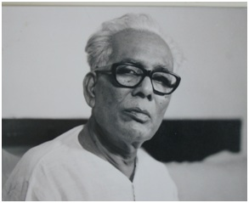
Art of-
Shilpacharya Zainul Abedin
Notes:
Students will tell this.

Slide 5
What might be our today’s lesson?

Slide 6
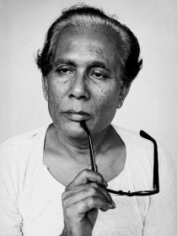
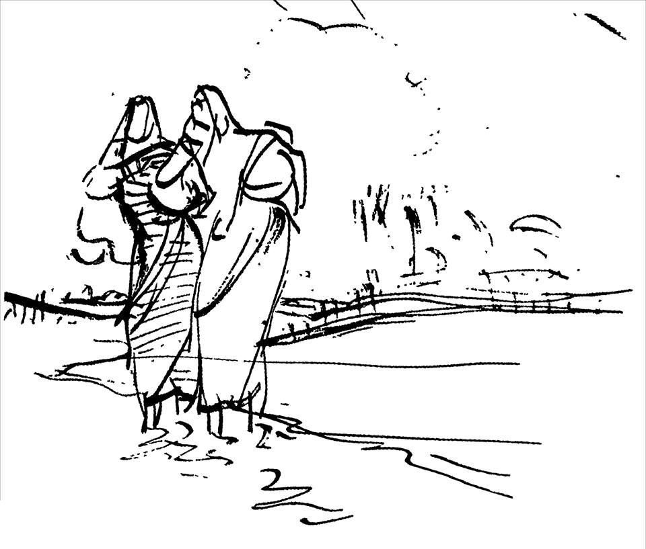
So, our today’s lesson is-
Zainul Abedin,
the greatest artist
Unit-7, Lesson-1
Notes:
Lesson declaration.

Slide 7
Learning outcomes
After the ss have studied this lesson, they will be able to-
a) tell the meaning of some key words.
b) read and understand the text
c) ask and answer questions
Notes:
All the four skills will be focused in this lesson.

Slide 8
Let’s Search the key words

Slide 9
Plight
Unfortunate situation
Depict
Representing by drawing
Milestone
a very important stage in the development of something
Compassion
sympathy, empathy

Slide 10
acclaimed
renowned, celebrated
harsh
cruel
destined
unavoidable
starvation
lack of food, famine
iconic
symbolic

Slide 11
knack
talent
artistic
creative
visionary
imaginative
scroll
a roll of paper for painting
heighten
Increase, intensify

Slide 12
regime
rule, government
dynamic
energetic
evident
clear, apparent
commemorate
show respect
devastating
destructive

Slide 13
visual
relating to sight used to illustrate something
inspiration
encouragement
tribute
respect
spotlight
focus
confidence
self-trust

Slide 14
Let’s read the text

Slide 15
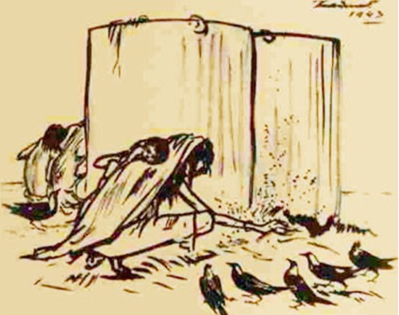
pioneer
the first man in a new field of knowledge
The pioneer of Bangladeshi modern art Zainul Abedin is widely acclaimed for his Bengal ‘Famine Sketches’.
famine sketches
drawing showing scarcity of food
Notes:
Please go according to animation.

Slide 16
Let’s see some famine sketches of 1943 -----
Through the series of sketches, Zainul not only documented the harsh famine of 1943 but also showed its -

Slide 17
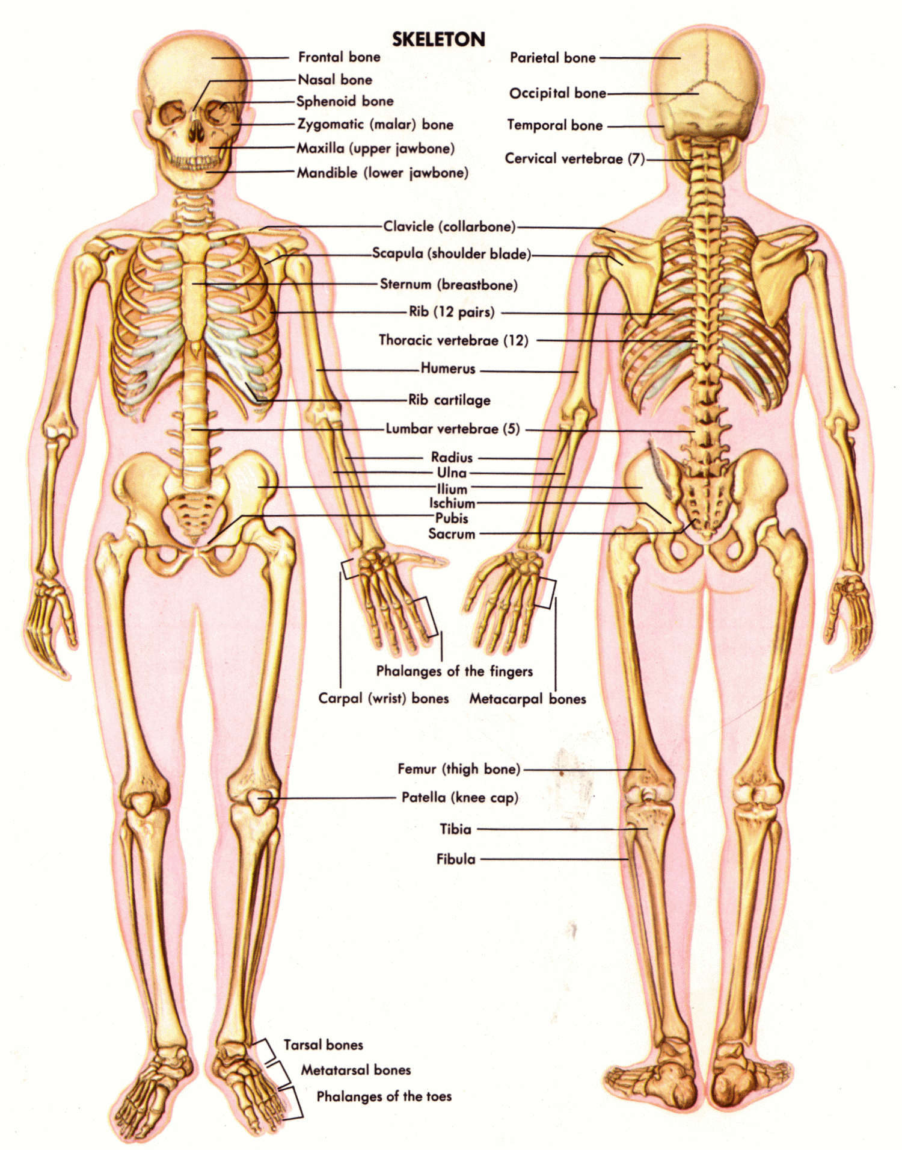
sinister face
through
the skeletal figures
of the people destined to die of starvation in a man-made plight.
Plight
sinister
destined
unavoidable
evil, harmful
Unfortunate situation

Slide 18
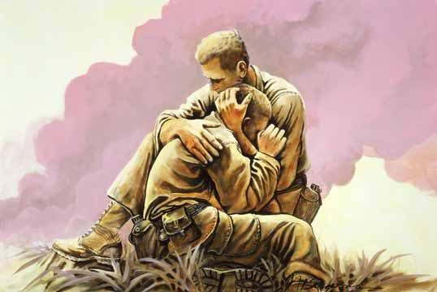
He depicted these extremely shocking pictures with human compasion.

Slide 19
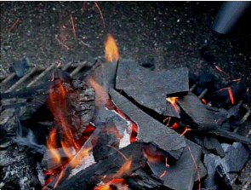
Charcoal = a black substance made by burning wood
Cheap ordinary packing paper
He made his own ink by burning charcoal and used cheap ordinary packing paper for sketching.
Notes:
Just click and advance according to animation.

Slide 20
iconic
symbolic
Using the ink and applying the brush where necessary, he produced the drawings and sketches which later became iconic images of human sufferings.

Slide 21
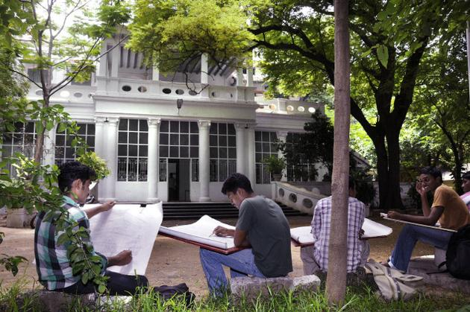
Government School of Art, Kolkata
Zainul developed a knack for drawing and painting when he was a high school student. After completing high school, he got admission to the Government School of Art, Calcutta (now Kolkata). He graduated with the first position in first class in 1938. He was appointed a teacher of the Art School while he was still a student there.

Slide 22
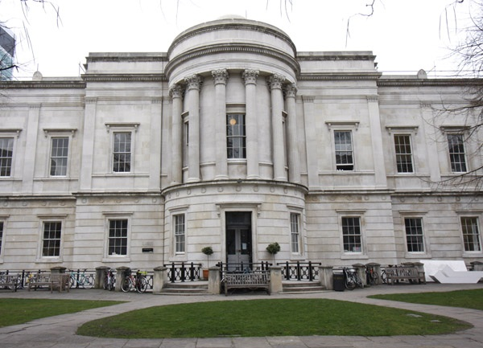
Slade School of arts, London
He also attended the Slade School of arts in London during 1951-52.
Notes:
He passed here for two years in London.

Slide 23
visionary
imaginative
Zainul Abedin is considered the founding father of Bangladeshi art. He was an artist of outstanding talent and earned international reputation. For his artistic and visionary qualities, he is referred to as Shilpacharya meaning ‘great teacher of art’ in Bangladesh.
artistic
creative

Slide 24
He was the first Principal of the first art school in Dhaka in East Pakistan (now Bangladesh).
Notes:
This was the first art school in Dhaka. But later its name was continued to Art Institute Dhaka.

Slide 25
scroll
a roll of paper for painting
He organized the Nabanna (harvest) exhibition in 1969. In the exhibition,
a 65-foot long scroll portraying the rural East Pakistan in phases from abundance to poverty.

Slide 26
Milestone
a very important stage in the development of something
This intensified the already heightened non-cooperation movement against the Pakistan regime. The exhibition was symbolic of the Bangalee artists’ protest and a milestone in our struggle for cultural and political freedom.

Slide 27
He designed the pages of the Constitution of the Bangladesh.

Slide 28
‡jvK wkí Rv`yNi
gallery
a building for the display of artworks
He founded the Folk Art Museum at Sonargoan, and also Zainul Abedin Shangrahasala, a gallery of his own works in Mymensing in 1975.

Slide 29
scenic
relating to natural scenery
Brahmaputra Nod
The river Brahmaputra plays a vital role in his paintings and a source of inspiration all through his career. Much of his childhood was spent near the scenic beauty of the river Brahmaputra.
Notes:
A series of beauty of this river influenced Zainul Abedin to become an artist in future.

Slide 30
A series of water colours that Zainul did as his tribute to the river earned him the Governor’s Gold Medal in an all-India exhibition in 1938. This was the first time when he came into spotlight and this award gave him the confidence to create his own visual style.
Zainul was born in Kishoreganj on 29 December 1914 and died on 28 May 1976.
visual
relating to sight used to illustrate something

Slide 31
Questions
1. Write in details how Zainul Abedin portrayed the sufferings of people.
2. What influence did the river Bramhmaputra have on Zainul Abedin? How did he show this influence in his works?
3. What did these work earn him later in his life?
4. How did his art help to intensify the noncooperation movement?
Elicit answers from -----
4. In his paintings, he showed how East Pakistan was becoming poorer and was deprived of cultural and political freedom during the Pakistani regime. Thus his art helped to intensify the noncooperation movement against the Pakistani regime.
1. Zainul Abedin made his own ink and used ordinary packing paper to draw the shocking pictures that depict the sinister face of the famine of 1943. Besides, he exhibited a 65 feet long scroll portrait in the ‘Nabanna’ exhibition in 1969 showing how the people of East Pakistan becoming poorer. He also painted ‘Monpura’ showing the death of people in the cyclone of 1970. Thus he portrayed the sufferings of people.
3. These works earned him the Governor’s Gold Medal in an all-India exhibition in 1938 which brought him into spotlight for the first time.
2. Zainul Abedin was inspired by the beauty of the river and was a source of inspiration all through his career.
He used water colours to paint the beauty of the river that was the tribute to the river paid by him.

Slide 32
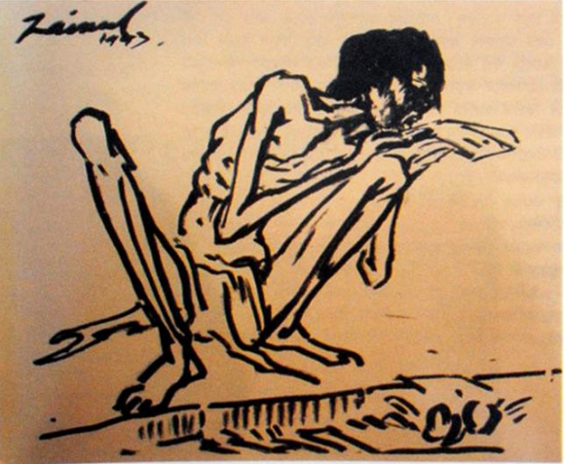
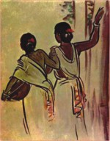
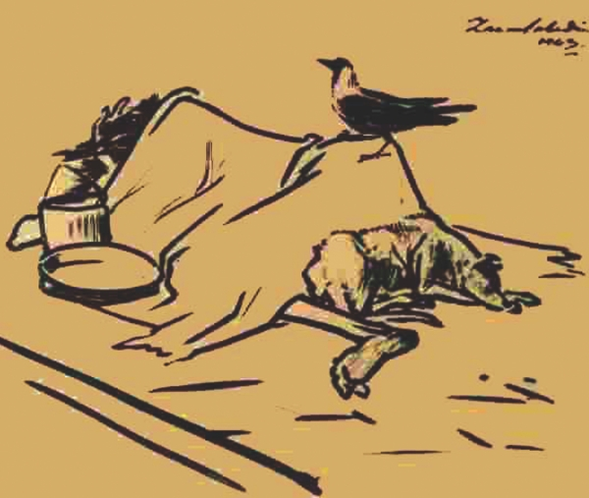
B Look at the series of pictures. Work in groups and talk about them. Now briefly write about what each picture portrays.
Picture 1
Picture 2
Picture 3
Notes:
Teacher may conduct this option giving the learners group works. Just the group will write two or three sentences about the pictures.

Slide 33
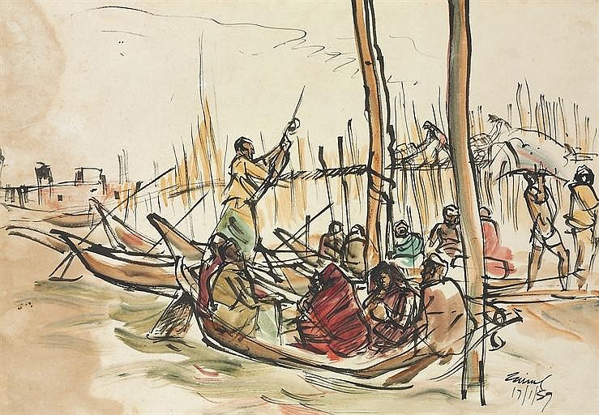
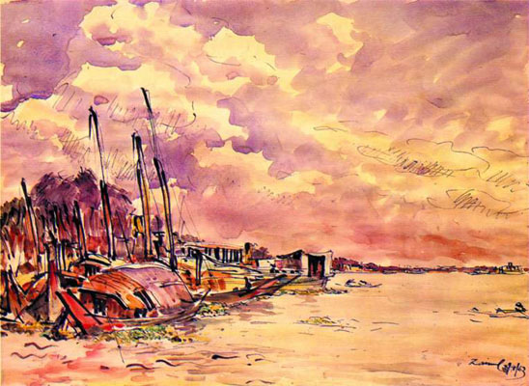
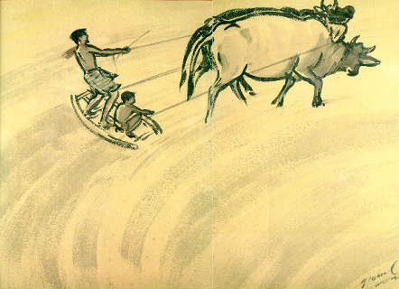
Picture 4
Picture 5
Picture 6
Picture 7
Notes:
Same as above.

Slide 34
Elicit answers from the groups -----
Group-F: Picture 6 depicts two men and two cows. It is a scene of ploughing land.
Group-B: Picture 2 portrays two women who are going to work.
Group-A: a skeletal human figure sitting beside a road. The person is suffering from starvation.
Group-D: --is about the rainy season. Some people are sitting on the boats and some are plying the boats.
Group-C: The third picture is very much shocking. Here a cow is sitting on a dead body. The person might die from hunger. A dog is lying beside.
Group-G: We can see that two cows are pulling a cart and a muscular man is pushing the cart and this picture symbolizes hardship of rural people.
Group-E: Picture 5 portrays a village beside a river. We can also see the sky is covered with clouds.

Slide 35
C Listen to the CD/ teacher and tick the word/s you hear.
1. The US Ambassador to Bangladesh considers Zainul Abedin a
a great painter. b popular painter.
c master painter. d unique painter.
2. Zainul’s art gallery was set up in ---------------.
a 1972. b 1973.
c 1974. d 1975.
3. The number of Zainul’s artwork preserved in the gallery is ------
a 53. b 62.
c 65. d 75.
Notes:
This is a CD related function. Whenever we will get the CD, we will provide this section then. Teacher may conduct it himself also.

Slide 36
4 The US Ambassador commented that the museum is a global
a wealth. b asset.
c gift. d treasure.
5 The US ambassador visited the gallery for
a 3 hours. b 2 hours.
c 1 hour. d ½ hour.
Notes:
Same as above.

Slide 37
Evaluation
D. Answer the questions.
1 Where is Zainul’s art gallery situated?
2 When did the Ambassador visit the gallery?
3 Who else were there with the Ambassador during his visit?
4 Which artworks of Zainul did the Ambassador specially mention?
5 How did ambassador feel after visiting the gallery?
1. ------ at Saheb Quarter Park of Mymensingh town.
2. ----- on Tuesday.
3. ----- the Deputy Commissioner of Mymensingh, the Police Superintendent and the Deputy Keeper of the art gallery ----------
4. ------- famine series.
5. ------- the ambassador said that he was honoured that his colleagues and he had the opportunity to experience the art of Zainul Abedin in his hometown.

Slide 38
Home work
Fill in each gap with a suitable word of your own based on the information from the text.
Zainul Abedin is the (a) _______ of Bangladeshi art. He was born on 29 December 1914 in Kishoreganj. Graduating with credit, he (b) _______ as a teacher for many years. He was an artist of (c) __________ talent and he showed it in his different sketches which were (d) ________ both nationally and internationally. He is also famous for (e) __________ the pages of constitution of Bangladesh and founding the Folk Art Museum.
pioneer
served
outstanding
acclaimed
designing

Slide 39
Thank you all.
Notes:
Last greeting.

