Slide 1
Now we’ll watch a video

Slide 2
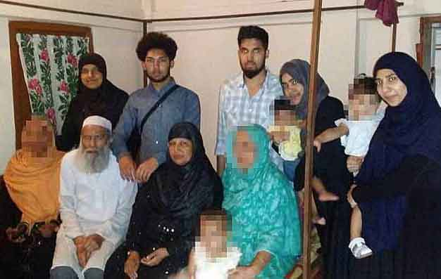

Slide 3
shamsunnoor

Slide 4
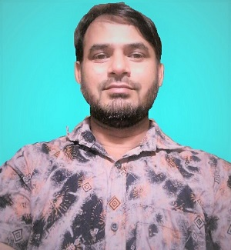
IDENTITY OF TEACHER
MD. SHAMSUNNOOR
HEAD TEACHER
MURERGAON GOVERNMENT PRIMARY SCHOOL
COMPANIGANJ, SYLHET.
Email- murergaongps@gmail.com
Contact- 01712-307039

Slide 5
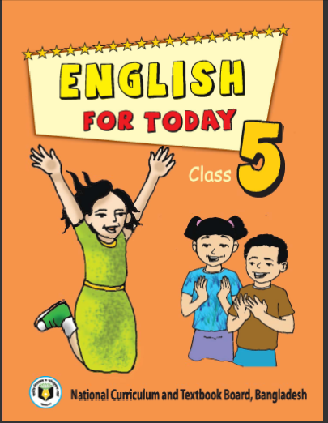
Identity of lesson
Class : Five
Subject : English
Unit : 3
Lesson : 1-2

Slide 6
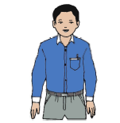
Look at the picture
Saikat’s father
Saikat’ mother
Saikat

Slide 7
Todays lesson is
Saikat’s family
Saikat Islam lives………and neighbours.

Slide 8
Learning Outcomes
By the end of the lesson the students will be able---
3.2 to undersstand questions about family and friends
1.1 to say words,phrases and sentences with proper
sounds stress and intonation.
1.7 to read paragraph and other texts.
8 to make sentences using words and phrases, following
instructions.

Slide 9
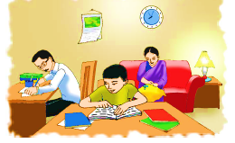
Look at the picture
Think about it and discuss with your partners.

Slide 10
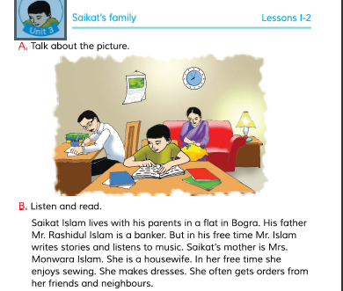
Open your book and read the text

Slide 11
New words identifying & meaning (Bengali):
Banker
ব্যাংক কর্মকর্তা
Flat
বাসা, বাড়ি
প্রতিবেশী
Neighbours
অবসর সময়
Free time
শোনা
Listen
Sewing
সেলাই করা

Slide 12
Similar words meaning in English :
Flat
Plane
Banker
Plane
Listen
Hear
Flat
leisure time
Free time
Financier
Sewing
Embroider
Neighbours
Near by Resident
Listen
Hear
Free time
leisure time
Simliar Words meaning in English :
Banker
Financier
Sewing
Embroider
Neighbours
Near by Resident

Slide 13
Answer the questions
Answer the questions
Some questions :
1. Who is Saikat ?
Answer-1 : Saikat is a student.
3. What does Saikat’s mother do ?
1. Who is Saikat ?
2. What is Saikat’s father ?
1. Who is Saikat ?
2. What is Saikat’s father ?
2. What is Saikat’s father ?
Answer-1 : Saikat is a student.
Answer-3 : Saikat’s mother is a housewife.
Answer-2 : Saikat’s father is a banker.
Answer-2 : Saikat’s father is a banker.
3. What does Saikat’s mother do ?
3. What does Saikat’s mother do ?
Answer-3 : Saikat’s mother is a housewife.

Slide 14
Pair work
Read the text in pairs

Slide 15
True or False
Write True or False
Saikat is a student of class 5.
True
b. Saikat’s father is a teacler.
False
Saikat is a student of class 5.
Saikat’s father is a teacher.
In her free time Mr Islam writes poem.
Saikat’s mother is a banker.
Saikat lives in Bogra.
c. In her free time Mr Islam writes poem.
False
Saikat is a student of class 5.
True
b. Saikat’s father is a teacler.
False
e. Saikat lives in Bogra.
True
False
d. Saikat’s mother is a banker.
c. In her free time Mr Islam writes poem.
d. Saikat’s mother is a banker.
False
False
e. Saikat lives in Bogra.
True

Slide 16
Evaluation
Write 5 sentences about Saikat’s family.

Slide 17
Homework
Write 5 sentences about your family.

Slide 19
End

