Slide 1
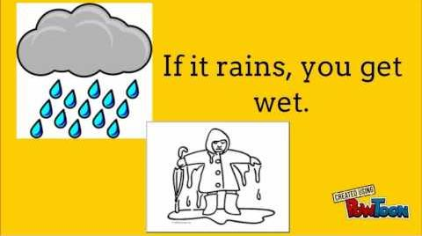
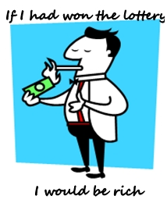
Technological knowledge
Welcome to my class
Pedagogical knowledge
Content knowledge
Md. Abdur Razzaak, Head Teacher, Dhalhara Westpara Secondary Girls’ School, Sadar, Magura. Contact: 01721588402

Slide 2
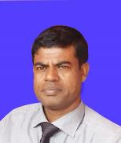
Technological knowledge
CONDITIONALS
Introduction
MD. ABDUR RAZZAK
Head Teacher
Dhalahara westpara Secondary Girls’ School
E-mail: abdurrazzakmt@gmail.com
Phone number: 01721588402
Pedagogical knowledge
Content knowledge
Class: 9 & 10
U-11
Time: 50 min
Md. Abdur Razzaak, Head Teacher, Dhalhara Westpara Secondary Girls’ School, Sadar, Magura. Contact: 01721588402

Slide 3
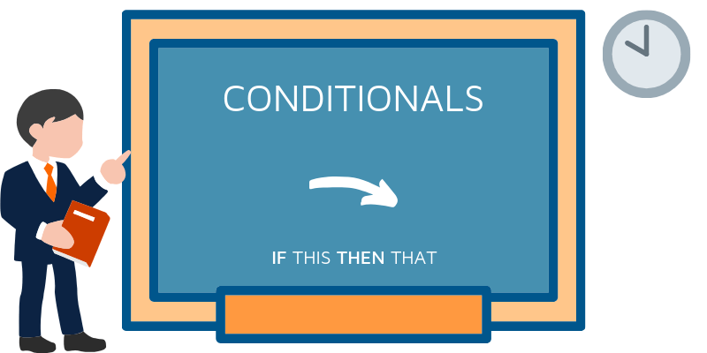
Technological knowledge
Now, could you guess what type of sentences you enjoy from the video clip?
Let’s enjoy a video clip
CONDITIONAL
SENTENCES
Now, do you think learning conditional sentences is important?
Pedagogical knowledge
Content knowledge
If so, let’s do some work on it.
Md. Abdur Razzaak, Head Teacher, Dhalhara Westpara Secondary Girls’ School, Sadar, Magura. Contact: 01721588402

Slide 4
Learning outcomes
After the end of the lesson the learners will be able to---
1.
Conditional sentence.
2.
Explain different kinds of conditional sentence.
3.
use conditional sentence in their real life.

Slide 5
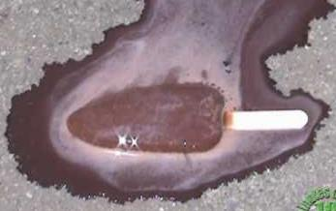
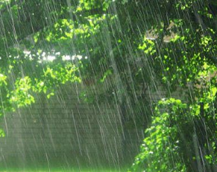
Technological knowledge
Observe, think and say
If the sentence is….
Heat the ice bar.
It melts.
There is a condition between the two sentences.
If you heat the ice bar, it melts.
It’s a conditional sentence.
Similarly
Pedagogical knowledge
Content knowledge
The sky is cloudy.
And if the sentence is….
If the sky is cloudy, it may rain.
It may rain.
There is a condition between the two sentences.
Now it’s a conditional sentence.
Md. Abdur Razzaak, Head Teacher, Dhalhara Westpara Secondary Girls’ School, Sadar, Magura. Contact: 01721588402

Slide 6
Technological knowledge
I’ll not go,
if it rains.
Main/independent clause
if/conditional/
depended clause
Grammar point: A conditional sentence is a type of sentence that states a condition and sentences are made up of a dependent clause and an independent clause. A condition is something that can only happen if something else occurs and it almost always begins with “if.”
Pedagogical knowledge
Content knowledge
Md. Abdur Razzaak, Head Teacher, Dhalhara Westpara Secondary Girls’ School, Sadar, Magura. Contact: 01721588402

Slide 7
Technological knowledge
Third
condition
Zero
condition
Kinds of conditional sentences
Pedagogical knowledge
Content knowledge
Second
condition
First
condition
Md. Abdur Razzaak, Head Teacher, Dhalhara Westpara Secondary Girls’ School, Sadar, Magura. Contact: 01721588402

Slide 8
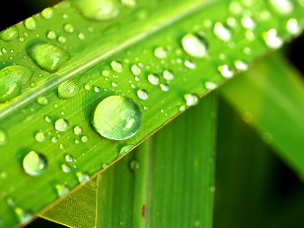
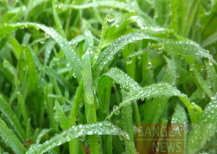
Technological knowledge
Zero conditional
Observe, think and say
If due falls, the grass wets.
present
present
Similarly
Pedagogical knowledge
Content knowledge
If I miss the bus, I am late for work
If people don’t eat, they get hungry.
Grammar point: If thee IF clause comes first, there must be a comma (,) after IF clause.
Md. Abdur Razzaak, Head Teacher, Dhalhara Westpara Secondary Girls’ School, Sadar, Magura. Contact: 01721588402

Slide 9
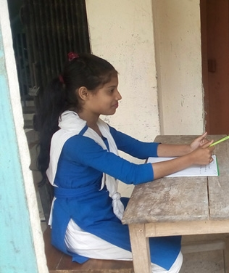
Technological knowledge
Individual Work 2 min.
click left side writing to check
A conditional sentence is a type of sentence that states a condition.
Pedagogical knowledge
What is conditional sentence?
Content knowledge
What is zero conditional?
condition with present form
Kinds of “conditionals” ?
4
Md. Abdur Razzaak, Head Teacher, Dhalhara Westpara Secondary Girls’ School, Sadar, Magura. Contact: 01721588402

Slide 10
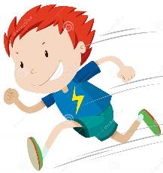
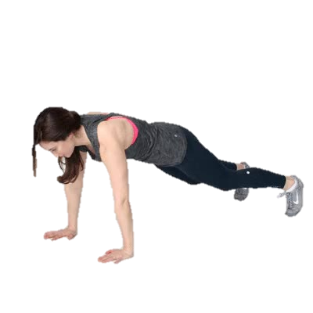
Technological knowledge
First conditional
If you run fast, you will get the prize.
present
future
Similarly
Pedagogical knowledge
Content knowledge
If you take exercise, you will be healthy.
If you run in the sun, you will be sick.
If anybody rises early, he/she will get enough time to work.
Structure: IF +present + future
Md. Abdur Razzaak, Head Teacher, Dhalhara Westpara Secondary Girls’ School, Sadar, Magura. Contact: 01721588402

Slide 11
Technological knowledge
Second conditional
If you ran fast, you would get the prize.
past
would
base form of verb
Similarly
Pedagogical knowledge
Content knowledge
If you took exercise, you would be healthy.
If you ran in the sun, you would be sick.
If anybody rose early, he/she would get enough time to work.
Structure: IF +past + would + base form of verb
Md. Abdur Razzaak, Head Teacher, Dhalhara Westpara Secondary Girls’ School, Sadar, Magura. Contact: 01721588402

Slide 12
Technological knowledge
Pair Work 3 min.
click left side writing to check
If + present + future
Pedagogical knowledge
What is first conditional?
Content knowledge
If +past + would + base form of verb
What is second conditional?
If it rains, I (go) out.---- ?
Won’t/do not go
If she runs fast, she (win) the race. --?
Will win
Had he a millionaire, he (help) the poor. --?
Would have helped
Md. Abdur Razzaak, Head Teacher, Dhalhara Westpara Secondary Girls’ School, Sadar, Magura. Contact: 01721588402

Slide 13
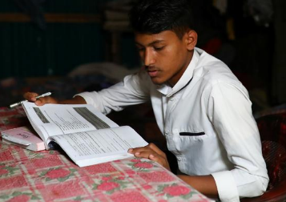
Technological knowledge
Third conditional
If he had studied well, you would have passed.
past perfect
would have
base form of verb
Similarly
Pedagogical knowledge
Content knowledge
If you had taken exercise, you would have been healthy.
Structure: IF +past perfect+ would have + past participle form of verb
If anybody had taken exercise, he/she would have been healthy.
Md. Abdur Razzaak, Head Teacher, Dhalhara Westpara Secondary Girls’ School, Sadar, Magura. Contact: 01721588402

Slide 14
Group work 10 min
Complete the following sentence in conditional form.
a. If you go out, I ------------TV.
b. If you heat ice, it -------.
c. Had he won the lottery, he------happy.
d. If he ------harder, he would pass.
e. ----you----the radio, you can hear the news.
f. If I had heard the news. I------go there.
g. If she missed the train, --------late.
Md. Abdur Razzak, Head teacher, Dhalhara Poshcimpara Secondary Girls’ School, Sadar, Magura, phone number: 01721588402

Slide 15
Technological knowledge
Evaluation
Tick ($√$) the correct passive form of verb from alternatives.
1. If you heat ice, it …. Which one of below is correct?
(b) melts
(a) melt
$√100$%
$$×$$
Pedagogical knowledge
(d) melting
(c) melted
$$×$$
Content knowledge
$$×$$
2. If he invites me, I (go). Which one of below is correct?
(a) go
(b) went
$$×$$
$$×$$
(c) will go
(d) gone
$√$100%
$$×$$
Md. Abdur Razzaak, Head Teacher, Dhalhara Westpara Secondary Girls’ School, Sadar, Magura. Contact: 01721588402

Slide 16
Technological knowledge
3. If I were a rich, I (help) him. Which one of below is correct?
(a) help
(b) would help
$$×$$
$√100$%
(c) helped
(d) helping
$$×$$
$$×$$
4. Had I been a rich, I (help) him. Which one of below is correct?
(a) help
(b) Would help
$$×$$
$$×$$
Pedagogical knowledge
Content knowledge
(c) would have helped
(d) helped
$√$100%
$$×$$
5. You may go if you (like). Which one of below is correct?
$$×$$
(a) likrd
(b) likes
$$×$$
(c) like
(d) would like
$√$100%
$$×$$
Md. Abdur Razzaak, Head Teacher, Dhalhara Westpara Secondary Girls’ School, Sadar, Magura. Contact: 01721588402

Slide 17
Technological knowledge
Home work
Pedagogical knowledge
Content knowledge
Write ten conditional sentences .
Md. Abdur Razzaak, Head Teacher, Dhalhara Westpara Secondary Girls’ School, Sadar, Magura. Contact: 01721588402

Slide 18
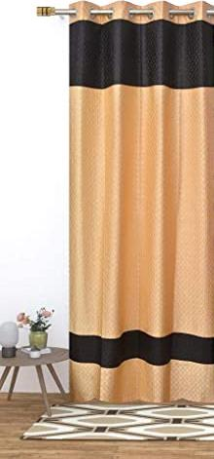
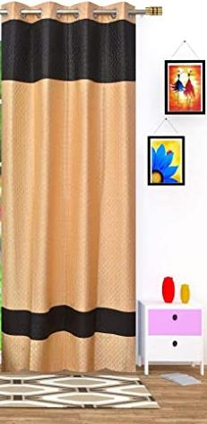
Technological knowledge
See you next class
Pedagogical knowledge
Content knowledge
Md. Abdur Razzaak, Head Teacher, Dhalhara Westpara Secondary Girls’ School, Sadar, Magura. Contact: 01721588402

