Slide 1
Good Morning

Slide 2
GREETINGS
Good morning, students
Teacher
Good morning, teacher
Student’s
Teacher
How are you today ?
Fine
Student’s

Slide 3
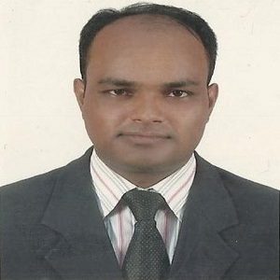
Teacher’s Identity
Lesson Identity
MD. ABDUL KADER
Assistant Teacher
Borni Govt. Primary School,
Companigonj, Sylhet.
Subject : English for Today
Class : Two
Topic : Shapes Unit:19
Lesson:1-3 (A) Page:38
Class Duration:50 minutes.

Slide 4
Ok, my dear students lets enjoy a video.

Slide 5
Ok, dear students our today’s lesson is
Shapes

Slide 6
Learning outcomes
Student will able to:
Listening
1.1. become familiar with English sounds by listening to common English Words.
1.1.1 become familiar with English sounds by listening to common English words.
Speaking
1.1.1 repeat after the teacher and say simple words and phrases with proper sounds and stress.
Reading
1.4. read words, phrases with the help of visual clues (about 30 new words) and simple sentences.

Slide 7
One Day One Word
Shape- আকৃতি

Slide 8
Square
These objects has four sides

Slide 9
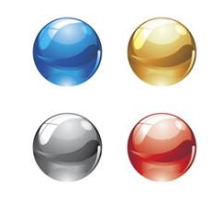
circle
These objects are round

Slide 10
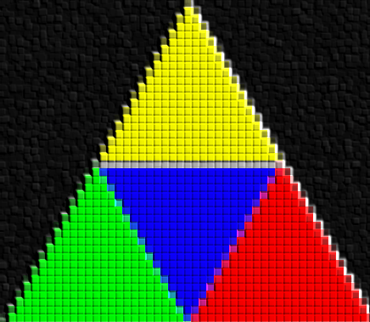
Triangle
These objects has three sides.

Slide 11
Rectangle
These objects has also four sides
But two are long and two are short

Slide 12
Look listen and say
1
2
3
4

Slide 13
Pair work
Look and say
square
circle
triangle
rectangle

Slide 14
wcw work
Match the words with the pictures
triangle
circle
rectangle
square

