Slide 1
Welcome to my online class

Slide 2
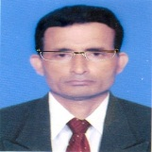
Identity
Manik Chandra Majumder
Senior Teacher
Gazirhat High School
Senbag, Noakhali.
Mobile No: 01717155169
gmail: manikmajumder01@gmail.com
Class : Nine-Ten
Subject : English 1st paper

Slide 3
Look at the pictures. What objects do you see in the pictures? How are they related?

Slide 4
Look at the pictures and think about our lesson .
Internet
Computer
Book
Online class

Slide 5
So, dear our today’s topic is-----
E-learning
Unit - 13
Lesson - 3
Page -171

Slide 6
Learning outcomes
After the end of the lesson, students will be able to—
a) read intensively and extensively,
b) tell the meaning of some new words,
c) complete sentences by filling gaps,
d) write the answer of questions.

Slide 7
Look at the pictures and make a difference between two pictures.
Traditional Classroom
E-classroom

Slide 8
Answer the questions. Your answer may be ‘Yes’ or ‘No’.
Have you ever experienced any digital education programmes in multimedia or CD/DVD?
Have you ever used any digitized educational resources such as Oxford Dictionary, Banglapedia or Wikipedia?
Have you ever heard of any online education course?
Have you ever seen a classroom teaching programme on TV?

Slide 9
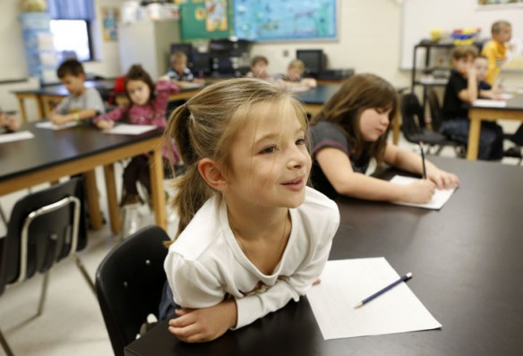
Word meaning and sentence making
Word: Thrilled
Meaning : excited, delighted, pleasurable
Sentence : The students are thrilled to hear the class without a printed book or a writing pad or even pen/ pencil.

Slide 10
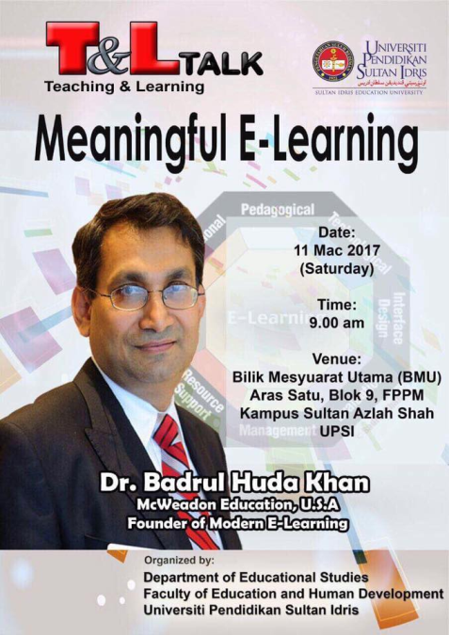
Meaning: a person who knows a lot about a particular subject
Word : Pundit
Sentence: Dr. Badrul Huda Khan is a pundit of e-learning.

Slide 11
Meaning: made to appear to exist by the use of computer software
Word : Virtual
Sentence : In a virtual campus everything takes place electrically through computer and internet technology.

Slide 12
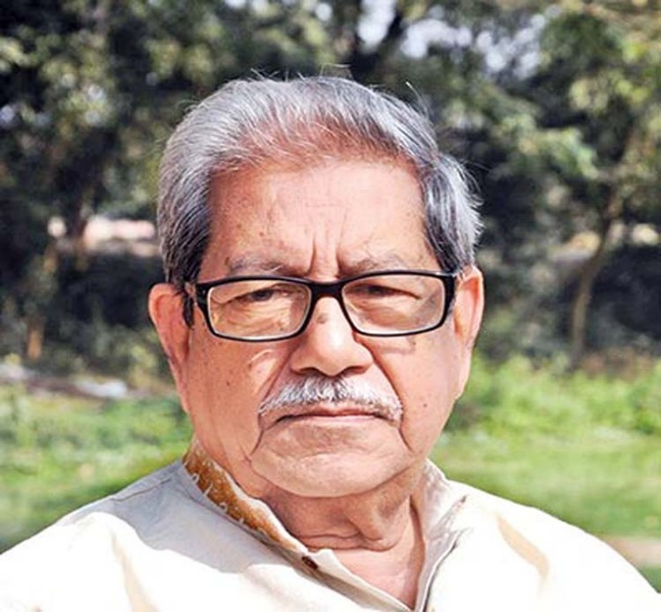
Meaning : One who versed in the methods of education
Word : Educationist
Sentence : Dr. Anisuzzaman was a great educationist of our country.

Slide 13
Meaning : Change data into digital form
Word : Digitalize
Sentence : The recording institute digitized the songs and made
them available on the Internet.

Slide 14
Read the text and answer the following questions.
Can you think of a classroom where there is no blackboard or desks? Do you believe that you can be a student without a traditional book or writing pad or even pen/pencil? Are you not thrilled to imagine that you have asked a question and your tutor is answering it while flying in a Boeing from Dubai to Dhaka?

Slide 15
These are all possible in a ‘virtual campus’ in the system of e-learning. No kidding! For quite a long time, educationists have been utilizing the advantages of computer technology. The social networking services have a huge potential to help educationists in this sector. They have access to millions of people worldwide.

Slide 16
Educationists have noticed that a large number of social network users come from young generation who especially belong to student community. So side by side with computer assisted teaching-learning software, online education programmes are evolving fairly rapidly to assist conventional education system. But is that e-learning?

Slide 17
We may confuse distant education or computer-based learning or computer-assisted training or even online education programmes with e-learning. But we should be cautious about the mix-up. Maybe you get some materials online from your tutor. Maybe you submit your assignment through e-mail. Or even you may take your test online. But there must be some conventional campus, a department/institute from where your certificate will come.

Slide 18
But in e-learning, as said by global e-learning guru every step such as, registration, admission, classroom entry and exit, class work, attendance, discussion with course mates, feedback, exams and finally certification must take place electronically through computer and the Internet technology in a virtual campus.

Slide 19
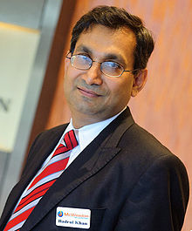
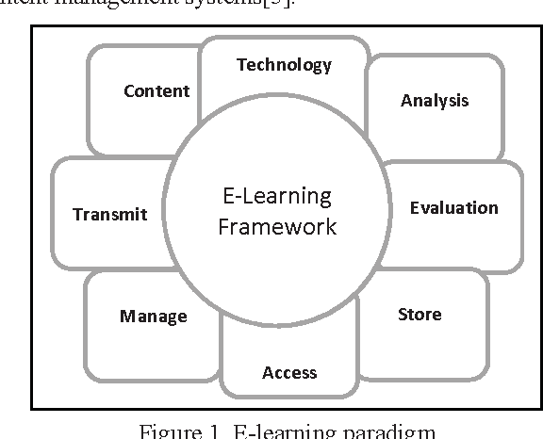
The revolutionary concept of e-learning is already in its practice phase in many parts of the world. Professor Khan has developed a framework and important literatures on e-learning which have been praised by pundits worldwide including Bangladesh. Professor Khan is especially enthusiastic about the prospect of e-learning in Bangladesh. How would you feel if Bangladesh contemplates South Asia’s first virtual university? Won’t it be a pioneering step for us in the world of e-learning? Let’s keep our fingers crossed

Slide 20
*Born and graduated in Bangladesh, Dr. Badrul H Khan was a professor at the George Washington University and the University of Texas, USA. He is one of the celebrated theorists in the field of e-learning.
Dr. Badrul H Khan

Slide 21
Complete the following sentences with suitable words.
1. Education experts-------------- utilizing the advantages of computer technology---------a long time.
2. In e-learning, everything from admission to certification must ----------electronically through computer and the Internet technology in a virtual campus.
3. In some online courses, you------------- your test online.
4. In case of online programmes, there----------- some conventional campus from where-----------------------------------.
5. In c-learning, all activities’------------------- by a system called Learning Management System (LMS).

Slide 22
Match your answer.
1. Education experts-------------- utilizing the advantages of computer technology---------a long time.
2. In e-learning, everything from admission to certification must ----------electronically through computer and the Internet technology in a virtual campus.
3. In some online courses, you------------- your test online.
4. In case of online programmes, there----------- some conventional campus from where-----------------------------------.
5. In c-learning, all activities’------------------- by a system called Learning Management System (LMS).
have been
for
be done
may take
must be
your certificate will come
are conducted

Slide 23
Evaluation
Why are online education programmes evolving rapidly ?
How can educationists help world people utilizing the advantages of computer technology?
Why doesn’t a student need traditional materials in e-learning ?
How does online education help a student ?

Slide 24
Home work
E. Suppose Badrul Huda Khan has come to visit your school and intended to meet students for a presentation on e-learning. Write a text message to invite your friend to attend that presentation.

