Slide 1
WELCOME TO ONLINE CLASS

Slide 2
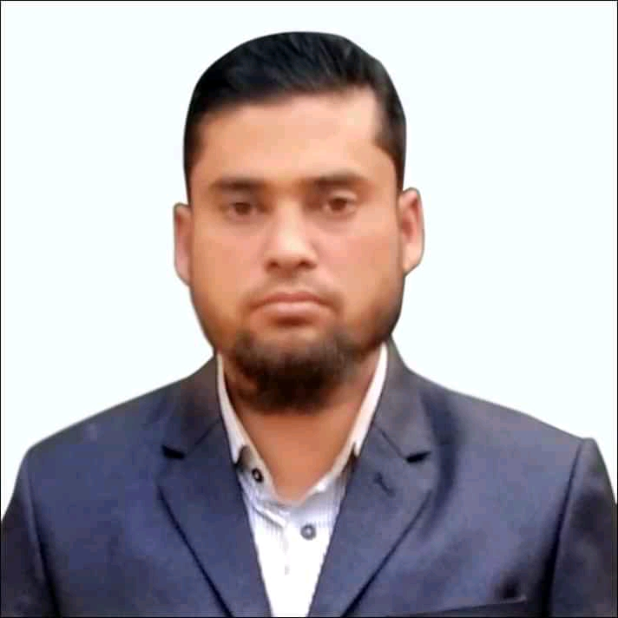
Identity
MD.ALAUDDIN
AssistantTeacher
Pagla Govt.Model High School and College.
South Sunamganj,Sunamganj

Slide 3
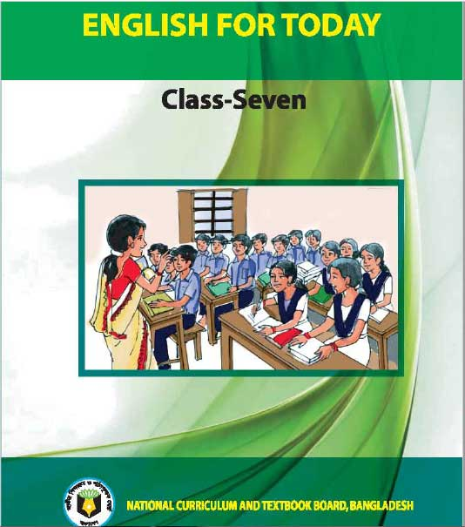
Class: Seven
Subject: English 1st Part
Unit: Five
Lesson: 1
Page No-45
Begum Rokeya

Slide 4
Learning outcomes-----------------
By the end of the lesson,The students will be able----
1.To explain about Begum Rokeya,s social activities.
2.To Tick the right answers
3.Complete a chart about Begum Rokeya

Slide 5
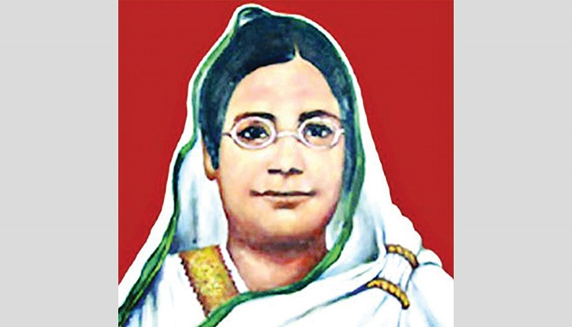
A.Look at the picture and ask and answer these questions.
Who is the woman?
2. What do you know about her?

Slide 6
VOCABULARY
Famous- বিখ্যাত-------------------Renowed
Social worker-সমাজ কর্মী-----------A man who works for society
Undivided- অবিভক্ত----------------not divided
Century- শতাব্দী-----------------a period of 100 years
Believed- বিশ্বাস করতেন-- ------------trsuted
Opprtunities-সুযোগ-সুবিধা--------good chance
Landlord-জমিদার---------------landowner
Cooperative-সহযোগিতা------------helping
Encourage-উৎসাহ দেওয়া ---------support।
Activity-কার্যাবলী---------------------doings

Slide 7
B.Read about Begum Rokeya.
Begum Rokeya(1880-1932) was a famous writer and a social worker . She lived in undivided Bengal in the early 20th century. She believed that women should have the same rights and opportunities as men have in the society. So she fought for their cause throughout her life.
Begum Rokeya was born in a village called Pairabondh, Rangpur in 1880. Her father Jahiruddin Muhammad Abu Ali Haider saber was an educated landlord. Rokeya was married to Khan Bahadur Sakhawat Hussian in 1896. Her husband was the Deputy Magistrate of Bhagalpur, now a district in the Indian state of Bihar. He was very cooperative , and always encouraged Rokeya to go on with her activities.
Many upper class Muslims of Bengal at that time learnt Arabic and Persian as medium of education and communication. But Rokeya had great love for her mother tongue. She learnt Bangla and English from her eldest brother Ibrahim.

Slide 8
C.Tick the correct answer.
1.Begum Rokeya fought for
a) democracy.
b)independence.
c)women’s right.
2.Rokeya was born in
a)a village.
b)a town.
c)a slum.
3.Rokeya loved
a)English.
b)Bangla.
c)Urdu.

Slide 9
4.Shakhawat Hossain’s working place was
a)Pairabandh.
b)Bhagalpur.
c)Rangpur.
5.Bhagalpur is a district in
a)Bangladesh.
b)West Bengal.
c)Bihar.

Slide 10
D.Complete the following chart with information from the text.
Begum Rokeya
occupation | born in | married in | family | language
Writer and social worker
Bangla
English
1880
1896
Landlord

Slide 11
E.Answer these questions
What was Begum Rokeya’s belief ?
Ans-Begum Rokeya”s belief was that women should have the same rights and opportunities as men in the society.
2.What did she fight for?
Ans-She fought for the cause of women.
3.What kind of family did she come form ?
Ans-She came an educated landloard Muslim family
4.Why did many upper class Muslims learn Arabic and Persian at that time ?
Ans-Many upper class Muslims learn Arabic and Persian at that time as medium of education and communication.

Slide 12
Thank You

