Slide 1
WELCOME

Slide 2
IDENTITY
Class-Two
Subject- English
Lesson 1-2
Unite-26
Time: 45 minutes
Ribon Rani Dash Assistant teacher
Bharapurni Gps
Lakhai,Hobigonj

Slide 3
Let’s watch a video

Slide 4
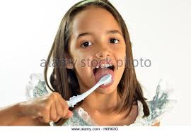
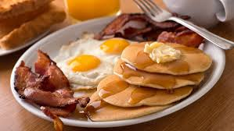
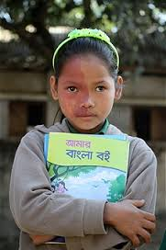
See the following pictures and try to say what is our today’s lesson?

Slide 5
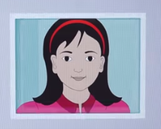
Today’s our lesson is
Kaniz’s life

Slide 6
Learning outcomes
students will be able---
Reading skill: 1.1.2 read simple words with proper sounds and stress.
Writing skill: 3.1.1 ask and answer questions about themselves.

Slide 7
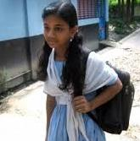
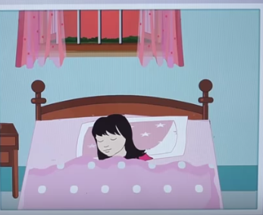
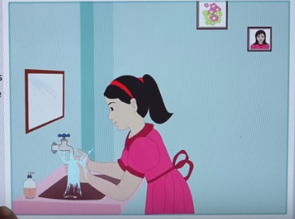
In the morning, she washes her face.
This is Kaniz.

Slide 8
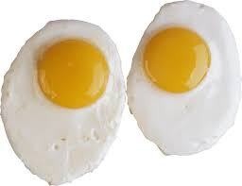
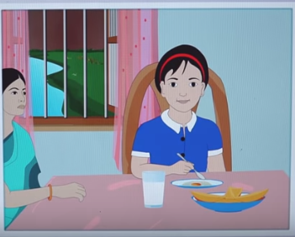
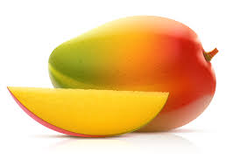
She has eggs and mangoes.
Then, she has breakfast.

Slide 9
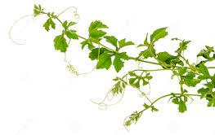
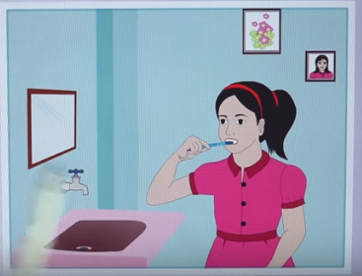
Then, she brushes her teeth.

Slide 10
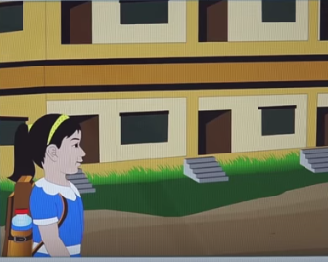
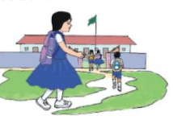
She goes to school.

Slide 11
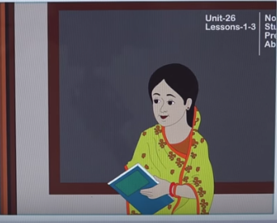
Miss Mariam is her teacher.

Slide 12
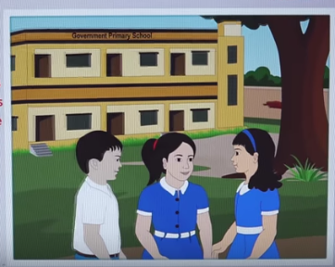
Sujon and Joya are her friends.

Slide 13
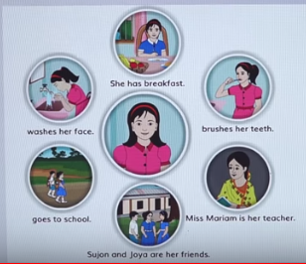
Kaniz’s life

Slide 14
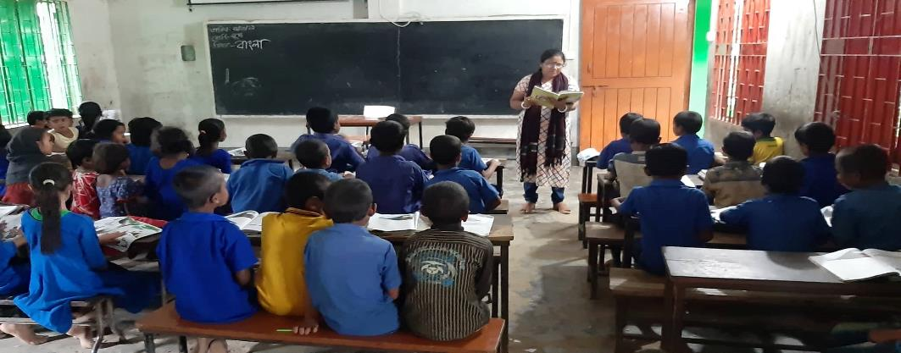
Teacher’s loud reading

Slide 15
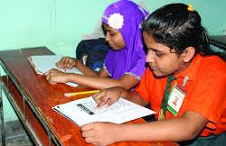
Pair work
Read the following words with proper sounds and stress:
Washes
Breakfast
Face
Morning
Brushes

Slide 16
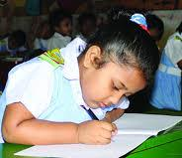
Individual work
Choose the new words in this lesson:
Breakfast
Washes
Morning
Brushes
Face
Teeth

Slide 17
Group work
Answer the following question.
1. Who is the girl?
2. What dose she have for breakfast?
Group -A
Group - B
1. Who is her teacher?
2. Who are her friends?

Slide 18
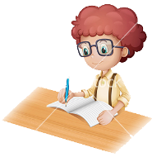
Evaluation
Choose the correct answer:
1. Who washes her face in the morning?
(d) Mariom
(b) Sujo
(c) Joya
(a) Kaniz
2. Kaniz teachers name is -
(a) Masum
(b) Toma
(c) Joya
(d) Mariom
3. Who is Kaniz friend?
(d) Mila
(b) Roma
(c) Jeva
(a) Sujon

Slide 19
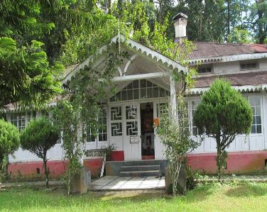
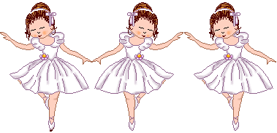
Home work
Write three sentence about your self.

Slide 20
One day one word
Teacher
শিক্ষক

Slide 21
GOOD BYE

