Slide 1


Good Morning

Slide 2
GREETINGS
Good morning, students
Teacher
Good morning, teacher
Student’s
Teacher
How are you today ?
Fine
Student’s

Slide 3
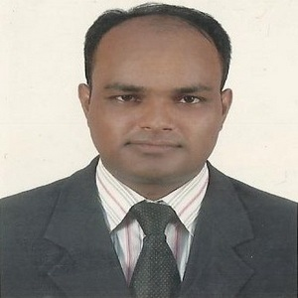

Teacher’s Identity
Lesson Identity
Subject: English. Class: Five. Unit:06, Lesson: 1
(Eat Healthy)
MD. ABDUL KADER
Assistant Teacher
Borni Govt. Primary School,
Companigonj, Sylhet.

Slide 4
Let’s enjoy a video

Slide 5
Ok, students our today’s lesson is
Eat Healthy

Slide 6
Learning outcomes
By the end of the lesson the students will be able to-
Listening:
3.3 understand questions about objects around them.
3.4 understand statements made by the teacher and students
Speaking:
1.1. say words, phrases and sentences with proper sounds, stress
and intonation.
6.2 talk about people, objects, events, etc.
Reading:
1.5.1 read words, phrases and sentences in the text with proper pronounciation, stress and intonation.
Writing:
8.1 make sentences using words and phrases, following instructions.

Slide 7
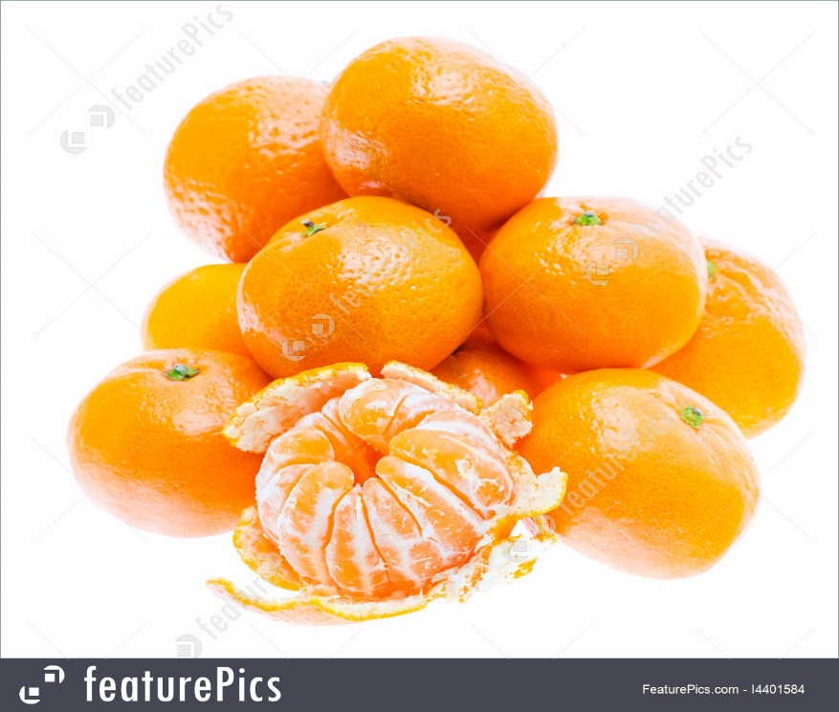
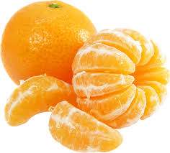
What is the name of this fruit?
Dear students, Lets see some pictures…..
It’s an Orange
Notes:
Rule: 1. Teacher will show the word chart 2. Students will chose three words and write down 3. Teacher will say any three words randomly one after one. 4. Students will cross the name if it matches with the teacher 5. The students who cross all of the three will shout “BINGO’ and will be the winner.

Slide 8
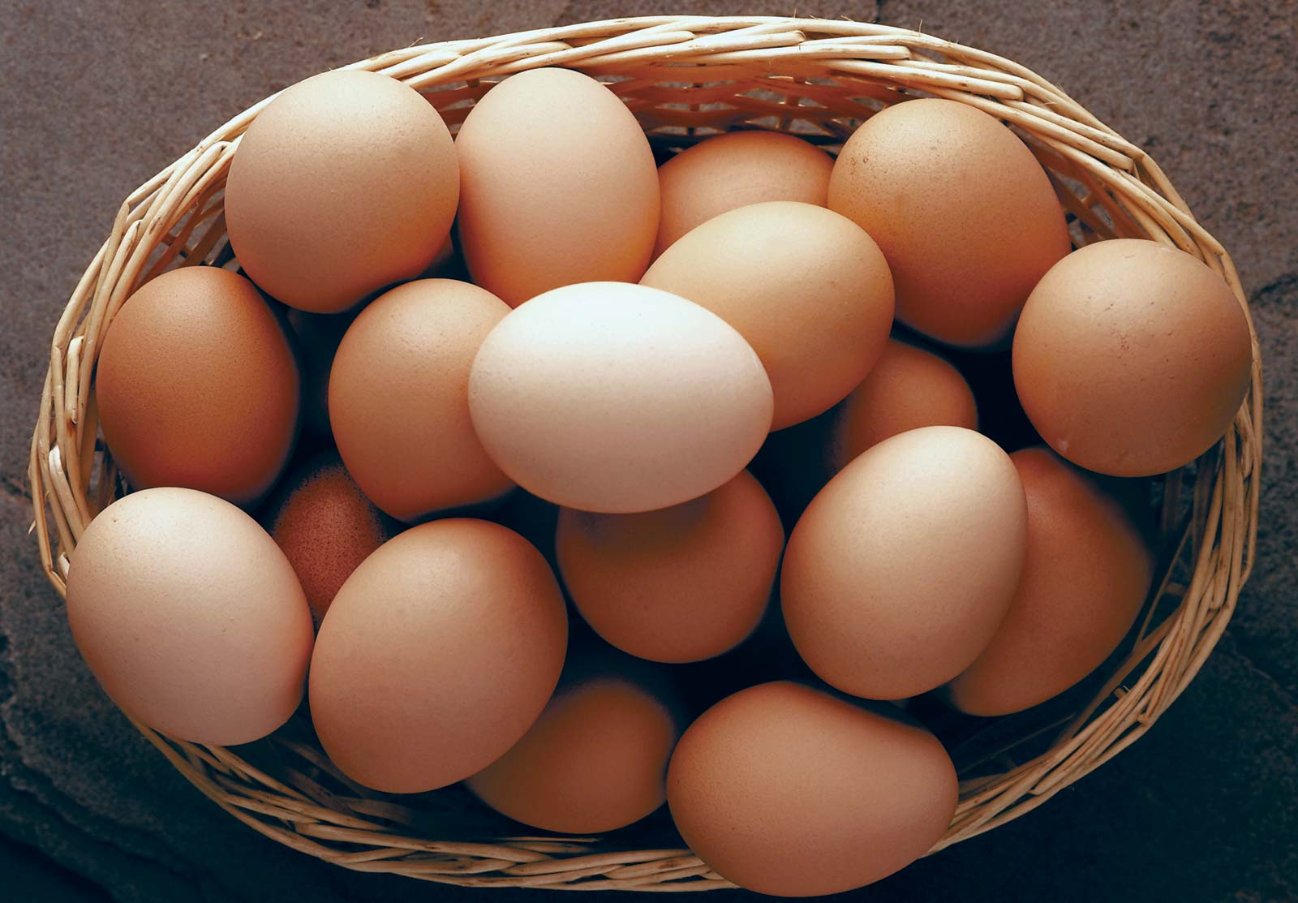
What are these?
These are eggs

Slide 9
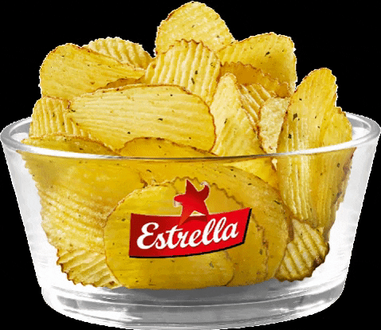
What can wee see in this pictures?
We can see chips.

Slide 10
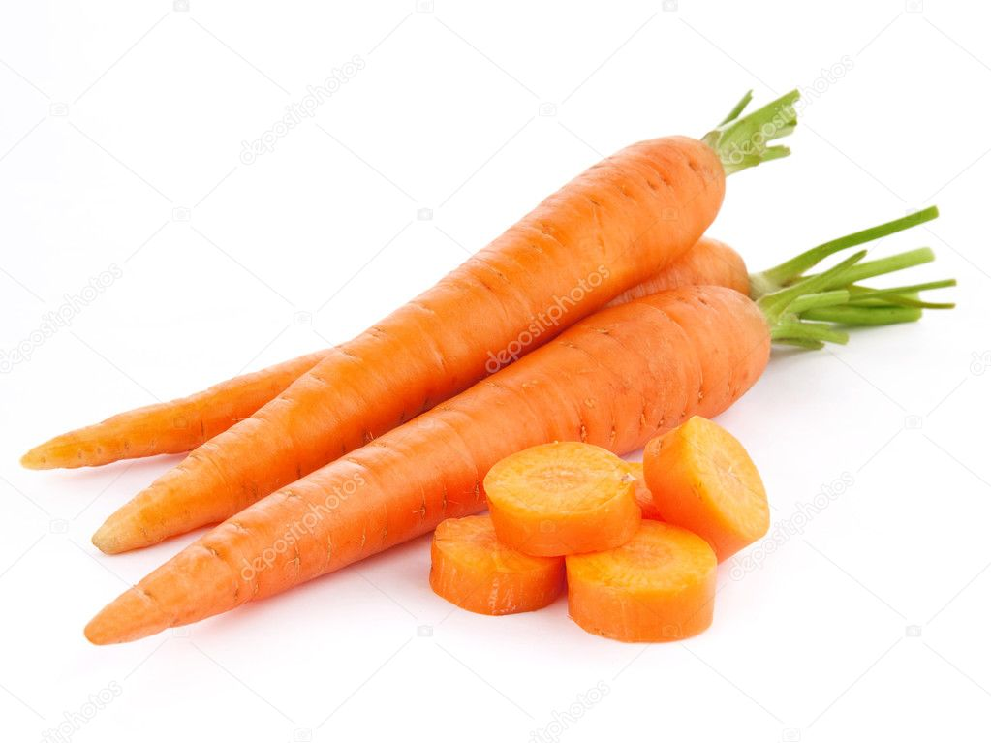
Tell me the name?
It’s carrots

Slide 11
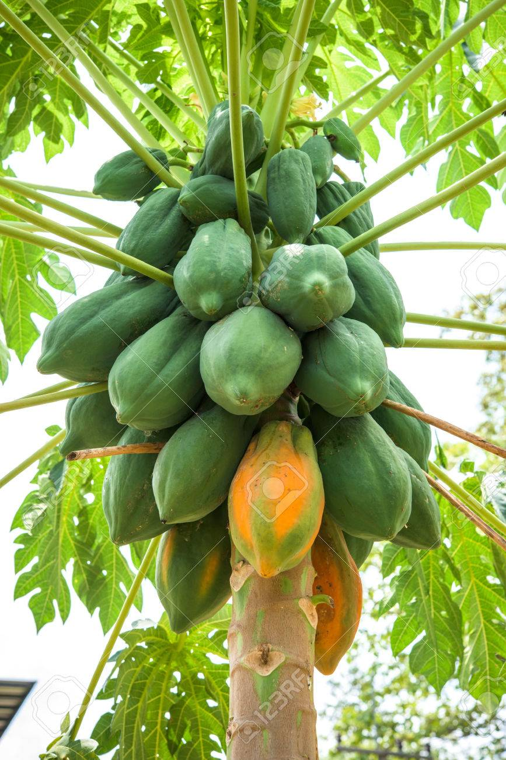
These are papaya and everyone eat this fruit.

Slide 12
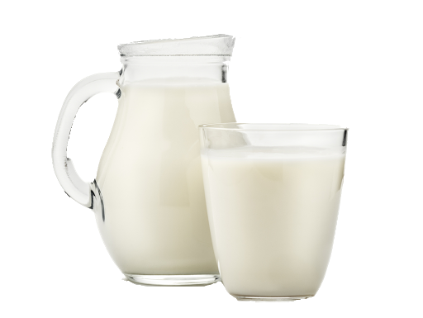
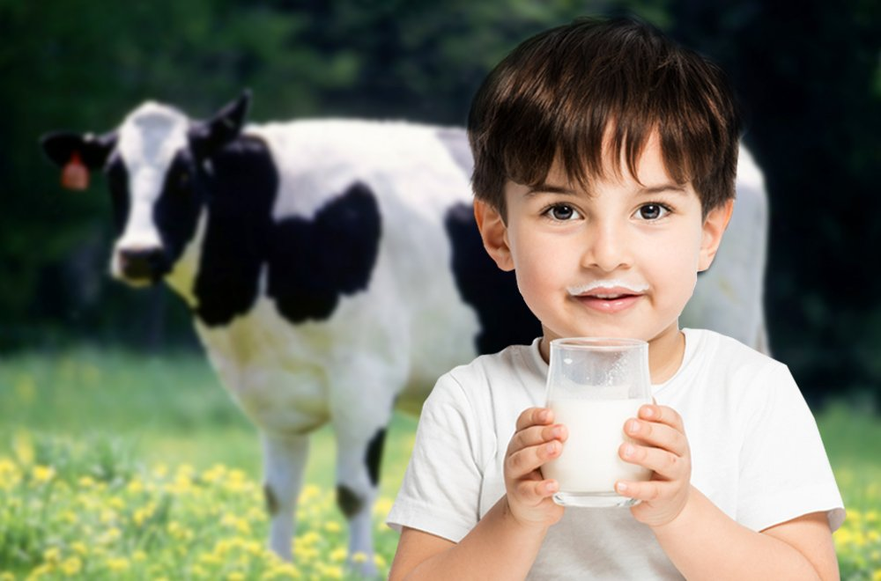
What is there in the glass?
milk

Slide 13
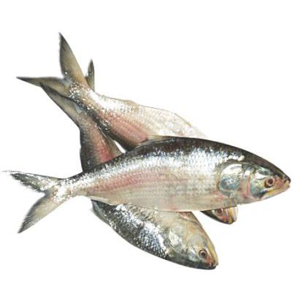
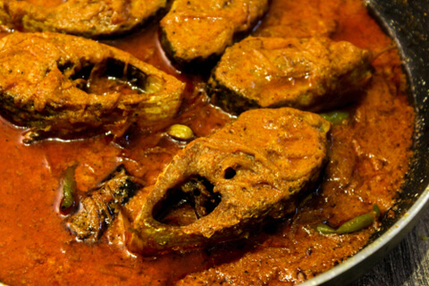
fish

Slide 14
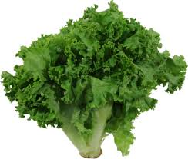
lettuce

Slide 15
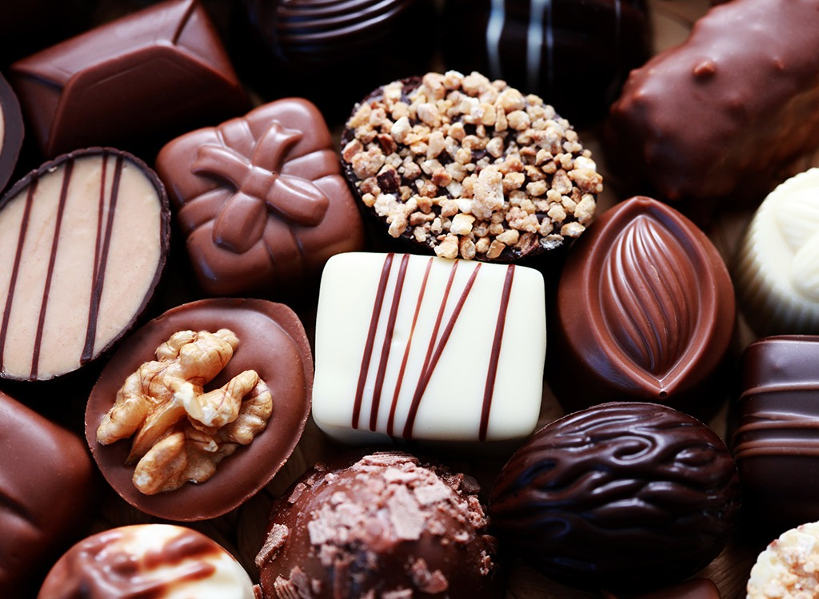
This is chocolate.

Slide 16
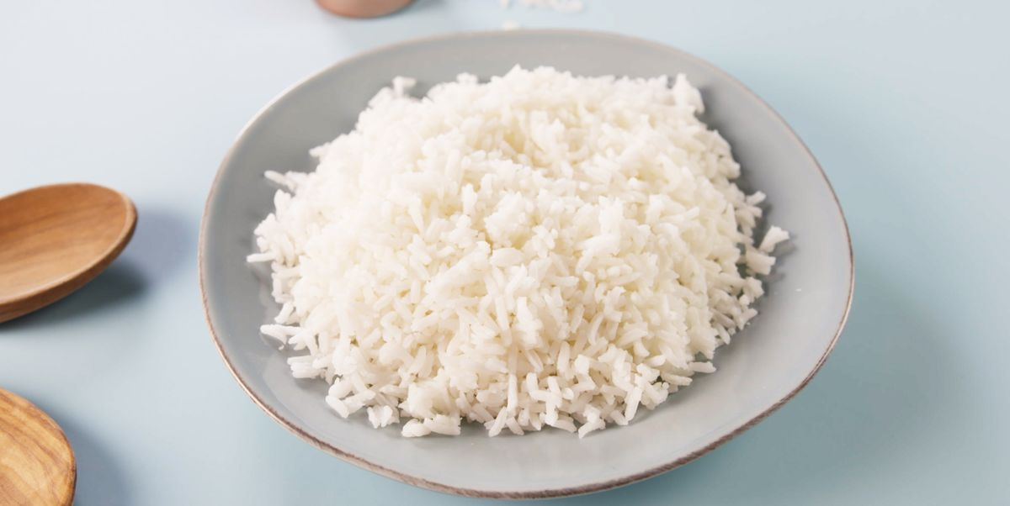
These are rice.

Slide 17
Open page no 22, listen and say with teacher.

Slide 18
A. Look, listen and say
Let’s do the activity
Say the name
of
the next pictures ?
carrots
Oranges
chips
ice-cream
milk
egg

Slide 19
Underline the foods you like and Circle the foods you think are healthy….

Slide 20
Let’s talk about food such as talking A & B.
          A: Do you like Ice-cream ?
          B: Yes, I like ice-cream. You?
          A: I like .too
          B: Do you like fish.
          A: Yes, I’m.

