Slide 1
WELCOME

Slide 2
INTRODUCTION
CLASS: SIX
SUBJECT: ENGLISH FIRST PAPER
LESSON: 25
TOPIC: WE LIVE IN A GLOBAL VILLAGE.
Mollika Khatun
Assistant teacher in English
Daffodil Residential Model School
Chirirbandar, Dinajpur.

Slide 3
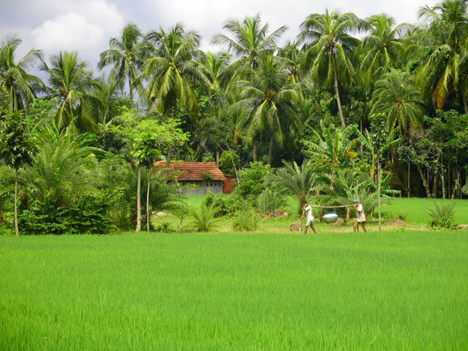
What is this?

Slide 4
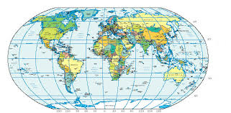
Yes, this is a picture of village in Bangladesh.
What you see?

Slide 5
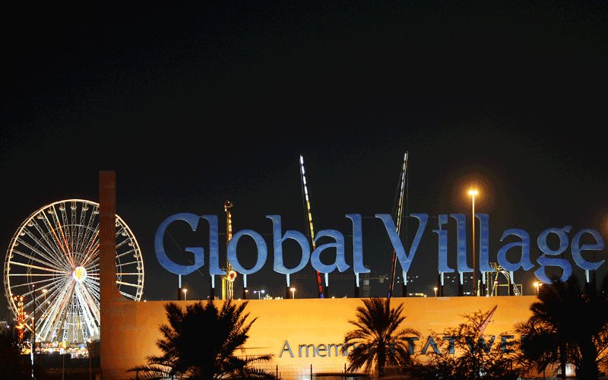
Thanks all. This is Map of World. So our Topic is ----

Slide 6
Learning Outcomes
By the end of the lesson Students will be able to---
Read and understand the text
Follow instructions, command, requests and act accordingly.

Slide 7
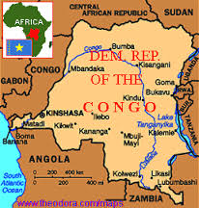
Do you know what is this?

Slide 8
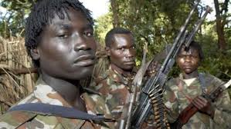
Yes, Its a Map and this is the map of Central African county Congo. There is violence among the political . Sohan uncle Zul live there.

Slide 9
Sohan’s uncle Zul met an interesting young man named Gurmit Shing.

Slide 10
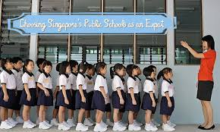
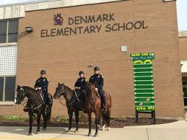
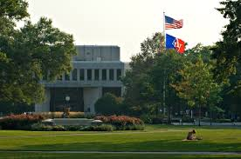
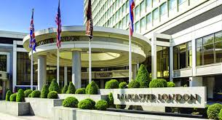
Gurmit Shing was born in India.
Gurmit Took education at Singapore, Denmark, US and UK..

Slide 11
Do you know what is this?

Slide 12
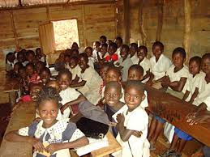
Yes, This is the symbol of voluntary Organization and Gurmit was a volunteer . He look after children's education in a community school.

Slide 13
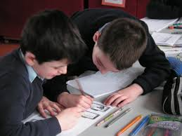
Pair Work
Discuss about Voluntary Organization
Discuss about community School.

Slide 14
Answer the following Questions
Where is Congo?
Why Mr. Gurmit Shing is a ‘Global Citizen’?
What do you mean by global village?

Slide 15
Read and Understand the texts and write a short note.

Slide 16
THANK YOU ALL

