Slide 1
WELCOME TO ALL

Slide 2
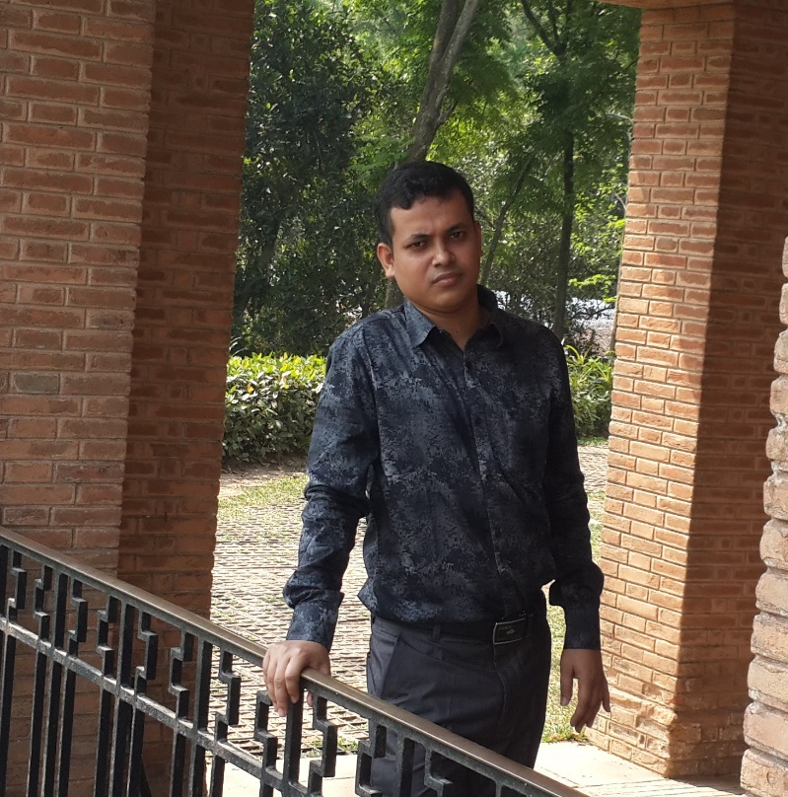
Teacher Introduction
Md. Azgar Ali
Assistant teacher
Lalbag Govt.Primary School.
Mobile 01842722027
azgarali31187@gmail.com
Cumilla Sadar Dakshin,Cumilla

Slide 3
CLASS: FIVE
SUBJECT:ENGLISH
Unit:14
Lesson -1
LESSON NAME:THE HARE AND THE TORTOISE

Slide 4
LEARNING OUTCOMES
LISTENING:4.2.1.Understanding and enjoy simple story.
SPEAKING: 1.1.1. Say words ,phrases and sentences with proper sounds and stress.
Reading: 5.1.2. Read silently with understanding story.

Slide 5
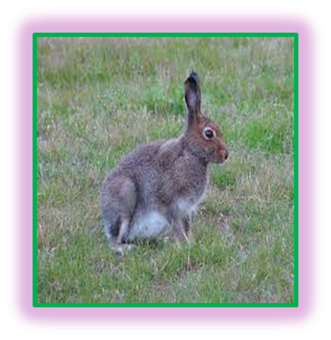
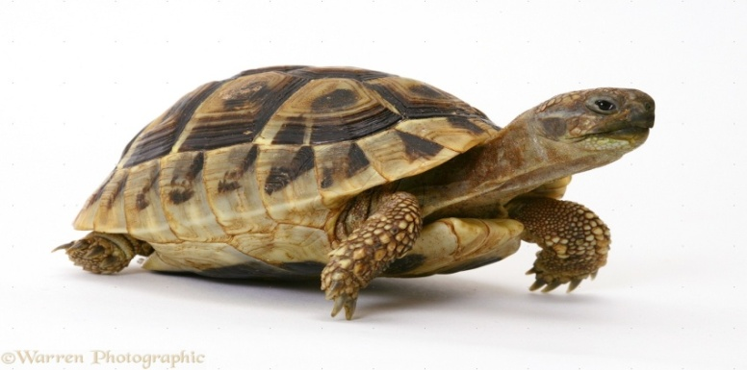
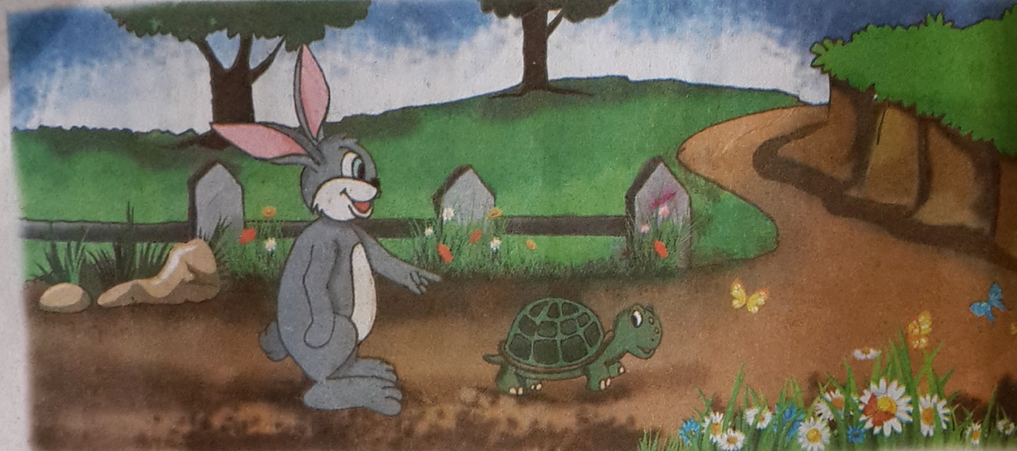
LESSON DECLARATION
Students enjoy the story
“THE HARE AND THE TORTOISE”

Slide 6
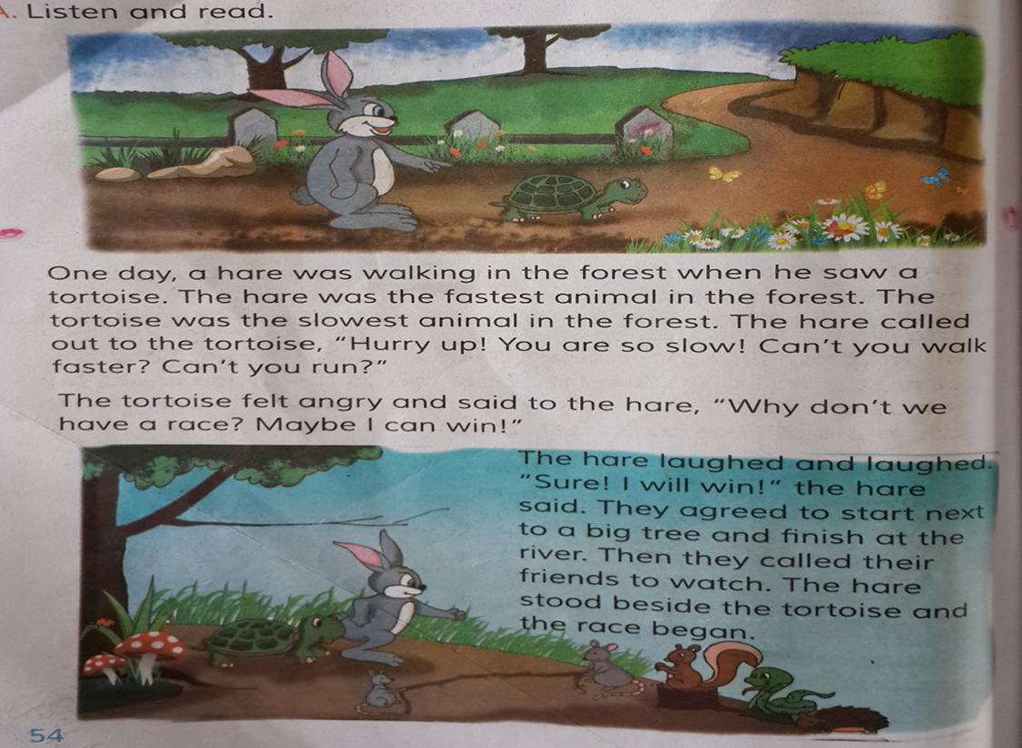
Open your book at page 54-55

Slide 7
LISTEN TO THE STORY ATTENTIVLY

Slide 9
New word
Forest …..বন/জঙ্গল
Fastest……দ্রুতগামী
Slowest…….ধীরগতি
Angry………রাগী/উত্তেজিত
Race………প্রতিযোগিতা
Laugh……..হাসা
Beside……. নিকটে বা পাশে
Quickly……তাড়াতাড়ি
Behind…….পিছনে
Nap……একটু ঘুমাইয়া লওয়া
Steadily…….অঠলভাবে
Believe…. বিশ্বাস করা
Won….. জয়ী হওয়া
Fuorios.......অগ্নিশর্মা

Slide 10
Task
1.Where was the hare walking?
2.Who went to sleep?
3.Where did the hare live?
4.Where did they stat their race?
5. Who won the race?

Slide 11
Answer
1.Where was the hare walking?
Answer: The hare was walking in the forest.
2.Who went to sleep?
Answer: The hare went to sleep.
3.Where did the hare live?
Answer: The hare live in the forest.
4.Where did they stat their race?
They started their race next to a big tree.
5. Who won the race?
Answer: The tortoise won the race.

Slide 12
Home work
Write a short composition about the story of the hare and the tortoise

