Slide 2
Introduction of the Lesson
Unit: 2
Lesson: 7
Page no: 09

Slide 4
New words of this Lesson
Fan -পাখা Van-ঠেলা গাড়ি
Vine-ছড়া Grape- আঙ্গুর
Like-পছন্দ করা From-হতে

Slide 5
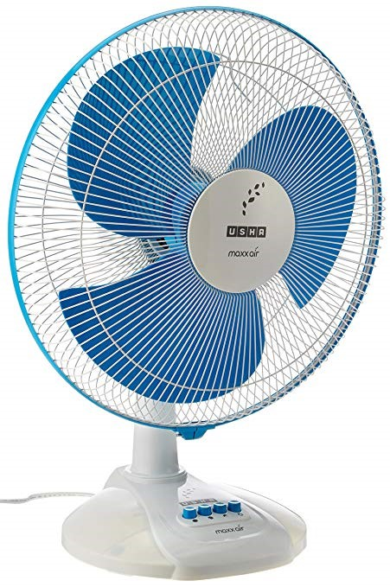
Fan

Slide 6
Van

Slide 7
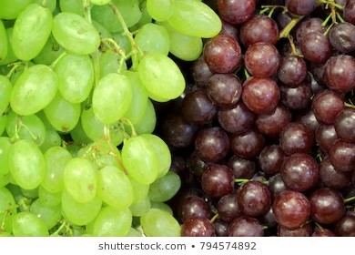
Graps

Slide 8
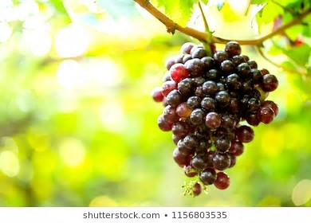
Vine

Slide 9
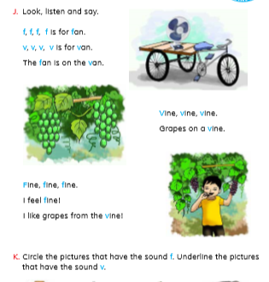

Slide 10
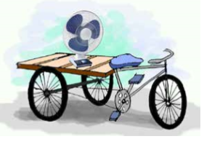
The fan is on the van.

Slide 11
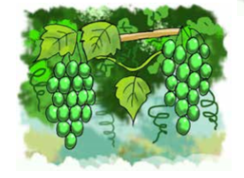
Grapes on a vine.

Slide 12
I like grapes from the vine!

Slide 14
Thanks

