Slide 1
GOOD MORNING

Slide 2
Introducing of teacher
Shaikh Md. Rahamat Ali,
Assistant teacher ,
66no. Khamkata G.P.S.,
Facilitator in English & TFD of
English in Action, Kiamuddin
cluster, Pirojpur sadar, Pirojpur.

Slide 3
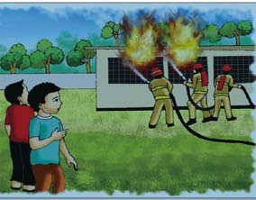
Class: FIVE
Subject: English
Unit: 9 (Occupations)
Lesson:1-2
Page no. 34

Slide 4
Learning Outcomes
1.3.1. Recognize which words in a sentence are stressed.
3.3.1. Understand questions about objects around them.
3.4.1. Understand statements made by the teacher and students.
1.1.1. Say words , phrases and sentence with proper sounds and stress.
1.1.2. Say sentence with proper intonation.
1.5.1. Read words , phrases and sentences in the text with proper pronunciation, stress and intonation.
1.6.1. Recognize and read statements commands , greetings , questions and answers.

Slide 5
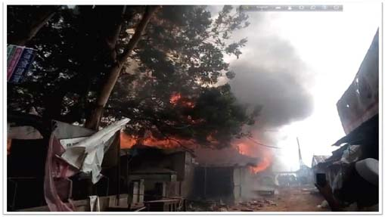
Let’s watch a video,
https://www.youtube.com/watch?v=rOjBkuD7DLs

Slide 6
Look at these pictures and think about them
A woman who takes care of sick people.
Nurse
Farmer
A person who grows crops.
A person who teaches students.
Teacher
A person who puts out fire.
Firefighter

Slide 7
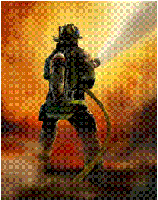
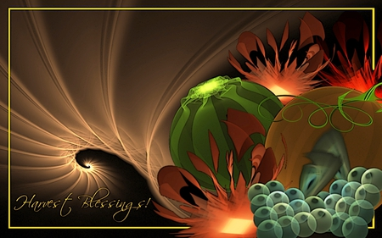
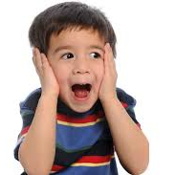
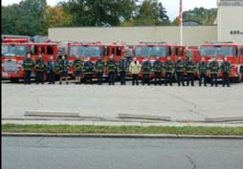
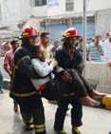
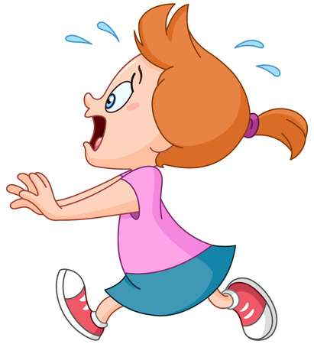
New words
Help
Fire fighter
Afraid
Volunteer
Safe and quit
Panicked

Slide 8
Similar word
Afraid – Frightened, scared, Fearful.
Safe – Out of danger, protected, Assured, Free from danger
Panic – Fear, Alarm, Be anxious.
Quiet – Calm, Cool, Peaceful.
Volunteer – Unpaid worker.
Help – Assistance, Support, Shelter.
Firefighter – Who put out fire.
Department – Division, Section.
Full-time – Work in full time.

Slide 9
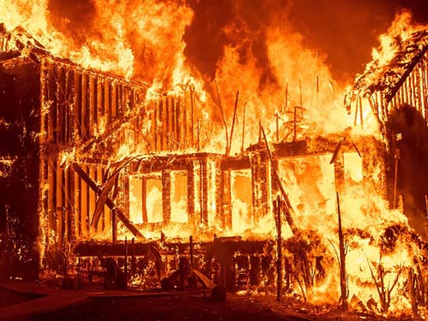
Today’s lesson
OCCUPATION

Slide 10
A long time ago, when Raju was in class 5, there was a fire in school. Everyone was very afraid but no one panicked.
Raju watched the firefighter from the school yard. He thought about the fire and the firefighters for a long time.
The teachers help the students to leave the building safely and quietly. Soon the firefighter came and put out the fire.

Slide 11
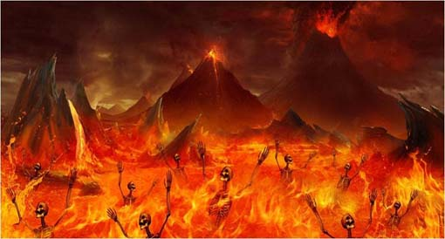
After college, Raju joined a volunteer fire department. As a volunteer he didn’t get any money for his work. But Raju didn’t mind.
Now Raju is a full-time firefighter. It is his job, so he earns money for it. Most of the time his work is putting out fires, but he also teaches new fighters about safety. He likes teaching very much.
In his free time, Raju visits school. He talks to students about fire safety. He tells them what to do. If there is a fire. They shouldn’t panic. They should listen to their teachers and leave the building quietly.

Slide 12
Teacher’s loud reading

Slide 13
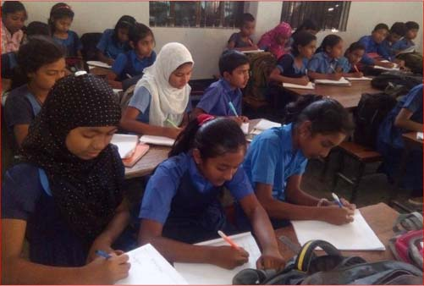
Student’s silent reading

Slide 14
Group work
Write T for true or F for false.
1. There were a fire at Raju’s school when he was in class 5.
F
T
2. The teachers left the students in the building during the fire.
T
F
3. Raju didn’t see the firefighters put out the fire at his school.
F
T
4. Raju always earns money for being a firefighter.
F
T
5. Raju also likes teaching.
T
F
6. Talking to student is part of Raju’s job.
F
T

Slide 15
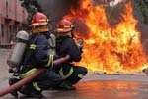
Sometimes We add –er or –or to a verb to make noun
Farm + er = Farmer
Teach + er = Teacher
Fight + er = Fighter
Drive + er = Driver
Sell + er = Seller
Fruitseller
Edit + or = Editor
Make + er = Maker
Dressmaker
Act + or = Actor
Sing + er = Singer

Slide 16
group Work: Group A [a.b.]; Group B [c,d];
Group d[e,f]
Give the Answer of The following Questions
a) What does a teacher do?
b) What does a driver do?
c) What does a editor do?
d) What does a singer do?
e) What does a farmer do?
f) What does a firefighter do?

Slide 17
Individual work
Match the words in column A with their meaning in B
Column A
Column B
a) Afraid
i. who puts out fire
b) Safe
ii. calm
c) Panic
iii. frightened
iv. division
d) Quiet
v. be anxious
e) Firefighter
vi. unpaid worker
vii. free from danger

Slide 18
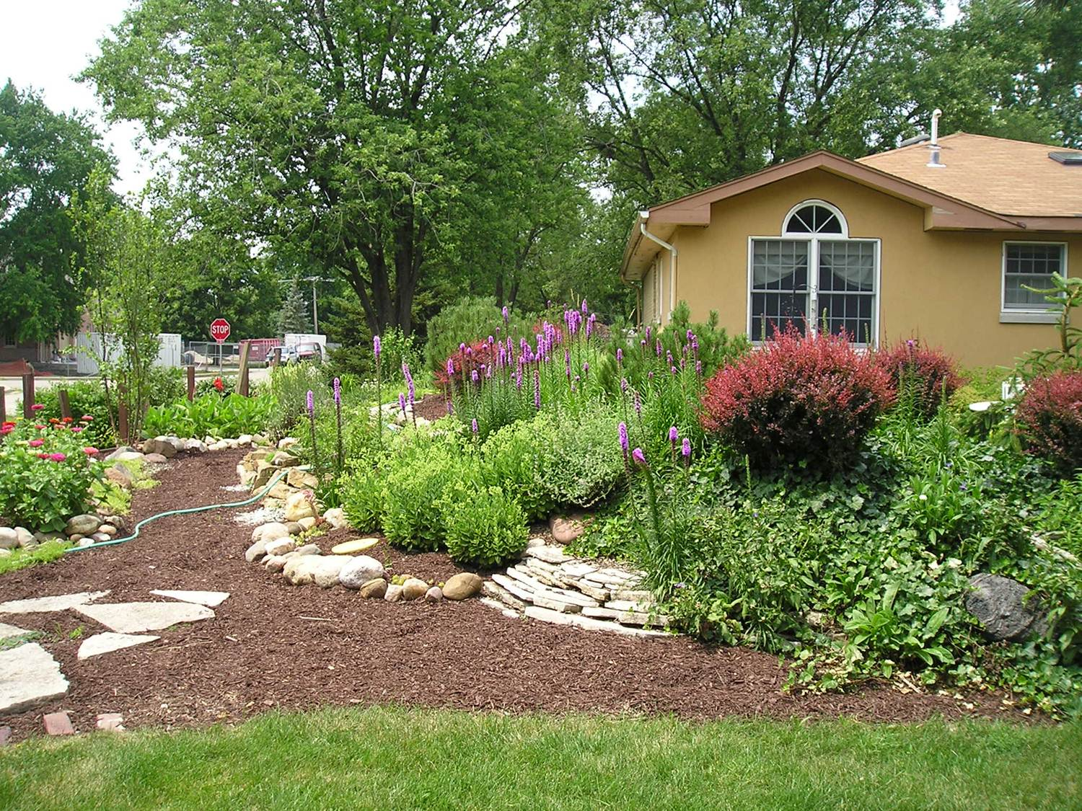
Home work
Write a short composition about firefighter

Slide 19
See you again

