Slide 1
WELCOME TO MULTI MEDIA CLASS
Md. Saiful Islam, Assistant teacher (English) Bagbari Chowbaria High School, Sadar Tangail

Slide 2
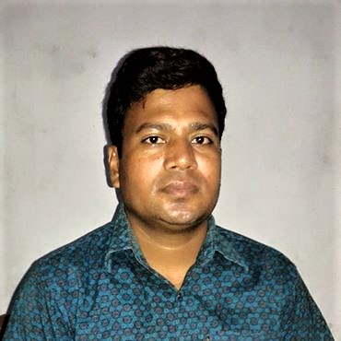
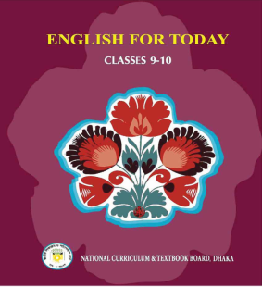
Introducing:
Md. Saiful Islam
Assistant Teacher (English)
Bagbari Chowbaria High School,
Tangail Sadar, Tangail
E-mail: hridoy9555@gmail.com
Class: Nine-Ten
Subject: English for today
Unit: 06
Lesson: 02
Time: 50 Minutes
Date: 28-08-2019
Md. Saiful Islam, Assistant teacher (English) Bagbari Chowbaria High School, Sadar Tangail

Slide 3
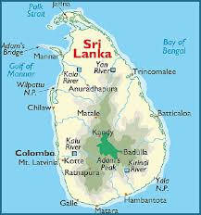
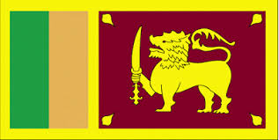
Lesson declaration
Sri Lanka: The pearl of the Indian Ocean
Md. Saiful Islam, Assistant teacher (English) Bagbari Chowbaria High School, Sadar Tangail

Slide 4
Learning outcomes:
After finishing the lesson, learners will be able to-
1. answer the questions.
2.choose the best answer from the alternative
3. say the meaning of the words
4. make a dialogue.
5. write a paragraph.
Md. Saiful Islam, Assistant teacher (English) Bagbari Chowbaria High School, Sadar Tangail

Slide 5
Anyone visiting Sri Lanka may often hear the word Ayubowan. This word means ‘ May you have the gift of long life’. It is with this traditional getting that everyone is welcomed to Sri Lanka.
Md. Saiful Islam, Assistant teacher (English) Bagbari Chowbaria High School, Sadar Tangail

Slide 6
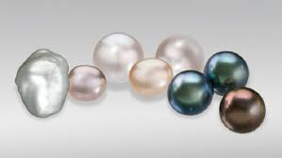
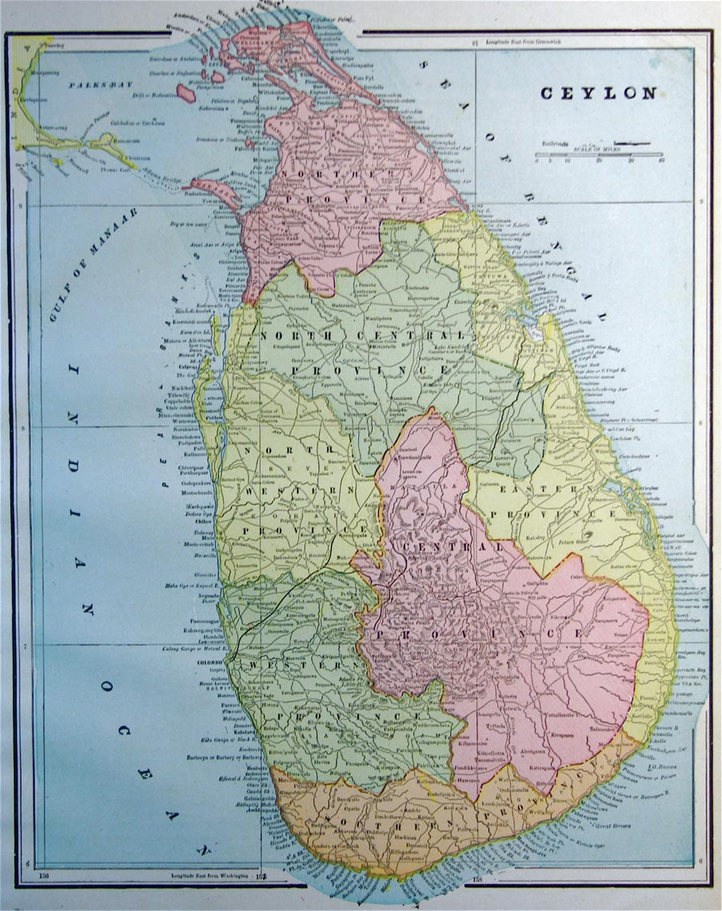
Sri Lanka is variously known as: Serendip, Ceylon, Teardrop of India, Pearl of the Indian Ocean, etc. These names reveal the richness and beauty of this island nation.
Md. Saiful Islam, Assistant teacher (English) Bagbari Chowbaria High School, Sadar Tangail

Slide 7
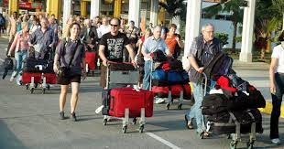
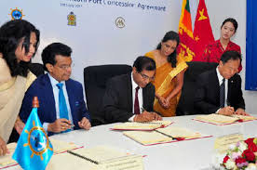
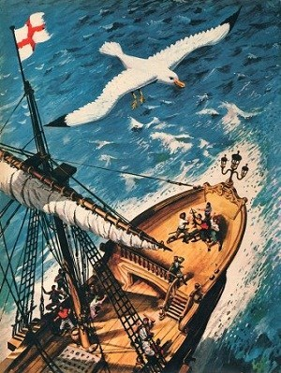
Many travellers, from ancient mariners and merchants to present day tourists, have attracted by the beauty of this island.
Md. Saiful Islam, Assistant teacher (English) Bagbari Chowbaria High School, Sadar Tangail

Slide 8
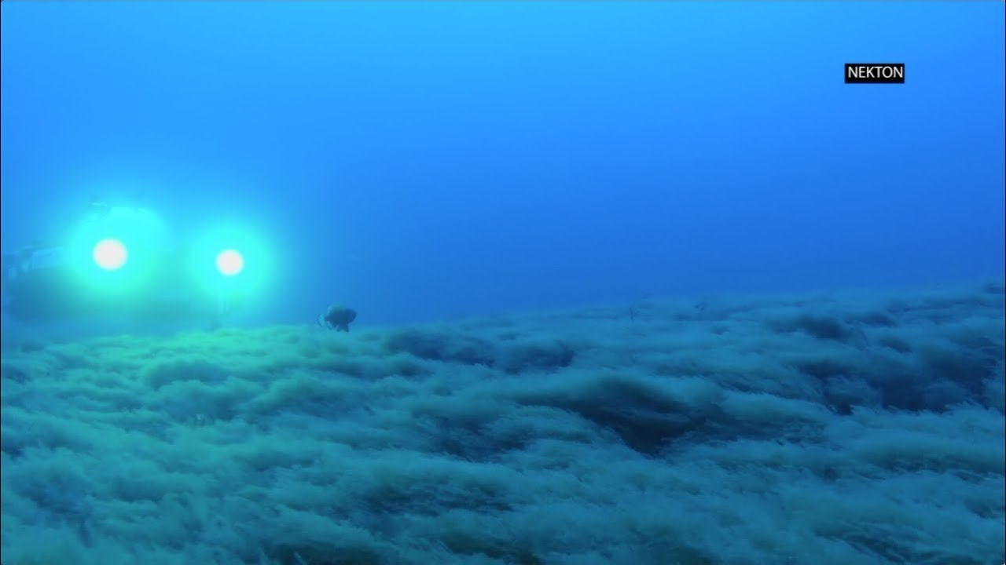
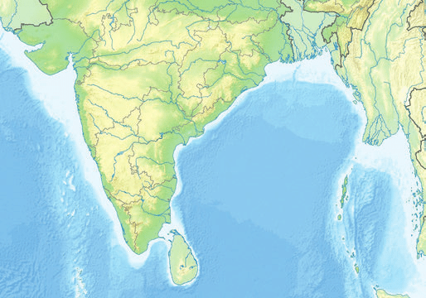
Sri Lanka is located in the Indian Ocean, just off the south-eastern coast of India. Shaped like a teardrop, the island of Sri Lanka measures about 415 kilometers from north to south, and about 220 kilometers from east to west, with a total land area of about 65,600 square kilometers. It has more than 1340 kilometers of coastline.
Md. Saiful Islam, Assistant teacher (English) Bagbari Chowbaria High School, Sadar Tangail

Slide 9
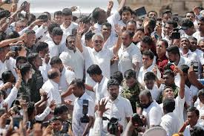
Despite its modest size Sri Lanka has a population of about 20 million. Sri Lanka is a multi- religious, multi-racial and multi- lingual country.
Md. Saiful Islam, Assistant teacher (English) Bagbari Chowbaria High School, Sadar Tangail

Slide 10
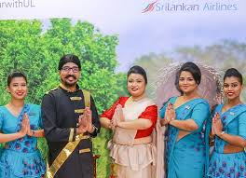
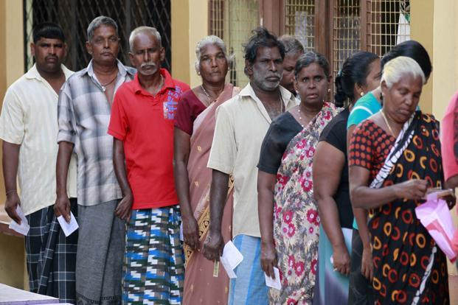
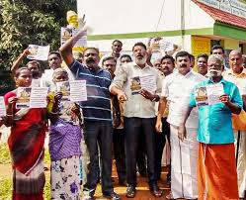
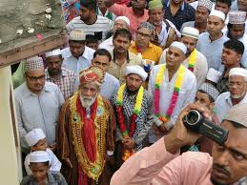
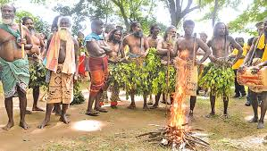
The four major ethnic groups are the Sinhalese, Sri Lankan Tamils, Indian Tamils and Sri Lankan Moors or Muslims. A fifth group, the Veddhas are the original inhabitants of the island.
Md. Saiful Islam, Assistant teacher (English) Bagbari Chowbaria High School, Sadar Tangail

Slide 11
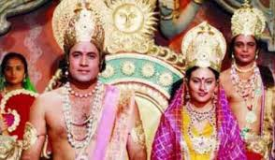
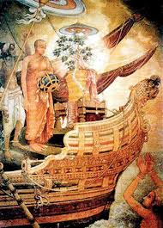
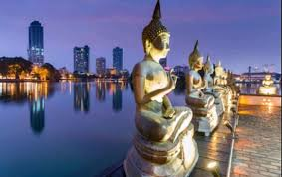
The ancient history of Sri Lanka is depicted in the Hindu epic the Ramayana. But the most important work on Lankan origin is related in Mahavamsa or “ The great Chronicle”.
Md. Saiful Islam, Assistant teacher (English) Bagbari Chowbaria High School, Sadar Tangail

Slide 12
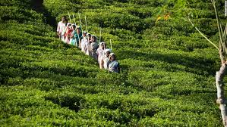
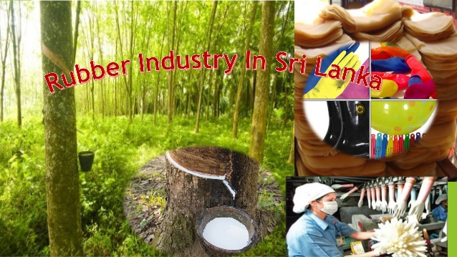
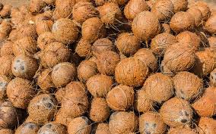
Sri Lanka’s economy has traditionally been based on agriculture. The emphasis is on exporting crops such as tea, rubber and coconuts. In fact, Sri Lanka is the largest tea exporter of the world.
Md. Saiful Islam, Assistant teacher (English) Bagbari Chowbaria High School, Sadar Tangail

Slide 13
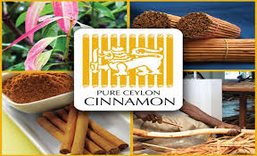
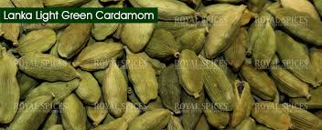
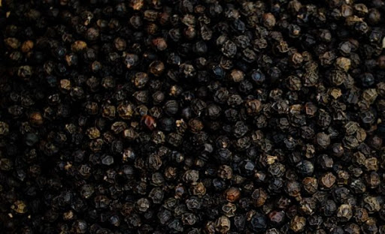
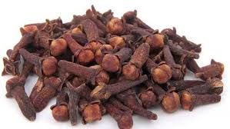
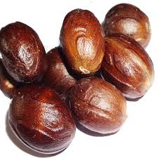
The country is also a major producer and supplier of a variety of spices such as cinnamon, cardamom, pepper, cloves, and nutmeg. Cinnamon first originated in Sri Lanka and was introduced later to the world by the Arab merchants.
Md. Saiful Islam, Assistant teacher (English) Bagbari Chowbaria High School, Sadar Tangail

Slide 14
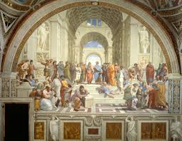
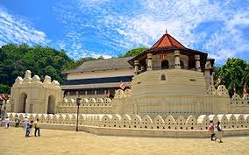
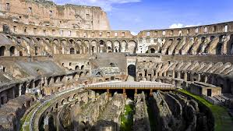
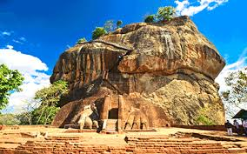
Sri Lanka’s archaeological treasures may be compared to other civilizations of the past like the Golden Age of Greece, the Roman Empire and Mayan citadels.
Md. Saiful Islam, Assistant teacher (English) Bagbari Chowbaria High School, Sadar Tangail

Slide 15
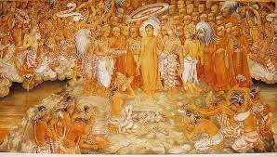
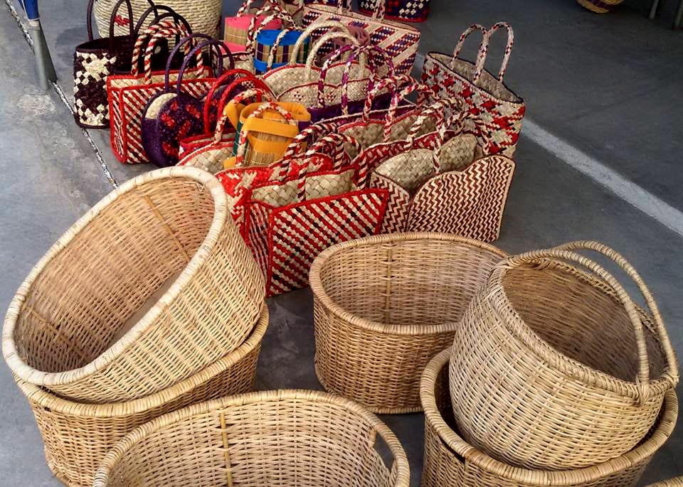
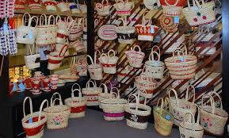
The culture that followed those glorious pasts has been enriched by the more recent influences of Western colonizers and Eastern traders. That resulted in developing a unique mix of races and religions, arts and crafts.
Md. Saiful Islam, Assistant teacher (English) Bagbari Chowbaria High School, Sadar Tangail

Slide 16
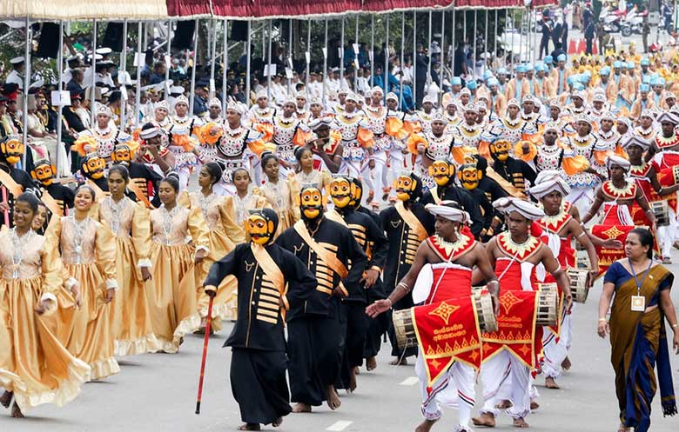
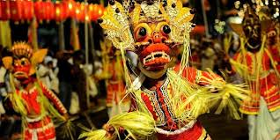
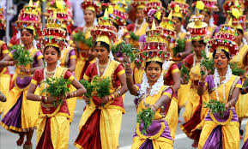
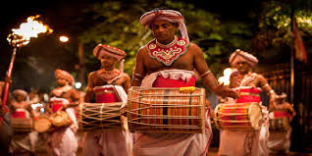
There are different religious festivals celebrated all the year round in Sri Lanka.
Md. Saiful Islam, Assistant teacher (English) Bagbari Chowbaria High School, Sadar Tangail

Slide 17
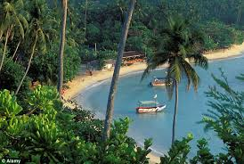
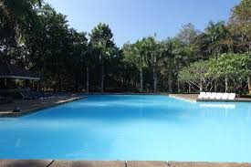
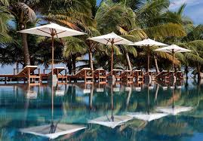
Besides the man-made riches, one may find the God-given blessings of nature in Sri Lanka. The island is circled by azure seas and is blessed with sandy beaches, green hills, cascading waterfalls.
Md. Saiful Islam, Assistant teacher (English) Bagbari Chowbaria High School, Sadar Tangail

Slide 18
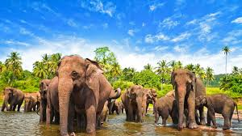
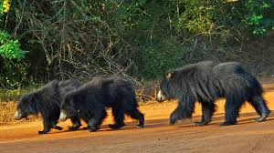
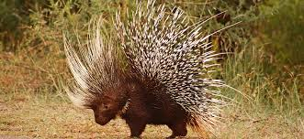
The country Sri Lanka is very enriched in various wild life. There are many types of wonderful animals in Sri Lanka.
Md. Saiful Islam, Assistant teacher (English) Bagbari Chowbaria High School, Sadar Tangail

Slide 19
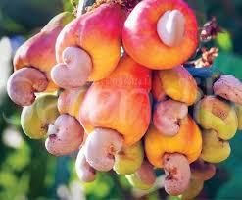
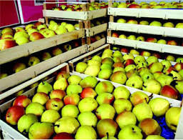
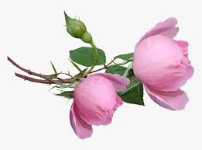
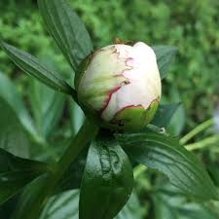
Various kinds of flowers and fruits have increased the economy of Sri Lanka.
Md. Saiful Islam, Assistant teacher (English) Bagbari Chowbaria High School, Sadar Tangail

Slide 20
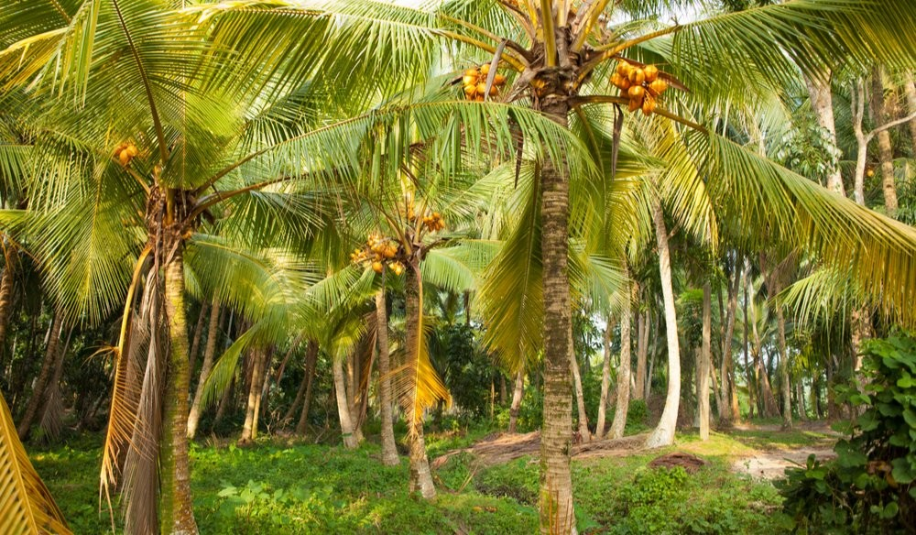
The country abounds with coconut groves, spice gardens, tea estates and many other gardens and woods.
Md. Saiful Islam, Assistant teacher (English) Bagbari Chowbaria High School, Sadar Tangail

Slide 21
Travellers from all over the world come to Sri Lanka. Here , a weary traveller can pass a relaxing day by palm-shaded lagoon looking at the endless ocean. And for the adventurous, days can be full of excitement snorkelling, swimming, fishing or sailing.
Md. Saiful Islam, Assistant teacher (English) Bagbari Chowbaria High School, Sadar Tangail

Slide 22
The capital of Sri Lanka is Colombo and her currency is Ruppy.
Md. Saiful Islam, Assistant teacher (English) Bagbari Chowbaria High School, Sadar Tangail

Slide 23
There four religions in Sri Lanka. They are: Buddhism-70.1%, Hinduism-12.6%, Islam-9.7% and Christianity-7.6%. The state language: The state languages of Sri Lanka are: Sinhale and Tamil.
Md. Saiful Islam, Assistant teacher (English) Bagbari Chowbaria High School, Sadar Tangail

Slide 24
Word meaning
Ancient- প্রাচীন- old
Chronicle- কালানুক্রমিক বিবরণ- a statement of occurances
Unique- অদ্বিতীয়- single
Gloriously- গৌরবান্বিতভাবে- magnificently
Traditional- ঐতিহ্যবাহী- conventional
Reveal-প্রকাশ করা- expose
Mariner- নাবিক- sailor
Modest- মাঝারি- middle in size
Attract- আকর্ষণ- allure
Supplier- সরবরাহকারী- providers
Inhabitant- অধিবাসী- a person living in a place
Epic- মহাকাব্য- a long poem about a great person or the past history of a nation
Variety- বৈচিত্র- diversity
Enrich- সমৃদ্ধ করা- to improve.
Available- প্রাপ্তিসাধ্য- that can be obtained or used
Blessing- আর্শীবাদ- God’s favour and protection
Grove- বাগান- garden
Abundant- প্রচুর- plentiful
Md. Saiful Islam, Assistant teacher (English) Bagbari Chowbaria High School, Sadar Tangail

Slide 25
Individual work:
Answer the following questions:
1. Which country is often known as the Pearl of the Indian Ocean?
2. What are the main exporting crops of Sri Lanka?
3. What are the four major ethnic groups of Sri Lanka?
4. Which country was mentioned in the great Indian epic the Ramayana?
5.How do the Lankan greet the foreigners?
Md. Saiful Islam, Assistant teacher (English) Bagbari Chowbaria High School, Sadar Tangail

Slide 26
Pair work
Make a dialogue between you and your friend on your visiting to Sri Lanka.
Md. Saiful Islam, Assistant teacher (English) Bagbari Chowbaria High School, Sadar Tangail

Slide 27
Group work
Write the meaning of the following words:
Ancient,Chronicle,Unique,Gloriously,Traditional,Reveal,Mariner,Modest,Attract,Supplier,
Inhabitant, Epic, Variety, Enrich, Available,
Blessing, Grove, Abundant
Md. Saiful Islam, Assistant teacher (English) Bagbari Chowbaria High School, Sadar Tangail

Slide 28
Evaluation
Choose the best answer from the alternatives:
1. The land area of Sri Lanka is------- square Kilometers.
(a) 75,600 (b) 65,600 (c) 85,600 (d) 55,600
2. The word’ ayubowan’ means-----
(a) May Allah bless you (b) May you be happy (c) May you have the gift of long life (d) None
3. Sri Lanka is variously known as ------
(a) Serendip (b) Ceylon (c) Land of the thunder dragon (d) Both (a) and (b)
4. The economy of Sri Lanka has conventionally based on--------
(a) Tea (b) agriculture (c ) industry (d) Business
5. Cinnamon first originated in ----------
(a) India (b) Sri Lanka (c) Nepal (d) Bhutan
6. The name of Sri Lanka’s currency is -----
(a) Taka (b) Dinar (c) Dollar (d) Ruppy
7. Most of the people of Sri Lanka are -----
(a) Hindus (b) Christians (c) Muslims (d) Bddhists
Md. Saiful Islam, Assistant teacher (English) Bagbari Chowbaria High School, Sadar Tangail

Slide 29
Home work
Write a paragraph about your neighbour
Md. Saiful Islam, Assistant teacher (English) Bagbari Chowbaria High School, Sadar Tangail

Slide 30
Allah hafez
Md. Saiful Islam, Assistant teacher (English) Bagbari Chowbaria High School, Sadar Tangail

