Slide 1
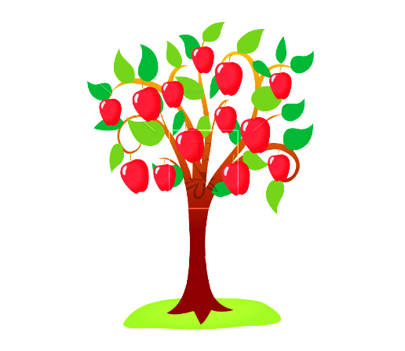

Slide 2
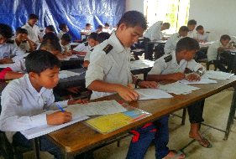
Introduction
Md. Shahidul Alom
Assistant Teacher of English
Rajar Gaon High School, Sylhet Sadar, Sylhet
Mobile: 01715 720 745
Email: msagainer@gmail.com
Fb: msamartyr
Class: IX-X
Subject: English Second Paper
Date: August 29, 2020
Total Student: 55

Slide 3
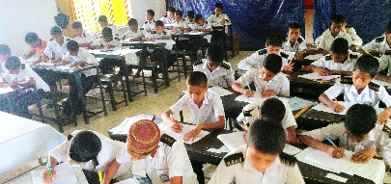
Read carefully and try to answer the following questions to get our topic of the class.
Last year a school arranged a writing competition in a national day on the topic of 'Life of Sheikh Mujibur Rahman'. All participants are asked to write on the topic. Ratul participated in the competition and got first prize.
a. Why did Ratul get the first prize?
b. What did Ratul write?
c. What do we call Ratul’s written thing?

Slide 4
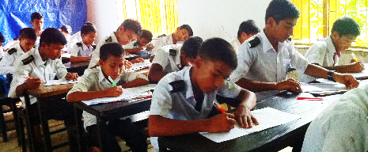
Our topic is on
Composition

Slide 5
Learning Outcomes
After studied this lesson students will be able to…
Know how to write a composition.

Slide 6
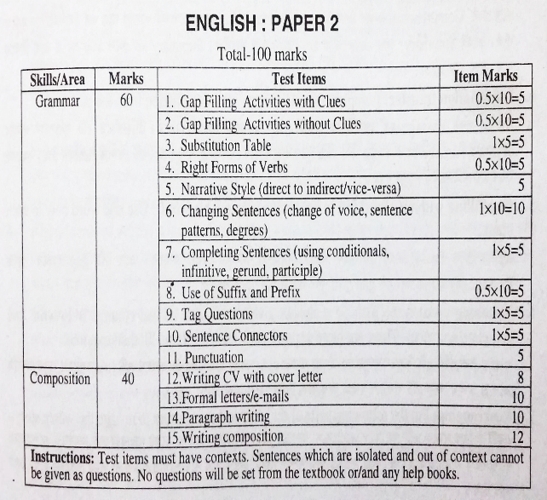
Find your topic in your syllabus
Marks Distribution of SSC
Question No: 15:
Marks: 12

Slide 7
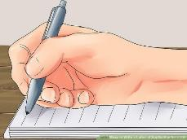
Composition topic is selected base on…
1. Personal Experience
2. Everyday Problems
3. Events and Incidents etc

Slide 10
Composition
Word limitation
200-250 words

Slide 11
Make sure that you have all the necessary parts in your Composition
Composition
Introduction
Body
Conclusion

Slide 12
The introduction?
The introduction is the first part of an essay and it is the one that introduces your subject and presents your stance on it. It is also called an “argument” which means that you will have to explain what led to the decision of writing about that topic.
The introduction should also capture the interest of the readers, so make sure that it is interesting enough so that no one will get bored while reading it. The final sentence should be the one that connects the introduction to the body.

Slide 13
The body?
The body can have more paragraphs, and it is up to you to decide how many you need in order to cover the subject. Each paragraph should have solid arguments and you should be able to convince the readers. Don’t forget to offer relevant examples so that you can illustrate your ideas in a better way.
Since you will have more paragraphs, make sure that you transition smoothly from one to another. You might need to use certain phrases, such as “furthermore”, or “moreover” in order to add more supporting arguments.

Slide 14
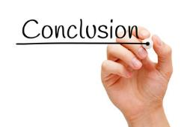
The conclusion?
This is the final part of your essay so it might be more important than you think since it represents the last impression of the reader. The conclusion should sum up your composition and it should be long enough to cover all the important points.
You can also use transitions such as “in conclusion”, or “to sum up”, and then continue by restating your original argument from the introduction.
These tips should help you structure an essay correctly.

Slide 15
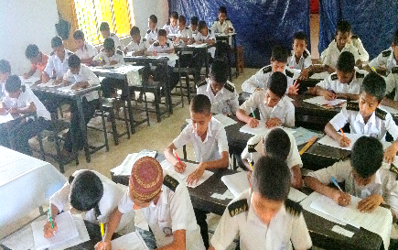
Example
15. Write a composition on ‘Physical Exercise’.

Slide 16
Answer to the question number : 15
With Title
Physical Exercise
Introduction: Physical exercise means the movement of our limbs according to some rules. It is good for health. It gives us health and energy. It is necessary for the preservation of health. We cannot enjoy sound health without it. Physical exercise makes a man active and strong. It keeps him free from various fatal diseases.
Various kinds of exercise: There are various kinds of physical exercise. Walking, riding, swimming, rowing and different types of games are good forms of exercise. All of them are not suitable for everybody. There are some forms of physical exercise like badminton, cricket, hockey, football, tennis are quite good. For the female table tennis and badminton are quite nice exercises. Other hand, walking which is a very common and easy exercise is good for the weak and the old.
Proper time of exercise: Physical exercise should not be taken all the time. It must be taken in the open air. So morning and evening are the best time for taking physical exercise. Closed room is not proper place for taking exercise. We should take physical exercise regularly. But remember, no exercise should be taken immediate after taking meal or in empty stomach. Do not take over exercise. It may tell up the health.
Importance: Physical exercise develops all parts of our body. It keeps us sound. It helps us to be cheerful and active. It also helps us digest food and keeps the body free from various diseases. Our life is full of struggles and activities. One can tackle them simply if one has physical fitness and mental alertness. Physical exercise is essential to make our body physically fit. A person can have a sound mind only when he has a sound body. So, in order to have a sound mind in a sound body physical exercise is of greatest significant for all. Exercise takes our mind away from the drudgery of work and fills it with joy. It increases our vitality. . Physical exercise also gives us fresh energy refreshes our mind and helps us to return to work with improved strength. So we should take physical exercise every day.
Conclusion: Health is the root of all happiness. Physical exercise keeps us healthy. Many people do not take physical exercise regularly. Then soon lose their health. They fall victims to many diseases. So the necessity of taking exercise should not be ignored. Physical exercise prolongs our life and strengthens our mind. If we want to keep our mind and body fresh, we should take regular physical exercise.

Slide 17
You can write also like this without title/heading of the para.
Indent first line of a para and don’t forget space between tow para.
Physical Exercise
Without Title
Physical exercise means the movement of our limbs according to some rules. It is good for health. It gives us health and energy. It is necessary for the preservation of health. We cannot enjoy sound health without it. Physical exercise makes a man active and strong. It keeps him free from various fatal diseases.
There are various kinds of physical exercise. Walking, riding, swimming, rowing and different types of games are good forms of exercise. All of them are not suitable for everybody. There are some forms of physical exercise like badminton, cricket, hockey, football, tennis are quite good. For the female table tennis and badminton are quite nice exercises. Other hand, walking which is a very common and easy exercise is good for the weak and the old.
Physical exercise should not be taken all the time. It must be taken in the open air. So morning and evening are the best time for taking physical exercise. Closed room is not proper place for taking exercise. We should take physical exercise regularly. But remember, no exercise should be taken immediate after taking meal or in empty stomach. Do not take over exercise. It may tell up the health.
Physical exercise develops all parts of our body. It keeps us sound. It helps us to be cheerful and active. It also helps us digest food and keeps the body free from various diseases. Our life is full of struggles and activities. One can tackle them simply if one has physical fitness and mental alertness. Physical exercise is essential to make our body physically fit. A person can have a sound mind only when he has a sound body. So, in order to have a sound mind in a sound body physical exercise is of greatest significant for all. Exercise takes our mind away from the drudgery of work and fills it with joy. It increases our vitality. . Physical exercise also gives us fresh energy refreshes our mind and helps us to return to work with improved strength. So we should take physical exercise every day.
Health is the root of all happiness. Physical exercise keeps us healthy. Many people do not take physical exercise regularly. Then soon lose their health. They fall victims to many diseases. So the necessity of taking exercise should not be ignored. Physical exercise prolongs our life and strengthens our mind. If we want to keep our mind and body fresh, we should take regular physical exercise.

Slide 18
Query
Ask anything you want to know

Slide 19
Home Work
15. Write a Composition on ‘ Newspaper’

Slide 20
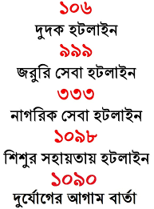
GOOD BYE

