Slide 2
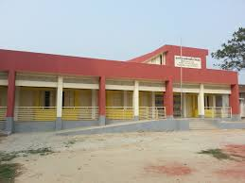
Teacher’s Identity
Md. Jasim Madbar
Assistant Teacher
No. Sona Khar Kandi Govt. Primary School
Shibchar, Madaripur

Slide 3
Class Identity
Class : Two
Subject : English
Unit : 19
Lesson : 1
Time : 40 Minutes
Date : 29 August, 2020

Slide 4
Learning Outcomes
Students will be able to…
1.1.1: become familiar with English sounds by listening to common English words
1.1.1: repeat after the teacher simple words with proper sounds and stress.
1.4.1: read words with the help of visual clues.

Slide 5
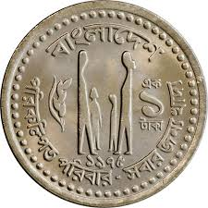
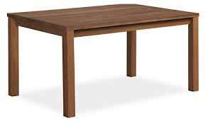
Look at the picture

Slide 6
Look at These

Slide 7
Shapes
Today’s Lesson

Slide 8
Learn the Name of the Shapes
Triangle
Circle
Square
Rectangle

Slide 9
Learn the Name of the Shapes
Rectangle
Square
Triangle
Circle

Slide 10
Now Match the Shapes with Their Names
Rectangle
Triangle
Square
Circle

Slide 11
Thanks

