Slide 1
Welcome
Notes:
For attractive presentation i used these fonts: Times New Roman, Rush, Alako-Bold, Forte, AR DARLING, AR DESTINE… For better look teachers are requested to download these fonts. Thank you

Slide 2
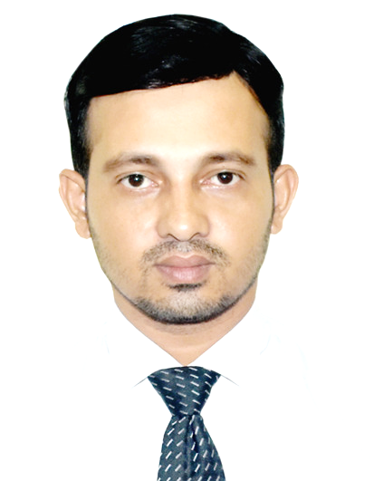
Starter
Md. Shahidul Alom
Assistant Teacher of English
Rajar Gaon High School
Sylhet Sadar, Sylhet 3100
Mob: 01715 7207 45
Email: msagainer@gmail.com
Fb: msamartyr
Notes:
For attractive presentation i used these fonts: Times New Roman, Rush, Alako-Bold, Forte, AR DARLING, AR DESTINE… For better look teachers are requested to download these fonts. Thank you

Slide 3
Information of the class
Class: IX-X
Subject: English II
Time: 45 Minutes
Date: 01.08.2020
For attractive presentation I used these fonts: Times New Roman, Rush, Alako-Bold, Forte, AR DARLING, AR DESTINE… For better look teachers are requested to download and install these fonts in your PC. Thank you

Slide 4
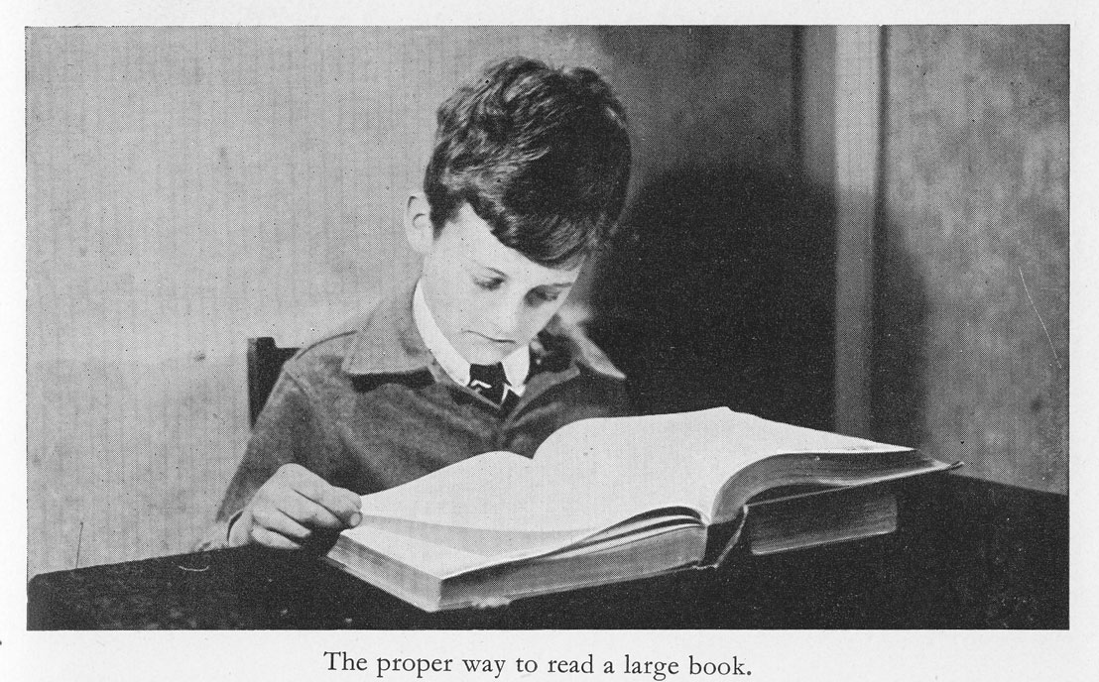
Look at the picture
Action
Action
Can you guess our lesson title
Notes:
For attractive presentation I used these fonts: Times New Roman, Rush, Alako-Bold, Forte, AR DARLING, AR DESTINE… For better look teachers are requested to download these fonts. Thank you

Slide 5
Our Topic is on
Right Form of The Verb
Part: II
Notes:
For attractive presentation i used these fonts: Times New Roman, Rush, Alako-Bold, Forte, AR DARLING, AR DESTINE… For better look teachers are requested to download these fonts. Thank you

Slide 6
Learning outcome
After studied this lesson students will be able to
use the correct form of the verbs
write and say correct sentences using correct verbs.

Slide 7
Easy way to learn right form of the verbs

Slide 10
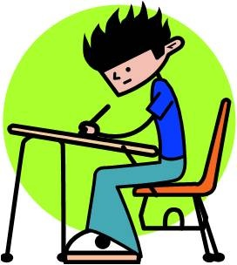
Individual Work
Match your answer
Fill in the blanks with right form of the verbs.
I look forward to ______________ you soon.
The snake was ________________ yesterday.
hearing
killed

Slide 14
Pair Work
Match your answer
Fill in the blanks with right form of the verbs.
is
One of the girls _______________ absent.
Everybody _________________ a child.
Some of the boys _____________ in the garden.
loves
are

Slide 17
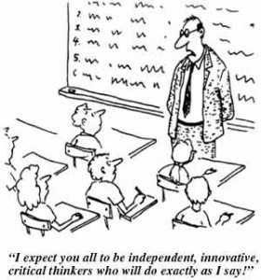
Evaluation
Match your answer
Fill in the blanks with right form of the verbs.
Time and tide ________________ for none.
Eighty Km ____________ a long distance.
All children ____________ innocent.
Nobody __________a liar.
Waits
is
are
believes

Slide 18
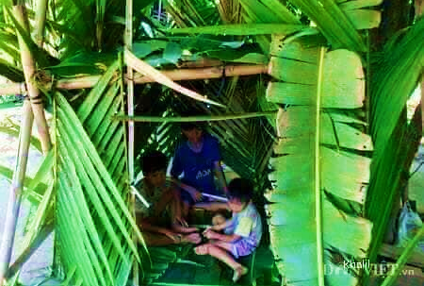
Fill in the gaps with right form of the verbs from the box.
Home Work
take forget be start walk welcome enter Thank answer Ask
My first day at school is a memorable day in my life. I will (a)__ the day as long as I live. It (b)__ in January, 1976, I (c)__ my schooling at a village primary school. My father (d)__ me to the school for admission. We (e)__ all the way to school . When I (f)__ the Headmaster’s room. I greeted him. I was (g)__ and given a seat. Then he (h)__ me some questions. As I (i)__ them, he (j)__ me cordially and affectionately.

Slide 19
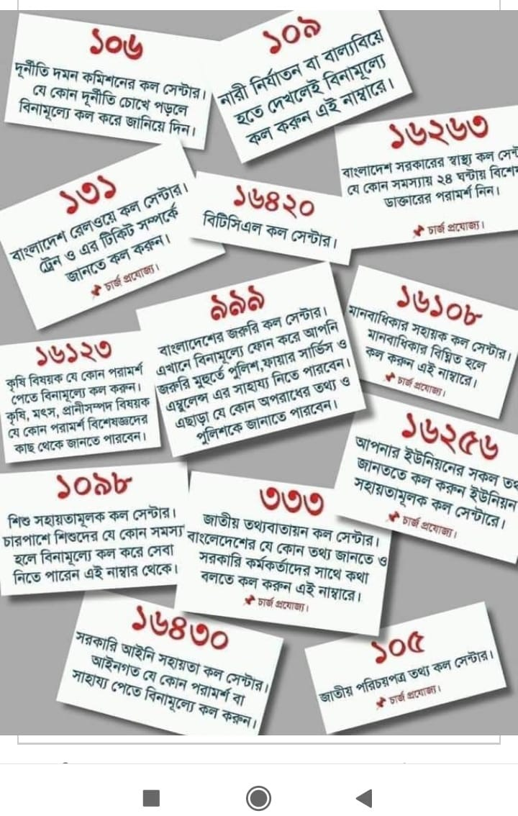
Thank You
Thank You
Thank You
Thank You

