Slide 1
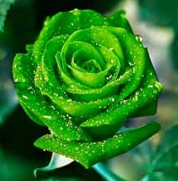
WELCOME

Slide 2
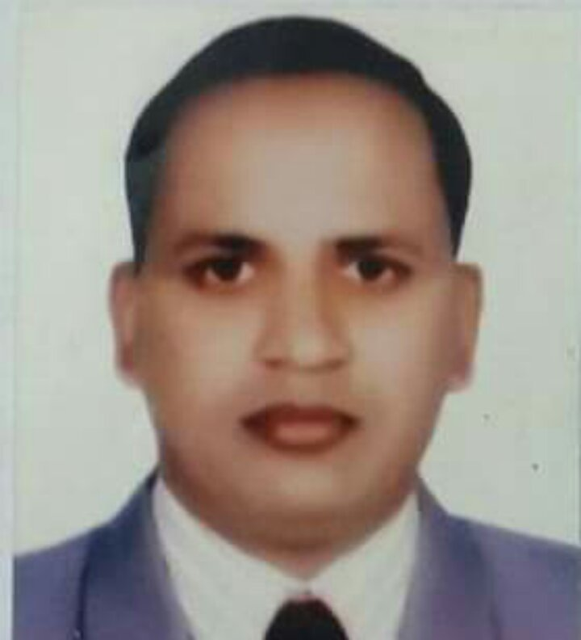
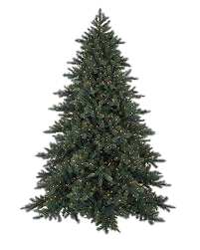
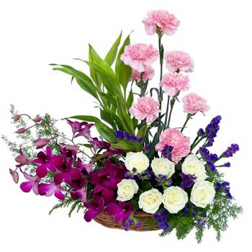
Presented By
Jatindra Mohon Das
Head Teacher
Shantipur Govt Primary School
Sunamgonj Sador, Sunamgonj.

Slide 3
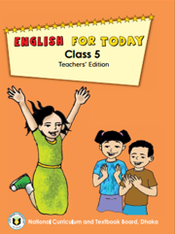
Lesson Identification
Class : Five
Subject : English
Happy Birth Day
Unit : 5
Lesson : A

Slide 4
Learning Outcomes
Students will be able to:
1.3.1 recognize which words in a sentence are stressed. .3.1.1 understand questions asked by the teacher about them. 1.1.1 say words, phrases and sentences with proper sounds and stress. 1.5.1 read words, phrases and sentences in the text with proper pronunciation, stress and intonation. 1.7.1 read paragraphs, dialogues stories, letters and other texts.

Slide 5
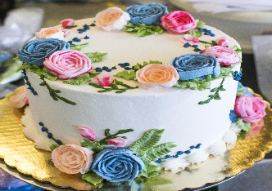
Let we watch a video

Slide 6
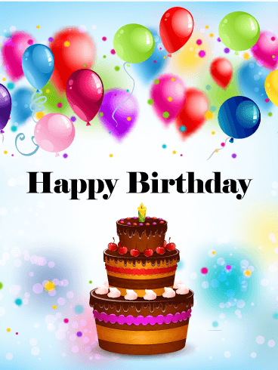
Declear the lesson

Slide 7
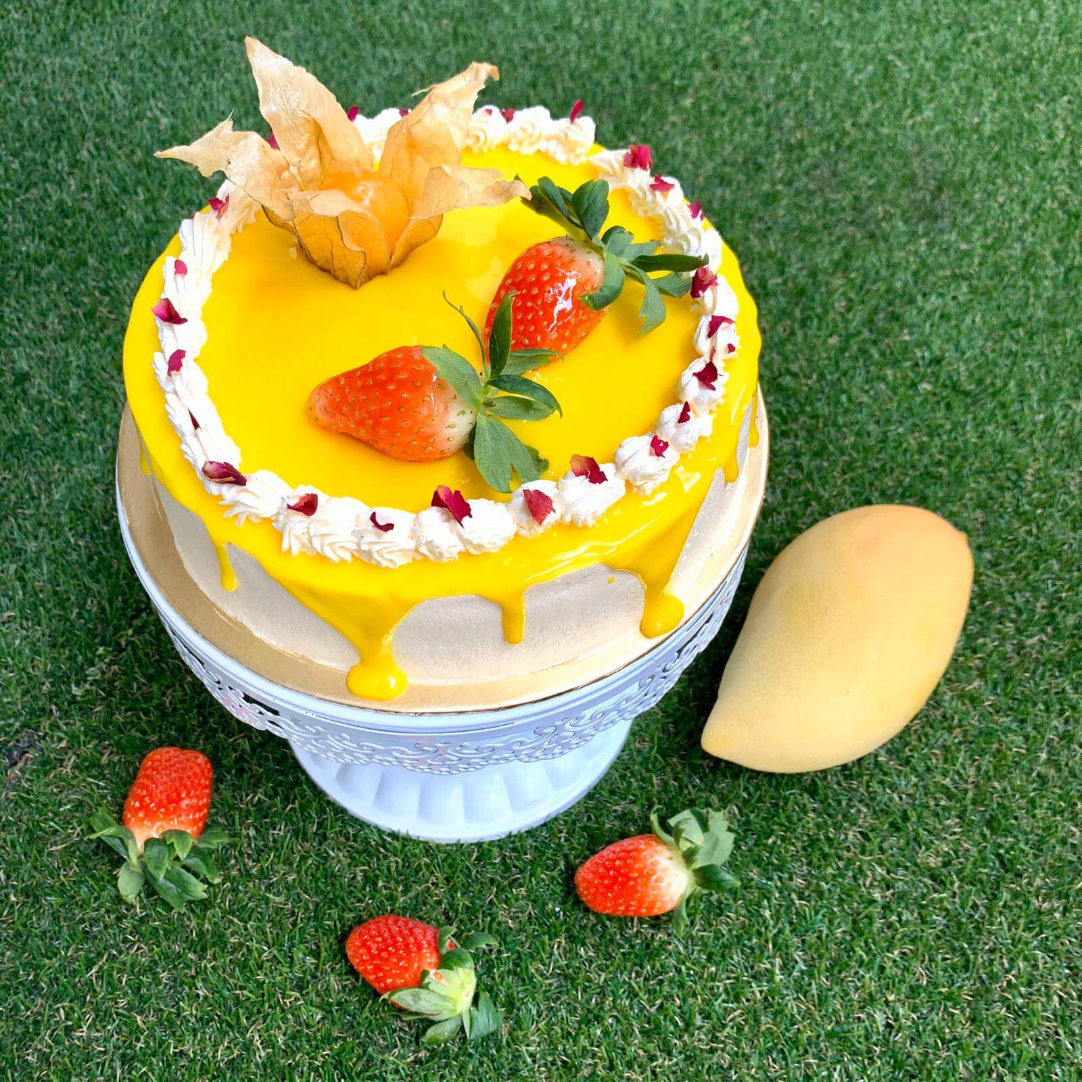
Any birth day use the cake.
When do you uses the cake?
What can you see the picture?
Birth Day Cake

Slide 8
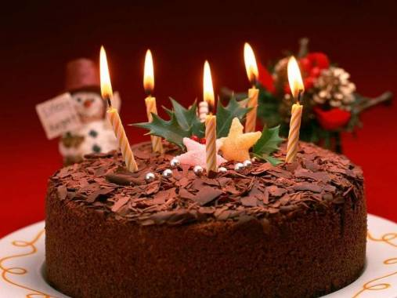
How many candles can you see on the cake?
There are five candles.

Slide 9
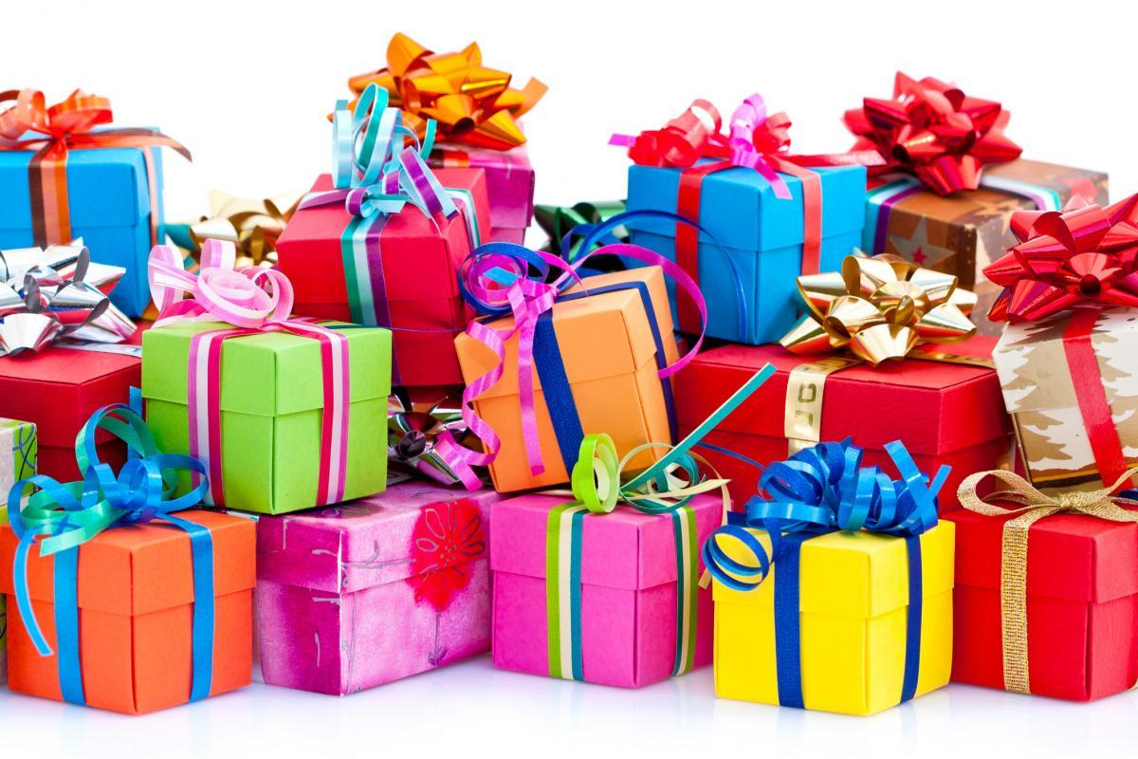
What do these packets look like?
When do we present these to others?
What do we do with these packets?

Slide 10
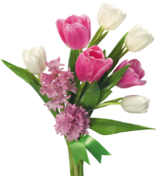
Do you know the meaning of the words
born, celebrate, blow out, party , wrap, enjoy, around.gift,candle,cake.

Slide 11
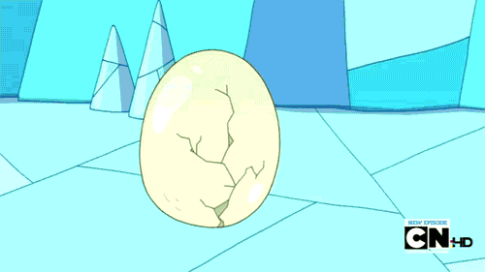
Born

Slide 12
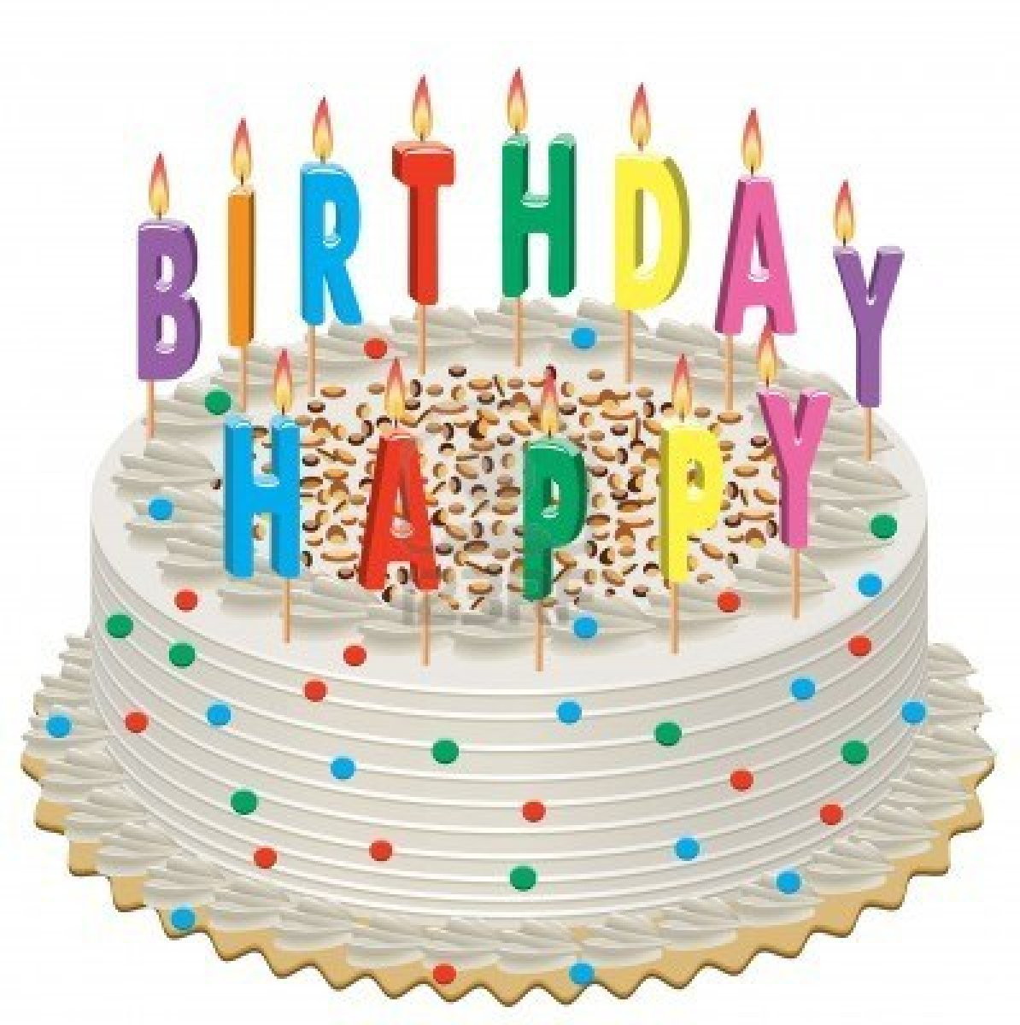
Cake

Slide 13
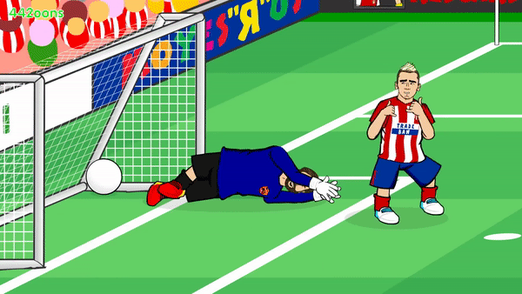
Celebrate

Slide 14
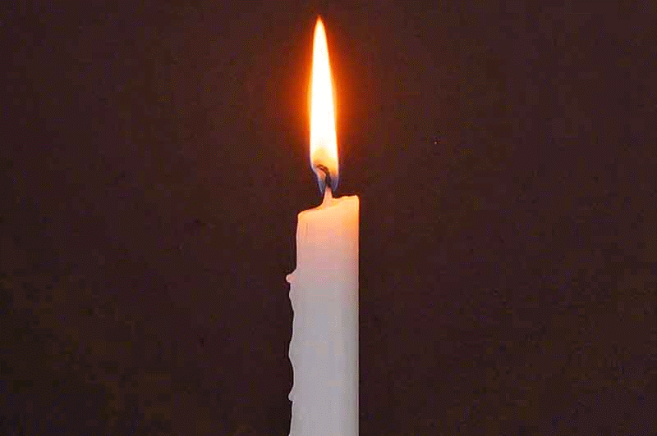
candle

Slide 15
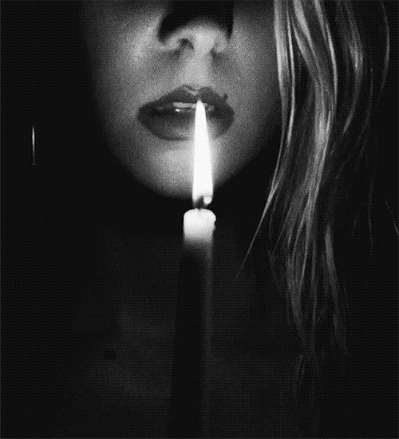
Blow out

Slide 16
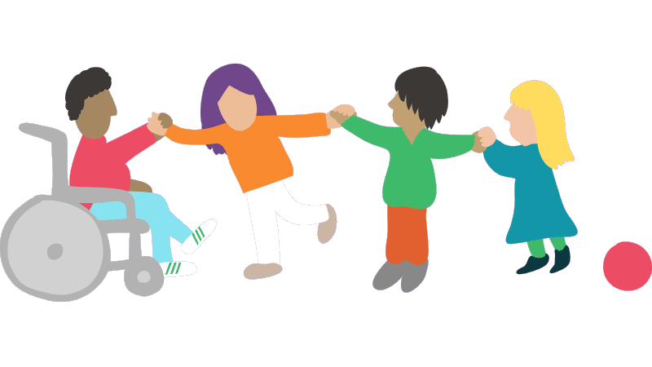
Enjoy

Slide 17
Words
Meanings
Celebrate
উদযাপন
Cake
কেক
Candle
মোমবাতি
উপহার
Gift

Slide 18
Cake |  | Patty
Words
Similarwords
Party
Festival
Warp
Buckle
Around
Every side

Slide 19
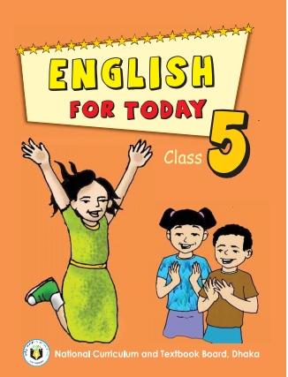
Connection with Textbook
Please open page 58 of textbook.

Slide 20
Find out the words.
born, celebrate, blow out, party , wrap, enjoy, around.gift,candle,cake.

Slide 21
Students , please read the text silently
and try to understand

Slide 22
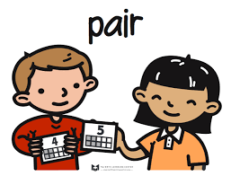
Pair work
Practice reading in pair.
A person’s birthday is a special day. This is the date when the person was born. People around the world celebrate birthdays in different ways. In many countries, people celebrate with a cake. There are candles on the cake. There is one candle for each year of the person’s life. People sing a song for the person. At the end of the song, the person blows out the candles. How old is the birthday girl in the picture? In some countries, there is often a party for a child’s birthday. The child’s friends come to the home. There is special food, like sweets. The children play games and sing. The friends often bring a birthday gift for the child. The gifts are wrapped in colourful paper. The gift may be a toy, a book or some clothes. In some countries, the friends don’t bring gifts. The most important thing is to enjoy the day and spend time with friends and family.

Slide 23
G W
Make sentences from the following words
Cake
There are candles on the cake.
Birthday
Birthday is our memorable day.
Spacial
A birthday party is a special day.

Slide 24
Home work
Write 5 sentences about your birthday party.

