Slide 1
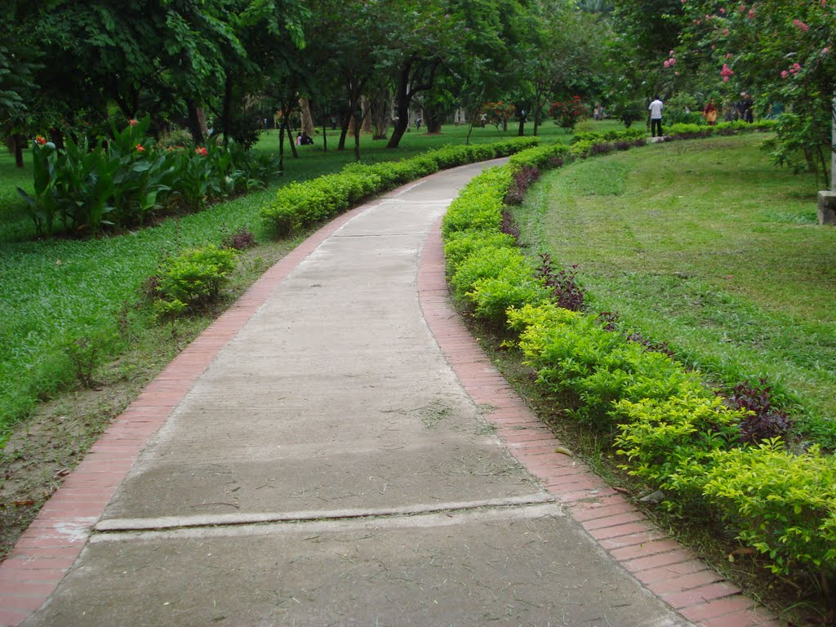
WELCOME
TO
THE LESSON

Slide 2
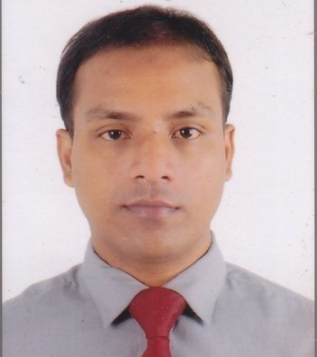
Introduction
Md. Ahsan Habib
Asstistant Teacher
SPPM High School
Chhatak, Sunamganj
Email:ahsanpress@gmail.com
English for Today
Class- VIII
Unit-3

Slide 3
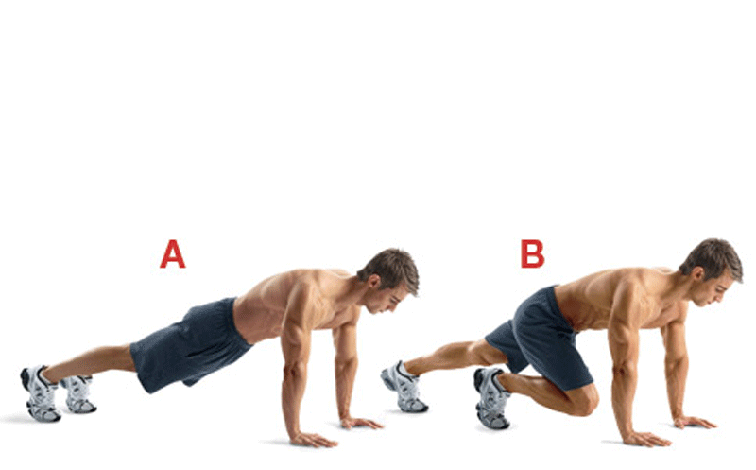
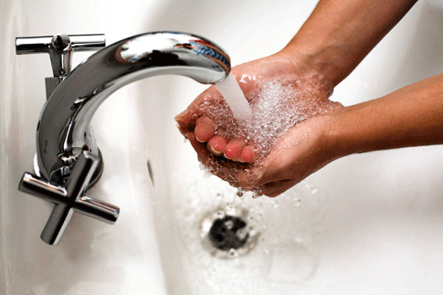
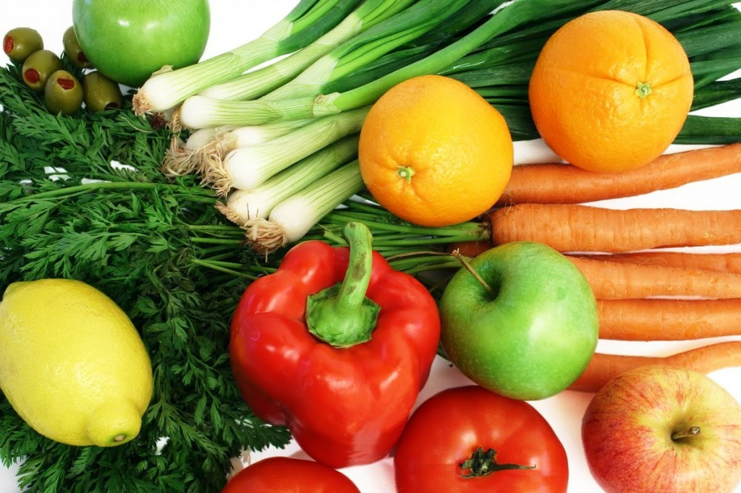
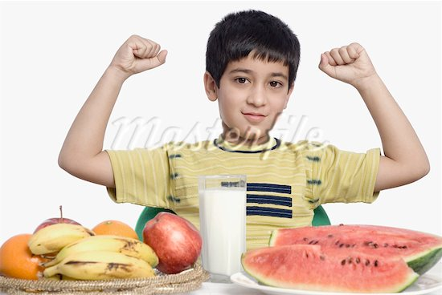
What can you see in the pictures?
Why do we do these ?

Slide 4
Health
Lesson-1

Slide 5
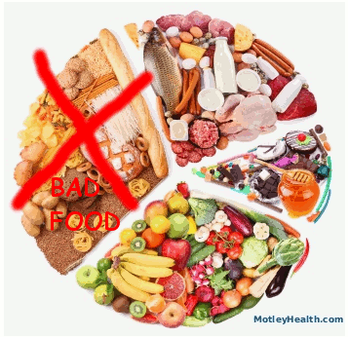
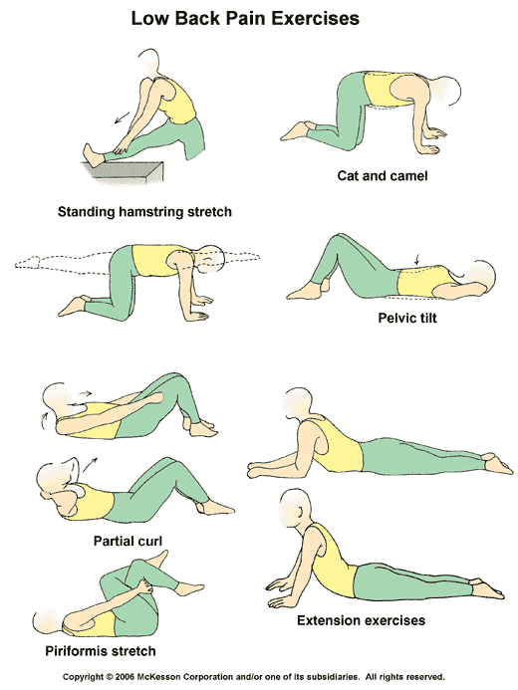
Learning outcomes:
By the end of the lesson students will be able to –
practice speaking skill through picture
discussion.
practice reading skill through
- multiple choice question.
-answering questions.
tell the importance of Physical exercise.
write a paragraph about how can we
maintain good health.

Slide 6
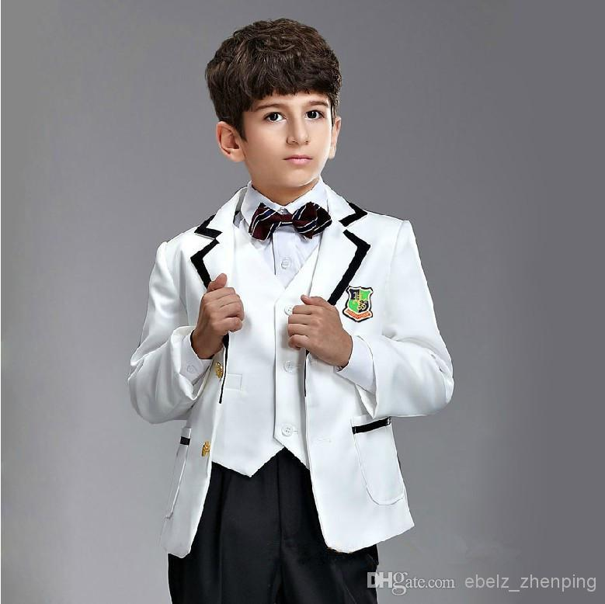
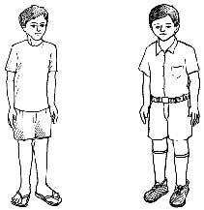
Look at and talk about the pictures.
1
2
3
4
Ask and answer the following question.
Which boy looks healthy?
Which boy is unhealthy?
Can you guess why they are so?

Slide 7
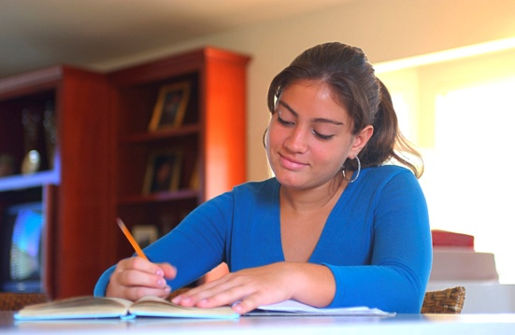
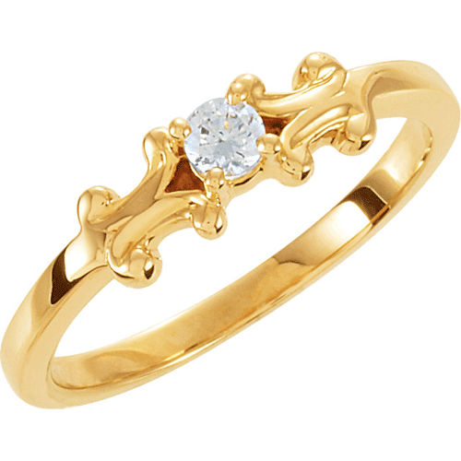
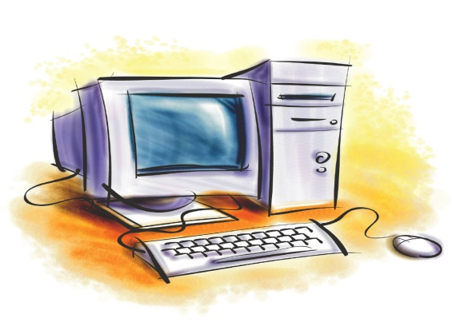
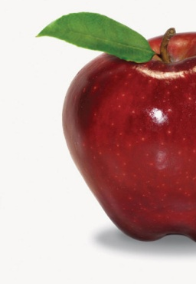
Vocabulary
(Guess the meaning of the following words .
essential
concentrate
equally
valuable

Slide 8
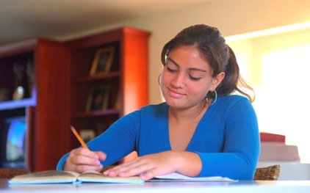
Vocabulary
essential
(adjective)
Meaning: : important/
completely necessary
Example: Computer is now an essential tool in any office.
concentrate
(verb)
Meaning: to give all attention
to something.
Example: The girl concentrates on her studies.

Slide 9
Vocabulary
1/2
1/2
adverb
equally
Meaning: in equal(=) parts, amount etc./to the same degree
Example: the apple is equally divided.
valuable
adjective
Meaning: very useful
Example: This jewellery is very
valuable .

Slide 10
Read the text in B then choose the best answer
1. Health means the condition of
a) our body b) our mind.
c) our body and mind d) our environment.
2. A healthy person is one who
a) is physically and mentally sound. b) eats good food.
c) has a lot of wealth. d) is overweight.
3. We need to eat
a) rich food. b) balanced food.
c) little food. d) lot of food.
4. The phrase ‘to keep late hours’ means
a) to go to bad late. b) to wake up late in the morning
c) to do things always. d) to be late for the class.
1.c) Our body and mind
Answer key
3.b) balanced food.
2.a) is physically and mentally sound.
4.a) to go to bad late.

Slide 11
Pair work
Why is good health essential for us ?
To lead a healthy life, to do the activity attentively...
Why is physical exercise necessary ?
To keep fit for work, to be strong and cheerful…

Slide 12
Pair work
Dear friends, write two more points of eatch of the following topics
Good health | Physical exercise

Slide 13
Let’s watch a video
Make a list What you have seen in the video.

Slide 14
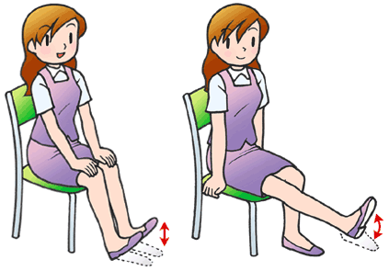
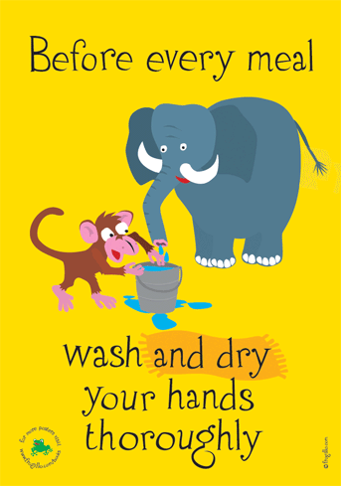
Group discussion
“Early to bed and early to rise
Makes a man healthy , wealthy and wise.”

Slide 15
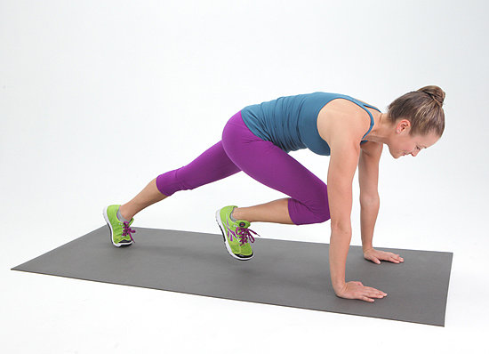
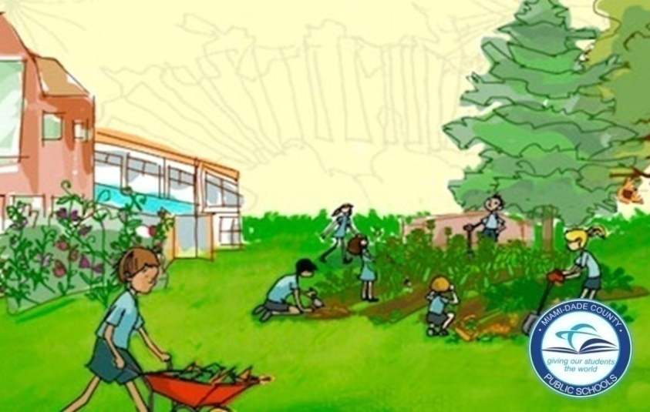
Group work
Write a short paragraph about how can we maintain good health?

Slide 16
Evaluation
Who can lead a healthy life?
What is good health?
How can we keep our body fit?

Slide 17
Home work
What will be your role to maintain a
healthy environment in your family?

Slide 18
Thank you

