Slide 1
Welcome dear learners
Notes:
This a welcome slide. The picture is about Autumn. It is related word to the topic. Teacher may change it.

Slide 2
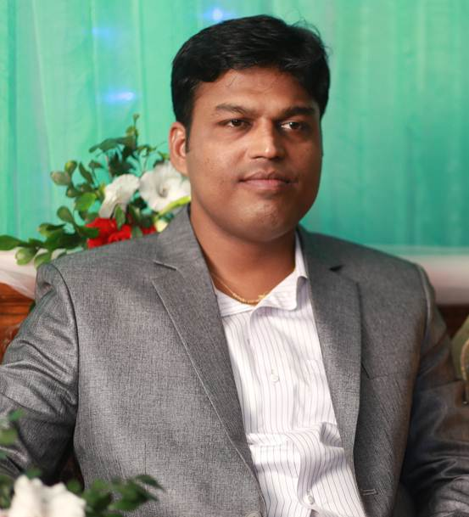
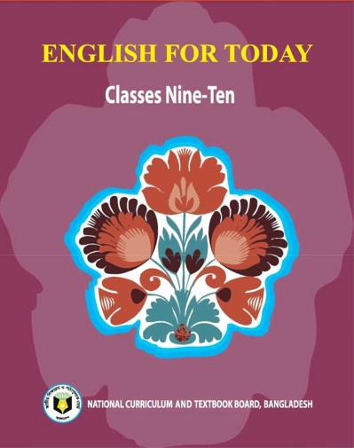
IDENTITY
Teacher
Lesson
Hirendra Debnath
MA(English),Bed
Assistant Teacher(English)
Puran Bazar Girls’ High School
01789-916684
Hirendra Debnath
hirendra0501@gmail.com
English For Today
Class : IX-X

Slide 3
Let us watch and guess
What is the video about?
Notes:
Through the video and question teacher may take out the lesson of today’s class.

Slide 4
Our today’s topic is-
Mother Teresa
(The beginning)
Unit-7, Lesson-4
Notes:
Nothing is related to take out ‘The beginning’ as lesson declaration. Mother Teresa is the main character of this topic. So I have enclosed Mother Teresa to the Lesson to make the lesson declaration clear.

Slide 5
Learning outcomes
After the ss have studied this lesson, they will be able to-
a) ask and answer question
b) read and understand text
c) write a summary
Notes:
Listening, speaking reading & writing skills will be focused in this lesson.

Slide 6
Let us know something about Mother Teresa

Slide 7
Which country belongs to this flag?
Macedonia
Notes:
Macedonia is focused here as Mother Teresa was born in this country.

Slide 8
Notes:
Skopje & Macedonia is shown in the map.

Slide 9
Macedonia
Capital city of
Notes:
This is the city where Mother Teresa was born.

Slide 10
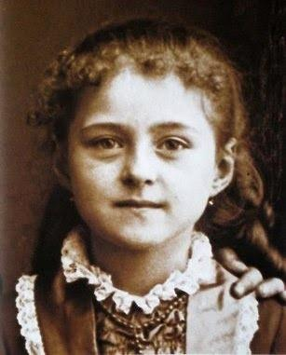
Born
26 August 1910
Place
Skopje
Macedonia
At the age of 12
She decided to be a missionary
At the age of 18
She left her paternal home
Agnes Gonxha Bojaxhiu
Notes:
A short information about Mother Teresa is introduced here.

Slide 11
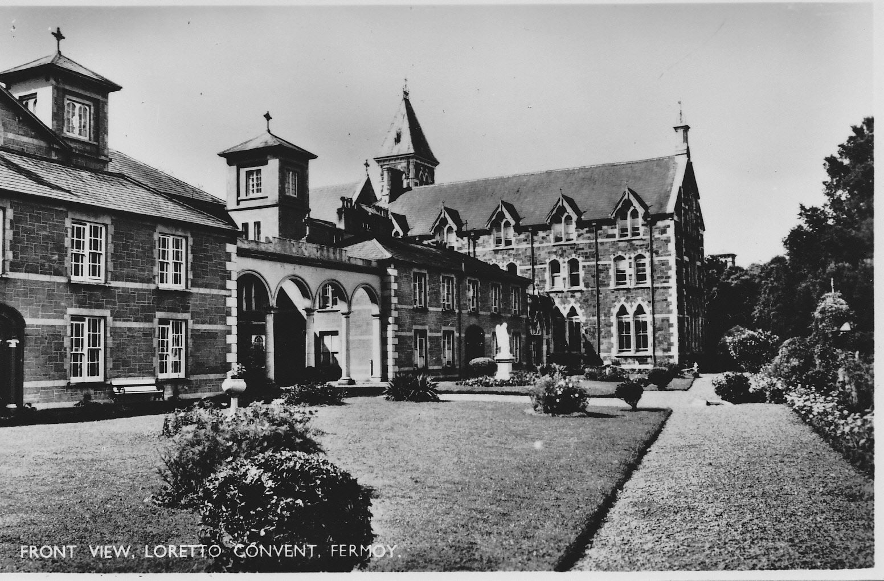
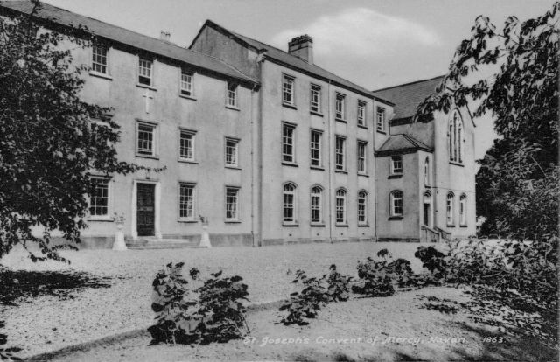
The Sister’s of Loreto, an Irish community of nuns
After leaving her paternal home she joined here.
Notes:
When she left her paternal home, she joined here first.

Slide 12
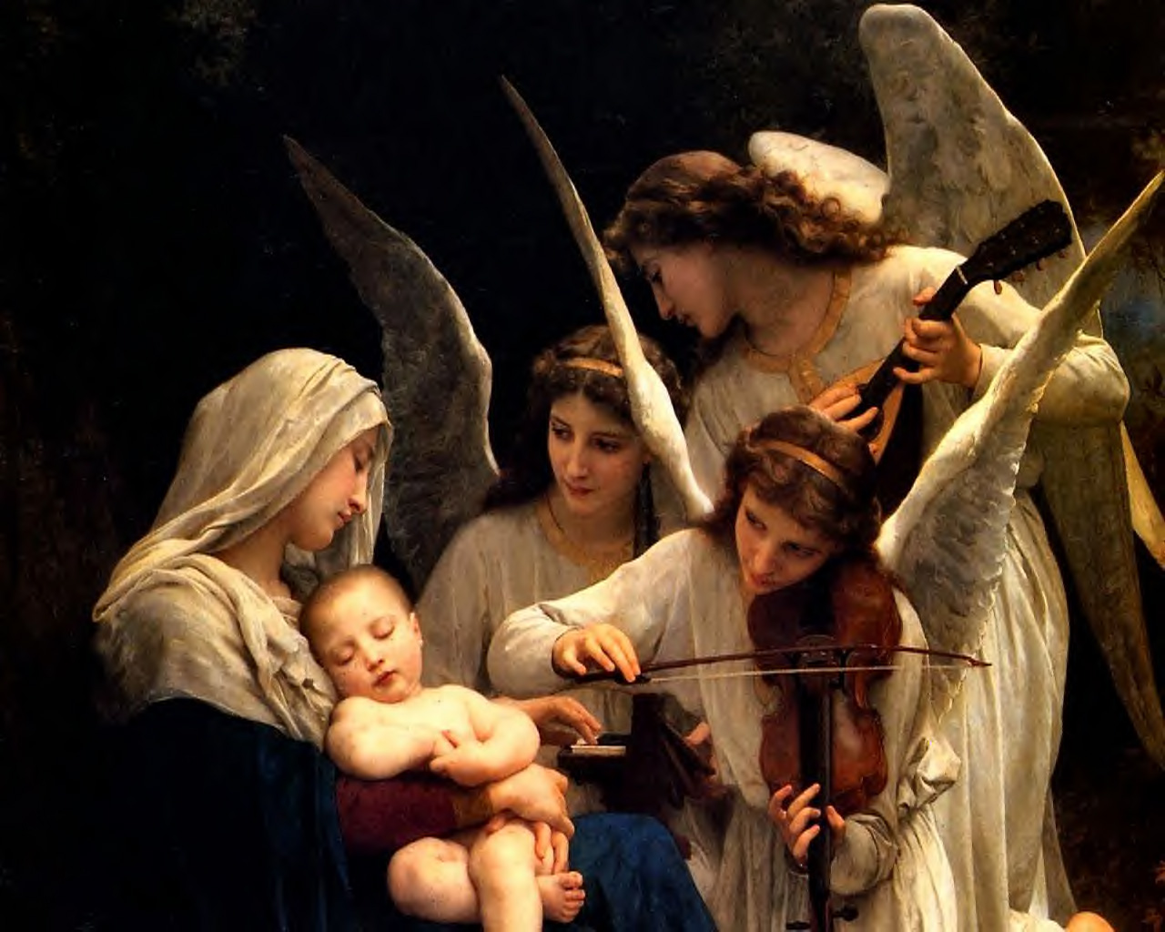
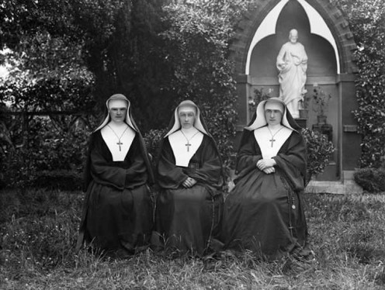
Institute of Blessed Virgin Mary Dublin
at present.
The Institute of the Blessed virgin Mary in Dublin where she was trained.
Notes:
She was trained here.

Slide 13
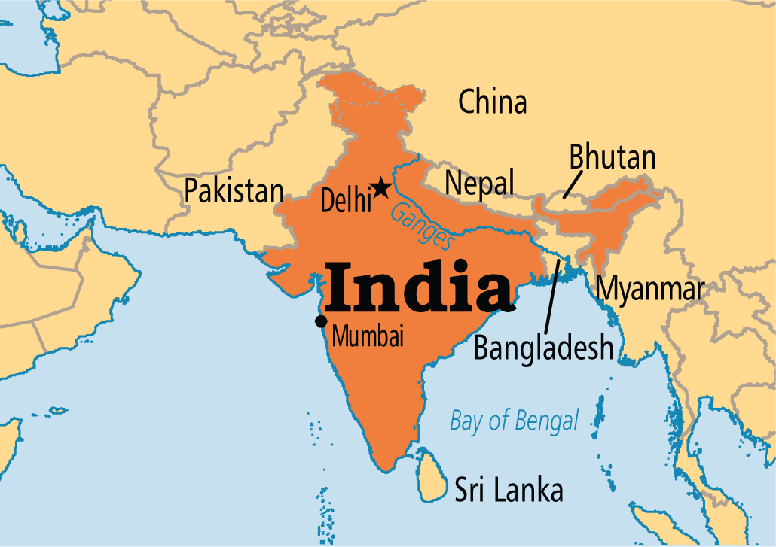
Then she came to
Notes:
A trigger is added with the flag of India. To show India in a map you may click on the flag of India.

Slide 14
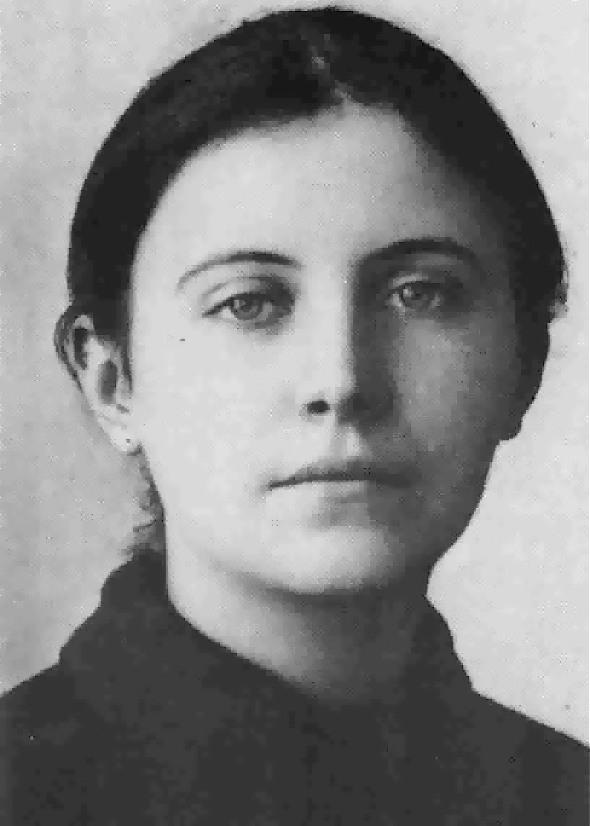
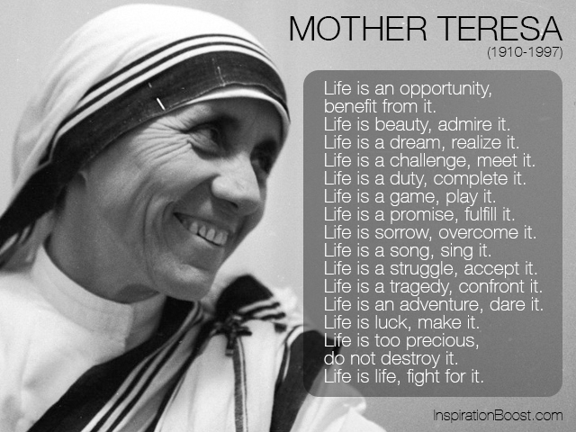
On May 1931
to
Agnes Gonxha Bojaxhiu
to
Teresa, then Mother Teresa
Notes:
‘Agnes Gonxha Bojaxhiu’ changed into ‘Teresa’ in 1931 is shown here.

Slide 15
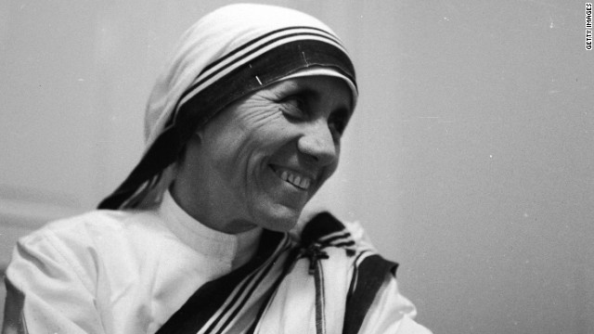
On May 24, 1931 she took her initial vows as a nun and continued to 1948.
Notes:
1931 is the traffic point of her life. Besides changing her name she vows as nun from here and lasts up to 1948.

Slide 16
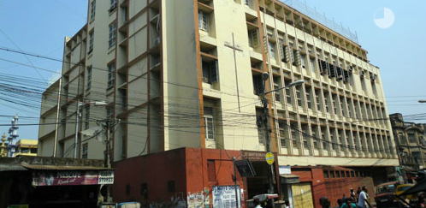
St. Mary’s High School, Calcutta (Now Kolkata)
Mother Teresa taught geography and theology at this school.
Notes:
St. Mary’s High School old model picture is not clear. So the latest one is shown here.

Slide 17
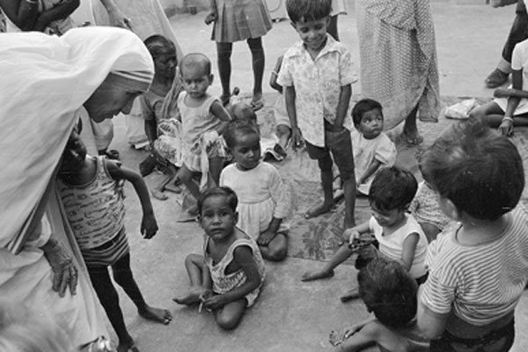
Poverty in Kolkata had a deep impact in her mind and in 1948 she devoted herself to work with the poor in Kolkata.
Notes:
Mother Teresa was impacted deeply observing the prevailing the poverty of the then Calcutta in1948.

Slide 18
Let’s Search the key words

Slide 19
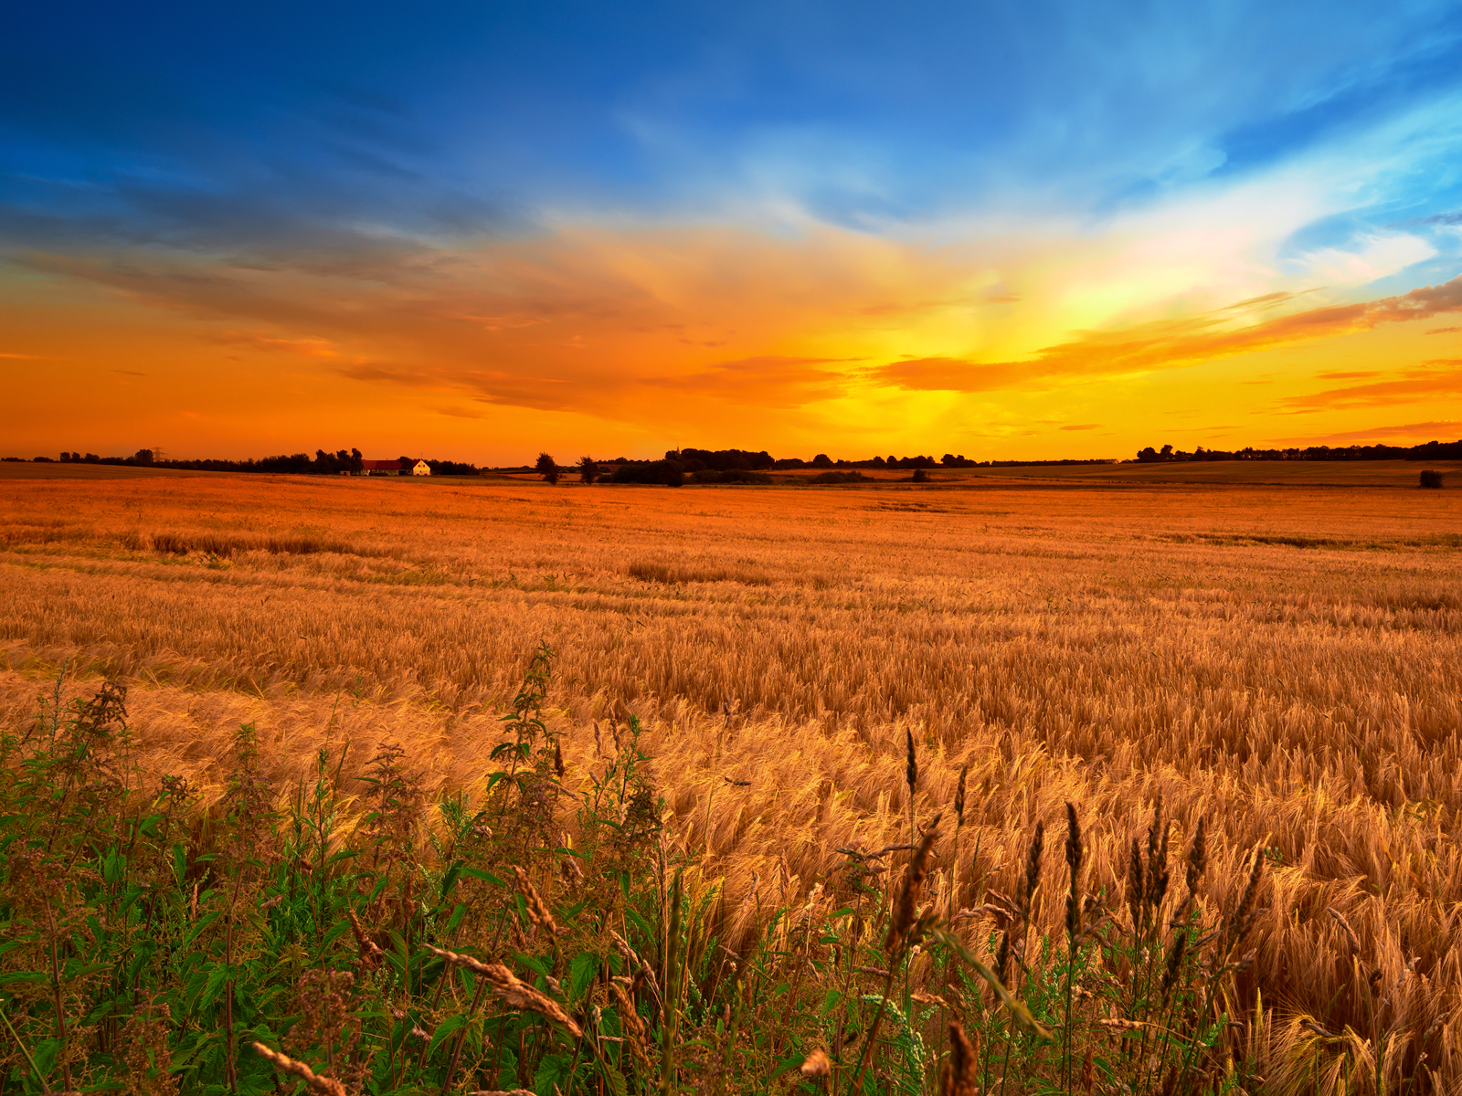
Autumn
Meaning
The season that comes after the rainy season
Nature takes a beautiful view in Autumn.
Notes:
Teacher may conduct this option according to animation.

Slide 20
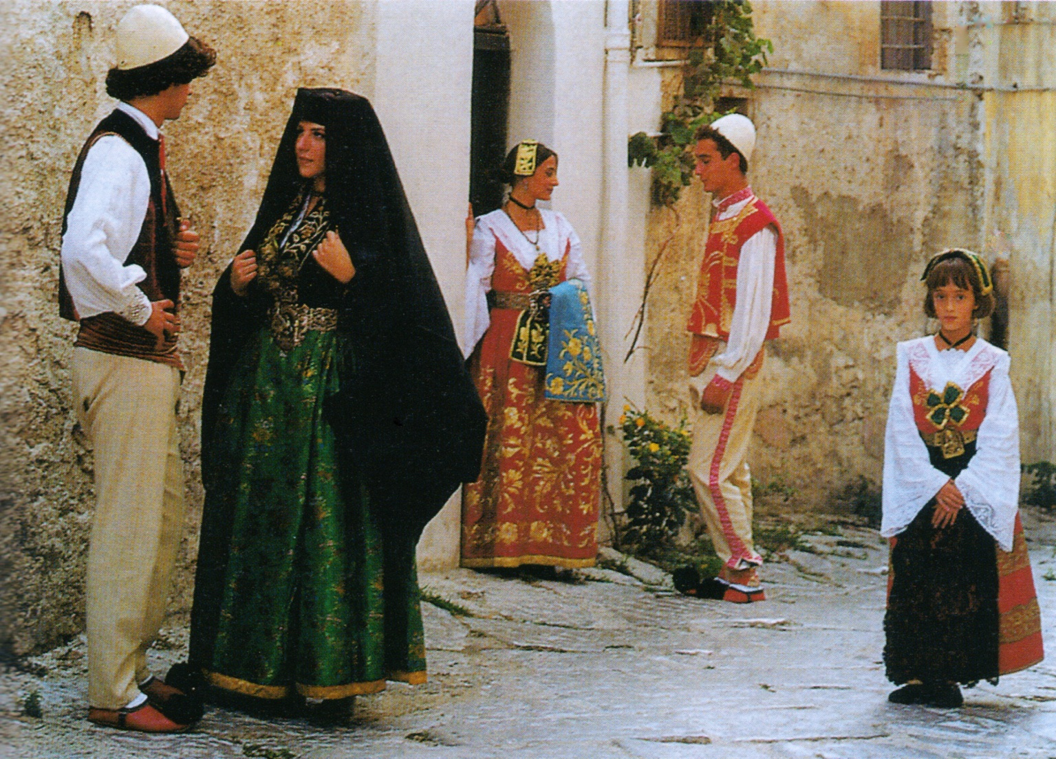
Descent
Meaning
Origin, Parentage, birth in the same group.
Mother Teresa was born in an Albanian descent.
Notes:
Teacher may conduct this option according to animation.

Slide 21
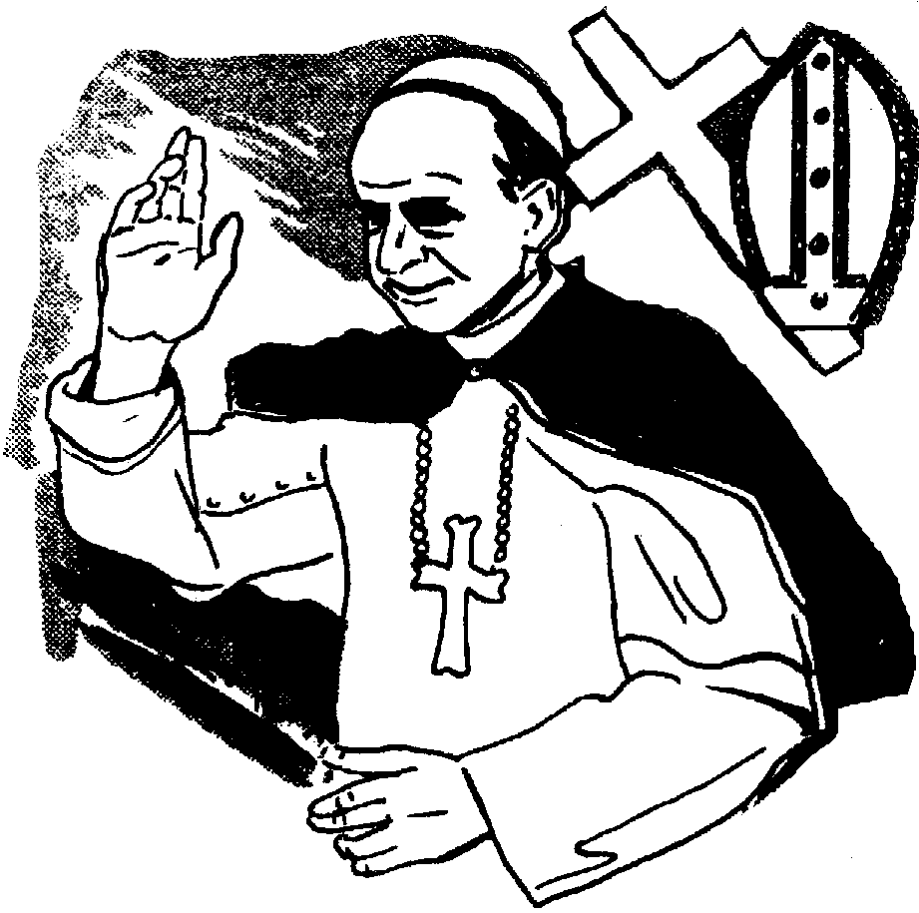
Catholic
Meaning
a religious division of Christianity
Mother Teresa was born in a Catholic merchant's family.
Notes:
Teacher may conduct this option according to animation.

Slide 22
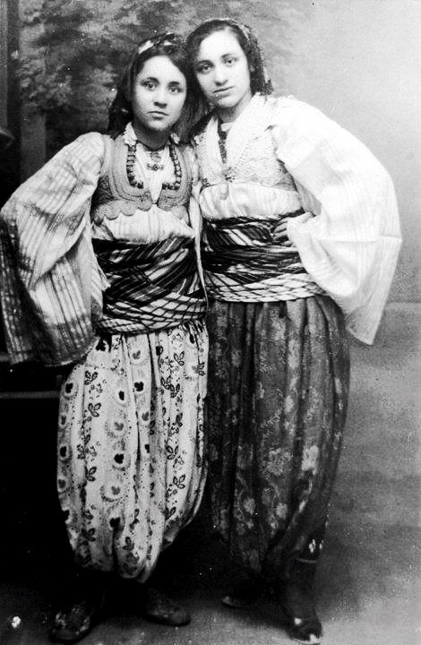
Siblings
Meaning
brother or sister
She was the youngest of the three siblings.
Notes:
Teacher may conduct this option according to animation.

Slide 23
urge
persuade someone to do something
missionary
person sent to promote Christianity
parental
connected to a parent or parents
community
a group of people living together
nun
a member of a religious community of women
vow
oath, pledge
theology
the study of religious faith
convent
a Christian community of nuns
devote
sacrifice, dedicate
slum
an area of a city that is very poor

Slide 24
Let us have a tour from the text.
Dear learners,
Open your book at page 99 and read silently from “It was Autumn, August 1910………… among the poorest of the poor in the slums of Kolkata, to answer the questions below.
What does ‘mother of humanity’ mean in the text?
(a) a good mother (b) a kind mother who has many children
(c) a mother who likes humans (d) a mother figure who serves the poor like her own children
Notes:
Teacher may conduct this option to make all the information of the topic clear to the students through silent reading. He may help them moving and monitoring in the class room.

Slide 25
Let’s read the text

Slide 26
A Read the text and choose the best answer.
It was Autumn. August 26, 1910. A little girl was born to an Albanian descent, rich Catholic merchant’s family in a small town called Skopje, Macedonia. She was the youngest of the three siblings and was named Agnes Gonxha Bojaxhiu. Who had known that this tiny, little girl would one day become the servant of humanity– loving and serving the poorest of the poor and become the mother of humanity. Yes, we are talking about none other than Mother Teresa. At the age of 12, she heard a voice from within her that urged her to spread the love of Christ. She decided that she would be a missionary. At the age of 18 she left her parental home. She then joined an Irish community of nuns called the Sisters of Loreto, which had missions in India.
After a few months of training at the Institute of the Blessed Virgin Mary in Dublin, Mother Teresa came to India. On May 24, 1931, she took her initial vows as a nun. From 1931 to 1948, Mother Teresa taught geography and theology at St. Mary's High School in Kolkata (then Calcutta). However, the widespread poverty in Kolkata had a deep impact on Mother Teresa and in 1948 she received permission from her superiors to leave the convent and devote herself to caring for the poorest of the poor in the slums of Kolkata.
Notes:
Teacher may use it any purpose he needs. Specially the students who have no text book with them, it may be helpful to them for silent reading.

Slide 27
Why did mother Teresa want be a missionary?
Because she heard
(a) the voice of her neighbours discussing it. (b) a voice in her dream.
(c) a voice within herself. (d) the voice of her parent about talking it.
3. Mother Teresa set out to join the missionary of the Sister’s of Loreto in the year.
(a) 1927 (b) 1928
(c) 1929 (d) 1930
4. Mother Teresa took her vows at the age of.
(a) 18 (b) 19
(c) 20 (d) 21
Notes:
Evaluation chapter.

Slide 28
B Read the text in A again and answer the questions.
1 Where did mother Teresa’s ancestors come from?
2 Where was her father’s home?
3 Why did she want to become a missionary?
4 What made her different from other girls at such an early age? What words and expressions are used in the text to describe this difference?
5 What did Mother Teresa do in the first seventeen years in India?
Notes:
Teacher may evaluate the students asking or writing the answers of thses questions.

Slide 29
Check your answers
1. ------ Albania
2. --------- at Skopje in Macedonia.
3. --------- to spread the love of Christ.
4. In her early age, Mother Teresa heard a voice from inside. It urged her to spread the love of Christ. So, she decided to be a missionary. All these made her different from other girls.
A voice from within, urged, love of Christ, missionary, mother of humanity etc are used in the text to describe this difference.
5. ----------- Mother Teresa taught geography and theology at St. Mary’s High School in Kolkata.

Slide 30
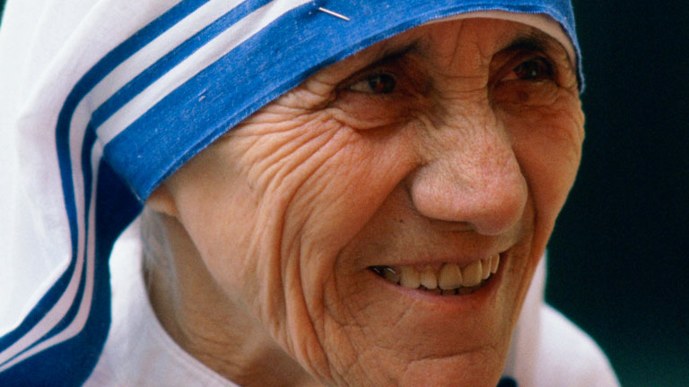
C Look at the picture and talk about her in pairs. Take the help of the question given below.
1. How old is she? Why do you think so?
2. What is she wearing?
3. How has she worn it?
Notes:
This is pair work option. Teacher may make a pair with two students to conduct this option

Slide 31
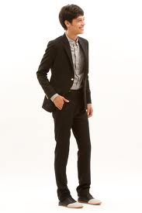
A discussion is given below
Hi friend, How are you?
I am fine and you?

Slide 32
Fine. Do you know who she is?
Yes, she is Mother Teresa.

Slide 33
How have you come to know her?
I have read about her in the newspaper. Now can you tell me how old she is?

Slide 34
Yes, she is over 80.
Why do you think so?

Slide 35
In her face, there are a lot of wrinkles. Can you tell what she is wearing?
Yes, it is a sharee that is the uniform of a nun.

Slide 36
Ok. Can you tell how she has worn it?
Yes, she has worn it by hiding her hair as a nun does.

Slide 37
Thank you.
Welcome.

Slide 38
Evaluation
Fill in each gap with a suitable word of your own based on the information from the text.
Agnes Gonxha Bojaxhiu was born on 26 August 1910, in Skopje in Macedonia. She was born to (a) ………… heritage. She was the youngest of the three siblings. At 18, she decided to be an (b) ………… . She joined the Loreto Sisters of Dublin (c) ………… had missions in India. In 1931, she made her first vows as nun, choosing the name of Teresa. She began a career (d) ………… theology and geography at St Mary’s High School in Kolkata. She could not but (e) ………… pity for the impoverished people of Kolkata.
Albanian
abbess
that/which
teaching
feel

Slide 39
Home Work
Write a summary of the passage in your own words in 150 words. .
Notes:
Students are supposed to write an article of a noble man or woman like Begum Rokeya or any other persons to practice writing skill.

Slide 40
Thank you so much.
Notes:
Ending slide.

