Slide 1
Welcome

Slide 2
Introduction of the teacher
Md Tazul Islam
Assistant teacher
Fokirnala govt primary school
Manikchari, Khagrachari.

Slide 3
Subject:English
Class: Two
Unit :13
Lesson :1-3
Total Time:35 minute
Date .

Slide 4
Lets see a video

Slide 5
Lesson : Days of the week
Todays lesson: A look listen and say
Page:26

Slide 6
Learning outcomes:students will able to
Listening:
1.1.1 become famillier with english sounds by listening to common english words.
3.1.2 understant simple question nd statements about familiar objects.
Speaking:
1.1.1 reapeat after the teacher simple words and phrases with proper sound and stress.
1.1.2 say simple words and phrases with proper sound and stress.
3.1.2 ask and answer questions about familliar objects.
5.1.1 say the names of the days of the week.
Reading :
3.1.1 recongnize and read the days of the week.

Slide 7
saturday
Sunday
Monday

Slide 8
friday
Tuesday
Thursday
Wednesday

Slide 9
Lets see a video

Slide 10
Monday
Tuesday
Sunday
Days of the week
Saturday
Wednesday
Thursday
Friday

Slide 12
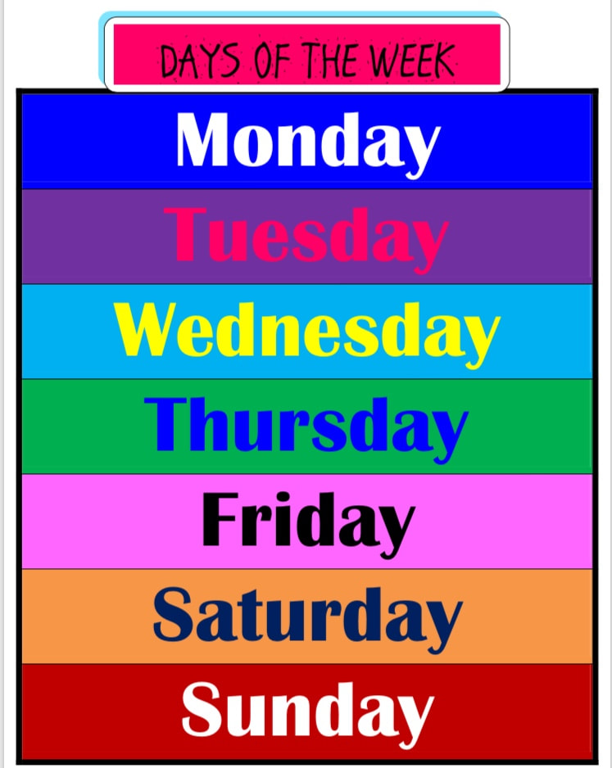

Slide 13
Open your book at page 26
Students read with the teacher

Slide 14
Pair work
One student say Sunday.
Other student say Monday.
s

Slide 15
Thursday
Wednesday

Slide 16
Monday
Friday
Saturday

Slide 17
Sunday
Tuesday

Slide 18
THANKYOU

