Slide 1
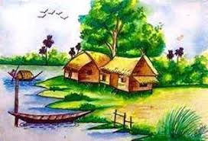
Welcome

Slide 2
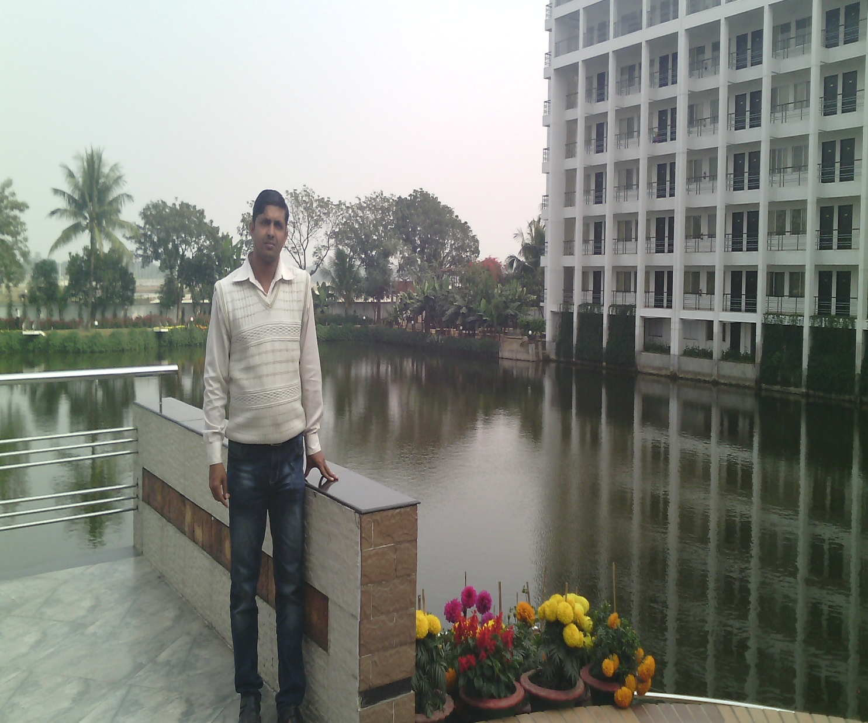
English For Today
Class-Nine ,Ten
Ujjal Kumar Ghosh
Assistant Teacher (English)
Chuadanga Krishnanagor high school
Panjia,Keshabpur,Jassore

Slide 3
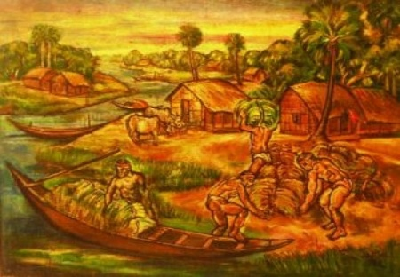
What are you looking in the picture?
Famous art

Slide 4
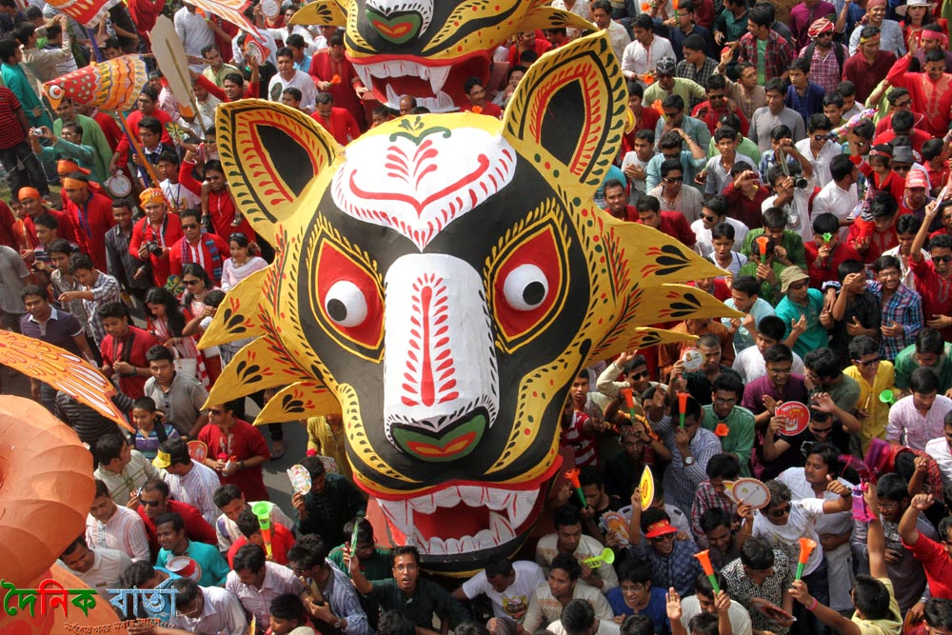
Procession of carukla
What are you looking in the picture ?

Slide 5
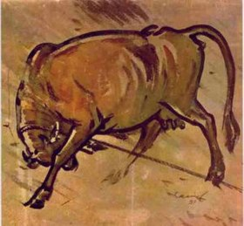

Slide 6
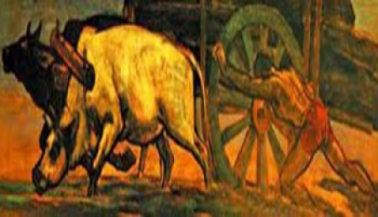
Who is the painter of these above picture?

Slide 7
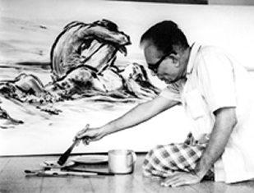
Do you know this man?
the great artist

Slide 8
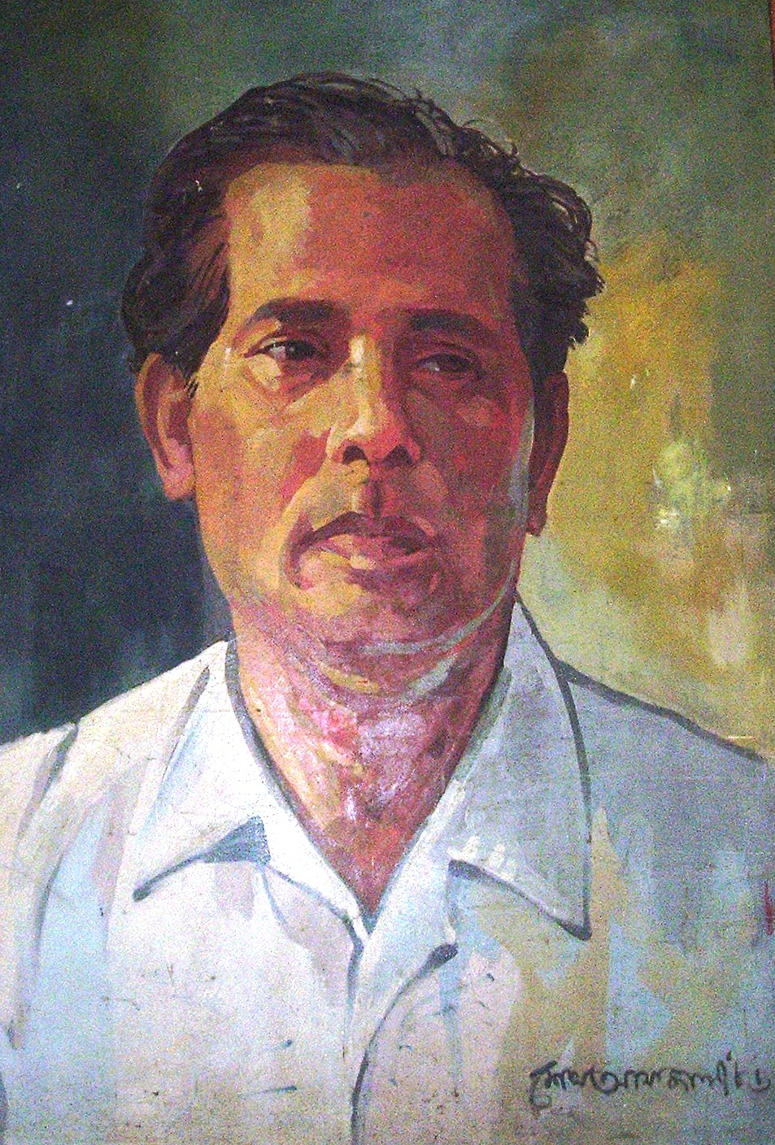
Who is the Pioneer of Bangladeshi modern art?
Zainul Abedin

Slide 9
Today’s lesson is---
Zainul abedin, the great artist
Class : Nine, Ten
English first paper
Unit: Seven
Lesson : One
Time:50 minutes

Slide 10
Learning outcomes
By the end of the lesson learning will be able to
Identify the picture .
Use words and make sentences.
Choose the correct answer from the alternative
Ask and answer question.

Slide 11
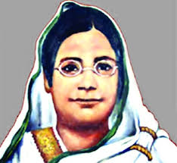
pioneer
Pioneer means developer, innovator , front runner ,
Begum Rokeya was a pioneer of women's awakening

Slide 12
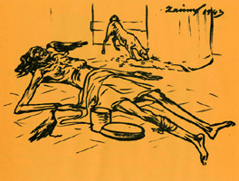
famine
Famine means scarcity of food, food shortages, deprivation
Zainul documented the harsh famine of 1940

Slide 13
compassion
Compassion means pity ,sympathy
Zainul depicted these extremely shocking pictures with human compassion.

Slide 14
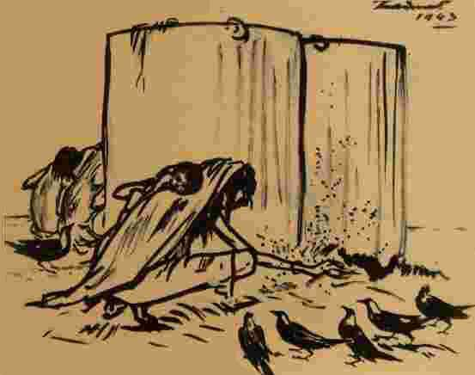
Let us have a tour from the text book

Slide 15
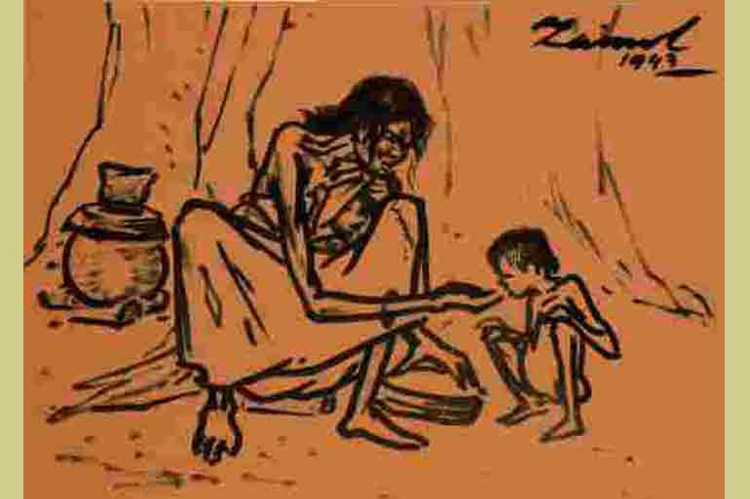

Slide 16
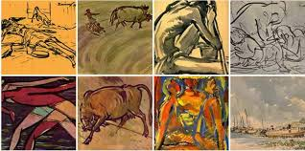

Slide 17
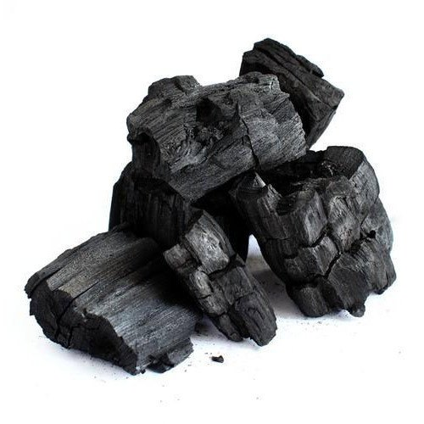
burning charcoal
ordinary packing paper

Slide 18
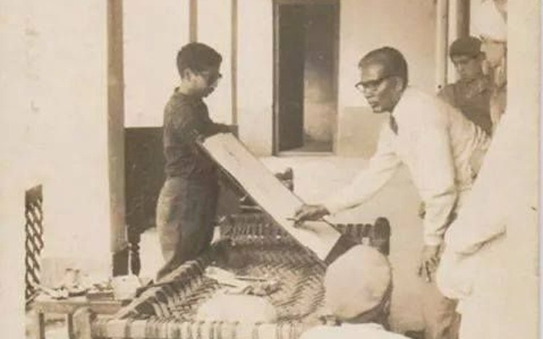

Slide 19
The pioneer of Bangladeshi modern art Zainul Abedin is widely acclaimed for his Bengal ‘Famine Sketches’. Through a series of sketches, Zainul not only documented the harsh famine of 1940 but also showed its sinister face through the skeletal figures of the people destined to die of starvation in a man-made plight. He depicted these extremely shocking pictures with human compassion. He made his own ink by burning charcoal and using cheap ordinary packing paper for sketching. He produced a series of brush and
ink drawings, which later became iconic images of human sufferings.

Slide 20
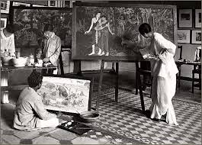
Government School of Art, Calcutta

Slide 21
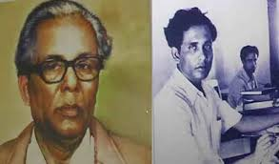

Slide 22
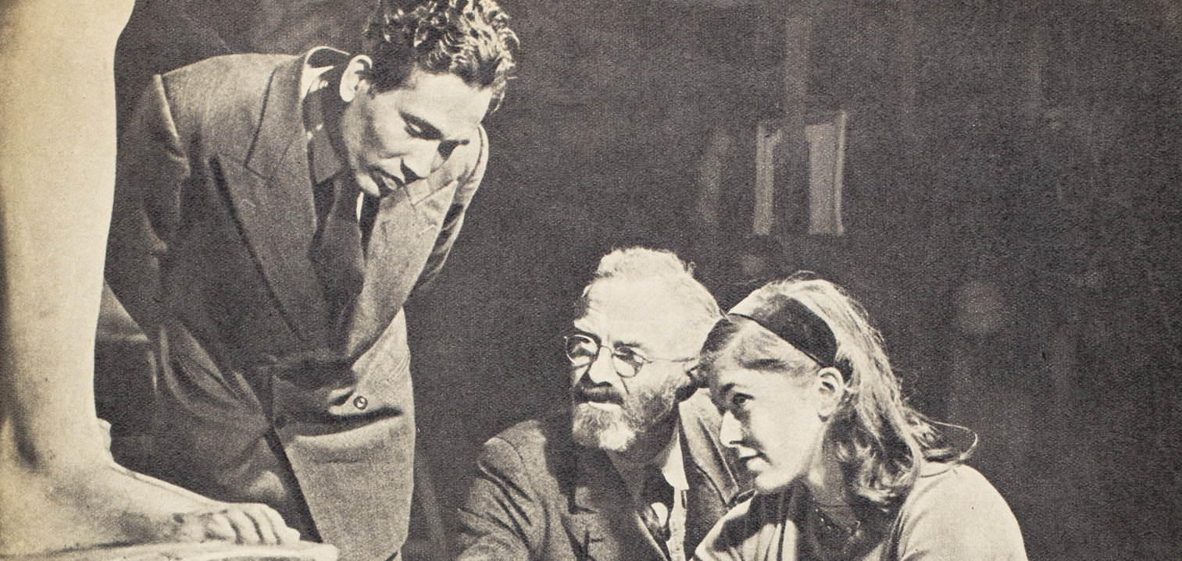
The Slade School of Arts, London

Slide 23
Zainul developed a knack for drawing and painting when he was a high school student. After completing high school, he got admission to the Government School of Art, Calcutta (now Kolkata). He graduated with the first position in first class in 1938. He was appointed teacher of the Art School while he was still a student there. He also attended the Slade School of Arts, London in 1951-52.

Slide 24
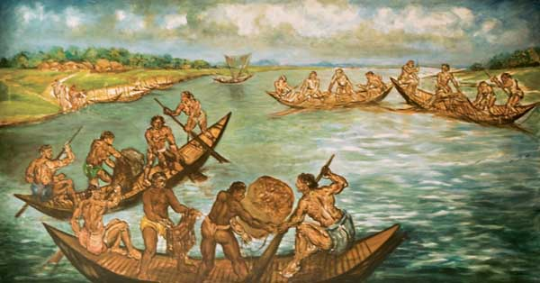
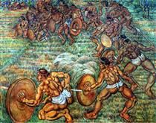
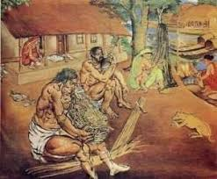
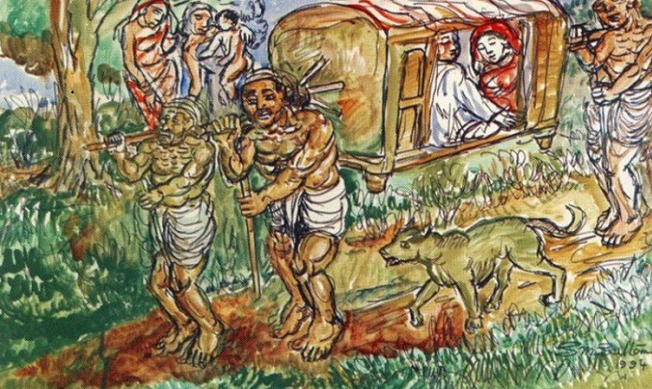

Slide 25
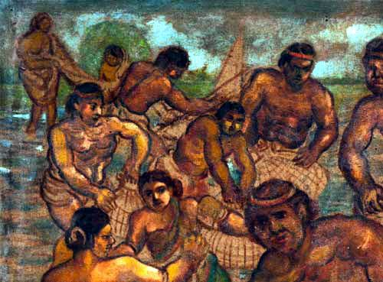
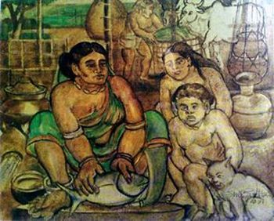

Slide 26
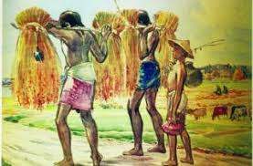
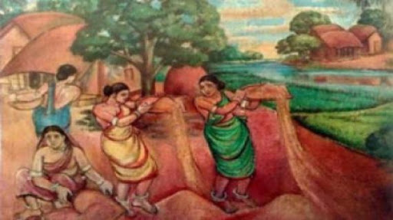

Slide 28
Zainul Abedin is considered the founding father of Bangladeshi art. He was an artist of outstanding talent and earned international reputation. For his artistic and
visionary qualities, he is referred to as Shilpacharya meaning ‘great teacher of art’ in Bangladesh. He was the first Principal of the first art school in Dhaka in East Pakistan (now Bangladesh). He organized the Nabanna (harvest) exhibition in 1969.In the exhibition, a 65-foot long scroll portraying the rural East Pakistan in phases from abundance to poverty. This intensified the already heightened non-cooperation movement against the Pakistan regime. The exhibition was symbolic of the artists’ protest and a milestone in demanding cultural and political freedom.

Slide 30
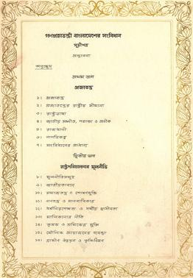
Zainul designed the pages of Constitution of Bangladesh

Slide 31
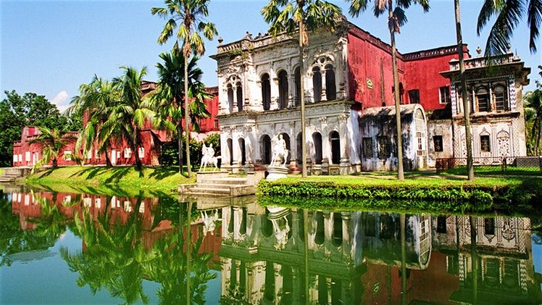
Sonargoan

Slide 32
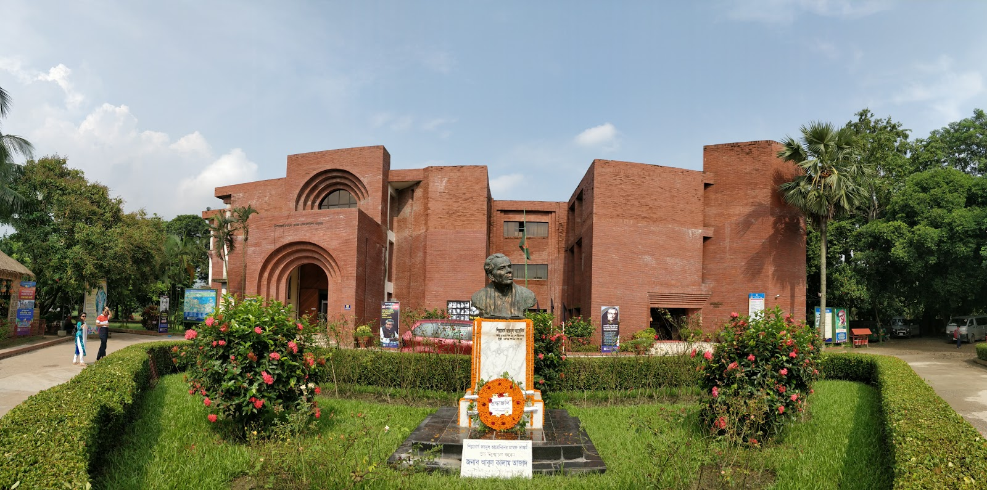
Folk Art Museum at Sonargoan

Slide 33
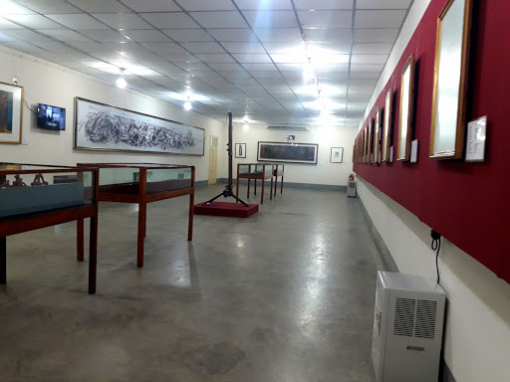
Zainul Abedin Shangrahasala

Slide 34
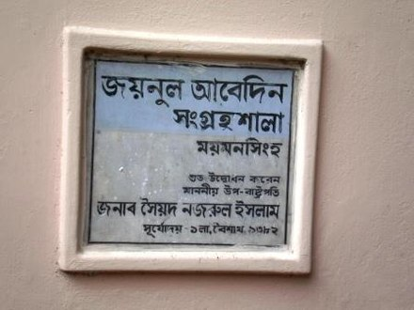

Slide 35
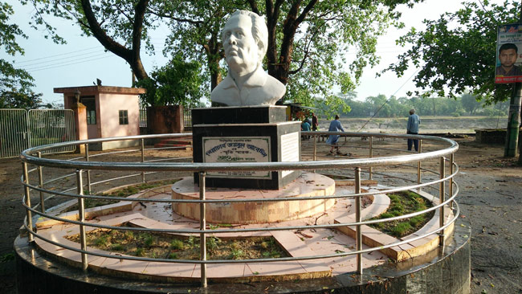

Slide 36
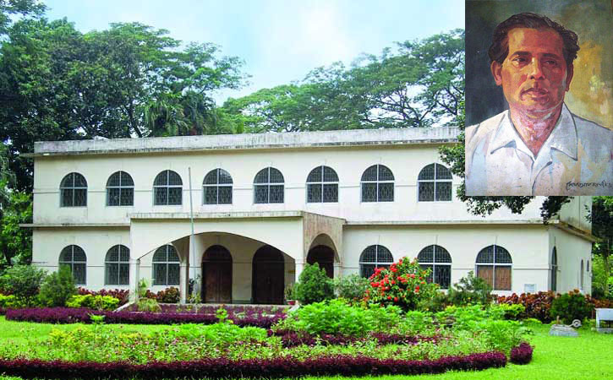
Zainul Abedin Shangrahasala, Mymensing .

Slide 38
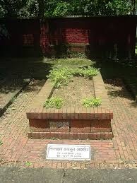

Slide 39
Zainul’s dynamic style of work is evident in a 30 foot long scroll painting called Manpura,which was done to commemorate the death of hundreds and thousands of people in the devastating cyclone of 1970.He designed the pages of Constitution of Bangladesh. He founded the Folk Art Museum at Sonargoan, and also Zainul Abedin Shangrahasala, a gallery of his own works in Mymensing in 1975. The river Brahmaputra plays a predominant role in his paintings and a source of inspiration all through his career. Much of his childhood was spent near the scenic beauty of the river Brahmaputra. A series of water colours that Zainul did as his tribute to the river earned him the Governor’s Gold Medal in an all-India exhibition in 1938. This was the first time when he came into spotlight and this award gave him the confidence to create his own visual style. Zainul was born in Kishoreganj on 29 December 1914 and died on 28 May 1976.

Slide 40
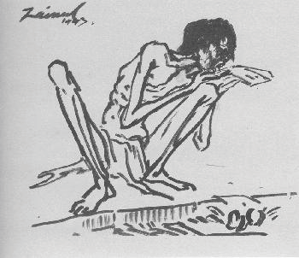
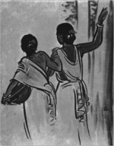
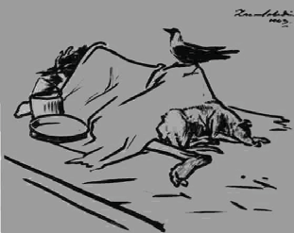
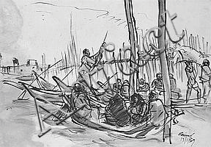
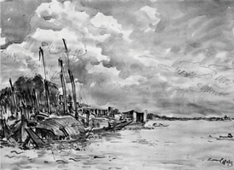
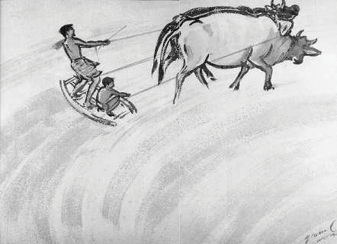
B Look at the series of pictures. Work in groups and talk about them. Now briefly write about what each picture portrays.
Picture 1
Picture 2
Picture 3
Picture 4
Picture 5
Picture 6

Slide 41
Picture 7
Group Work
Answer of Group A:Picture1.It depicts a skeletal figure , that is sitting beside a road and suffering from being hungry.

Slide 42
Answer of Group B: Picture 2:It portrays two women , who are going to work to survive.
Answer of Group C:Picture3:It delineates a very heart rending picture . Here a crow is sitting on a dead body , Who died from hunger.
Answer of Group D:Picture 4:In this picture there is a watery place, where there are some boats, some people are in the boats and some are sailing the boats.
Answer of Group E:Picture5:It portrays the picture of a village by the side of a river . We see that the sky is covered with clouds.
Answer of Group F: Picture6:In this picture two farmers are on a leveler . They are at the back of two cows .They are leveling the soil and pulling the cows by sitting to keep the balance.
Answer of Group G:Picture 7:In this picture a cart is being driven by two cows with Much hardship and a man is pushing the cart from its behind.

Slide 43
Individual Work
D Listen to the CD/teachar and tick the word/s you hear.
1 The US Ambassador to Bangladesh considers Zainul Abedin a
a great painter.
b popular painter.
c master painter.
d unique painter.
2 Zainul’s art gallery was set up in ---------------.
a 1972.
b 1973.
c 1974.
d 1975.
Master painter
1975

Slide 44
3 The number of Zainul’s artwork preserved in the gallery is ---------
a 53.
b 62.
c 65.
d 75.
4 The US Ambassador commented that the museum is a global
a wealth.
b asset.
c gift.
d treasure.
5 Mozena visited the gallery for
a 3 hours.
b 2 hours.
c 1 hour.
d ½ hour.
62
Treasure
1 hour

Slide 45
Homework
1 Write in detail how Zainul Abedin portrayed the sufferings of people.
2 What influence did the river Brahmaputra have on Zainul Abedin?
How did he show this influence in his works?
3 What did these works earn him later in his life?
4 How did his art help to intensify the noncooperation movement?

Slide 46
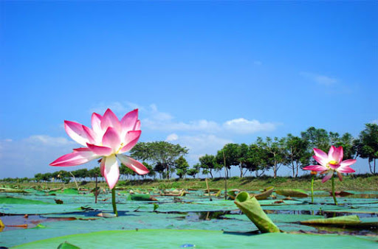
Goodbye

