Slide 2
Teacher’s Identity
Md. Mahfujul Hoq Romel
Assistant Teacher
Satbaria Govt. Primary School.
Chandanaish, Chattogram.
mromel071@gmail.com

Slide 3
Sub: English
Class: 4
Time: 30 minutes

Slide 4
Warm up Activity

Slide 5
Lesson Title : Occupations
Unit : 39
Lesson : 1

Slide 6
Learning Outcomes
By the end of the lesson the students will be able to :
Say words with proper sound and stress.
Write simple WH questions.

Slide 7
Singer

Slide 8
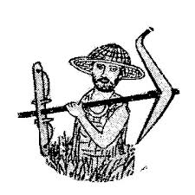
Farmer

Slide 9
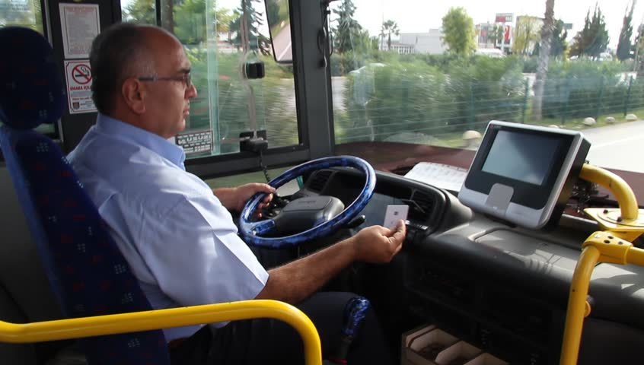
Driver

Slide 10
Photographer

Slide 11
Postman

Slide 12
Doctor

Slide 14
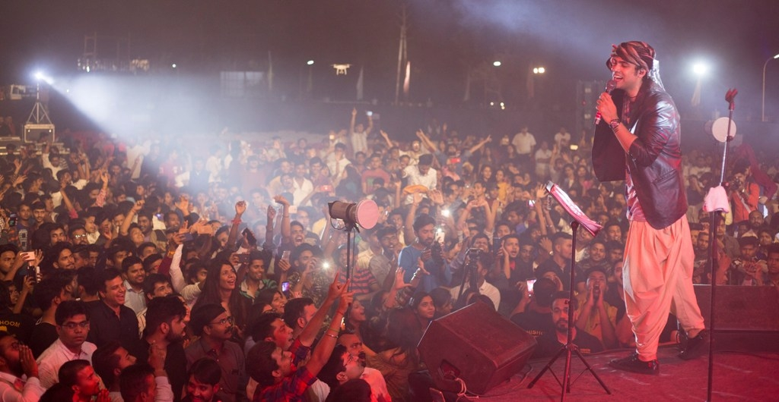
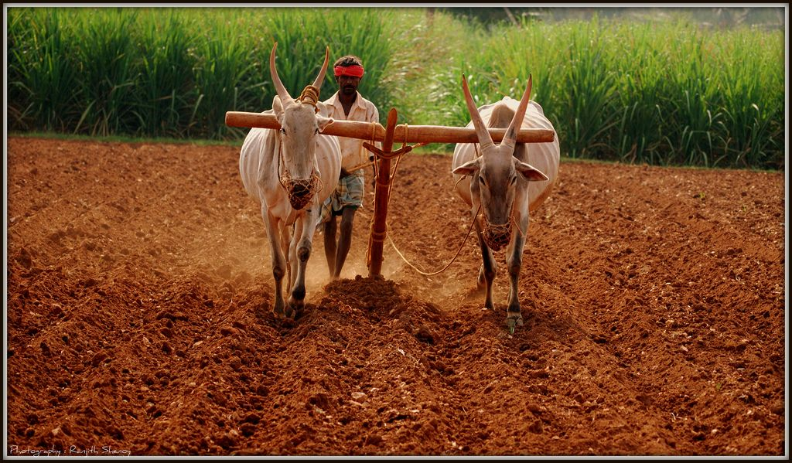
A person who sings songs is called singer.
A person who grows food is called farmer.

Slide 15
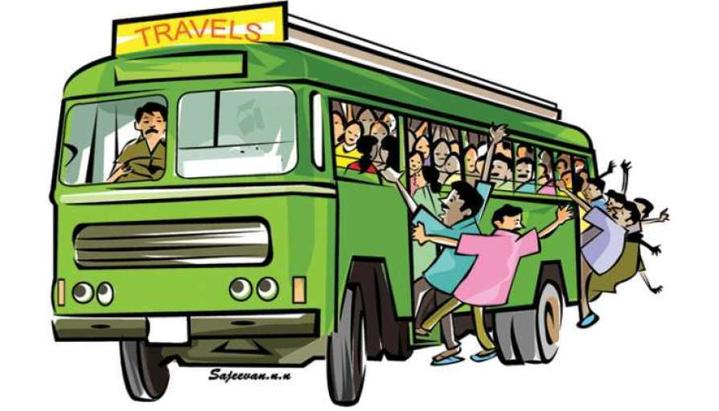
A person who drives a car or a bus is called driver.
A person who takes photos is called photographer.

Slide 16
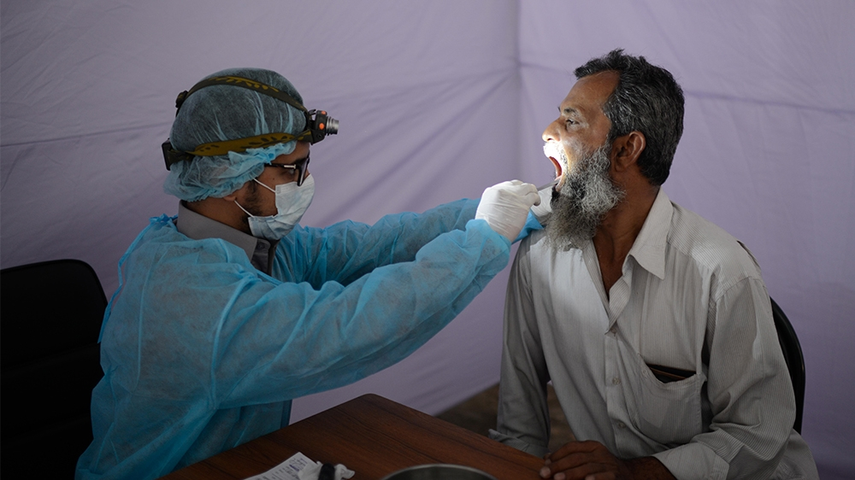
A person who brings letter to people is called postman.
A person who helps sick people is called doctor.

Slide 17
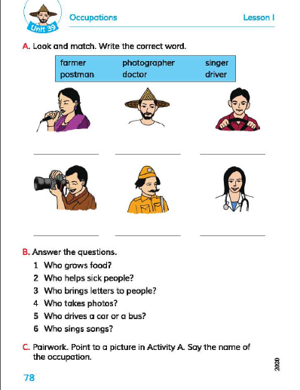
Home Task

