Slide 2
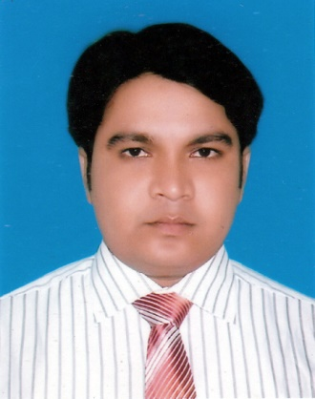
TEACHER INTRODUCTION
MD.SAIFUL ISLAM (SOHEL)
Assistant Teacher (English)
Achia High School, Aikdia.
Muksudpur, Gopalganj.
Mobile: 01717-377371
E-mail: islammdsaiful981@gmail.com

Slide 3
CLASS : Nine-Ten
Learning Area : Writing
Topic : Paragraph
Date :
LESSON INTRODUCTION

Slide 4
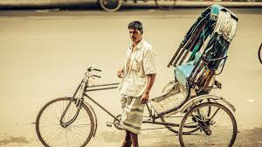
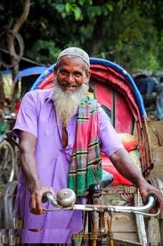
Look at the pictures below and try to guess what we are going to learn today.
What can you see in the pictures?
What does he do?

Slide 5
Today we are going to learn about………..
A Rickshaw Puller
Notes:
Teacher will ask the Students to write the topic on their Note book.

Slide 6
By the end of this lesson, Students wiil be able to........
Ask and answer questions.
Write paragraph on given topic.
Learning Outcomes

Slide 7
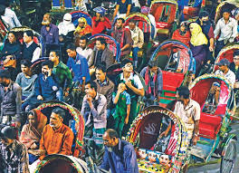
Now, answer the following questions.
Ques-1: Who is a rickhsaw puller? Where does we see him?
Ans: A rickshaw puller is a person who pulls rickshaw for his livelihood. He is seen almost everywhere in our country. He is greatly seen in big cities and towns.

Slide 8
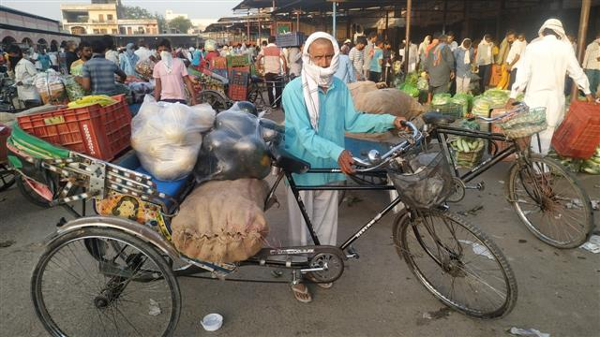
Ques-2: How does he earn his livelihood?
Ans: He earns his livelihood by pulling rickshaw. He also carries passengers and goods from one place to another on payment.

Slide 9
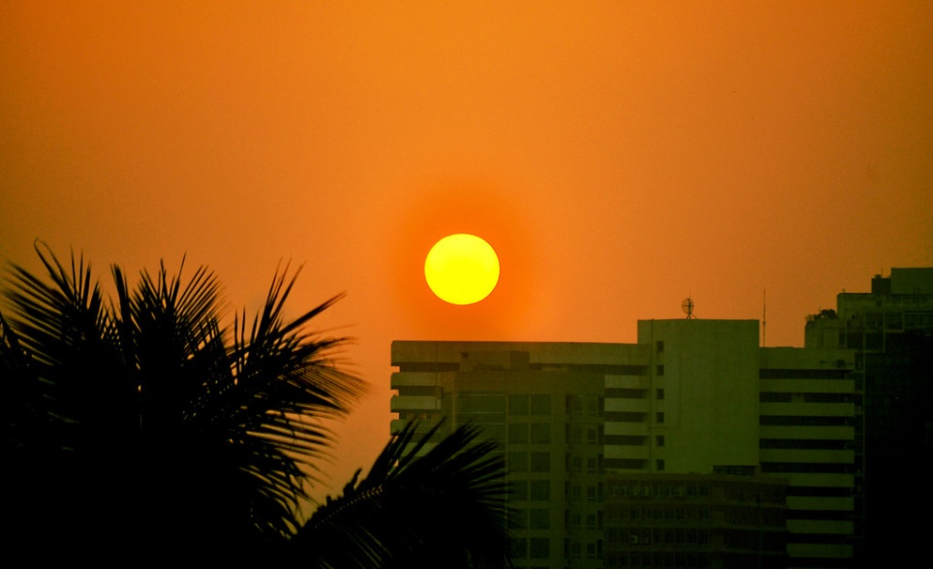
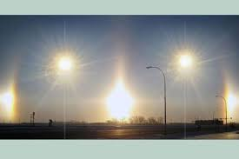
Ques-3: How long does he work everyday?
Ans: A rickshaw puller works from dawn to dusk and sometimes to late night. He has to pull the rickshaw in the sun and in the rain.
Ques-4: Does he own any rickshaw ?
Ans: Most of the rickshaw pullers do not have any rickshaw of their own. He hires a rickshaw from the owner on a daily basis. There are few who have their own rickshaw.

Slide 10
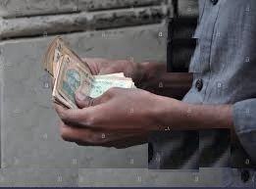
Ques- 5: How much does he earns in a day ?
Ans: He earns very little. He supports his family with hardship. If he becomes sick, he cannot drive his rickshaw and earn money.

Slide 11
Ques- 6: How does he behaves with the passengers ?
Ans: He is generally gentle by nature. He behaves gently with the passengers. But sometimes he demands high fare when the weather is very hot or foul.

Slide 12
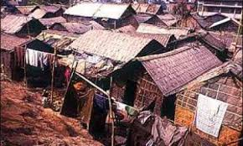
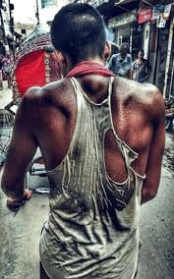
Ques- 7: Does he take any rest?
Ans: He feels tired but cannot take any rest.
Ques- 8: Where does he live in? What is his social status?
Ans: He lives in a slum. He has to live from hand to mouth as he earns very little to support his family.
Ans: His social status is very low. He cannot mix with the people of middle or high class in society. He is not respected in society either.

Slide 13
Ques- 9: What happens in case of earning very little?
Ans: When he earns very little his family passes a day with little food or starve. He leads a hard and miserable life. He cannot enjoy and happiness in his life.

Slide 14
Evaluation
What does a rickshaw puller do when someone gives him
more fare?
2. When he does not have any passenger, what does he do?
3. When does he usually starts his work?

Slide 15
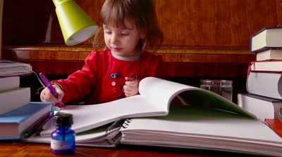
Home Work
Write a similar paragraph on the topic.....
Life of a Rickshaw Puller

