Slide 1
WELCOME
Md. Saiful Islam, Assistant teacher (English), Bagbari Chowbaria High School, Tangail Sadar Tangail

Slide 2
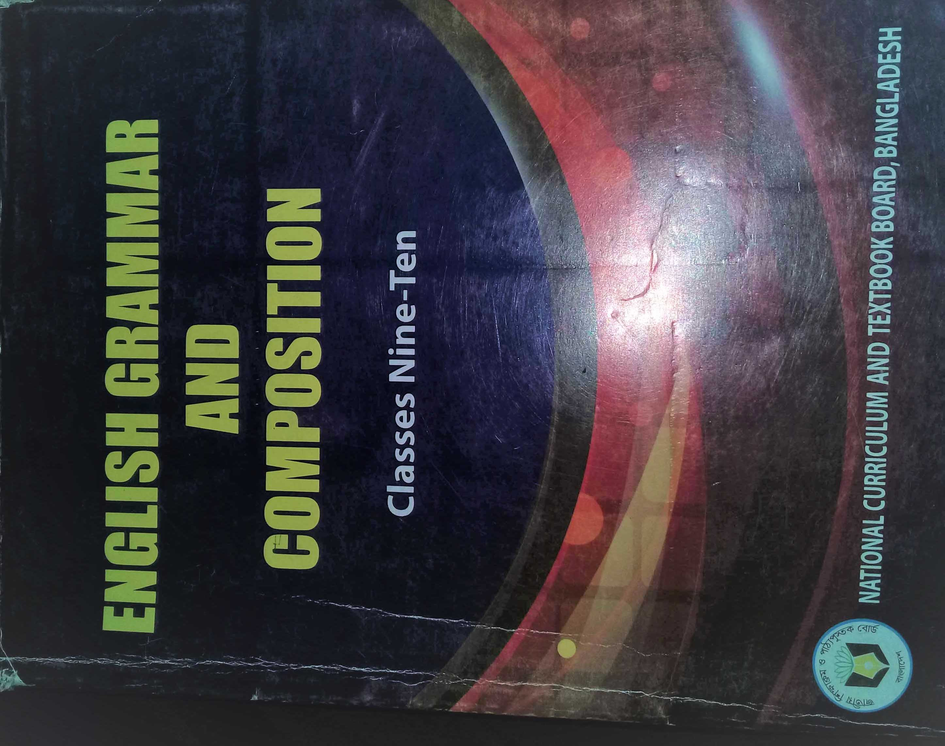
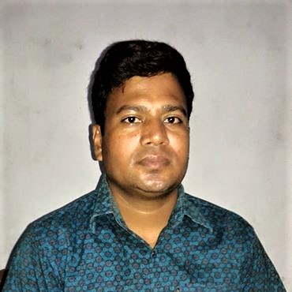
Introducing
Md. Saiful Islam
Assistant teacher (English)
Bagbari Chowbaria High School,
Tangail Sadar Tangail
Class: 9-10
Subject: English 2nd paper
Unit: 09
Topic: Tag question
Date: 01-12-2020
Md. Saiful Islam, Assistant teacher (English), Bagbari Chowbaria High School, Tangail Sadar Tangail

Slide 3
Look at the following sentences.
They are planting trees, are n’t they?
The poor live from hand to mouth, don’t they?
You are a student of class nine, aren’t you?
What are these examples?
These are the examples of tag questions.
Md. Saiful Islam, Assistant teacher (English), Bagbari Chowbaria High School, Tangail Sadar Tangail

Slide 4
Lesson declaration:
They are flying kites, aren’t they?
Tag question
Md. Saiful Islam, Assistant teacher (English), Bagbari Chowbaria High School, Tangail Sadar Tangail

Slide 5
Learning outcomes:
After finishing the lesson, learners will be
able to ----
Define tag question
Identify tag question
Use different tag questions
Define different rules
Md. Saiful Islam, Assistant teacher (English), Bagbari Chowbaria High School, Tangail Sadar Tangail

Slide 6
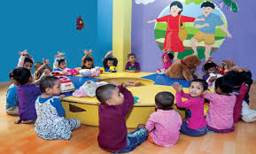
What is tag question?
A tag question is a question that is used at the end of a statement to get the support from the listeners.
They are playing, aren’t they?
She is reading, isn’t she?
Md. Saiful Islam, Assistant teacher (English), Bagbari Chowbaria High School, Tangail Sadar Tangail

Slide 7
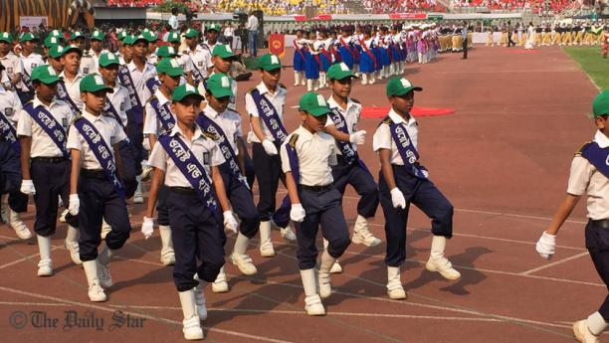
The following verbs are used to make tag questions:
am, is, are, was, were, shall, should, will, would, may, might, can , could, must, ought to, dare, need, have, has, had, do , does , did.
They are displaying their performance, aren't they?.
Md. Saiful Islam, Assistant teacher (English), Bagbari Chowbaria High School, Tangail Sadar Tangail

Slide 8
Formation of tag questions:
Am not =aren’t/ ain’t
Are not= aren’t
Is not= isn’t
Was not= wasn’t
Were not= weren’t
Shall not= shan’t
Will not= won’t
Would not= wouldn’t
May not= mayn’t
Might not= mightn’t
Must not= mustn’t
Can not= can’t
Could not= couldn’t
Have not= haven’t
Has not= hasn’t
Had not= hadn’t
Need not= needn’t
Ought not= oughtn’t
Do not= don’t
Does not= doesn’t
Did not= didn’t
Dare not= Daren’t
Md. Saiful Islam, Assistant teacher (English), Bagbari Chowbaria High School, Tangail Sadar Tangail

Slide 9
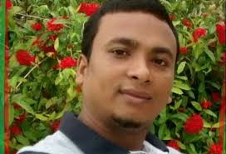
How to make tag questions with auxiliary verb:
If the sentence is positive, the structure is: Given sentence + , + verb +n’t + subject (pronoun form) + (question mark) ?
(a) We were going to school regularly, were n’t we?
(b) Mr. Arif is a qualified businessman, isn’t he?
Md. Saiful Islam, Assistant teacher (English), Bagbari Chowbaria High School, Tangail Sadar Tangail

Slide 10
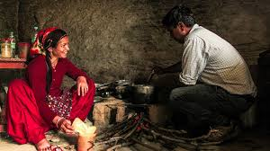
If the sentence is negative, the structure is: Given sentence + , + verb + subject (pronoun form) + (question mark) ?
(a) Cooking is not only the work of women, is it?
(b) Birds cannot swim, can they?
Md. Saiful Islam, Assistant teacher (English), Bagbari Chowbaria High School, Tangail Sadar Tangail

Slide 11
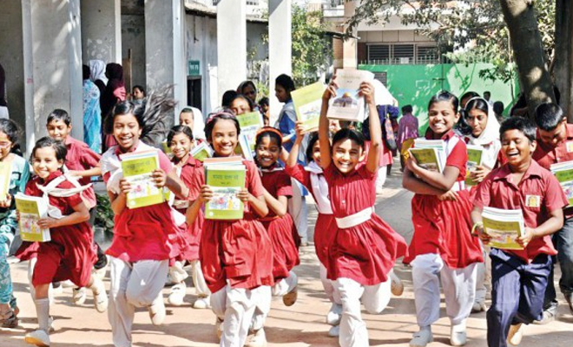
How to make tag questions without auxiliary verb:
If the sentence is positive, the structure is: Given sentence +, + do/does/did +n’t + subject (pronoun form) + (question mark) ?
(a) They go to school regularly, do n’t they?
(b) He has a book, does n’t he?
(c) Rafiq had a dog, did n’t he?
Md. Saiful Islam, Assistant teacher (English), Bagbari Chowbaria High School, Tangail Sadar Tangail

Slide 12
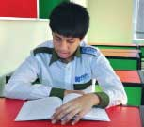
If the sentence is negative, the structure is: Given sentence + ,+ do/does/did + subject (pronoun form) + (question mark) ?
(a) Karim does not waste his time, does he?
(b) They do not swim, do they?
(c) I did not take tea, did I?
Md. Saiful Islam, Assistant teacher (English), Bagbari Chowbaria High School, Tangail Sadar Tangail

Slide 13
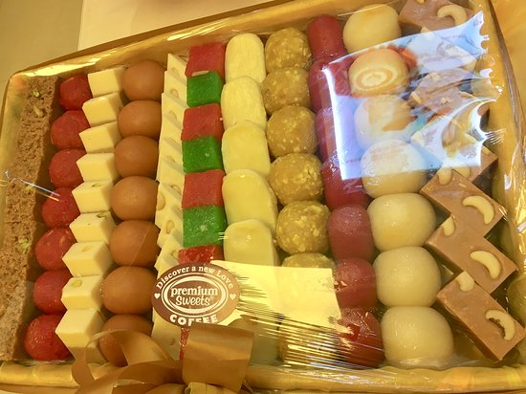
If the subjects are: every body, every one, some body, some one, any body, any one, either, all. The structure will be: given statement + , + aren’t/weren’t/won’t/wouldn’t/mustn’t/shouldn’t/can’t/couldn’t/mayn’t/needn’t/daren’t/haven’t/hadn’t+ they +? ( incase of auxiliary verbs)
(a) Every one is in the meeting, aren’t they?
(b) Every body is fond of sweet, are n’t they?
Md. Saiful Islam, Assistant teacher (English), Bagbari Chowbaria High School, Tangail Sadar Tangail

Slide 14
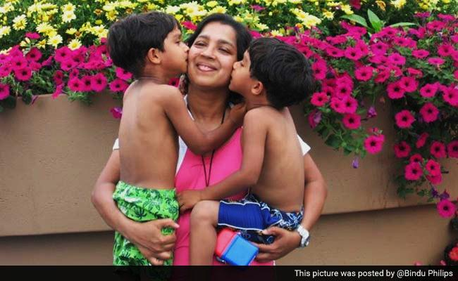
If the subjects are: every body, every one, some body, some one, any body, any one, either, all then the structure will be: given statement + , + don’t / didn’t + they +? ( if there is no auxiliary verbs)
(a) Every one wants to be happy, don’t they?
(b) Every mother loves her child, don’t they?
Md. Saiful Islam, Assistant teacher (English), Bagbari Chowbaria High School, Tangail Sadar Tangail

Slide 15
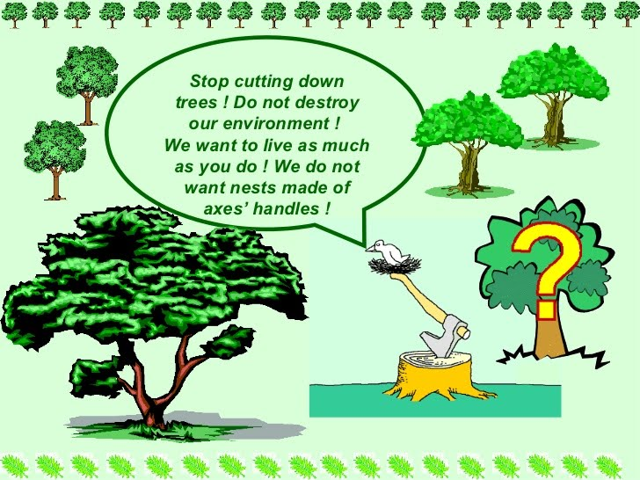
If the subjects are: no body, no one, none, neither. The structure will be: given statement + , + are/ were/ will/can/could /must/might/should/need+ they +? ( incase of auxiliary verbs)
(a) No body is happy, are they? (b) None can live without trees, can they?
Md. Saiful Islam, Assistant teacher (English), Bagbari Chowbaria High School, Tangail Sadar Tangail

Slide 16
If the subjects are: no body, no one, none, neither. The structure will be: given statement + , + do / did+ they +? ( if there is no auxiliary verbs)
(a) No body dislikes playing, do they? (b) None took their seat, did they?
Md. Saiful Islam, Assistant teacher (English), Bagbari Chowbaria High School, Tangail Sadar Tangail

Slide 17
How to tag of imperative sentence:
Given sentence + , (comma) + will you/ can you/ can’t you/ won’t you +? (question mark)
(a) Do your home work, will you/ can you? (b) Be kind to animals, will you?
Md. Saiful Islam, Assistant teacher (English), Bagbari Chowbaria High School, Tangail Sadar Tangail

Slide 18
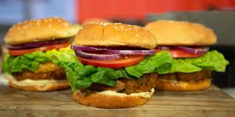
[ Note: In case of negative sentence, the structure is: Given sentence + , (comma) + will you/ can you?]
(a) Do not take junk food, will you? (b) Do not laugh at the poor, will you?
Md. Saiful Islam, Assistant teacher (English), Bagbari Chowbaria High School, Tangail Sadar Tangail

Slide 19
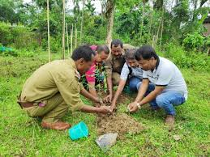
If the imperative sentence begins with let us/ let’s, the structure will be: Given sentence + , (comma) + shall we +?
(a) Let us plant trees, shall we? (b) Let’s go out, shall we?
Md. Saiful Islam, Assistant teacher (English), Bagbari Chowbaria High School, Tangail Sadar Tangail

Slide 20
If there is ‘please or kindly’ in the imperative sentence, the structure will be: Given sentence + , (comma) + won’t you?
Please, call in a doctor, won’t you? (b) Kindly, lend me your book, won’t you?
Md. Saiful Islam, Assistant teacher (English), Bagbari Chowbaria High School, Tangail Sadar Tangail

Slide 21
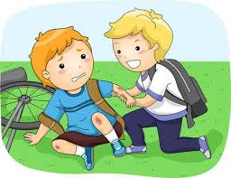
If the subject is ‘Man’ and it refers to the man kind then the structure will be: Given sentence +comma(,) + plural form of verb+ n’t (in case of affirmative sentence)+ they+ question mark (?)
(a) Man is a social being, aren't they? (b) Man helps each other, don't they?
Md. Saiful Islam, Assistant teacher (English), Bagbari Chowbaria High School, Tangail Sadar Tangail

Slide 22
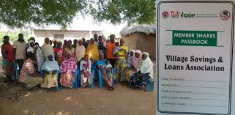
If the subject is ‘Man’ and it refers to the man kind then the structure will be: Given sentence +comma(,) + plural form of verb+ (in case of negative sentence)+ they+ question mark (?)
(a) Man can not live alone, can they? (b) Man does not live long, do they?
Md. Saiful Islam, Assistant teacher (English), Bagbari Chowbaria High School, Tangail Sadar Tangail

Slide 23
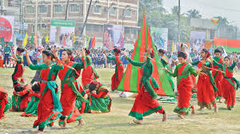
How to tag Exclamatory sentence
Incase of exclamatory sentence the structure will be: Given sentence + comma (,) + verb n’t +subject question mark (?)
(a) How sweetly they dunce, don’t they? (b) What a fool he is, is n’t he?
Md. Saiful Islam, Assistant teacher (English), Bagbari Chowbaria High School, Tangail Sadar Tangail

Slide 24
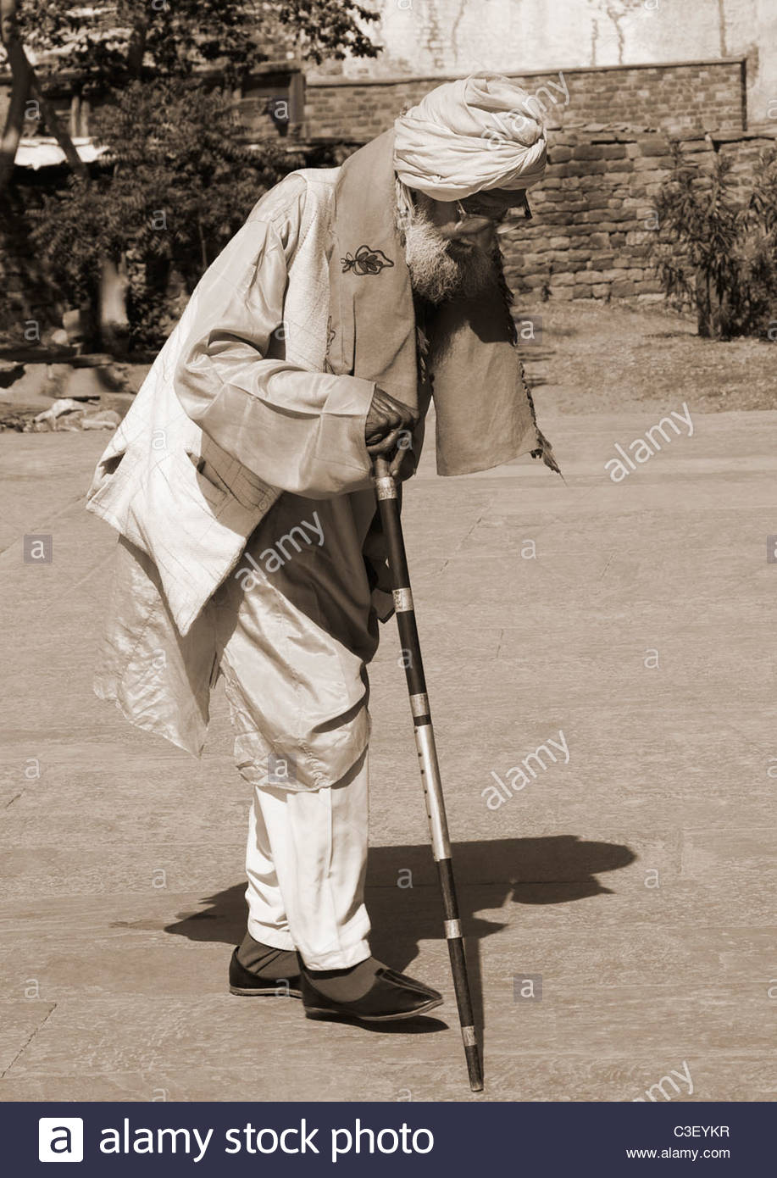
Seldom, little, few, barely, hardly, rare, rarely, never, scarcely, few and far between – are negative. So, their tag will be positive.
Structure: Given statement + , + auxiliary verb/ do/does/ did ( according to their usages).
(a) He can hardly walk, can he? (b) A barking dog seldom bites, does it?
Md. Saiful Islam, Assistant teacher (English), Bagbari Chowbaria High School, Tangail Sadar Tangail

Slide 25
If the subject is ‘there’ then the structure will be: Given sentence + comma (,) verb+ n’t ( if the sentence is affirmative) + there +?
(a) There is a pond in the village, is n’t there? (b) There lived a farmer, did n’t there?
If the subject is ‘there’ then the structure will be: Given sentence + comma (,) verb+ ( if the sentence is negative) + there +?
(a) There is no ghost, is there?
Md. Saiful Islam, Assistant teacher (English), Bagbari Chowbaria High School, Tangail Sadar Tangail

Slide 26
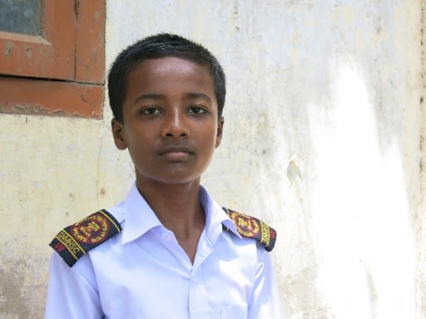
When the subject is ‘I’ and verb 'am’ then the structure will be: Given sentence + comma (,) are n’t ( if the sentence is affirmative) + I +?
(a) I am student, aren't I?
Md. Saiful Islam, Assistant teacher (English), Bagbari Chowbaria High School, Tangail Sadar Tangail

Slide 27
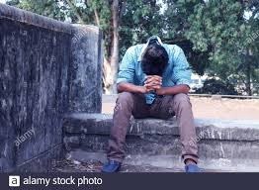
When the subject is ‘I’ and verb 'am’ then the structure will be: Given sentence + comma (,) am ( if the sentence is negative) + I +?
(a) I am not happy, am I? (b) I am not playing cricket, am I ?
Md. Saiful Islam, Assistant teacher (English), Bagbari Chowbaria High School, Tangail Sadar Tangail

Slide 28
Individual work
What do you mean by tag question? Give at least two examples.
Answer:
A tag question is a question that is used at the end of a statement to get the support from the listeners.
Example: (a) We are Bangladeshi, aren’t we? (b) Bangladesh got freedom in 1971, didn’t she?
Md. Saiful Islam, Assistant teacher (English), Bagbari Chowbaria High School, Tangail Sadar Tangail

Slide 29
Pair work
Add tag question of the following sentences:
Karim is a boy of class five. He goes to school everyday. He does not make a noise in the class. That is why every teacher loves him very much. One day he will be a great person of the country.
Md. Saiful Islam, Assistant teacher (English), Bagbari Chowbaria High School, Tangail Sadar Tangail

Slide 30
Group work
Write five rules of tag questions.
(1) If the sentence is positive, the structure is: Given sentence + , + verb +n’t + subject (pronoun form) + (question mark) ?
(2) If the sentence is positive, the structure is: Given sentence +, + do/does/did +n’t + subject (pronoun form) + (question mark) ?
(3) Incase of exclamatory sentence the structure will be: Given sentence + comma (,) + verb n’t +subject question mark (?)
(4) If the subject is ‘Man’ and it refers to the man kind then the structure will be: Given sentence +comma(,) + plural form of verb+ (in case of negative sentence)+ they+ question mark (?)
(5) When the subject is ‘I’ and verb 'am’ then the structure will be: Given sentence + comma (,) are n’t ( if the sentence is affirmative) + I +?
Md. Saiful Islam, Assistant teacher (English), Bagbari Chowbaria High School, Tangail Sadar Tangail

Slide 31
Evaluation
Add tag question of the following sentences:
Mr. Kamal is an honest man,-------------?
Man is the best creation of Allah,------------------?
How charming the scenery of Rangamati is,----------?
Birds can not swim,--------------?
Let us drop the matter,--------------?
I am not lazy like you,---------?
Every body hates a liar,----------------?
There was little water in the jar,-------------?
Do not waste your time,------------?
Nobody likes him,------------?
isn’t he
aren’t they
isn’t it
can they
shall we
am I
don’t they
was there
will you
do they
Md. Saiful Islam, Assistant teacher (English), Bagbari Chowbaria High School, Tangail Sadar Tangail

Slide 32
Home work
Write a paragraph about ‘A rainy day’ and add tag question of all the sentences of it.
Md. Saiful Islam, Assistant teacher (English), Bagbari Chowbaria High School, Tangail Sadar Tangail

Slide 33
Allah Hafez
Md. Saiful Islam, Assistant teacher (English), Bagbari Chowbaria High School, Tangail Sadar Tangail

